Slide 1

GSA OSDBU
National Training Session November 2024
Prepared For:
Presenters:
Mauricio Vera Jody Venkatesan
Assistant National Director President & CEO
Veteran Institute for Procurement Platinum Business Services, LLC
November 7, 2024

Slide 2
At VIP - We Train Companies, Not Individuals, to Become
“Procurement Ready”
Who is VIP for?
VOSB/SDVOSB owner, principal, or C-level executive
Is there a cost?
No. Training provided at no cost* to Veteran-Owned Small Businesses
The first program in the nation to train
Veteran-Owned Small Businesses on how to accelerate their success and growth in the federal contracting market.
*training, meals, and lodging included
Duration of training?
2,700+
The comprehensive certification program takes place in-person over a
3 day-27-hour period
Companies from all 50 states, Washington D.C., Puerto Rico, and Guam graduated from the program
Training location
Potomac, MD - William F. Bolger Center,
11 miles from Washington D.C.

Slide 3
We Arm Vets to WIN!
START
GROW
ADVANCE
Designed for Veteran-owned small businesses looking to enter or expand in the federal market.
Created to increase the Veteran-owned small businesses’ ability to win and maintain federal contracts.
Tailored for Veteran entrepreneurs interested in taking their business to the next level of sustained growth.
The Veteran Institute for Procurement provides specialized training for owners, principals, and C-level executives from Veteran-owned small businesses looking to enter or grow in federal procurement.
INTERNATIONAL
AEROSPACE
COMMERCIAL
Purpose-built for Veteran-owned small businesses considering entering or expanding their business overseas.
Developed to accelerate Veteran-owned small businesses’ success in the federal aerospace market.
Designed to help secure and effectively manage contracts in the commercial sector.
Applications open for all programs
**NEW**
Apply at: nationalvip.org

Slide 4
VIP Waters the Plants
Some Plant Seeds
Notes:
There are many resources offered by local, state, and federal government, along with non profits that help businesses in their start-up phase.
VIP picks up where they leave off, as we say, they plant the seeds and VIP waters the plant.
Of our 1,700 graduates on average they have been in business 7 years and have 12 employees.
In our next slide, I'll review in more detail the qualifiers for each of our programs

Slide 5

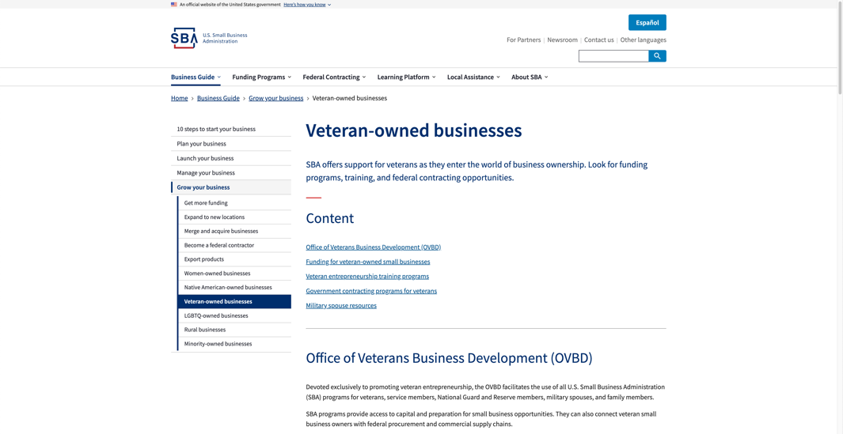
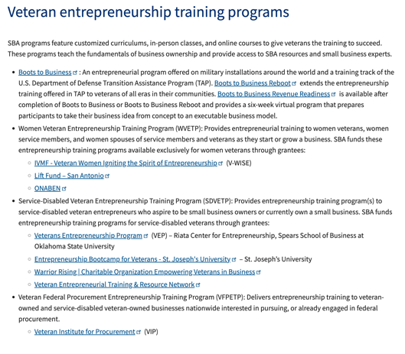

VIP is an Official SBA
Federal Procurement Training Resource
Funded in part through a Grant with the U.S. Small Business Administration.

Slide 6
Program Requirements
A preview of the eligibility requirements for each VIP program

Slide 7
Federal Procurement Training
VIP Offers Three Market-based Training Classes for Established Veteran-Owned Businesses Looking to Enter or Grow in Federal Procurement:
START
GROW
ADVANCE
Designed for Veteran-owned small businesses looking to enter or expand in the federal market.
Requirements
Created to increase the Veteran-owned small businesses’ ability to win and maintain federal contracts.
Requirements
For Veteran entrepreneurs interested in taking their business to the next level of sustained growth.
Requirements
Years in Business | Employees | Revenue
1 | 1 | (some)
Years in Business | Employees | Revenue
2+ | 3+ | (some)
Years in Business | Employees | Revenue
5 | 3+ | $10M
Must be full-time, have a working website, and registered in SAM.gov.
Must be currently performing on a federal contract(s)
Must be currently performing on a federal contract(s)

Slide 8
Sector Specific Training
VIP Offers Three Sector-Specific Training Classes for Established Veteran-Owned Businesses Looking into the International, Aerospace or Commercial markets
INTERNATIONAL
AEROSPACE
COMMERCIAL
For Veteran-owned small businesses considering entering or expanding their business overseas.
Requirements
Developed to accelerate Veteran-owned small businesses’ success in the federal aerospace market.
Requirements
For Veteran-owned small businesses looking to enter and win in the public sector market.
Requirements
Years in Business | Employees | Revenue
3+ | 4+ | (some)
Years in Business | Employees | Revenue
3+ | 3+ | (some)
Years in Business | Employees | Revenue
3 | 1+ | $3M
Must be currently performing on a federal contract(s)
Must be currently performing on a federal contract(s)
Must be a for-profit Veteran-owned small business

Slide 9

How the VIP Program Reduces Risk to Help Accelerate Growth
over
$37
Billion
Attendees learn how to minimize negative impact to business growth
In Federal Prime Awards to VIP Graduates Since 2010*
Expert Instruction
“Procurement Ready”
Overcome Barriers
All training is provided by industry experts who are actively working in their specialized area of instruction.
Graduates receive the knowledge, tools, and resources to win and successfully perform in federal contracting.
Graduates learn how to identify potential obstacles before negative impact on the health of their business and revenue.
* Federal prime award data provided by Fedmine.us

Slide 10
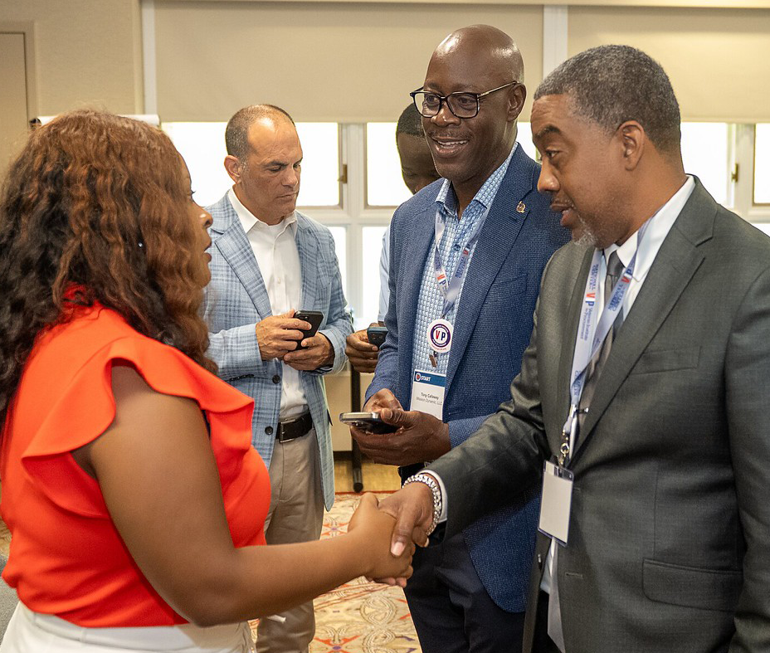
The Gift That Keeps on Giving
In addition to the invaluable education, VIP grads enter a community of support that provides ongoing possibilities to partner, access exclusive opportunities, and options to explore continuing education on emerging topics and trends.
Strategic Connections
Exclusive Portal: Access to potential teaming partners using the VIP MARKETPLACE
Matchmaking Opportunities: Direct connections with primes and federal agencies
Mentorship
Instructor Access: Ongoing support from industry and government experts
Alumni Collaboration: Connect with VIP graduates to brainstorm ideas and partner
Continued Education
Webinars on hot-button topics, lessons learned and other federal procurement related information

Slide 11
VIP is Here to Serve
Veteran Entrepreneurs
Upcoming VIP Training
UPCOMING CLASSES
START
March 18-20, 2025
TBA
Sept 30 – Oct 2, 2025
INTERNATIONAL
AEROSPACE
COMMERCIAL
October 22-24, 2024
December 10-12, 2024
January 28-30, 2025
February 25-27, 2025
June 10-12, 2025
June 24-26, 2025
November 12-14, 2024
March 4-6, 2025
April 8-10, 2025
GROW
ADVANCE
Applications open for all programs
Apply at: nationalvip.org

Slide 12
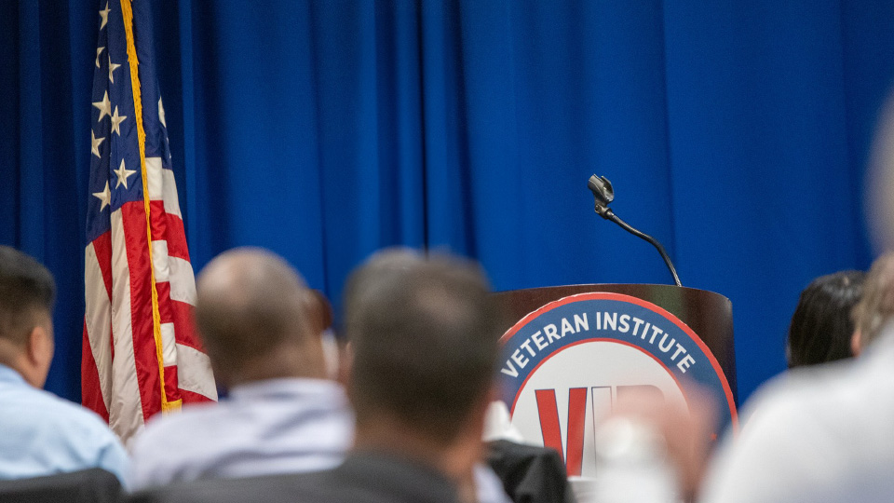


Questions?
Apply at: nationalvip.org
/national-veteran-institute-of-procurement/
@winningvets

