Slide 1

Welcome to the Uber for Government
Getting started: I’m new to Uber and need to start from the beginning
Already have a personal profile: I have a personal Uber profile and need to set up Uber for Government
Multiple profiles: Toggling between multiple profiles
Fixing mistakes: Switching profiles if I charge the wrong one

Slide 2
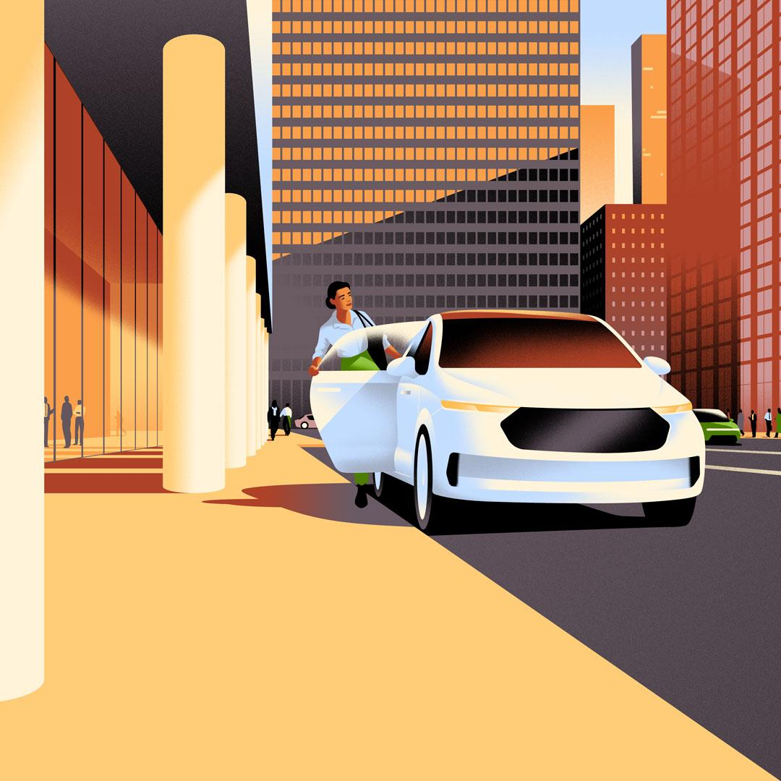

For New Uber Users
Download the Uber app and create an account. A personal profile is automatically generated once an account is created.
Download the Uber app from the App store (iPhone) or Google Play (Android)
Open the app and tap “Sign Up”
Create a personal profile: Enter your name, a personal email address, and phone number you wish to use with Uber. You can use your personal phone. Create a password.
Tap “Next”, add a personal payment method, and follow the steps to complete your personal account set up.
Go to the next page to setup your Uber for Government account.
Important note:
Before linking your Uber for Government profile, you must have a personal profile on your phone, please create one if you don’t have one.

Slide 3
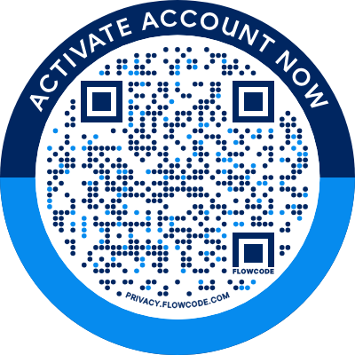

1. Creating your Uber for
Government Profile
URL: https://t.uber.com/Uber4gov
Scan the QR code or click the link: Use your phone or computer.
Complete the invitation request form: Enter your information. Only your first name, last name, and .gov email address are required. Click “submit”.
Check your work email inbox: After submitting your information, you will receive an email from Uber inviting you to join the Uber for Government rideshare program.
Pro tip:
Scan the QR code if your phone has the Uber app on it.

Slide 4
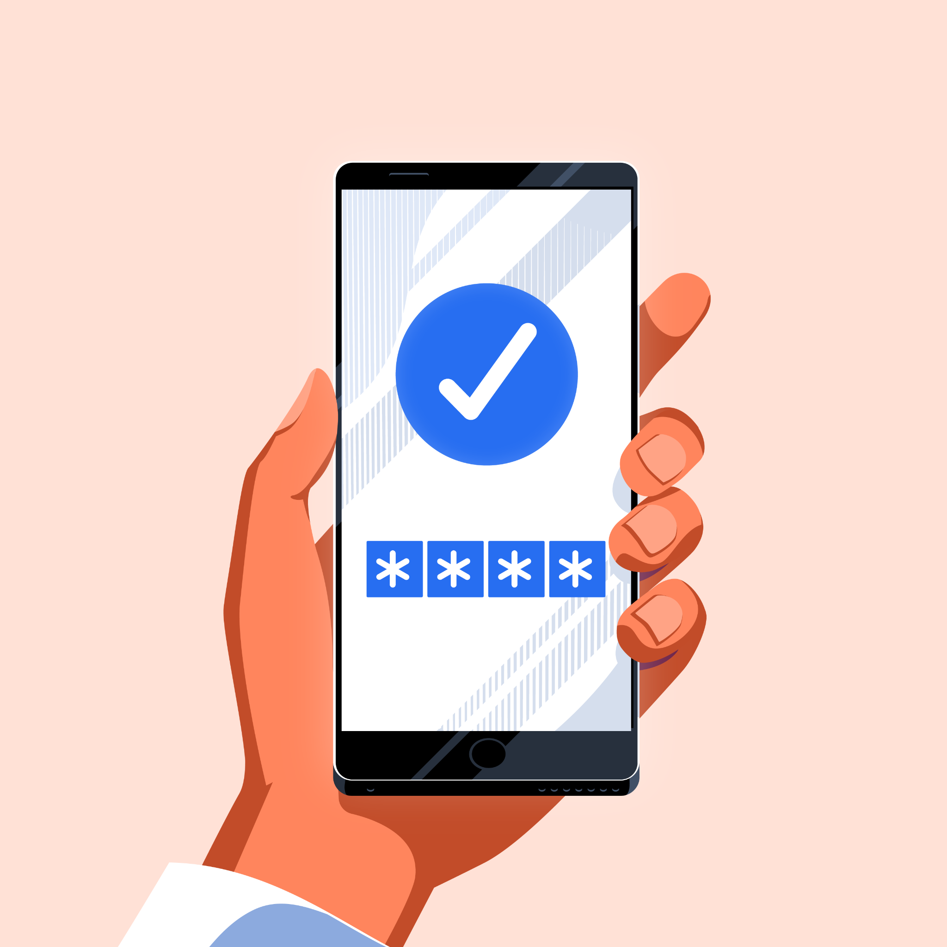
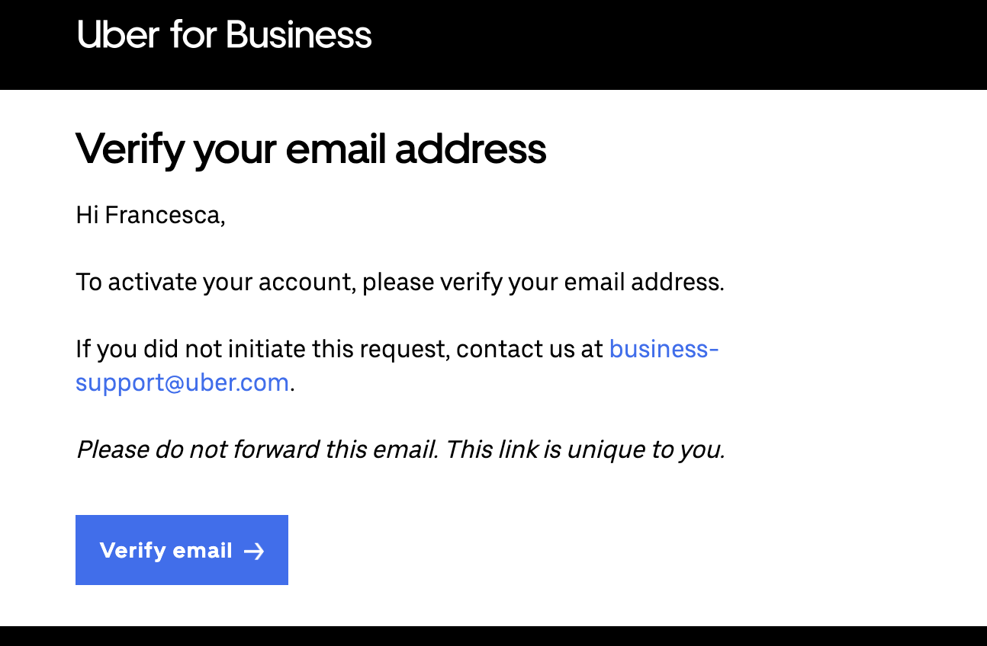
2. Creating your Uber for
Government Profile
4. Open the Uber for Business email from your computer
Click “Verify email”, which will redirect you to a page with a QR code.
Important note:
Please do not forward your email invitation. **This is a unique link and will not work if forwarded - it will not work.**

Slide 5
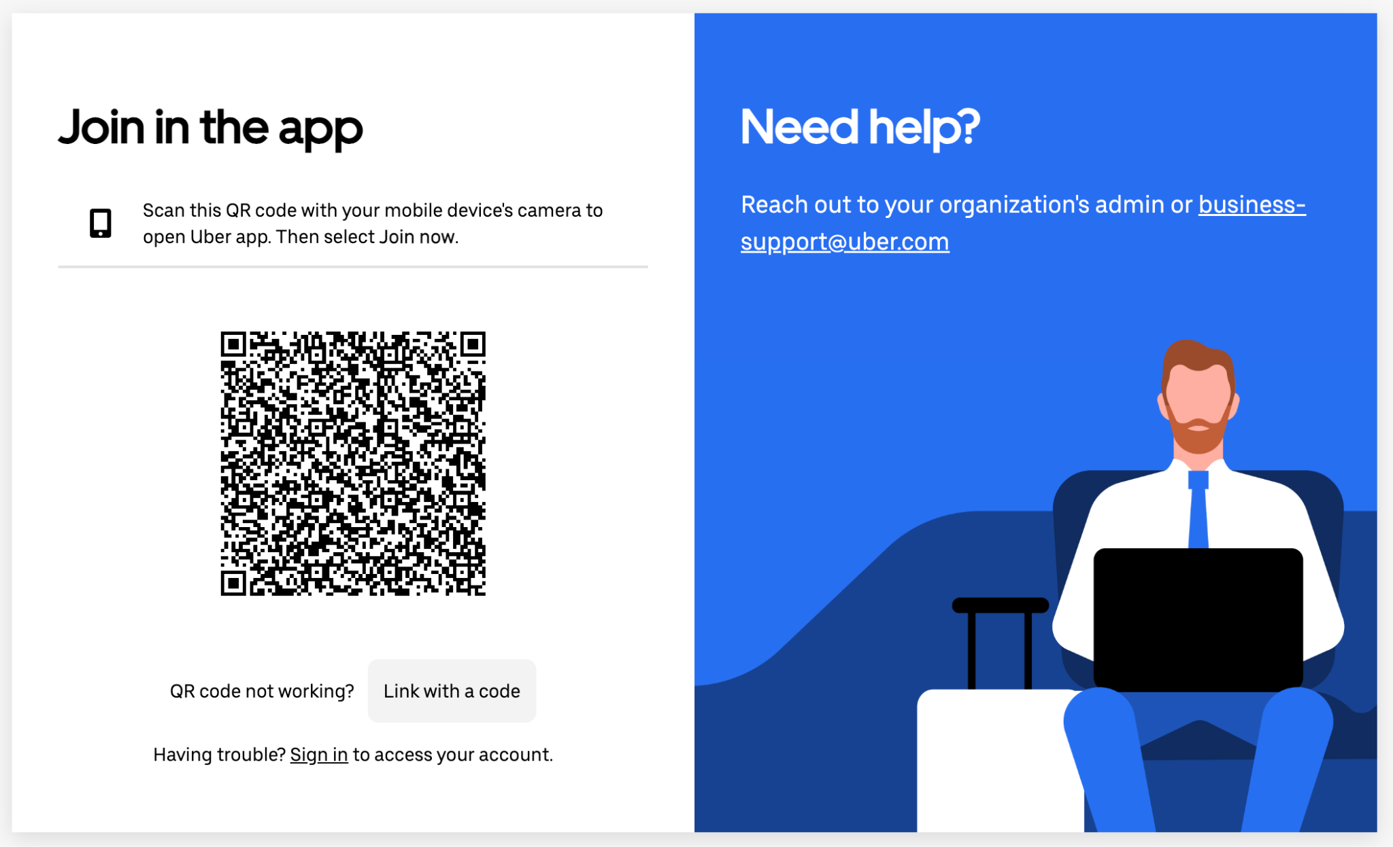
3. Creating your Uber
for Government Profile
Scan the QR code from the phone you will use for Uber. This will open to Uber app. Important Note: If you are not yet signed into Uber on this device, please do so first.
Select “Join Now” then “Accept” input your government travel card or other travel payment method regularly used for travel.
Select “Skip” in the top right corner when asked to link an expense program.
Toggle to your Uber for Government profile when you’re ready for your first trip or meal delivery.
Your unique
QR code
here
For support, reach out to business-support@uber.com for assistance.

Slide 6

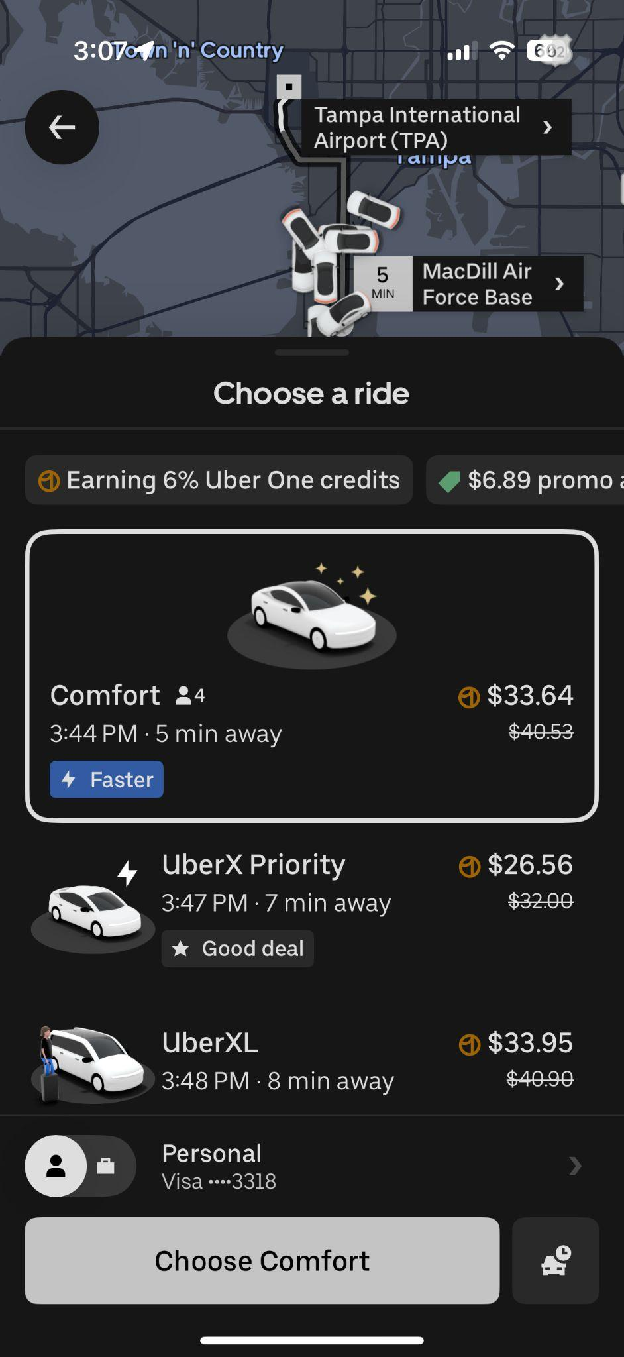
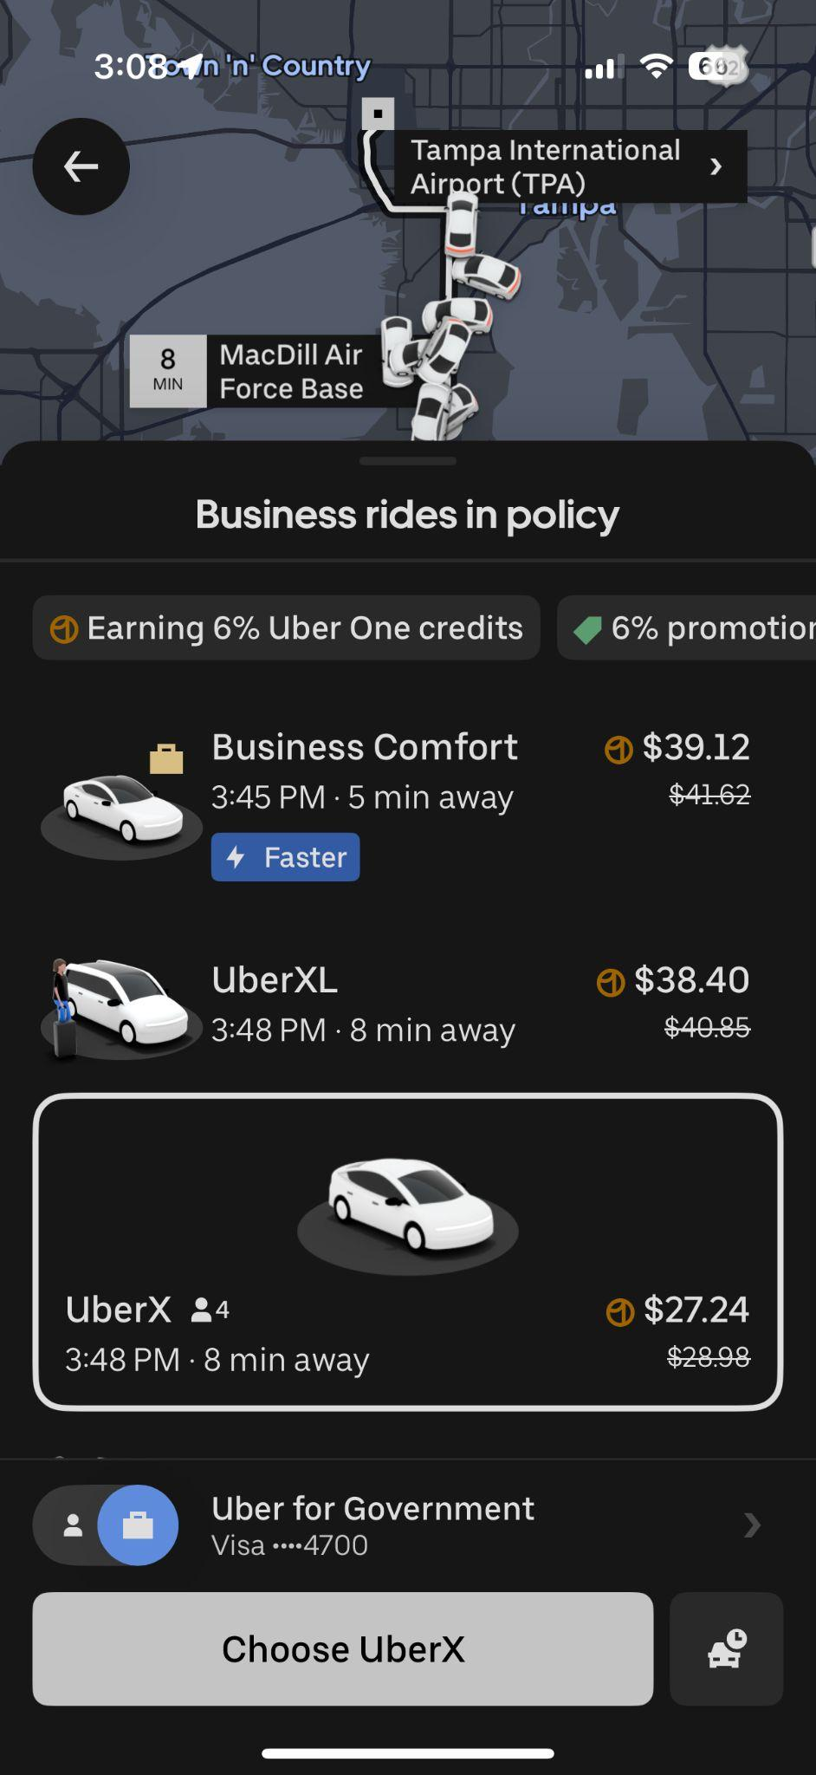
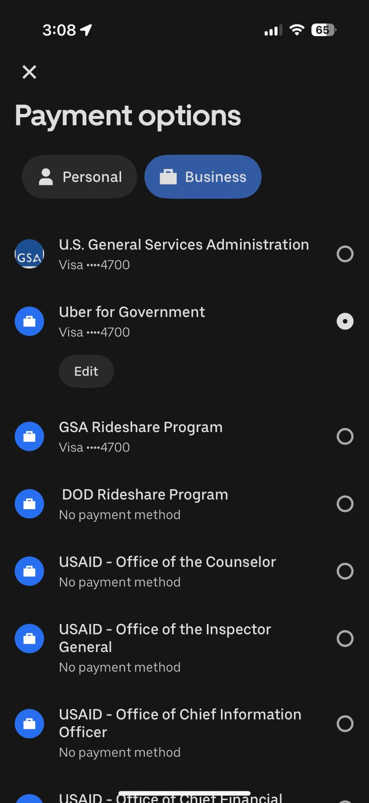
Toggling between your personal, Uber for Government and fleet/transportation profiles
Toggling between personal and government
Toggling between personal and multiple government profiles
Fleet Program
Fleet Program
Toggle over from the personal profile to the Uber for Government program.
If you have multiple “business profiles” you can toggle between Uber for Government and your transportation and/or fleet programs by clicking on the “business profile and then selecting the account you are looking for.
6

Slide 7
Switching to the correct profile after a trip or meal
Navigate to the “Activity” tab located at the bottom of the home screen
Select the ride or meal delivery you would like to correct
Select “Customer Support”
Select “Browse Help Topics”
Select “Other payment support”
Select “Change payment method for this trip”
Select “Switch profile”
Select the proper payment profile

Slide 8

Thank you!
Questions? We’re here for you.
Email: business-support@uber.com

