Slide 1



Welcome
Protecting the Federal Supply Chain

Slide 2

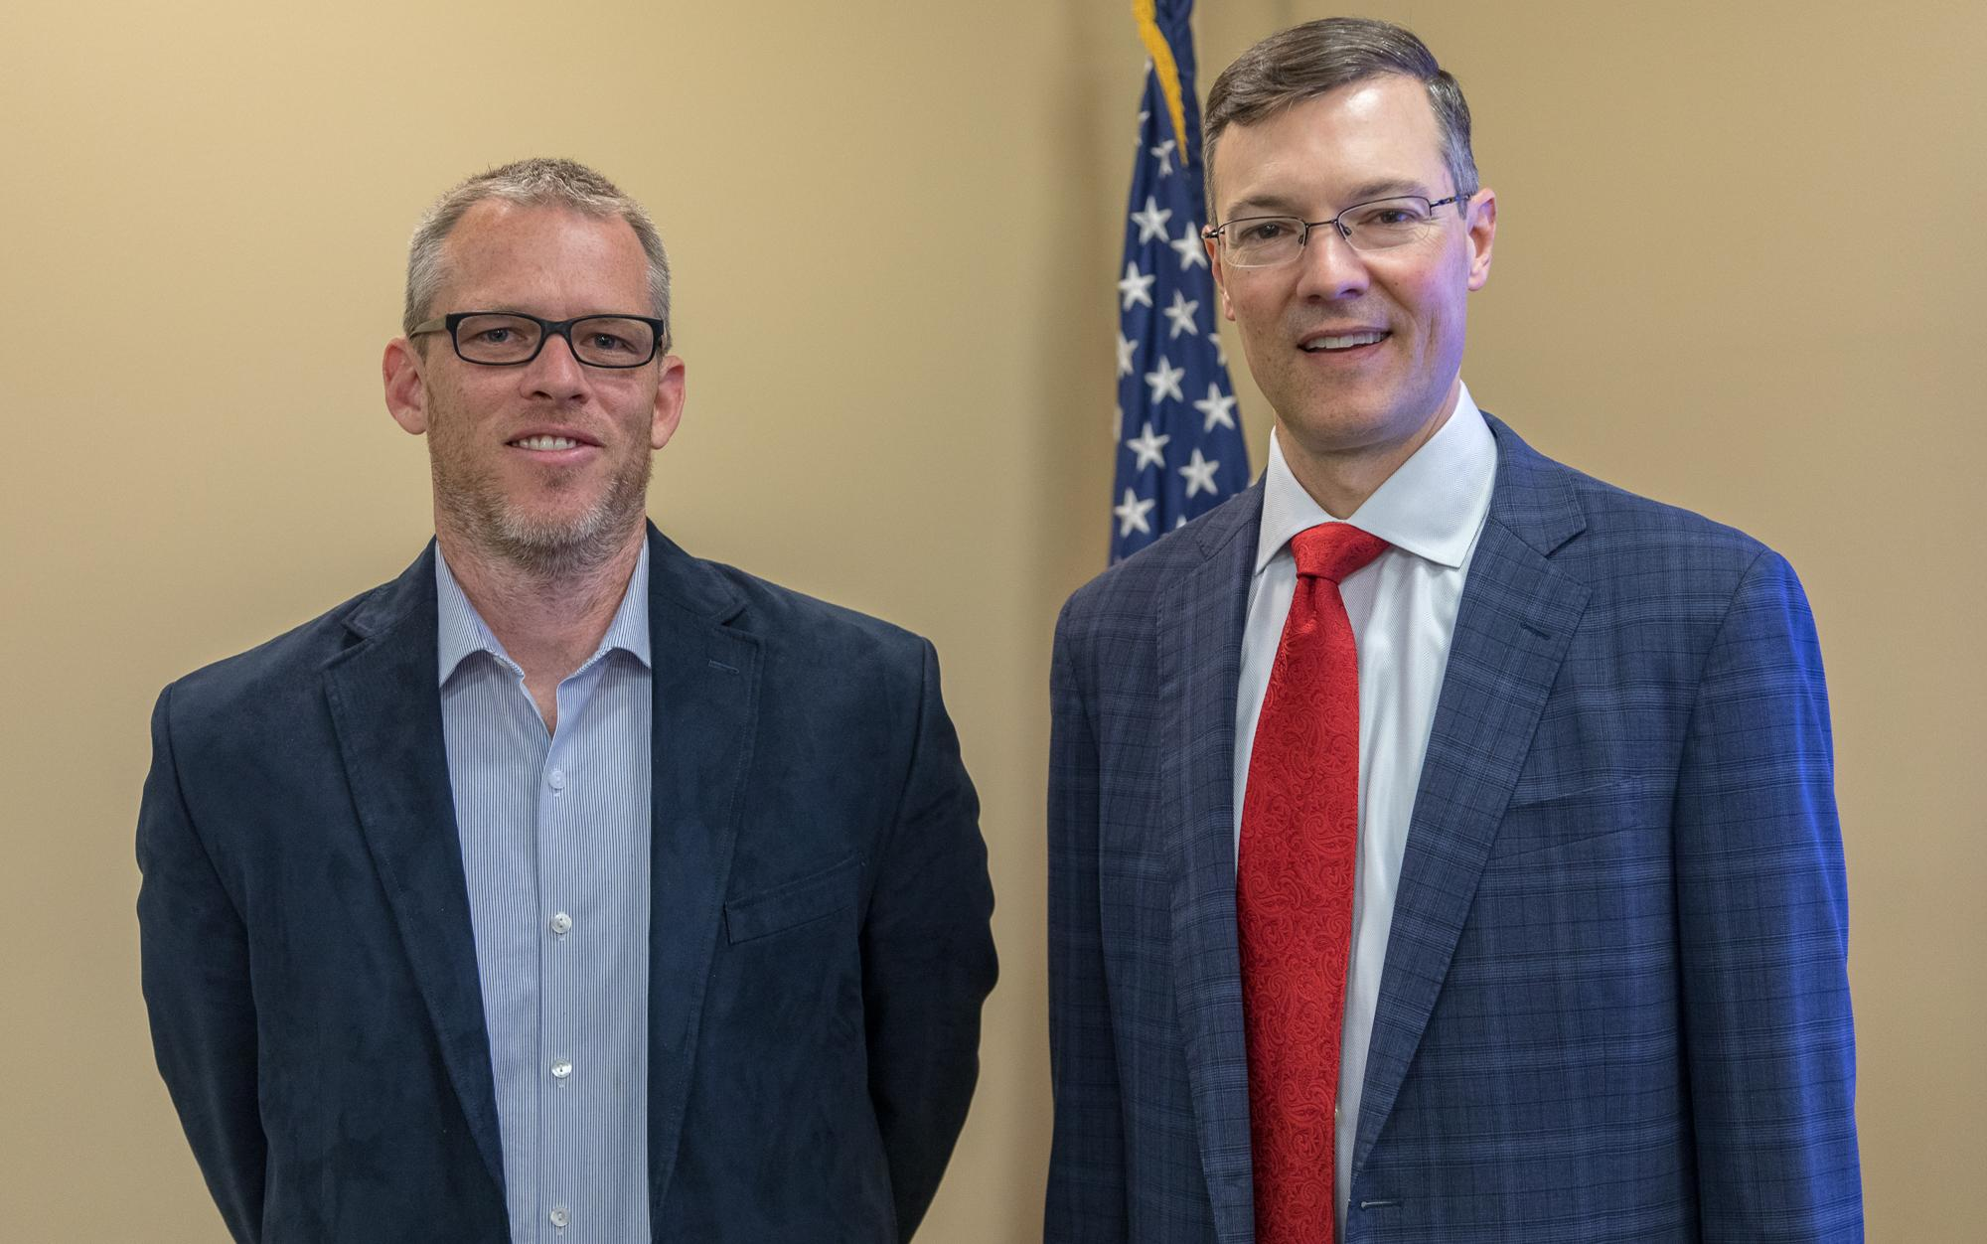
INTRODUCING TODAY’S PRESENTERS
Kelley Artz, Supply Chain Risk Management Technical Lead, Office of Policy and Compliance, GSA
Brennan Conaway, Program Analyst, Office of Policy and Compliance, GSA

Slide 3
Today’s Agenda:
Supply Chain Risk Management (SCRM) 101
What Baseline SCRM Requirements are in FAS Contracts?
  Kaspersky Lab
  Section 889
  Trade Agreements Act (TAA)
  “Made in America” (MiA) Country of Origin Designations
GSA’s Vendor Risk Assessment Program (VRAP)
Overview Executive Order 14028: Improving the Nation’s Cybersecurity

Slide 4
Supply Chain Risk Management 101

Slide 5


How Do You Say SCRM?
“SCRIM”
NOT “SCRUM”
NOT “SCREAM”
2

Slide 6
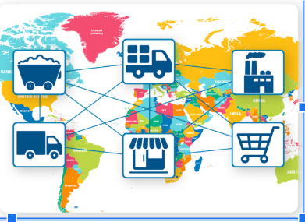
Globalization & Complexity of ICT Supply Chain:

Slide 7
Supply Chain Risk:
Definition from Secure Technology Act
Risk of sabotage or malicious manipulation
Design, manufacturing, production, distribution, installation, operation, maintenance, disposition, or retirement
Surveil, deny, disrupt or use information stored or transmitted
What?
When?
How?
2

Slide 8
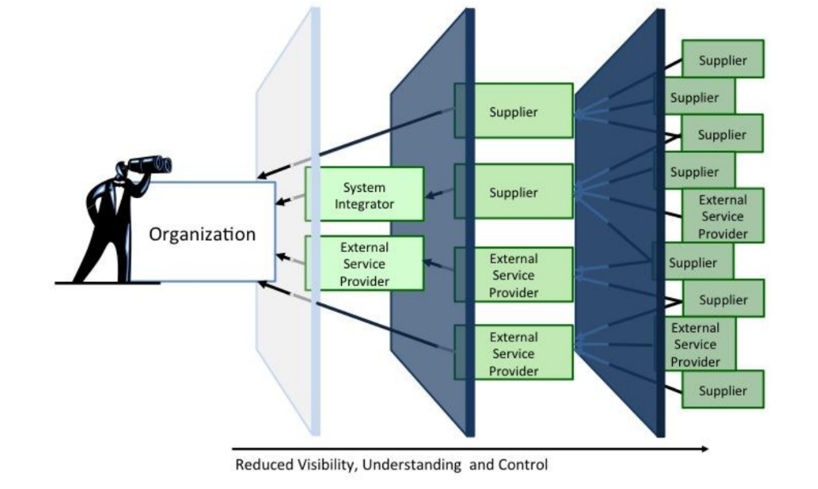
Layers of Complexity- Visibility?

Slide 9
What Baseline SCRM Requirements are in FAS contracts?

Slide 10
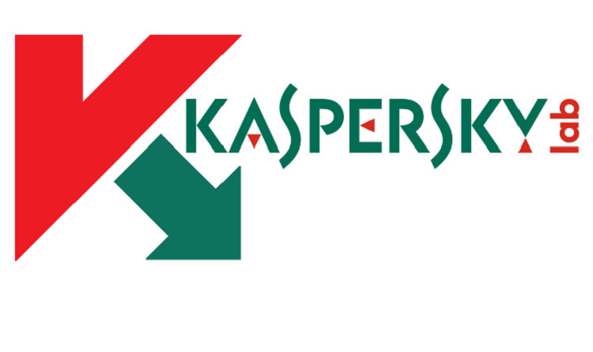
Kaspersky Lab:
Background: U.S. intelligence determined that software
firm, Kaspersky Lab, collaborates with the Russian government.
Prohibition: Contractor are prohibited from—
  Providing “covered articles” (i.e., hardware, software or service developed by Kaspersky) to the Government
  Using any covered article in the development of data or deliverables first produced in the performance of the contract.
Contract clause: FAR 52.204-23 requires Contractors to report to the Government if a covered article was provided to the Government during contract performance

Slide 11





Section 889 of the 2019 NDAA:
Background: Chinese intelligence and security services may use the following Chinese information technology firms and their equipment as routine and systemic espionage platforms
  Huawei Technologies Company
  ZTE Corporation
  Hytera Communications Corporation
  Hangzhou Hikvision Digital Technology
Company
  Dahua Technology Company
Prohibitions: There are two Section 889
prohibitions - “Part A” and “Part B”

Slide 12
Section 889 of the 2019 NDAA:
Prohibition
  Part A: The Government cannot obtain covered telecom
  Part B: Contractors cannot use covered telecom
Provisions: Offerors must represent in the System for Award Management before contract award and, potentially, as part of their offer (FAR 52.204-26 and FAR 52.204-24)
  Do you provide covered telecom? Do you use covered telecom?
Clause: Contractors must report to the Contracting Officer if they discover they have used covered telecom during performance of the contract (FAR 52.204-25).

Slide 13
Trade Agreements Act Compliance:
Most FAS contracts are subject to the Trade Agreements Act (TAA)
  Under TAA, the Government treats offers from foreign countries with whom we have trade agreements (e.g., Canada, German, and Chile) the same as American made products.
  Items from other countries (e.g., China) may not be offered.
Clause: FAR 52.225-5 requires the Contractor to deliver U.S.-made or “designated country end products”
Provision: FAR 52.225-6 requires offers to certify that products are U.S.-made or “designated country end products”

Slide 14
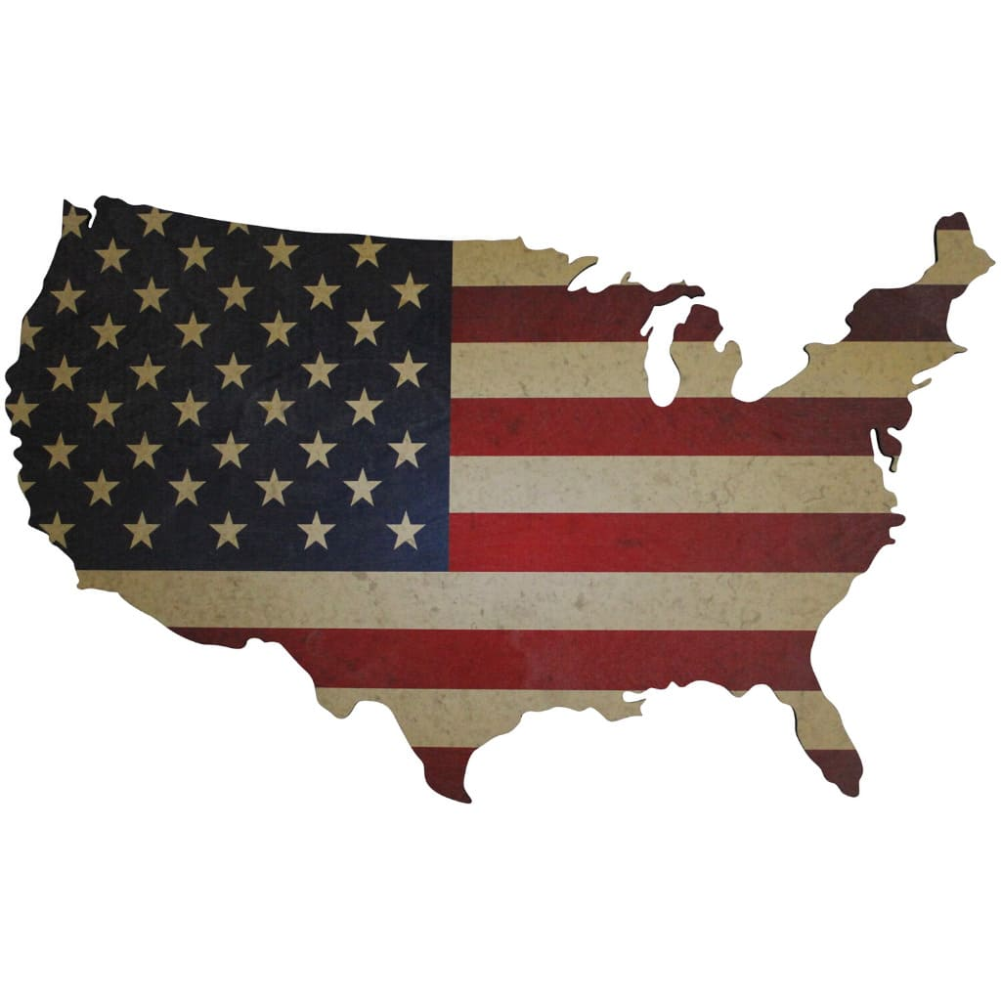
Accurate “Made in America” Designations:
U.S.-made products mitigate supply chain risks and support the goals of Executive Order 14005 Ensuring the Future Is Made in All of America by All of America's Workers
Therefore, FAS seeks to ensure that Contractor “US” country of origin designations are accurate.
Clause: I-FSS-600 Contract Price Lists requires Contractors
to provide accurate information (include country of origin
designations) on GSAAdvantage! and elsewhere

Slide 15

Does FAS Only Rely on Contractor Self-Certification?
No! FAS uses data analytics to search for potentially non-compliant items on GSAAdvantage! on a regular basis.
GSA blocks and/or removes non-compliant products from Schedule contracts and GSAAdvantage!. This includes Kaspersky, Section 889, TAA non-compliant, and products misdesignated as “made in the U.S”.
FAS usually works to educate contractors that offer prohibited products, but takes corrective action if violations persist
“Robomods” mitigate supply chain risk on MAS contracts.

Slide 16
Executive Order 14028: Improving the Nation’s Cybersecurity

Slide 17
A Changing Landscape for War
Cyber Executive Order 14028 is largely in response to the Solarwinds attack.
  Russia’s Solarwinds supply chain attack used a software update to penetrate at least 9 federal agency networks and hundreds of businesses. The sophistication of the attack and the measures used to avoid detection surprised forensic experts.
  Wake up Call for vulnerability of US national and economic security due to weak cyber defenses and increasing reliance on digital technology for nation’s infrastructure.
Broad reaching EO has requirements for the Federal Acquisition Regulation (FAR) Council, NIST, DHS, DoC, GSA , FEDRAMP and OMB. Aggressive timelines to emphasize the urgency of our national challenge.
For cybersecurity professionals and those associated with “critical software”, the implications of the Cyber EO are equivalent to how the US responded to 9/11.

Slide 18
Overview Cyber EO 14028
Signed May 12, 2021
Calls for bolstering cybersecurity in Information Technology (IT) and Operational Technology (OT) by protecting federal networks, improving information-sharing on cyber issues, and strengthening the United States’ ability to respond to incidents
Remove Barriers to Threat Information Sharing Between Government and the Private Sector
Modernize and Implement Stronger Cybersecurity Standards in the Federal Government. Seeks to modernize the FedRAMP program and to help move the Federal government to secure cloud services and a zero-trust architecture. Mandates deployment of multifactor authentication and encryption with a specific time period
Improve Software Supply Chain Security. Improves the security of software by establishing baseline security standards for development of software sold to the government, including requiring developers to maintain greater visibility into their software and making security data publicly available
Establish a Cybersecurity Safety Review Board that convene following a significant cyber incident to analyze what happened and make concrete recommendations for improving cybersecurity

Slide 19
NIST Definition of Critical Software
EO-critical software is defined as any software that has, or has direct software dependencies upon, one or more components with at least one of these attributes:
  Is designed to run with elevated privilege or manage privileges;
  Has direct or privileged access to networking or computing resources;
  Is designed to control access to data or operational technology;
  Performs a function critical to trust; or,
  Operates outside of normal trust boundaries with privileged access.
The definition applies to software of all forms (e.g., standalone software, software integral to specific devices or hardware components, cloud-based software) purchased for, or deployed in, production systems and used for operational purposes.
Other use cases, such as software solely used for research or testing that is not deployed in production systems, are outside of the scope of this definition.

Slide 20
NIST Guidelines, July 2021
Minimum Standards for Developer Verification of Software
Eleven recommendations for software verification techniques as well as providing supplemental information:
  Threat modeling to look for design-level security issues
  Automated testing for consistency and to minimize human effort
  Static code scanning to look for top bugs
  Heuristic tools to look for possible hardcoded secrets
  Use of built-in checks and protections
  “Black box” test cases
  Code-based structural test cases
  Historical test cases
  Fuzzing
  Web app scanners, if applicable
  Address included code (libraries, packages, services)

Slide 21
FAS Cases Opened August 4th
Case Number | Title | Brief Synopsis
2021-019 | Standardizing Cybersecurity Requirements for Unclassified Federal Information Systems | Standardizes common cybersecurity contractual requirements across Federal agencies
2021-017 | Cyber Threat and Incident Reporting and Information Sharing | Increases sharing of information about cyber threats and incident information between the Government and certain providers; requires certain contractors to report cyber incidents to Government.

Slide 22
Estimated Major Milestones
Q1 FY2022
Q2 FY2022
Q3-Q4 FY2022
Q1 FY2023
FAR Cases 2021-019 & 2021-017
Feb 6, 2022
NIST Issue guidance identifying practices that enhance security of software supply chain
Initiate pilot programs, identifying IoT cyber & secure software development practices or criteria for consumer labeling programs
Sep 7 - Oct 1, 2021
Public Comments on DHS CISA Zero Trust Maturity Model
Sep 20 - Oct 15, 2021 DoC call for comments
Nov 8, 2021
NIST Publish Preliminary guidelines for enhancing software supply chain security
FAR Cases Public Comment & reconciliation of comments
May 13, 2022
NIST Review & submit summary report of pilot programs
Final FAR Cases and Implementation to begin

Slide 23
Implications for our Vendor Partners
Engage in Public Comment on New FAR Clauses impacting cybersecurity requirements, and providers of critical software, as well as sharing of cyber threats and incidents
Providers of critical software may anticipate enhanced documentation to support compliance with the new security standards, including software labeling and Software Bill of Materials requirements
Engage in NIST workshops and consider responding to calls for public comment, particularly for matters involving standards for software labeling to include IOT and requirements for Software Bills of Material

Slide 24
Implications for our Vendor Partners
Review CISA guidance for Zero Trust and consider responding to call for comments by October 1
Expect Modifications of contract language and FAR clauses to reflect new guidance from NIST and CISA. If your company cannot accept the modification, you will not be able to sell software to the Federal government.
Update Your Compliance Program: Keep abreast of proposed updates to the FAR and prepare for changes that could impact your entity’s compliance and train appropriate personnel

Slide 25
Questions?

Slide 26
Cyber EO References
Cybersecurity Executive Order 14028
CISA Zero Trust Maturity Model Draft Paper: https://www.cisa.gov/sites/default/files/publications/CISA%20Zero%20Trust%20Maturity%20Model_Draft.pdf
NIST Definition of Critical Software Under Executive Order 14028
OUSD Acquisition & Sustainment, Open FAR Cases
NIST Guidelines on Minimum Standards for Developer Verification of Software
Department of Commerce Request for Comment (Posted 9/20; comments due +45 Days)

Slide 27
Contact us:
Kelley Artz
  E-mail: kelley.artz@gsa.gov
Brennan Conaway
  E-mail: brennan.conaway@gsa.gov

Slide 28
Small Business Resources
U.S. General Services Administration (GSA) - https://www.gsa.gov
  Office of Small & Disadvantaged Business Utilization (OSDBU) - https://www.gsa.gov/osdbu
  Federal Acquisition Service (FAS) - Commercial Products & Services - https://www.gsa.gov/fas
  Public Buildings Services (PBS) - Construction, Architecture, Interior Design, and Real Estate - https://www.gsa.gov/pbs
Small Business Administration (SBA) - https://www.sba.gov
  SBA Size Standards - https://go.usa.gov/xFR9p
  Small Business Loans - https://go.usa.gov/xFRPD
Procurement Technical Assistance Centers (PTACS) - https://www.aptac-us.org/
System for Award Management (SAM) - https://go.usa.gov/xFNkS
Federal Agency Procurement Forecasts - https://go.usa.gov/xFRbn

Slide 29
Thank You!

