Slide 1


BUSINESS
PLATINUM
SERVICES
PROPRIETARY: Use or disclosure of data contained on this sheet will not be disclosed outside the Government and will not be duplicated, used, or disclosed--in whole or in part--for any purpose – FEDCON only
Platinum Business Services, LLC. is a full-service IT solutions consulting firm founded in 2008.
We provide a full suite of information technology services, program management, financial management, and administrative support solutions to the U.S. Federal government.

Slide 2


WHAT WE DO
CORE CAPABILITIES
NAICS
IT Services​
Cybersecurity​
Information Assurance
Data Analytics​
Cloud Services​
DevSecOps​
Project/Program Management​
Enterprise Architecture Services​
Emerging Technologies​
Advanced Data Management and Analytics​
Artificial Intelligence / Machine Learning​
Visualization and Dashboarding​
System Modernization​
Administrative Support Services​
Financial Management Services
541519
518210
541511
541512
541611
541219
SINS
54151HACS
54151HEAL
54151S
518210C
PROPRIETARY: Use or disclosure of data contained on this sheet will not be disclosed outside the Government and will not be duplicated, used, or disclosed--in whole or in part--for any purpose – FEDCON only

Slide 3
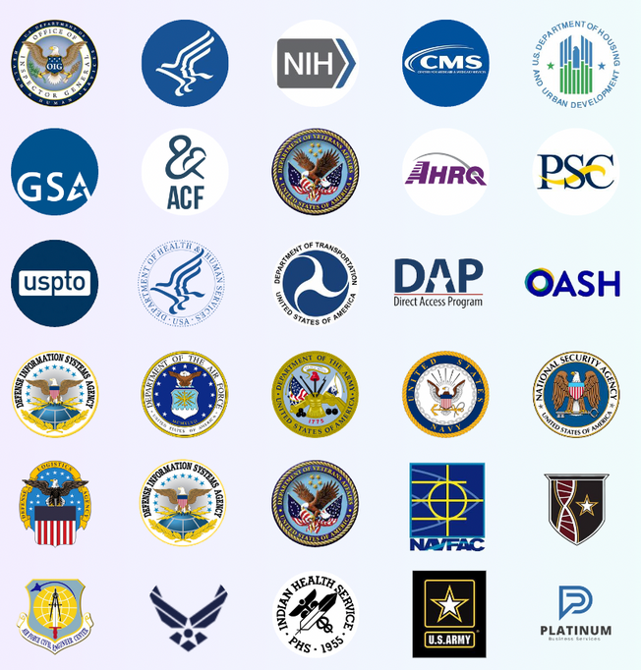
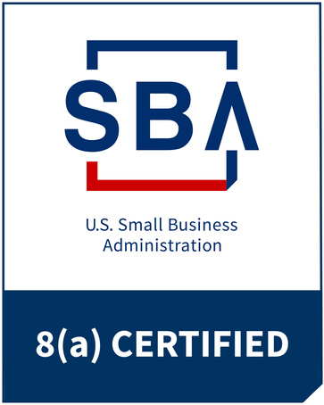










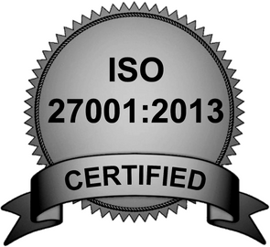


CERTIFICATIONS
SBA Certified HUBZone, 8(a) and SDVOSB
OASIS + SDBOSB & HUBZone
We hold a top-secret facility clearance, our accounting system meets DCAA compliance standards, and we are certified for CMMIDEV/3, CMMISVC/3, ISO 9001:2015 and 27001:2013

