Slide 1

GSA Public Buildings Service
Overview and GSA FY 24 Opportunities
Khadijah Robinson
Procurement Analyst
April 18, 2024

Slide 2
Agenda
What We Do
PBS Priorities
GSA Sustainability Goals
Capital Investment Program
GSA’s role in BIL and IRA
Where to find GSA Opportunities
PBS Industry Engagement Summit
Closing Remarks

Slide 3
GSA Opportunity for Impact
GSA Portfolio:
Serves over 1.1 million employees across 50 federal agencies and 400 bureaus
Operates 1,400 owned buildings with over 186M square feet across the U.S.
Manages over 7,000 leases representing 184M square feet
Pays utilities on a real estate footprint that represents 6% of the entire federal footprint
GSA Energy:
Seventh largest U.S. federal facilities energy user in FY20 [17.9 Trillion BTU]
Our electricity alone represents 4% of the entire U.S. Federal Government’s electricity usage.

Slide 4
What We Do
The Public Building Service (PBS) also:
  Promotes innovative workplace solutions
  Acts as a green technologies proving ground
  Supports development of urban communities
  Provides space for child care centers
  Donates or sells underutilized real estate for federal agencies
  Commissions artwork for new federal buildings
  Conserves federally-owned artworks, the largest public collection in the country
  Supports sustainable designs

Slide 5
PBS Strategic Approach
PROGRAMS | STRATEGIC GOALS | SUCCESS
Greenhouse gas management and reduction Sustainability excellence in projects and practices Climate adaptation, risk, and resilience | Energy & water efficiency, waste reduction 100% carbon pollution-free electricity (CFE) by 2030, 100% 24/7 CFE by 2035 100% zero-emission vehicles (ZEV) by 2035 Drive change and innovation in planning, design, construction, and operations Create a sustainability culture in PBS Build climate literacy and capacity Advance climate adaptation, bolster risk management, & safeguard federal assets | Net-zero-emission federally-owned portfolio by 2045 50% sustainable buildings; skilled workforce Climate-ready resilient federal buildings

Slide 6
FY 2024 Capital Investment Request
Project List
Major Repair and Alterations Projects (cont'd)
Chicago, IL Everett McKinley Dirksen U.S. Courthouse
Los Angeles, CA Federal Building - 11000 Wilshire Boulevard
Pittsburgh, PA Joseph F. Weis, Jr. U.S. Courthouse
Indianapolis, IN Major General Emmett J. Bean Federal Center
Paducah, KY Federal Building and U.S. Courthouse
Beaumont, TX Jack Brooks Federal Building U.S. Post Office and Courthouse
Tacoma, WA Tacoma Union Station
Washington, DC Ronald Reagan Building Complex (inc. IRA)
Detroit, MI Patrick V. McNamara Federal Building Garage (incl. IRA)
Special Emphasis
Consolidation Activities Program
Judiciary Capital Security Program
Fire Protection and Life Safety Program
Energy and Water Retrofit and Conservation Program
Inventory Risk Mitigation and Resilience Program
New Construction
Washington, DC DHS Consolidation at St. Elizabeths
Kansas City, MO Hardesty Federal Complex Remediation
Washington, DC Southeast Federal Center Remediation
Seattle, WA Design of Replacement Facility
Major Repair and Alterations Projects
Philadelphia, PA James A. Byrne U.S. Courthouse
Boston, MA John J. Moakley U.S. Courthouse
Atlanta, GA Sam Nunn Atlanta Federal Center
Oklahoma City, OK William J Holloway Jr. U.S. Courthouse & U.S. PO/Courthouse
New York, NY Silvio J. Mollo Federal Building
Boston, MA Thomas P. O’Neill, Jr. Federal Building
Martinsburg, WV IRS Enterprise Computing Center
Sacramento, CA 801 I Street Federal Building
The FY 2024 request is pending Congressional action

Slide 7
FY 2025 Capital Investment Request
Project List
Major Repair and Alterations Projects (cont'd)
Brooklyn, NY Emanuel Celler U.S. Courthouse
Washington, DC Stewart Lee Udall Federal Building
Washington, DC Howard T. Markey National Courts Complex
Suitland, MD Washington National Records Center
Washington, DC Robert C. Weaver Federal Building
Philadelphia, PA Mid-Atlantic Social Security Center
Chicago, IL Ralph H. Metcalfe Federal Building
Washington, DC Federal Office Building - 7th and D
Special Emphasis
Optimization Program
Fire Protection and Life Safety Program
Judiciary Capital Security Program
Childcare Systems and Security Program
Energy and Water Retrofit and Conservation Measures Program
New Construction
None
Major Repair and Alterations Projects
Boston, MA John F. Kennedy Federal Building
Washington, DC William Jefferson Clinton Complex
Washington, DC Robert F. Kennedy Federal Building
Woodlawn, MD Centers for Medicare and Medicaid Services Headquarters Campus
Washington, DC Orville Wright Federal Building
New York, NY Jacob K. Javits Federal Building Complex
Seattle, WA Henry M. Jackson Federal Building
Cleveland, OH Carl B. Stokes U.S. Courthouse
The FY 2025 request is pending Congressional action

Slide 8



BIL Background
Bipartisan Infrastructure Law (BIL)
The Bipartisan Infrastructure Law includes a total of $3.4 billion for GSA to build and modernize land ports of entry (LPOEs) on the country’s northern and southern borders.
CBP received $330 million, to remain available until September 30, 2026, for furniture, fixtures and equipment for the LPOEs modernized by GSA under the program.
The investments will improve commerce and trade, create good-paying construction jobs, and incorporate new and innovative sustainability features.
* Public Law 117-58, Signed into Law by President Joe Biden on November 15, 2021

Slide 9
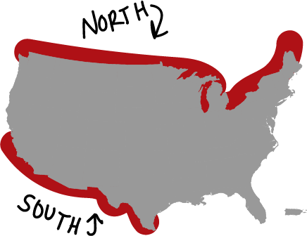
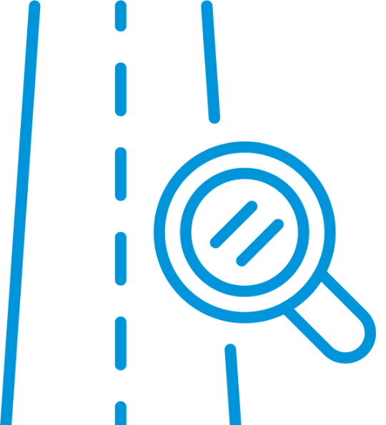
BIL Background Highlights
$3.75B
>60 LPOEs
26
21
3
LPOEs
Locations
Leased
New Construction
and Modernization
Paving & Roadway
Improvements
LPOE Acquisitions
Across Northern and Southern Borders
Roadway and Inspection Services Improvement
Aging facilities and site constraints
General Services Administration ($3.4 billion) - Site, Design, Construction
Department of Homeland Security - Customs and Border Protection (CBP) $330M - Furniture & Equipment
for the Department of Transportation-Federal Motor Carrier Safety Administration (FCMCSA)

Slide 10






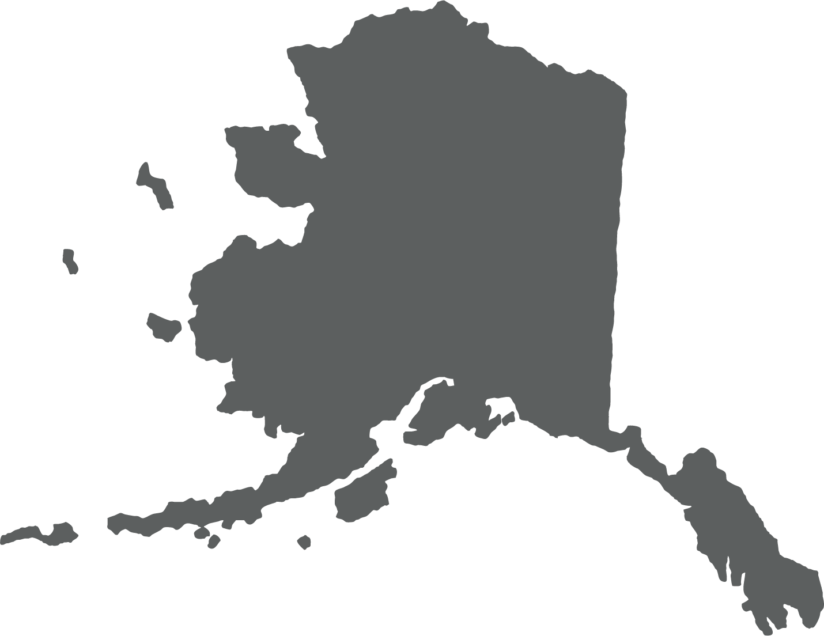

Land Port of Entry BIL Project List
Northern Border - 20 Major Modernizations
Maine
Calais-Ferry Point - $30M
Houlton - $20M
Fort Fairfield - $35M
Limestone - $15M
Coburn Gore - $85M
New York
Rouses Point - $25M
Tout River - $15M
Idaho
Porthill - $45M
Washington
Sumas - $135M
Lynden - $90M
Blaine -$15M
Minnesota
Grand Portage - $92M
I Falls - $249M
Vermont
Norton - $25M
Beebe Plain - $15M
Richford - $25M
Highgate Springs - $150M
Alburg Springs - $10M
Alaska
Alcan - $170M
North Dakota
Dunseith - $70M

Slide 11



Land Port of Entry BIL Project List
Southern Border - Six Major Modernizations
Texas
Brownsville - $115M
El Paso - $650M
Arizona
Douglas (Existing) $165M
Douglas (New) - $170M
San Luis - $307M
California
Calexico - $85M

Slide 12
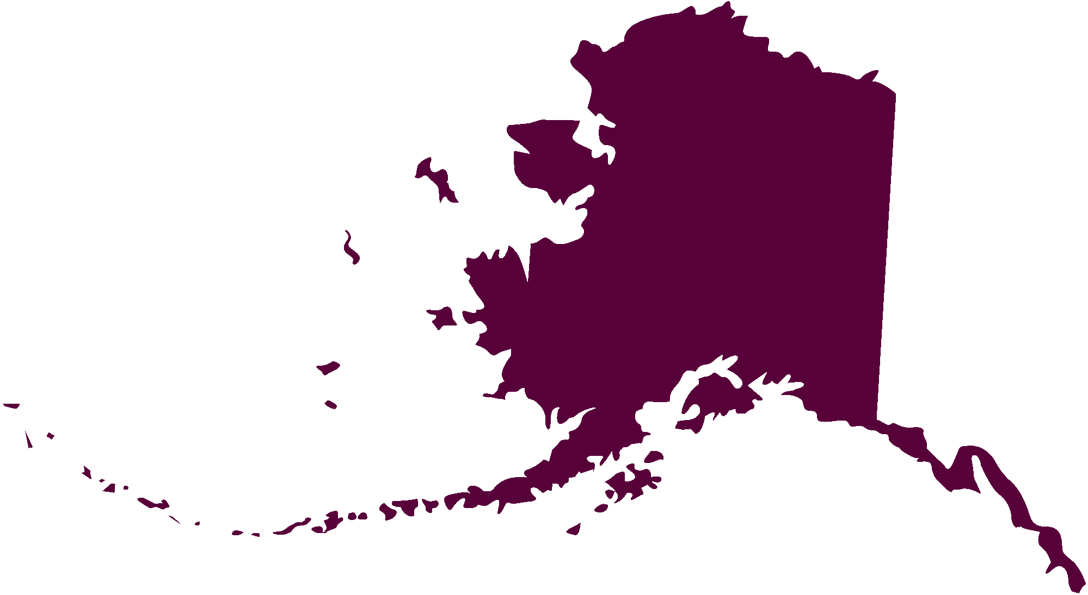
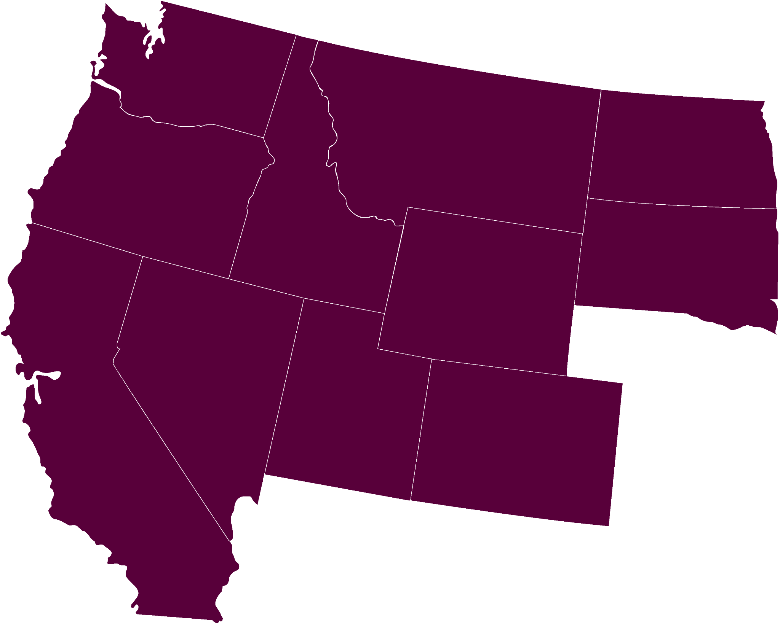
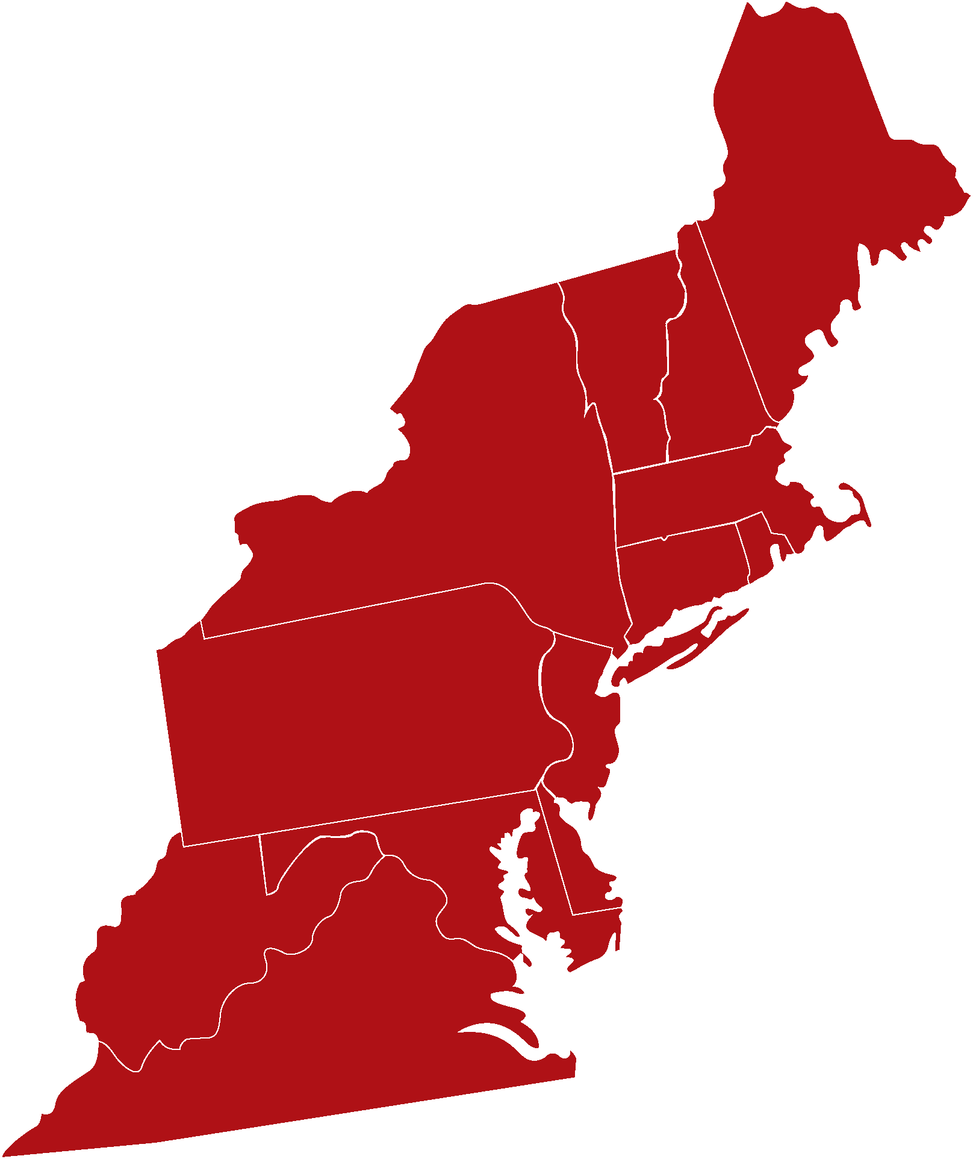
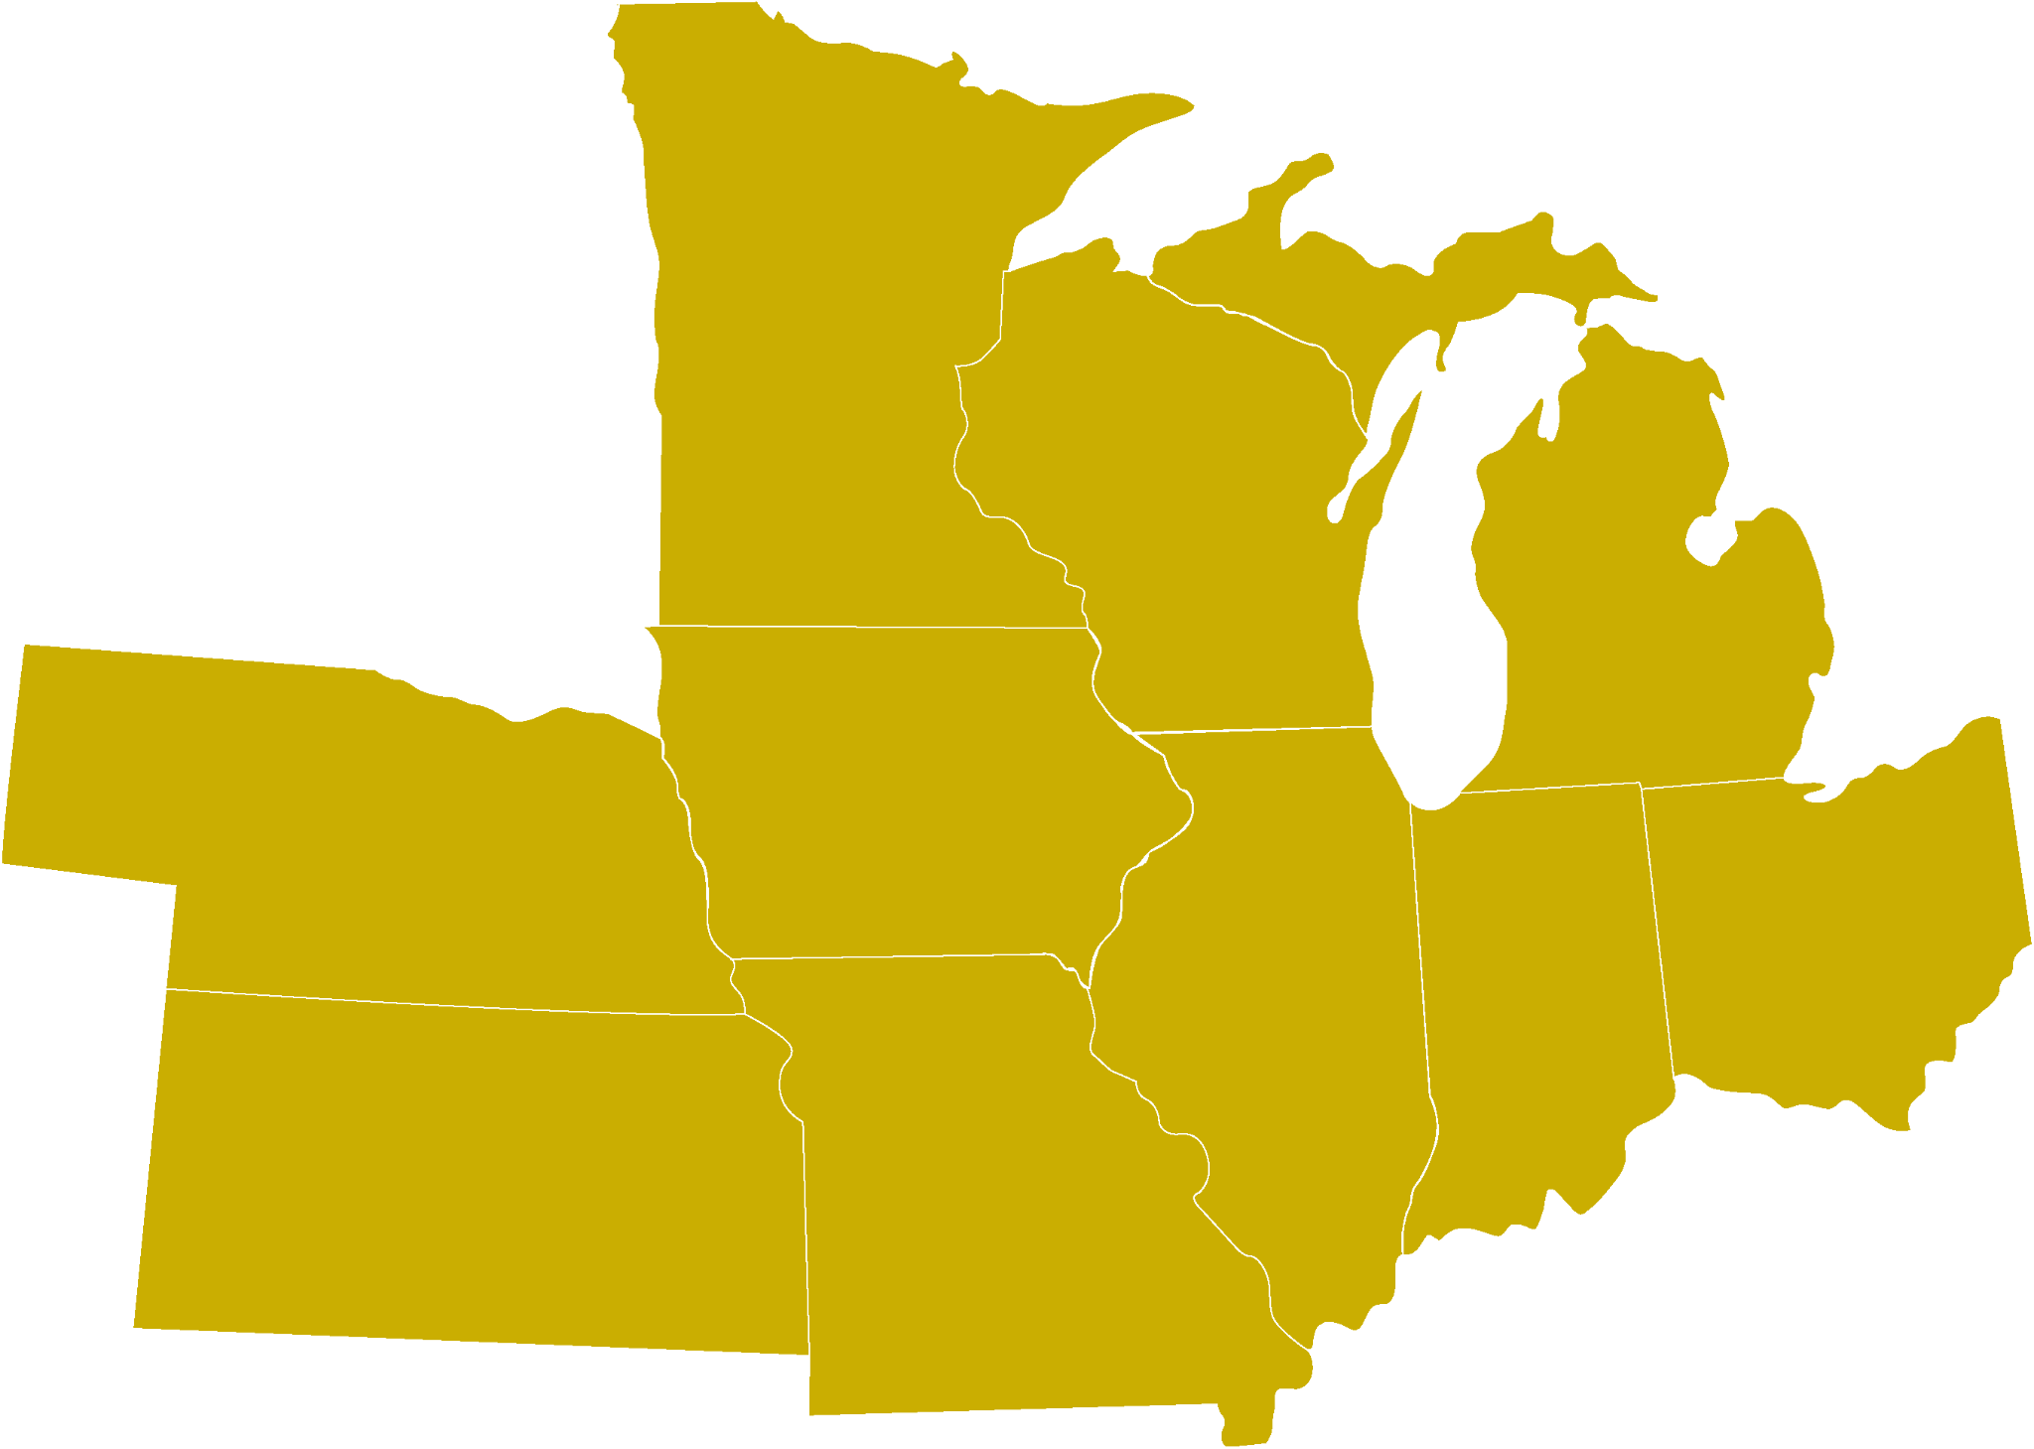

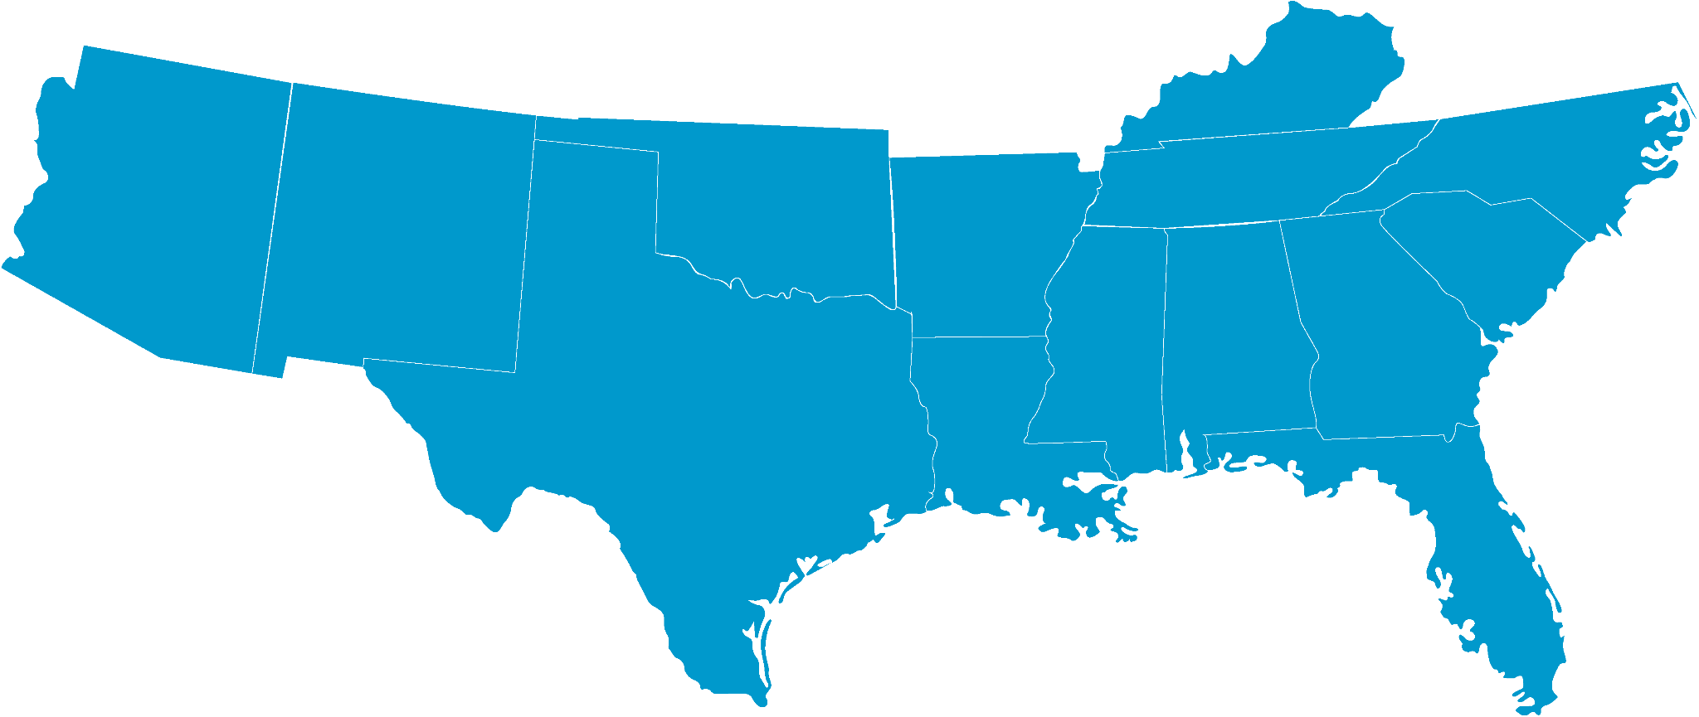

Public Building Services (PBS)
Governmentwide Design/Build and Construction IDIQ Contracts for Electric Vehicles
Supply Equipment (EVSE) Installation and Related Infrastructure Improvements
IDIQ Services | Four Geographic Zones Each Geographic Zone has a $500M Ceiling
Feasibility Studies and Site Assessments Utility Coordination Construction & Design/Build Services Electrical Infrastructure Upgrades (e.g., Switchgear, Transformers, Etc.) EVSE Installation Site Work (e.g., Trenching, Bollards, Signage, Pavement Markings, Etc.) Testing and Commissioning | All Zones are now available for use! | Recent executive action sets goals including 100% zero-emissions vehicle acquisitions by 2035, which will also entail deploying zero-emission vehicle refueling infrastructure for the federal fleet.
D
A
C
B

Slide 13





EVSE IDIQ Objectives
Support EVSE installation at federal locations nationwide | Small business opportunities
For use by GSA and other federal agencies | Part of “One-GSA” complimentary contract solutions
Streamlined procurement process

Slide 14
Inflation Reduction Act (IRA)
At a Glance
1 | 2 | 3
Assistance for Federal Buildings §60502 (HPGB) | Use of Low-Carbon Materials §60503 (LEC) | GSA Emerging Technologies §60504 (E&ST)
$250M to remain available until September 30, 2031 To convert GSA facilities to high-performance green buildings (as defined in Section 401 of EISA) | $2.15B to remain available until September 30, 2026 To acquire and install materials and products for construction or alteration of GSA buildings that have substantially lower levels of embodied greenhouse gas emissions, as determined by EPA | $975M to remain available until September 30, 2026 For emerging and sustainable technologies, and related sustainability and environmental programs

Slide 15




IRA Program Objectives
Successfully deploy low-embodied carbon materials and emerging sustainable technologies to strategically transition the federal real estate portfolio to net zero emissions.
Reducing Harmful Emissions | Creating Good Paying Jobs | Improving Efficiency and Reducing Long-term Costs | Catalyzing American Innovation
Avoid million of metric tons in embodied carbon through the use of low-embodied carbon construction materials and improved energy efficient building operations. | Resulting project will support an estimated 9,500 annual economy wide jobs across the length of the projects (approximately 43,000 total job years). | By making federal buildings more energy efficient, these projects will reduce operating costs and save money for taxpayers over the long run. | By increasing demand for low-carbon materials and emerging/sustainable technology here in the U.S., these investments will strengthen America’s domestic industrial base and catalyze innovation and job growth in homegrown industries that produce next generation materials, products, and equipment.

Slide 16
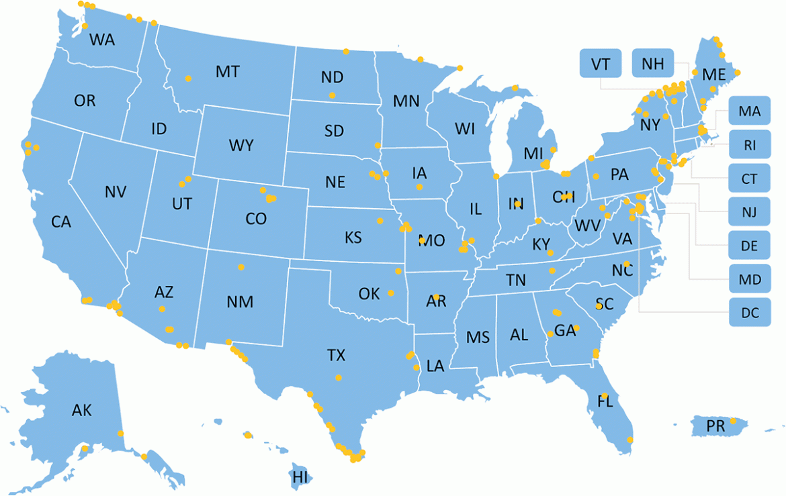
GSA IRA LEC Project List
Project info web pages are linked for many of these locations

Slide 17
Helpful links
GSA’s Inflation Reduction Act webpage
Low-embodied Carbon material requirements
Low-embodied Carbon Projects, Fact Sheet, and FAQs
GSA’s Bipartisan Infrastructure Law webpage
Land Port of Entry Projects
GSA Forecast of Contract Opportunities: Acquisition Gateway
Open Market opportunities over $25,000: sam.gov
EPA's Interim Determination for low-embodied carbon materials
Federal Buy Clean Initiative: sustainability.gov

Slide 18






Small Businesses Outreach Plan
National and Regional Industry Engagement
Helping
Small Businesses
Cross Functional Collaboration
Partnering Opportunities and Industry Engagement
Industry Engagement Strategy
for National Initiatives
Provide assistance to vendors who are interested in doing business with GSA. Focus on PBS National Initiatives.
Inform the public of opportunities and promote industry events in nationally and in each region.
Develop useful resources to assist contractors who are interested in doing business with PBS.
Involve partners in the planning process and promote industry events on various platforms

Slide 19

PBS FY 24 Small Business Goals
PBS will host national and regional industry engagement events throughout the year to help meet national small business goals of:
  Small Business 33%
  Small Disadvantaged Business 21.90%
  Woman Owned 5%
  Small Disadvantaged Veteran Owned Small Business 5%
  HubZone 3%
Industry Engagement Strategy
for National Initiatives

Slide 20


Strategic Acquisition for Quality Services
Small Business
Outreach
Work with OSDBU, PBS Divisions & Regions
  Early engagement
  and involvement in acquisition planning
  Maximize small and socioeconomic small business opportunities
  Focus on PBS Strategic Initiatives (IRA, LPOE, EV, Workforce Development)
  Sources Sought Notice
  Capabilities/Matching Sessions
  National & Regional Industry Days
Industry Engagement Strategy
for National Initiatives

Slide 21

Helpful Links
GSA Forecast of Contract Opportunities: Acquisition Gateway
Open Market opportunities over $25,000: sam.gov (search contract opportunities)
Prepare for Getting on the GSA Schedule: MAS Roadmap
EPA Interim Determination on LEC materials (scroll down to ‘Working With Other Federal Agencies’)
Federal Buy Clean Initiative: sustainability.gov
USAspending is the official open data source of federal spending information, including information about federal awards such as contracts, grants, and loans .https://www.usaspending.gov/

Slide 22
Helpful Links
GSA Office of Small Disadvantaged Business Utilization (OSDBU) Getting On GSA Schedule Webinar
How to Access GSA Contract Opportunities
How to Become a GSA Schedule Holder
GSA (OSDBU) Marketing Training for 8(a) STARS III Industry Partners
Upcoming OSDBU Events & Contacts
Find your local GSA Small Business Advocate
PBS National IRA Industry Day (March 21, 2024) Registration Link

Slide 23
In fiscal year 2024 we anticipate more than 100 IRA project opportunities in 39 states.
Where to Find GSA Opportunities
The best resources to locate GSA opportunities are the SAM.gov Contract Opportunities Search and the Forecast of Contracting Opportunities Tool.
The Forecast of Contracting Opportunities Tool provides information on expected federal contracting opportunities. The tool assists with acquisition planning by helping vendors learn about potential prime contracting opportunities early in the process. Users can easily filter the data by agency, location (place of performance), NAICS Code, contract type, and more.
Where to Find Help
GSA has several useful resources for vendors seeking to do business with GSA.
FAS GSA Schedules
Office of Small and Disadvantaged Business Utilization
Office of Citizen Services and Innovative Technologies
Procurement Technical Assistance Centers (PTACs)

