Slide 1
Making Market Research Easy
Enhancing Industry Partnerships
presented by
Kerry Durkan, Market Research Analyst

Slide 2

AGENDA
Why Market Research is conducted
Overview of MRAS
Program Successes
Service Offerings and Process
Effectively completing MRAS RFI Surveys
Ensuring customers get accurate information about your business
What GSA does with the results
Reminders and Resources

Slide 3

Market Research
Government Acquisition Professionals need to understand the marketplace to make informed acquisitions decisions so that they can meet agency goals.
The information and feedback Industry Partners provide, helps customers to visualize the competition and socioeconomic responses that customers can expect.

Slide 4

Why Research?
Drive Mission Capabilities
Gain efficiency
Innovate
Start The Conversation
Understand and begin to act
Gathering feedback
Listening to Stakeholders
Make Informed Decisions
Understand market constraints
Ensure regulatory compliance
See the solutions
Understand the impact
Recognize opportunities

Slide 5

What is GSA's Market Research as a Service (MRAS)?
MRAS uses the latest research techniques to help agencies visualize the competition and streamline the market research process.
Reduces acquisition time
Aligns Agency needs with GSA contracts and solutions
Identifies the business size appropriate for the requirement

Slide 6
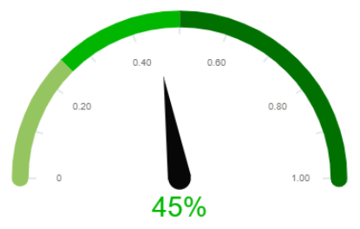
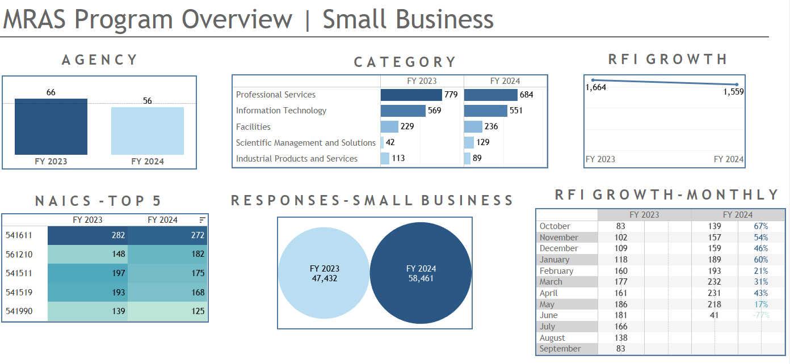
MRAS Value Add - What’s in it for Me?
Conversions: approximately 45% of MRAS RFIs are awarded to GSA contract holders = $60 Billion in awards
GSA as a Broker
GSA acts as a liaison between customers and industry partners
Customer feedback may not be timely, so GSA is an alternate available resource
Partnering with Customers to Meet Small Business Goals

Slide 7
MRAS Value Add - What’s in it for Me?
Increased Facetime - Without any additional work from you!
More visibility as a potential source - we share previous market research reports with customers that have similar requirements.
MRAS - Number of Agencies Served
MRAS - Number Requests Per Agency
Agency | FY23 | FY24
Air Force | 252 | 203
Army | 153 | 176
Dept. of Health and Human Services (HHS) | 145 | 205
GSA | 112 | 70
Dept. of Homeland Security | 102 | 103

Slide 8
MRAS Value Add - What’s in it for Me?
Free Lead Sourcing
Notifications of current MRAS RFIs are sent to industry partners based on NAICs/SINs held
Top 5 SINs
SINs | FY23 | FY24
OASIS SB Pool 1 | 313 | 287
OASIS 8a Pool 1 | 297 | 283
54151S Information technology professional services | 272 | 264
541611 Web Based Marketing - Services | 227 | 226
OASIS Pool 1 | 271 | 218
Top 5 NAICS
NAICS | FY23 | FY24
541611 Management and Financial Consulting etc. | 282 | 272
561210 Facilities Support Services | 148 | 182
541511 Web Based Marketing - Services | 197 | 175
541519 Other Computer Related Services | 193 | 168
541990 All Other Professional, Scientific, and Technical Services (Non-IT) | 139 | 125

Slide 9

MRAS Service Offerings
GSA Advantage Product Market Research
Rapid Review
Request for Information & Market Research Report
Industry Outreach
Customers can search up to 20,000 items on GSA Advantage at once.
Identifies if the requirement fits scope of existing GSA acquisition solutions in 48-72 hours.
Streamlines the RFI process and consolidates the results into one report with visuals.
GSA connects customers with industry partners to discuss current MRAS RFIs.

Slide 10
MRAS at a Glance
Customers
Projects
Collaboration
Awards
Over 350 customers supported
Over 60 agencies served
Over 1,650 RFIs issued
Product Research and Rapid Reviews
MAS PMO, GSS, and ITC Outreach
Monthly Industry Days with over 2,000 participants
Connecting Industry with customers and their requirements
About 45% of requirements researched are awarded to a GSA contract holder.

Slide 11

MRAS Success Story
Customer: Department of the Navy
Requirement: The Navy Cloud Service Management Organization seeks industry support for cloud migrations efforts. Including the development, design, security, and operation of the NECE.
Results: A Market Research report delivered to the Customer within 2 weeks, identifying 37 small businesses which helped to define their acquisition strategy.

Slide 12
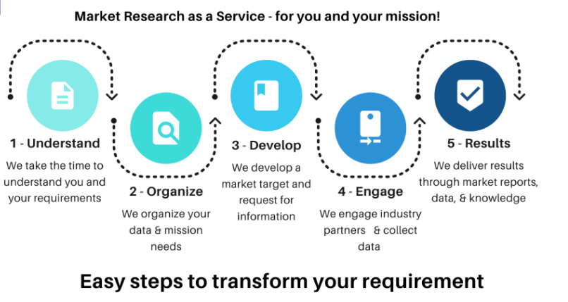
The MRAS Process

Slide 13

How we Research
We use commercially available software to streamline the process.
We keep it simple
We ask questions with a purpose but consider how we want to visualize the data.
We use video, websites, demos, manuals, and more.

Slide 14
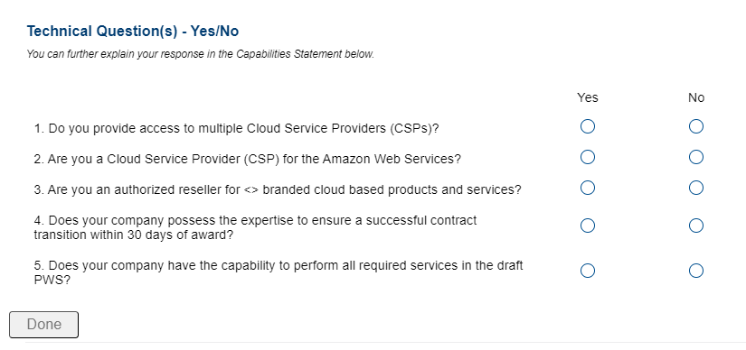
How we Research
We ask yes or no questions.
We ask for ranges, pre-set percentages, and more.
We ask questions with visualization and creating data sets in mind.

Slide 15
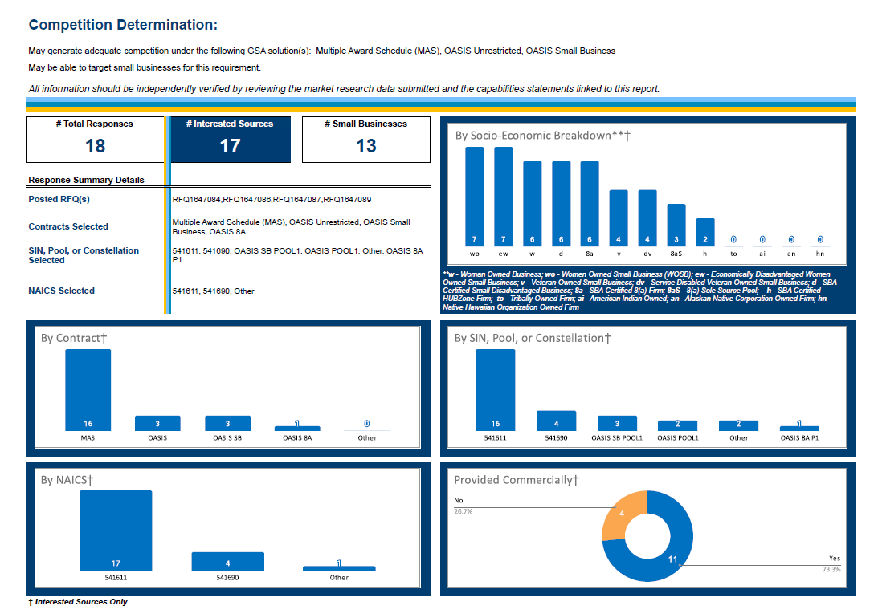
We Produce Visuals to Make Decisions Easier
We ask yes or no questions.
We ask for ranges, pre-set percentages, and more.
We ask questions with visualization and creating data sets in mind.

Slide 16

The Results
Industry
Visibility as a potential source in front of customers.
Access to GSA and Agency Points of Contacts.
Responses to RFIs lead to additional business; 50% or more of the requirements we research go to a GSA contract holder
Agency Acquisition Professionals
Provides agencies with visuals and data they can include in reports to Small Business.
Provides agencies with narratives they can leverage for Acquisition Planning.
Gives agencies an outlook on whether competition and socio-economic participation is likely.

Slide 17

How to find MRAS Surveys/RFIs
**Not all RFIs posted in eBuy are posted by the MRAS Team.**
All MRAS RFIs are posted on GSA’s eBuy site as a Request for Quote (RFQ), Seeking Sources or Information Only under the applicable SINs and contracts.
If you’re under the SIN and contract for that RFI you will get notified via email from eBuy and rfi@research.gsa.gov.
All MRAS RFIs include a URL that will take you to the RFI Survey Platform.
Make sure your company email in eLibrary is current and up to date, as RFI requests will be sent to that email.

Slide 18
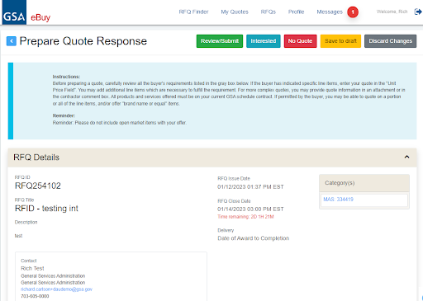
New "Interested" Feature in eBuy
A new feature has been added to eBuy. Contractors may notify a customer they are interested in a Request for Information (RFI) or Request for Quote (RFQ).
When viewing a RFQ in eBuy, you may select the new “Interested” button located at the top right.
Checking the "Interested" feature DOES NOT mean you will be included in the market research report to customers for MRAS RFIs

Slide 19
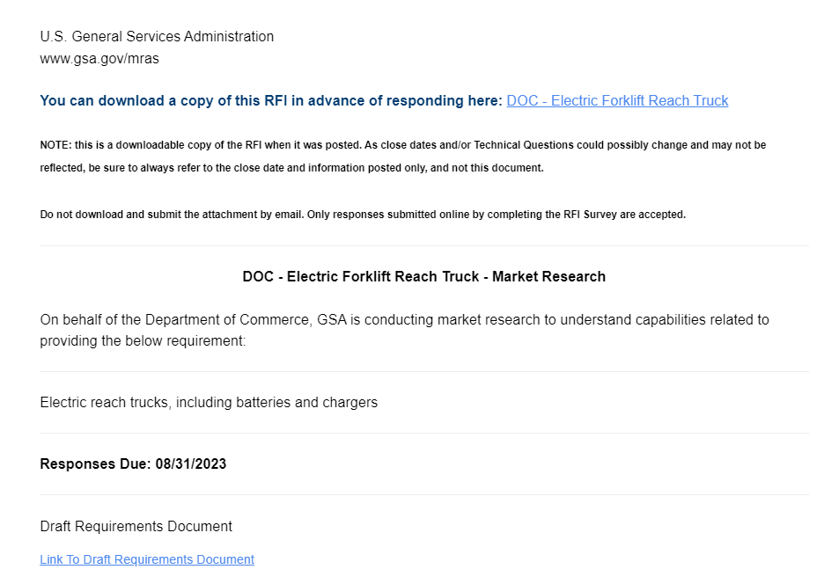
Survey Description
Download a copy of the survey including all questions.
Review the Scope description in the summary
Be sure to download any requirements attachments like the PWS or SOW

Slide 20
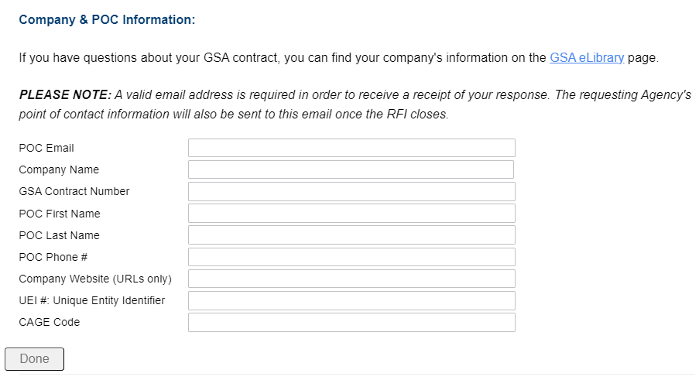
Company Information
Be sure to include a URL only

Slide 21
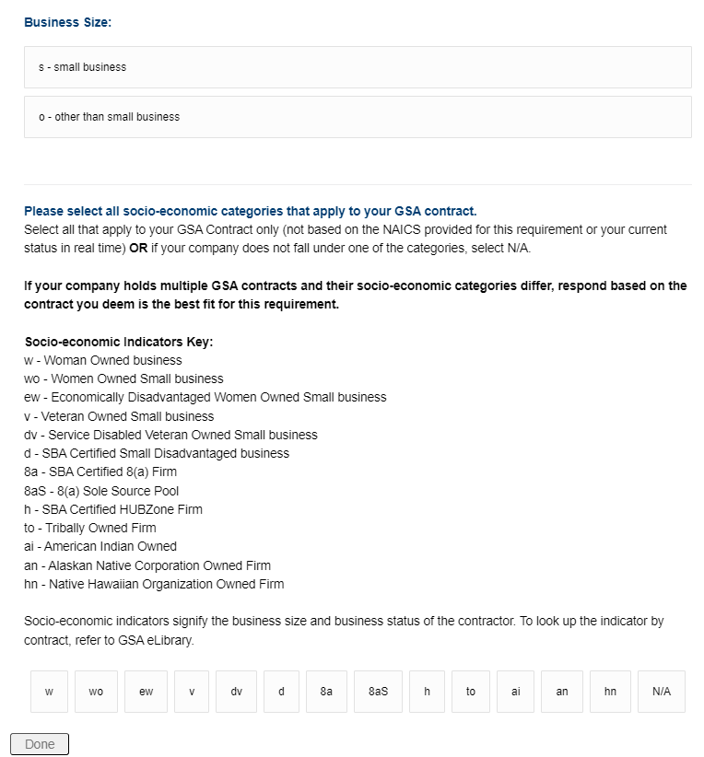
Business Size
Select “other” if you are not a small business

Slide 22
Reminder: Using Socio-economic Designations
Use the socio economic designation as listed on your GSA contract accurately as customers use that info to set aside to that socio economic category
Using incorrect socio-economic designations will give you 0% chance to quote the requirement because it won't show up in eBuy for your company.
Omitting socio-economic designations you do hold reduces the chances of a possible set-aside that may increase your probability of win.

Slide 23
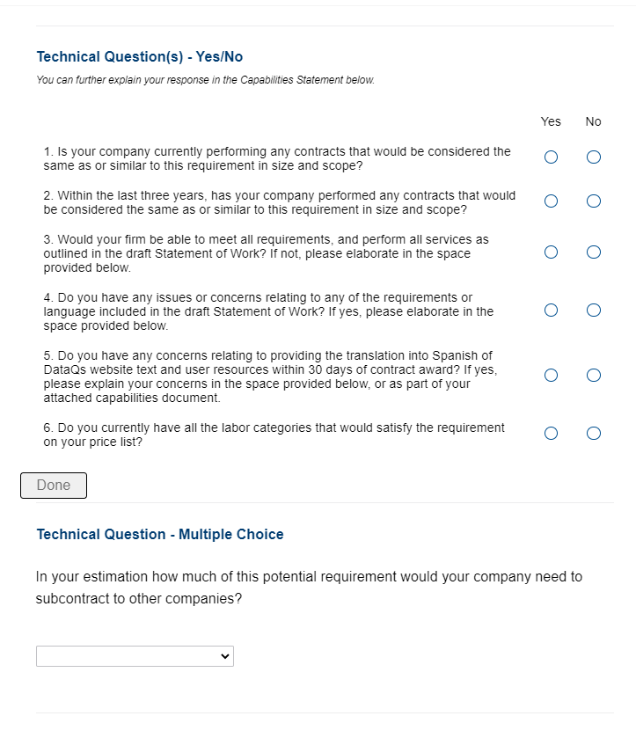

Technical Questions
Examples of technical questions, answers can be explained in capabilities statement

Slide 24
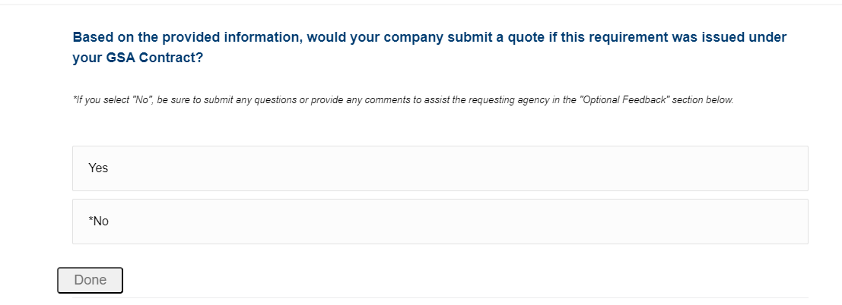
Offers
By selecting YES, your responses will be included in the report

Slide 25
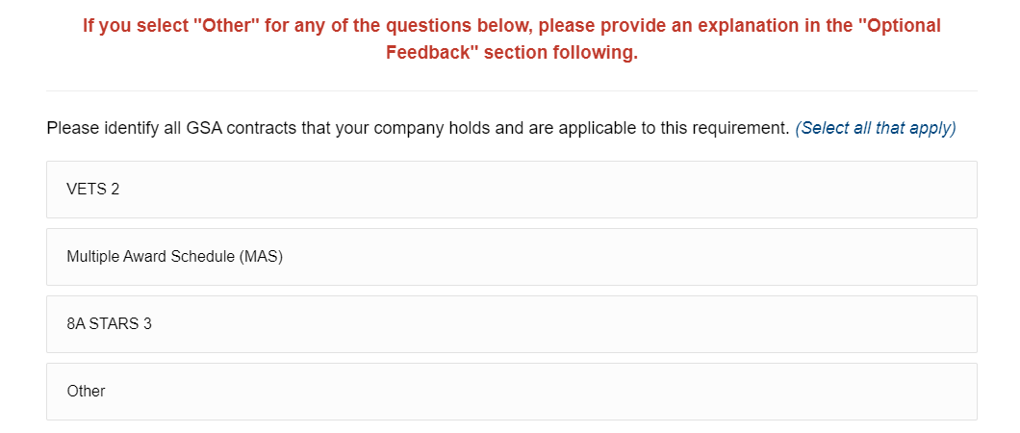
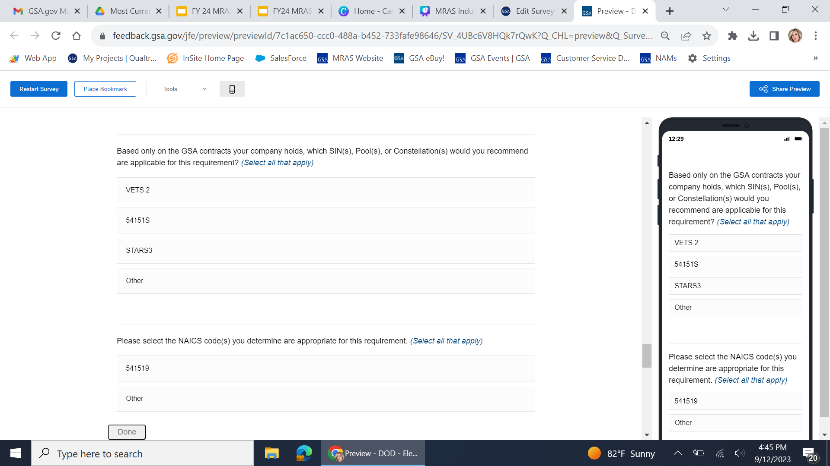
Contract/SIN/NAICS
Multiple answers can be selected here. Non GSA Contract Holder information will be filtered out of our reports as we only research markets within GSA Contracts.
Choose the SIN or NAICS most appropriate for the requirement

Slide 26
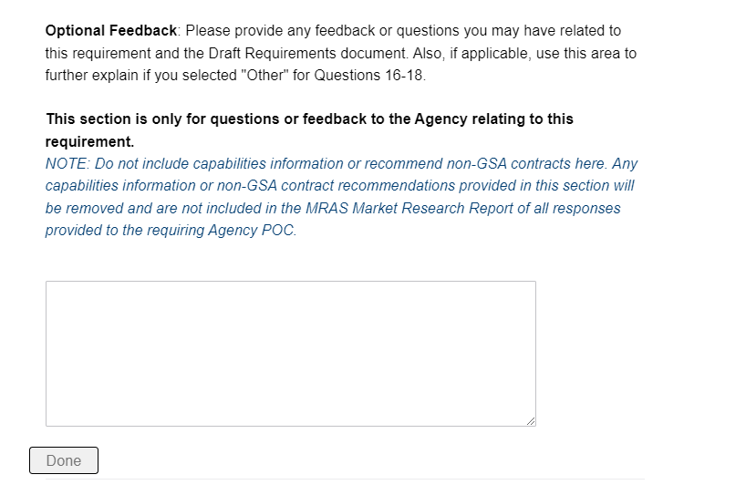
Feedback
Provide honest feedback about the survey, include questions or concerns you may have about the requirement

Slide 27
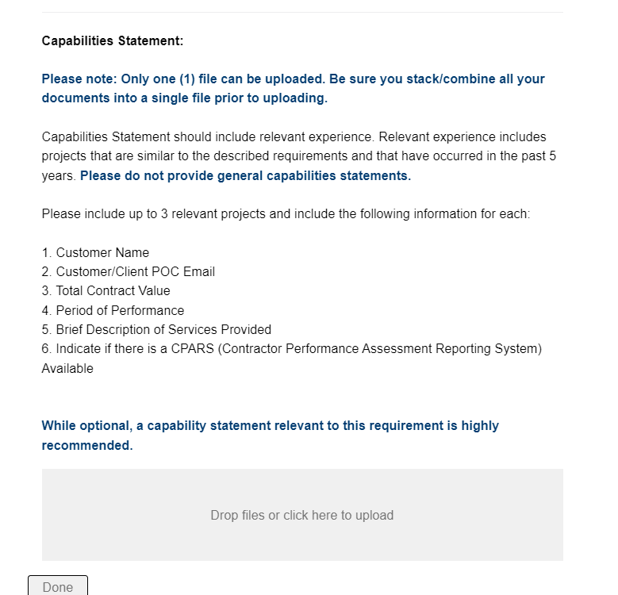
Capability Information
Include more information about relevant experience in your capabilities statement

Slide 28
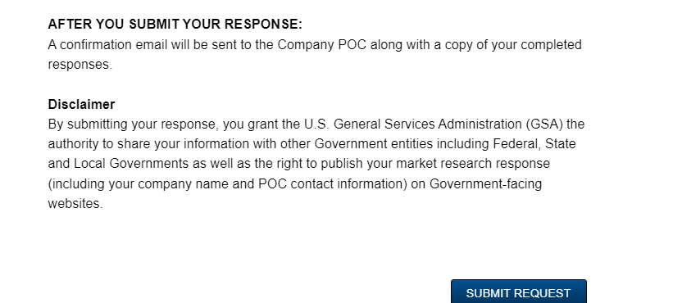
Submitting Your Response
POC Information will be sent to you should you have additional questions.
By submitting your response to the survey, you agree to have your information shared with other Government entities

Slide 29

What Happens Next?
A Market Research Report summarizing your responses is sent to Agency Acquisition Professionals.
Feedback you provide regarding the requirement is summarized in a report to Agency Acquisition Professionals.
An Agency Point of Contact is provided to you if you have further questions regarding the RFI or requirement.

Slide 30

Tips for your Capability Statement
You have two instances to include a capability statement:
In the “Company Information” section, in the “Capability Statement URL” field, for general capabilities statements.
Upload a more specific Capabilities Statement at the end of the survey
Also note:
Combine your files, only one document can be uploaded.
Provide more information on any technical questions that you answered as “No”.
Be sure to elaborate on any additional open ended questions.
This an optional document unless noted otherwise.

Slide 31

Reminders - Attachments
Submitting a response to our RFIs:
Ensures your information is included in the final report to the customer.
Please DO NOT email attachments:
Attachments or capabilities statements sent via email, will not be included in the report and will not be forwarded to the customer.
Forward any attachments not included in your RFI response to the customer directly using the POC information provided.

Slide 32
Reminders - Points of Contact and Questions
Agency POC information:
Emailed 5-10 days after RFIs closes.
POC information will only given to vendors that respond to the RFI.
Requests to resend POC email will not be provided for RFIs that have closed more than 45 days ago.
Questions:
Include questions in the Optional Feedback section.
The Agency will answer your questions at their discretion after the RFI closes. Reach out to the GSA POC if you do not receive a response.
MRAS is unable to provide information regarding the expected acquisition strategy, or expected RFP date. Please contact the Agency POC for this information.

Slide 33

Reminders - Extensions and Updates
NO EXTENSIONS ARE GRANTED. This is only market research and the RFIs are meant to be streamlined. Respond with whatever information you have by the due date.
Email RFI@Research.GSA.gov if you need to update your response to a survey prior to the Due Date.
After you respond to a survey, you will receive an email with a confirmation of your responses.

Slide 34

MRAS Help Requests
Email RFI@Research.GSA.gov OR submit an Industry Help Request Form if you need additional assistance with any of the following:
Agency or GSA POC information
To update your responses to a survey prior to the Due Date.
Issues accessing the RFI survey
Please be sure to include:
Your Business Name
Email
Description of the RFI from eBuy
RFQ number (not mandatory).

Slide 35

What Our Customers are Saying....
"MRAS helped me avoid doing it the way it's always been done before."
“...I used MRAS and in 10 days, had 40 people respond. GSA then went over the report and did a deep dive to identify specific socioeconomic factors. It was very helpful!"
"...the customer utilized the MRAS RFI process to determine their overall acquisition strategy. The MRAS program has proven to be a value added program!
"I am very satisfied with this process,...I am extremely happy with the results and plan to utilize the services again....I will share this positive experience with other supervisors in my organization and encourage them to utilize these services as well. Great Job!"

Slide 36
Industry Training
Making Market Research Easy - Enhancing Industry Partnerships
Want to learn more about Requests for Information (RFIs) and how they can be a useful tool for your business? This webinar will bring innovative insights on how to respond to GSA’s RFIs by providing tips and tricks from the experts on how to fill out these important surveys. Participants in this session will walk away with a better understanding of why GSA collects industry responses and and how the data collected shapes future purchasing decisions. Register now for this monthly webinar to stay informed and hear directly from GSA experts!
www.gsa.gov/events
(future dates for Making Market Research Easy webinars)
REGISTER NOW

Slide 37
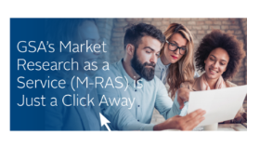
MRAS Resources
For Assistance click: Industry Help Request Form
Click HERE to sign up for future MRAS Industry Training
For any additional questions, email: RFI@Research.GSA.gov
Visit www.Buy.GSA.gov/MRAS for more information on GSA’s Market Research as a Service (MRAS)

Slide 38
Additional Vendor Resources
How to get on GSA Schedule
Additional Industry Training
Vendor Support Center
Office of Small Business Utilization
APEX Accelerators (formally known as the Procurement Technical Assistance Program), is authorized by Congress to expand the number of businesses capable of participating in government contracts. The program focuses on building a strong, sustainable, and resilient U.S. supply chains by assisting businesses that pursue and perform under contracts with the DoD, other federal agencies, state and local governments and with government prime contractors.

Slide 39

THANK YOU

