Slide 1


Small Business Works 2024
GSA OSDBU A.C.T.S on Maximizing Small Business Opportunities
U.S. General Services Administration

Slide 2
MAS 8(a) Pool
Nicole Papanier
Procurement Analyst in the Multiple Award Schedule (MAS) Policy Division
GSA

Slide 3
Agenda
MAS 8(a) Pool Overview
Process for Existing MAS Contractors
Process for New MAS Offerors
8(a) Competitive and Sole Source Eligibility
Order Instructions
Questions

Slide 4
Overview of MAS 8(a) Pool
GSA/SBA 8(a) Partnership Agreement was signed June 23, 2022, authorizing the establishment of an 8(a) pool under MAS for the exclusive participation of 8(a) Program Participants
8(a) eligibility determinations completed at the contract level, for both existing MAS 8(a) contractors, as well as new offerors at the time of award
Upon acceptance into the 8(a) pool, contracts are eligible for both competitive and sole source 8(a) awards
Contractors that are accepted into the MAS 8(a) pool are not limited to competitive 8(a) and sole source 8(a) awards. 8(a) pool contractors remain eligible to compete for any other MAS orders for which they are otherwise qualified.

Slide 5
8(a) Competitive and Sole Source Eligibility
Upon acceptance by SBA 8(a) pool contractors will be eligible for competitive and sole source 8(a) awards
For competitive awards, because eligibility is obtained at the contract level, the order level CO is not required to obtain an eligibility determination at the order level
8(a) pool contractors that have exited the 8(a) Program may continue to receive new competitive orders under the MAS contract for up to five (5) years from the date of entrance into the 8(a) pool, or until rerepresentation in accordance with FAR 19.301-2(b)(1) (whichever is first).
Contractors eligible for competitive awards only will be indicated in GSA eTools with a “8(a)” icon
Ordering agencies may continue to receive credit toward their prime contracting small business goals for such competitive orders awarded to MAS 8(a) pool contractors.

Slide 6
8(a) Competitive and Sole Source Eligibility
For sole source awards, order level offer and acceptance is required
Contractors remain eligible for sole source awards as long as
They are active participants in the 8(a) Program at the time of the task/delivery order award;
Continue to meet all 8(a) Program eligibility requirements, as determined by SBA; and
Qualify as small for the size standard corresponding to the NAICS code assigned to the order, at the time of task/delivery order award.
Contractors eligible for sole source and competitive awards will be indicated in GSA eTools with a “8(a)S” icon

Slide 7
New Indicators on e-Tools
FAS has added indicators for each 8(a) pool contractor for display on GSA eTool websites (e.g., eLibrary, GSA Advantage!), indicating a contractor’s eligibility for 8(a) awards.
Contractors eligible for sole source and competitive awards will be identified with the indicator “8aS” or “8(a) Sole Source Pool”*
Contractors eligible for competitive awards only will be identified with the indicator “8a” or “SBA Certified 8(a) Firm”
*There is one pool- the MAS 8(a) Pool- in which contractors are eligible to compete for sole source and competitive awards. All references to a “Sole Source Pool” on GSA eTools and GSA.gov will be updated to clarify that there is one MAS 8(a) Pool.

Slide 8
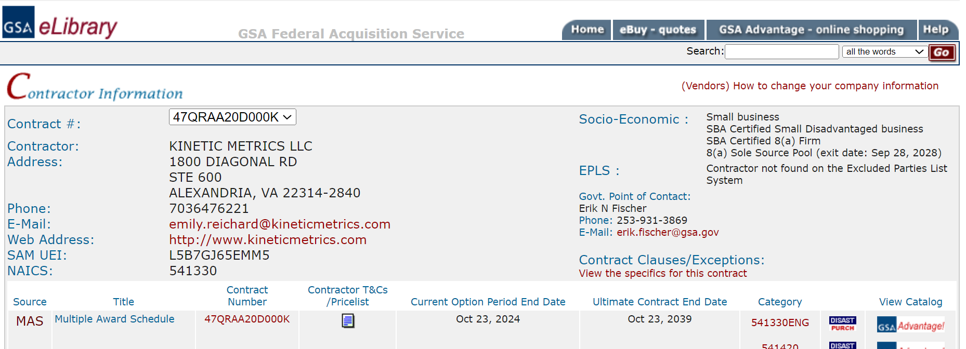
New Indicators on E-library

Slide 9
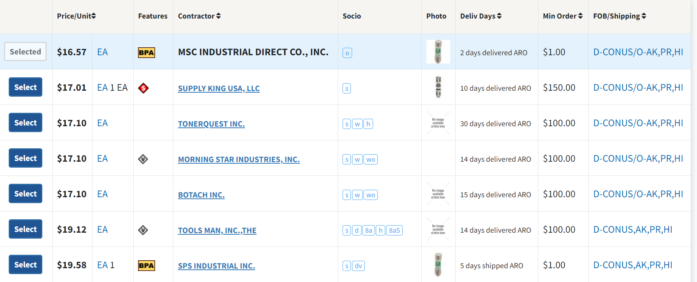
New Indicators on GSA Advantage

Slide 10
Order Instructions:
How to Make a Competitive Award
Perform market research Identify MAS 8(a) contractors that are suitable for the requirement.
Check eLibrary Verify the following in eLibrary that:
The 8(a) contractors are in the MAS 8(a) pool and eligible for competitive awards, having either an “8a” or “8aS” indicator.
The 8(a) contractors have the appropriate special item number (SIN) for the request for quote (RFQ).
Follow the ordering procedures Complete the order in accordance with FAR 8.405-5 (a)(2)(i) and (ii) for setting aside orders and BPAs.

Slide 11
Order Instructions:
How to Make a Sole Source Award
Perform market research Identify a MAS 8(a) contractor that is suitable for the requirement.
Verify the following in eLibrary:
The 8(a) contractor is in the MAS 8(a) pool and is eligible for sole source awards, having the “8aS” indicator.
The 8(a) contractor has the appropriate special item number (SIN) for the request for quote (RFQ).
Complete offer and acceptance at the order level: Check the contractor’s 8(a) exit date displayed in eLibrary, to ensure that the contractor will be an eligible 8(a) at the time of order award. At the time of order award, your contractor must be an active 8(a) program participant and must qualify as small for the size standard corresponding to the NAICS code assigned to the task/delivery order.

Slide 12
Order Instructions:
How to Make a Sole Source Award
Select the MAS 8(a) contractor Make a selection in accordance with FAR 19.804-1.
Offer the contract to SBA You can use our 8(a) sole source offer letter template. Offer the contract to SBA in accordance with FAR 19.804-2. Find your state and local SBA district office.
Wait for SBA decision If SBA determines that the offered contract is eligible, they’ll accept it, per FAR 19.804-3.

Slide 13
Questions?
Existing MAS 8(a) contractors may submit questions regarding their 8(a) Pool status to: opcpolicymailbox@gsa.gov

Slide 14
Thank You!

Slide 15

GSA

