Slide 1


Welcome How to Obtain Surety Bonds: What Every Small Business Should Know!
Welcome
How to Obtain Surety Bonds:
What Every Small Business Should Know!

Slide 2
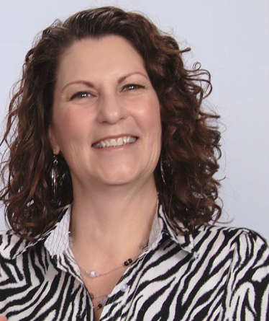

INTRODUCING TODAY’S PRESENTERS
INTRODUCING TODAY’S PRESENTERS
Tamara E. Murray
Underwriting Marketing Specialist
Office of Surety Guarantees
SBA
Kevin Valdes
Underwriting Marketing Specialist
Office of Surety Guarantees
SBA

Slide 3

SBA Surety Bonds for Small Businesses – YouTube
Notes:
(Link to embedded video if needed: SBA Surety Bonds for Small Businesses – YouTube)

Slide 4

SBA guarantees contract bonds
A variety of bond types and amounts:
1
Bid
2
Performance
3
Payment
4
Maintenance
For each government and private sector
contract up to $6.5 million.
For each direct federal contract,
the limit is $10 million.

Slide 5



Evaluation based on capacity, capital, and character
Capacity (your ability to complete the work) is based on experience in your field, key personnel experience, and day-to-day business management practices.
Capital is based on your company’s profitability and the quality of your financial statements.
Character means the small business owner’s personal credit history and business reputation.

Slide 6

We help small businesses facing barriers to success by creating access and opportunity for them to qualify for contract bonding, increase bonding capacity, and grow their business.

Slide 7

Providing access and creating stability
You gain access to bid, performance,
payment, and maintenance bonds.
Our guarantee allows small businesses to qualify for more bonding.

Slide 8
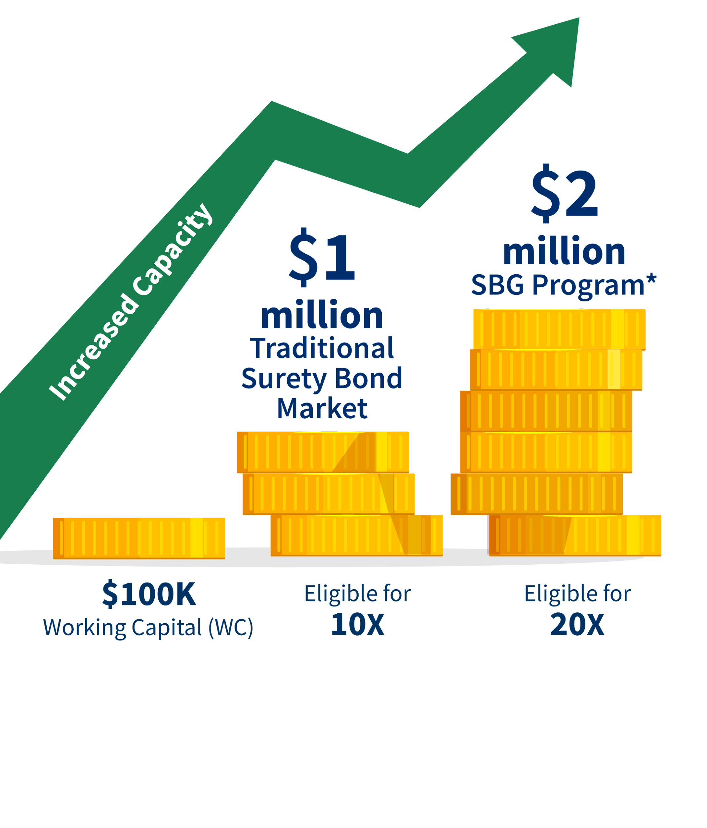
Benefits of SBA guaranteed bonds
  Working capital requirement is about half what is normally required for contract surety bonds.
  We count the unused portion of bank lines of credit (BLOC) as working capital.

Slide 9

Typical contract bond costs
Bid bond guarantee fees
are never charged by the SBA.
Contractor’s fee
is a percentage of the contract amount that is paid to the SBA
for the guarantee.
Surety premium
is a charge paid to the surety company for the bond.

Slide 10
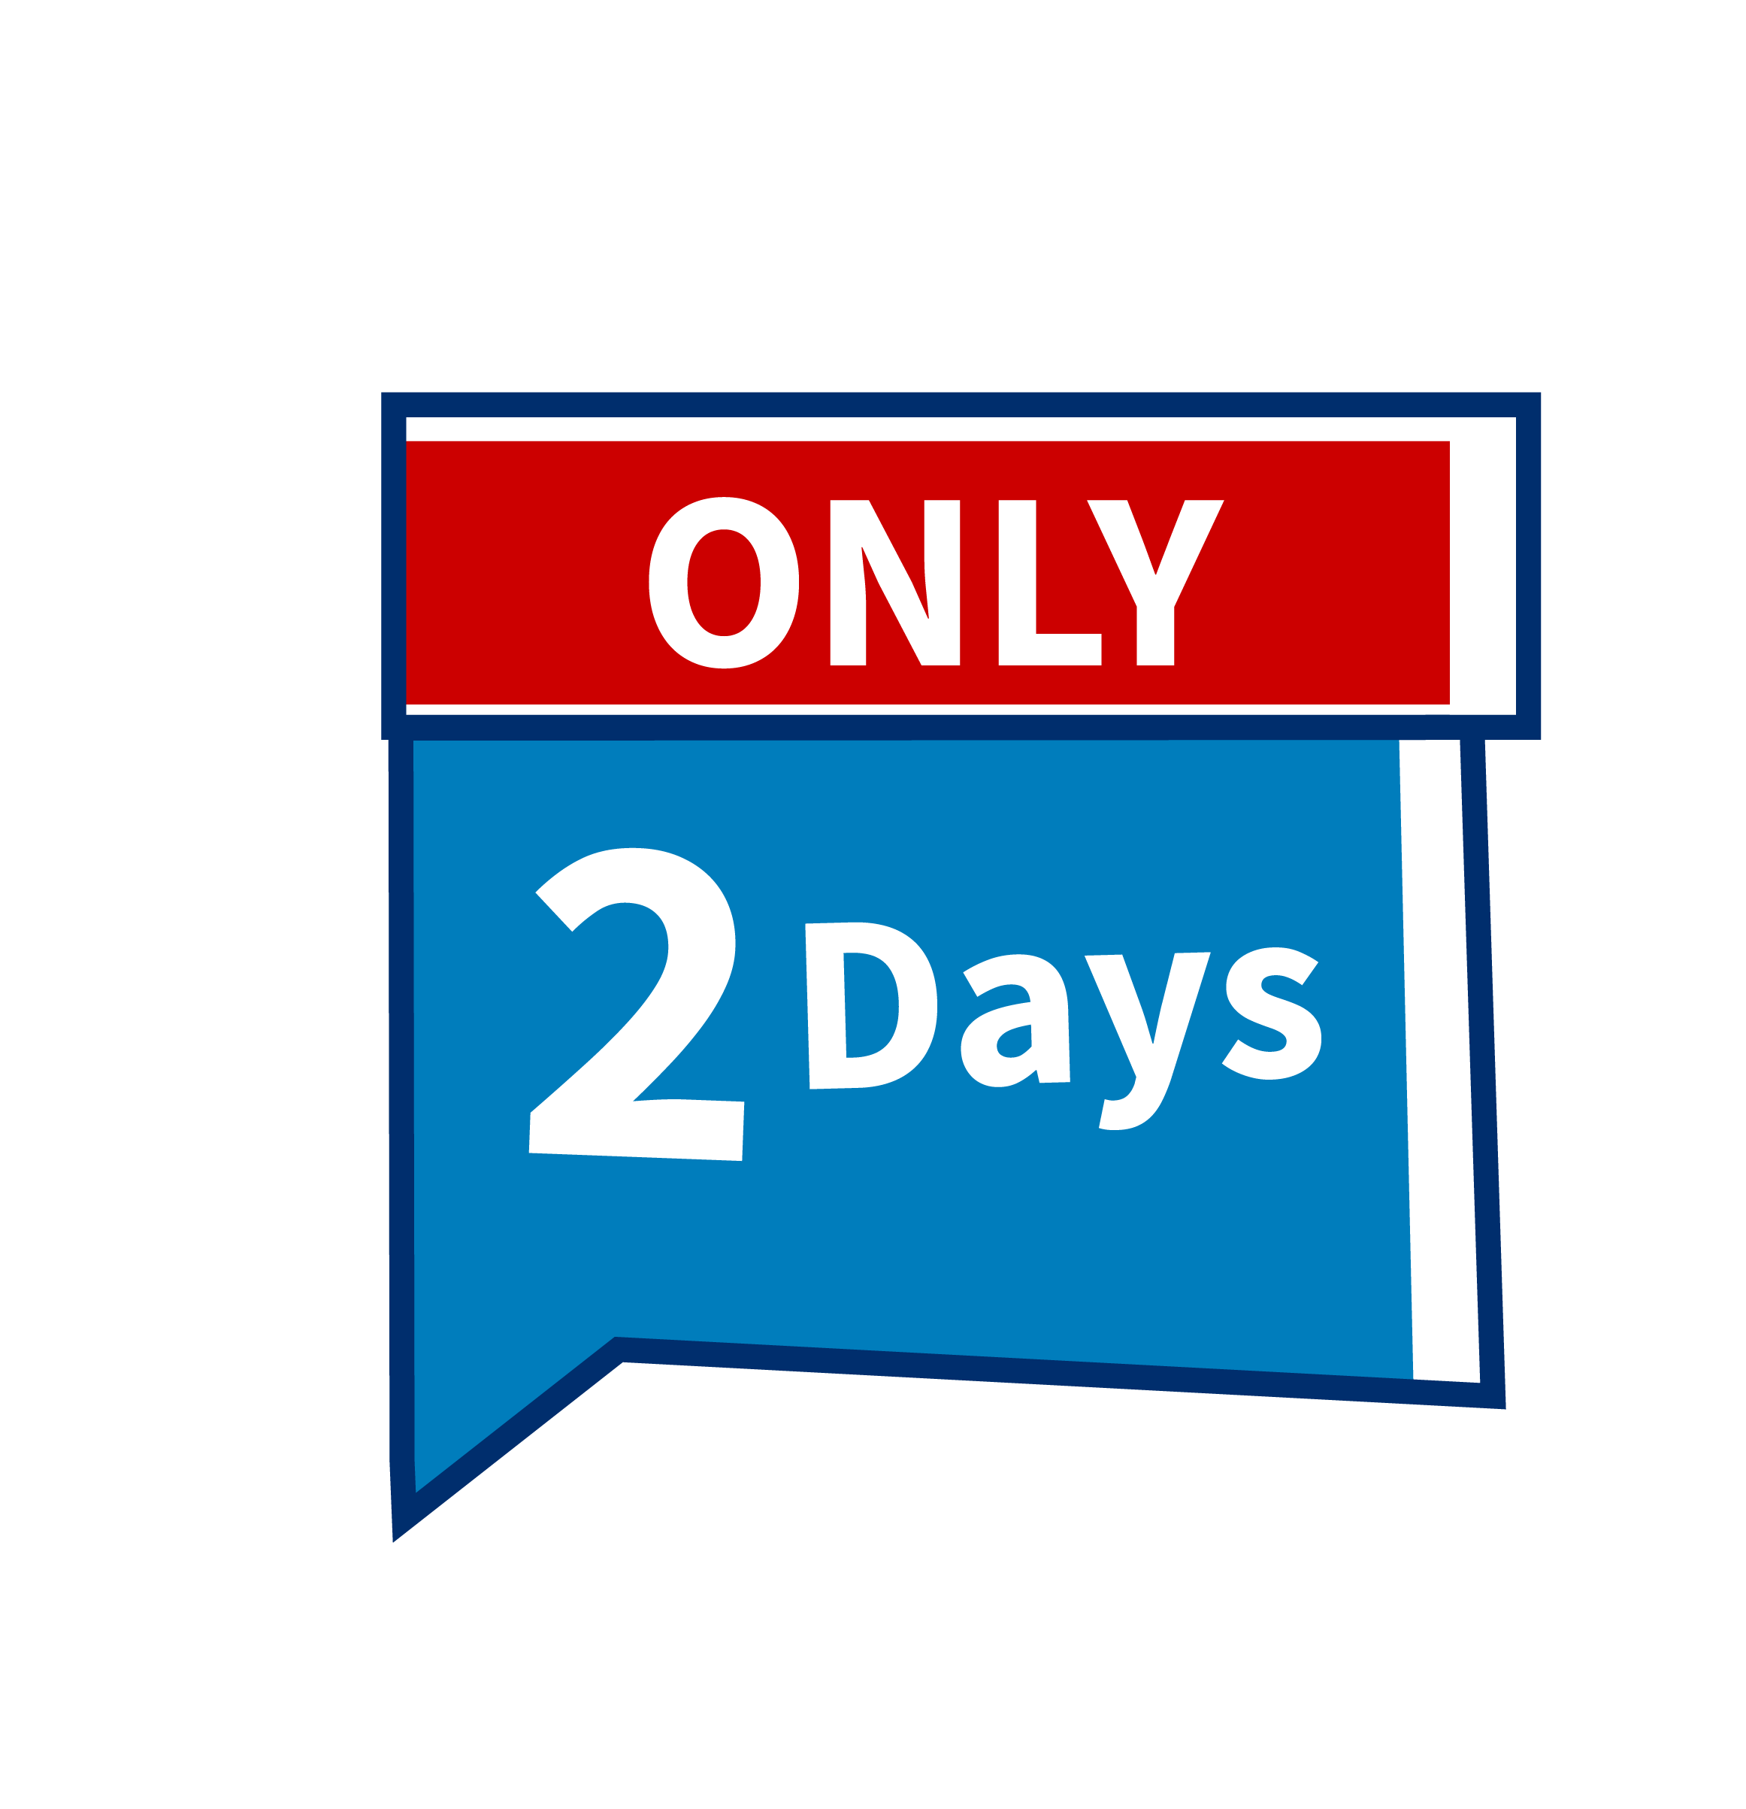
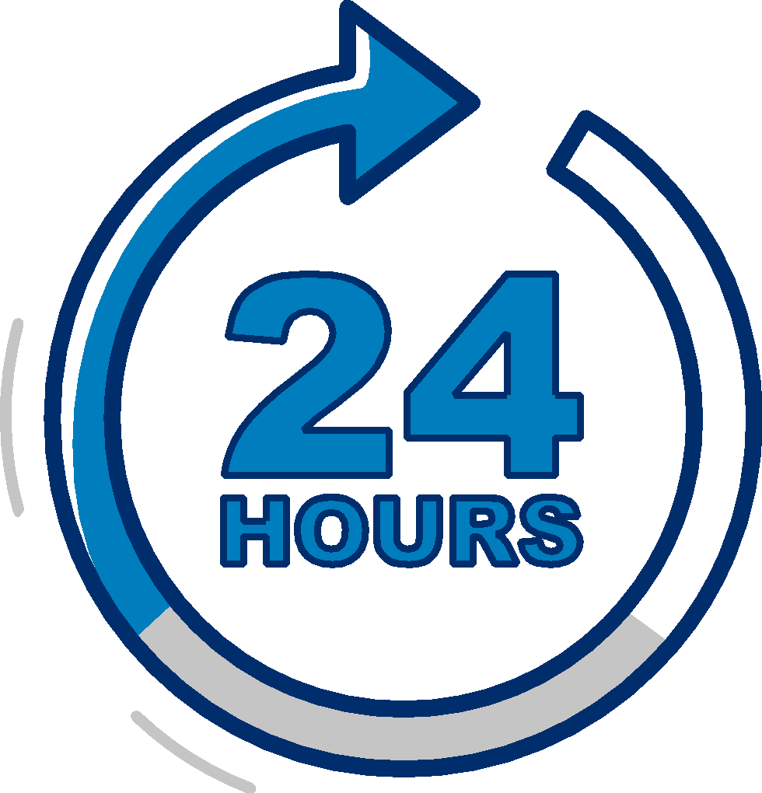
Prior Approval Program and QuickApp =
Fast decisions to meet your needs
Prior approval program delivers underwriting decisions in 2 days.
QuickApp decisions within 24 hours on bonds of $400,000 or less.

Slide 11
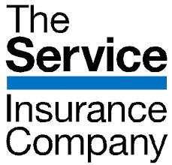






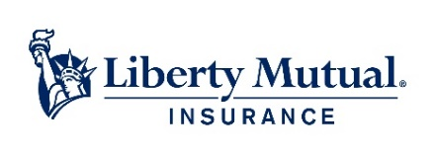





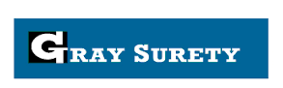




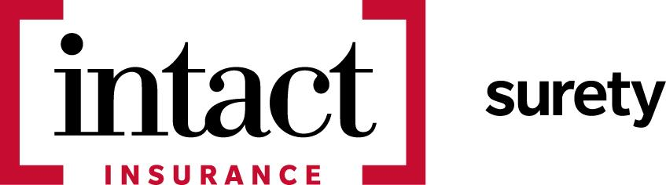
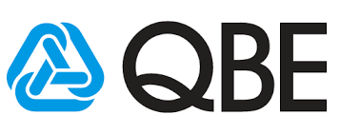
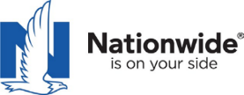





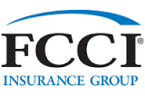

A network of trusted partners
UC&S

Slide 12


Find an SBA-authorized bond agent
Visit
sba.gov/osg

Slide 13

Vera Hall, Small Business Owner
“The ability to get this type of bonding through the SBA’s Surety Bond Guarantee program allows you as a small business owner to realistically compete with larger corporations for contracts that you want and need to grow your business.”
Let the SBG Program help your business grow.

Slide 14
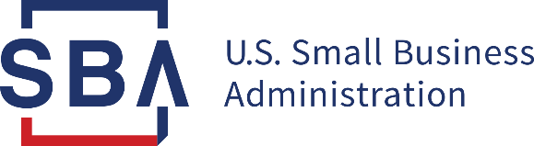
Thank you!
Any questions?
Presenter contact information
Tamara E. Murray
Underwriting Marketing Specialist
(303) 995-5786
tamara.murray@sba.gov
sba.gov/osg

Slide 15
Questions?

Slide 16
Contact us:
Tamara E. Murray
Underwriting Marketing Specialist
(303) 995-5786
tamara.murray@sba.gov

Slide 17
Small Business Resources
U.S. General Services Administration (GSA) - https://www.gsa.gov
  Office of Small & Disadvantaged Business Utilization (OSDBU) - https://www.gsa.gov/osdbu
  Federal Acquisition Service (FAS) - Commercial Products & Services - https://www.gsa.gov/fas
  Public Buildings Services (PBS) - Construction, Architecture, Interior Design, and Real Estate - https://www.gsa.gov/pbs
Small Business Administration (SBA) - https://www.sba.gov
  SBA Size Standards - https://go.usa.gov/xFR9p
  Small Business Loans - https://go.usa.gov/xFRPD
Procurement Technical Assistance Centers (PTACS) - https://www.aptac-us.org/
System for Award Management (SAM) - https://go.usa.gov/xFNkS
Federal Agency Procurement Forecasts - https://go.usa.gov/xFRbn

Slide 18
Thank You!

