Slide 1


Welcome
How to get on the GSA Schedule:
What you need to know!

Slide 2
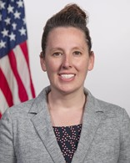

Training Overview
The Multiple Award Schedule Offer Process + Resources
Multiple Award Schedule (MAS) Program Overview
Is MAS a Good Fit
MAS Offer Process and Roadmap
Learning Resources & Technical Support
Stephanie Shutt
Director MAS PMO,
U.S General Services Administration

Slide 3
Multiple Award Schedule (MAS) Program Overview

Slide 4
Multiple Award Schedule (MAS)
The MAS program, commonly referred to as GSA’s Schedule program or Federal Supply Schedule, is the premier commercial acquisition vehicle program within the Federal Government with over $36 billion in GSA Schedule sales annually.
GSA’s Multiple Award Schedule (MAS) is an indefinite delivery, indefinite quantity (IDIQ) contract for commercial products and services that are available for use by Federal agencies worldwide.
Other types of Government-wide multiple award contracts:
  Government-Wide Acquisition Contracts (GWAC)
  Multi-Agency Contracts (MACs)

Slide 5
Is MAS a Good Fit?

Slide 6
Which Category(ies) Apply to You?
Facilities | Furniture and Furnishings | Human Capital | Industrial Products and Services
Information Technology | Miscellaneous | Professional Services | Office Management
Scientific Management and Solutions | Security and Protection | Transportation and Logistics | Travel
Notes:
Review the available offerings attachment in the solicitation for the subcategories and SIN.

Slide 7
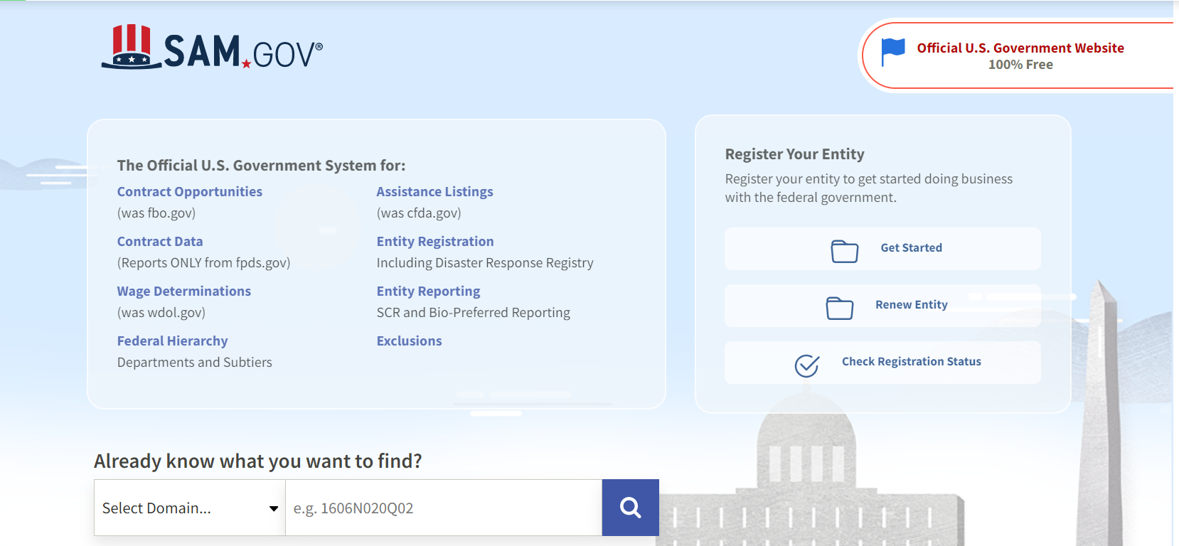
Is there a demand for my products and/or services?
Government-wide contracting database
Identify who bought what, how much was spent, when and where
Identify products and services the government bought and your organization may want to offer

Slide 8
Am I Competitive?
The below GSA websites can help you conduct market analysis to ensure your organization can compete for MAS order awards:
GSA eLibrary: gsaelibrary.gsa.gov
GSA Advantage!®: gsaadvantage.gov
GSA Schedule Sales Query Plus (SSQ+): https://d2d.gsa.gov/report/fas-schedule-sales-query-plus-ssq

Slide 9

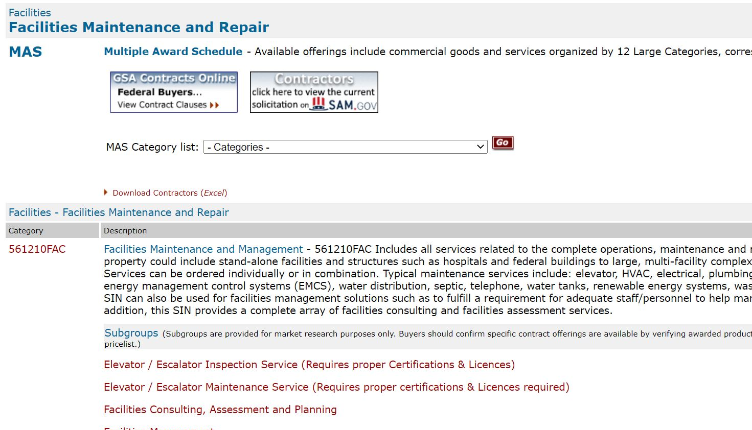
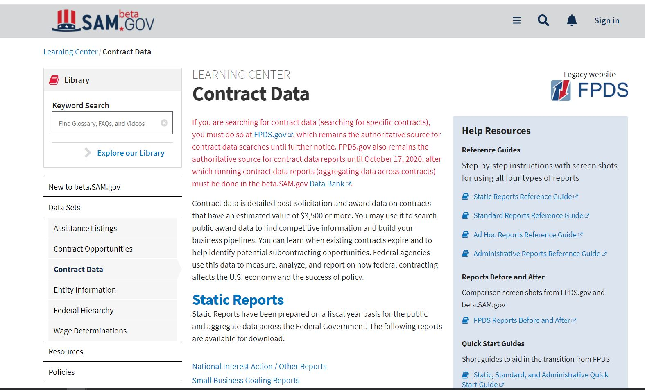
GSA eLibrary
Contains GSAs Schedule and the contractors under the MAS Schedule program.
Review Schedule Categories and Subcategories
Identify your potential competitors for orders under the program

Slide 10

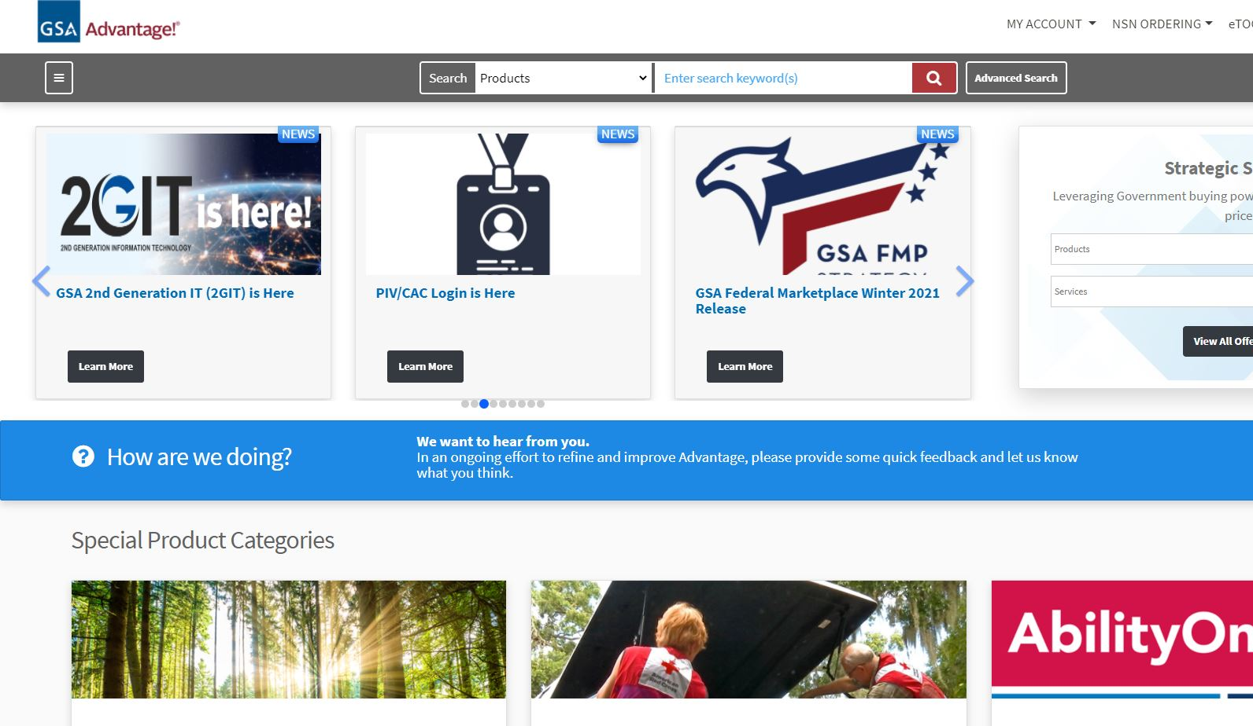
GSA Advantage!
GSA Advantage!® is the government's premier online shopping system. Government buyers use GSA Advantage!® to purchase millions of high quality products, services, and solutions from thousands of approved commercial vendors.
Search for items, services, and suppliers
Perform market research
Compare features, pricing, delivery times,
warranty terms, services, and other terms and conditions

Slide 11
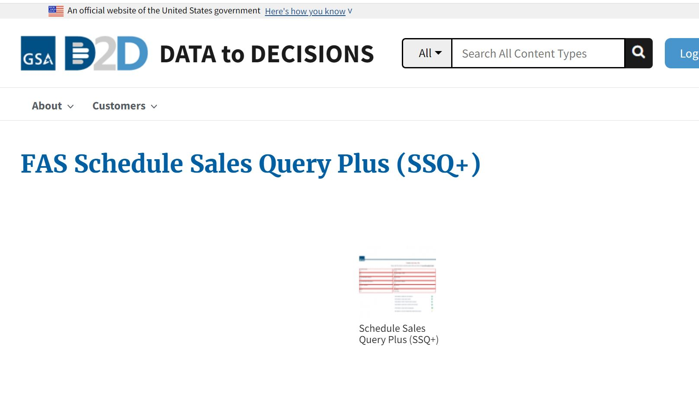
Schedules Sales Query Plus (SSQ+)
https://d2d.gsa.gov/report/fas-schedule-sales-query-plus-ssq
The Schedule Sales Query Plus (SSQ+) enables you to easily access the sales, business size and NAICS information reported by our GSA Schedule contractors.

Slide 12
MAS Offer Process and Roadmap

Slide 13
MAS Roadmap Process (gsa.gov/masroadmap)
Get Ready | Assemble Your Offer | Finalize Your Offer
Train Register Understanding the Solicitation | Complete These Forms Compile Information | Submit Your Offer Review and Negotiate Sell

Slide 14
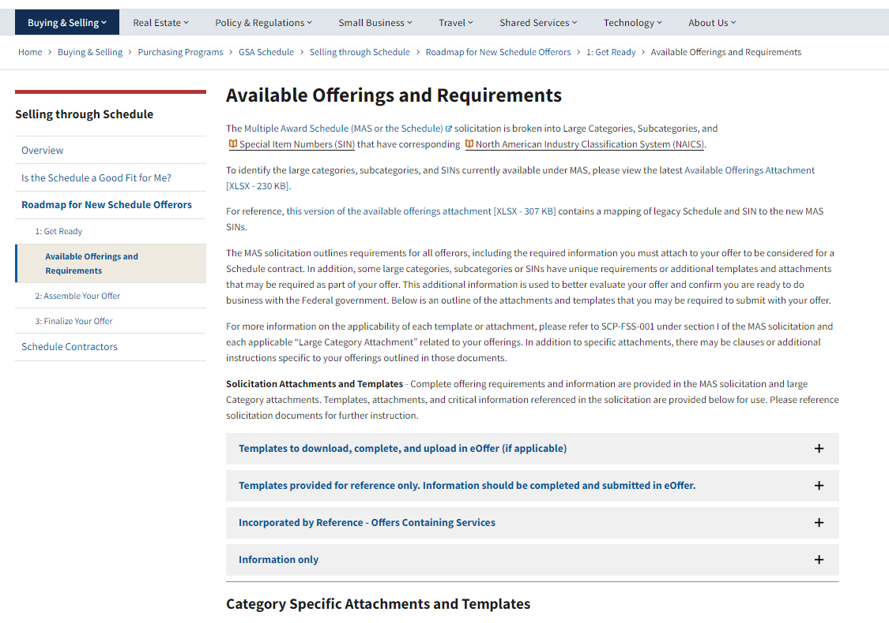
Download and Complete Applicable Templates
gsa.gov/MASCategoryRequirements

Slide 15
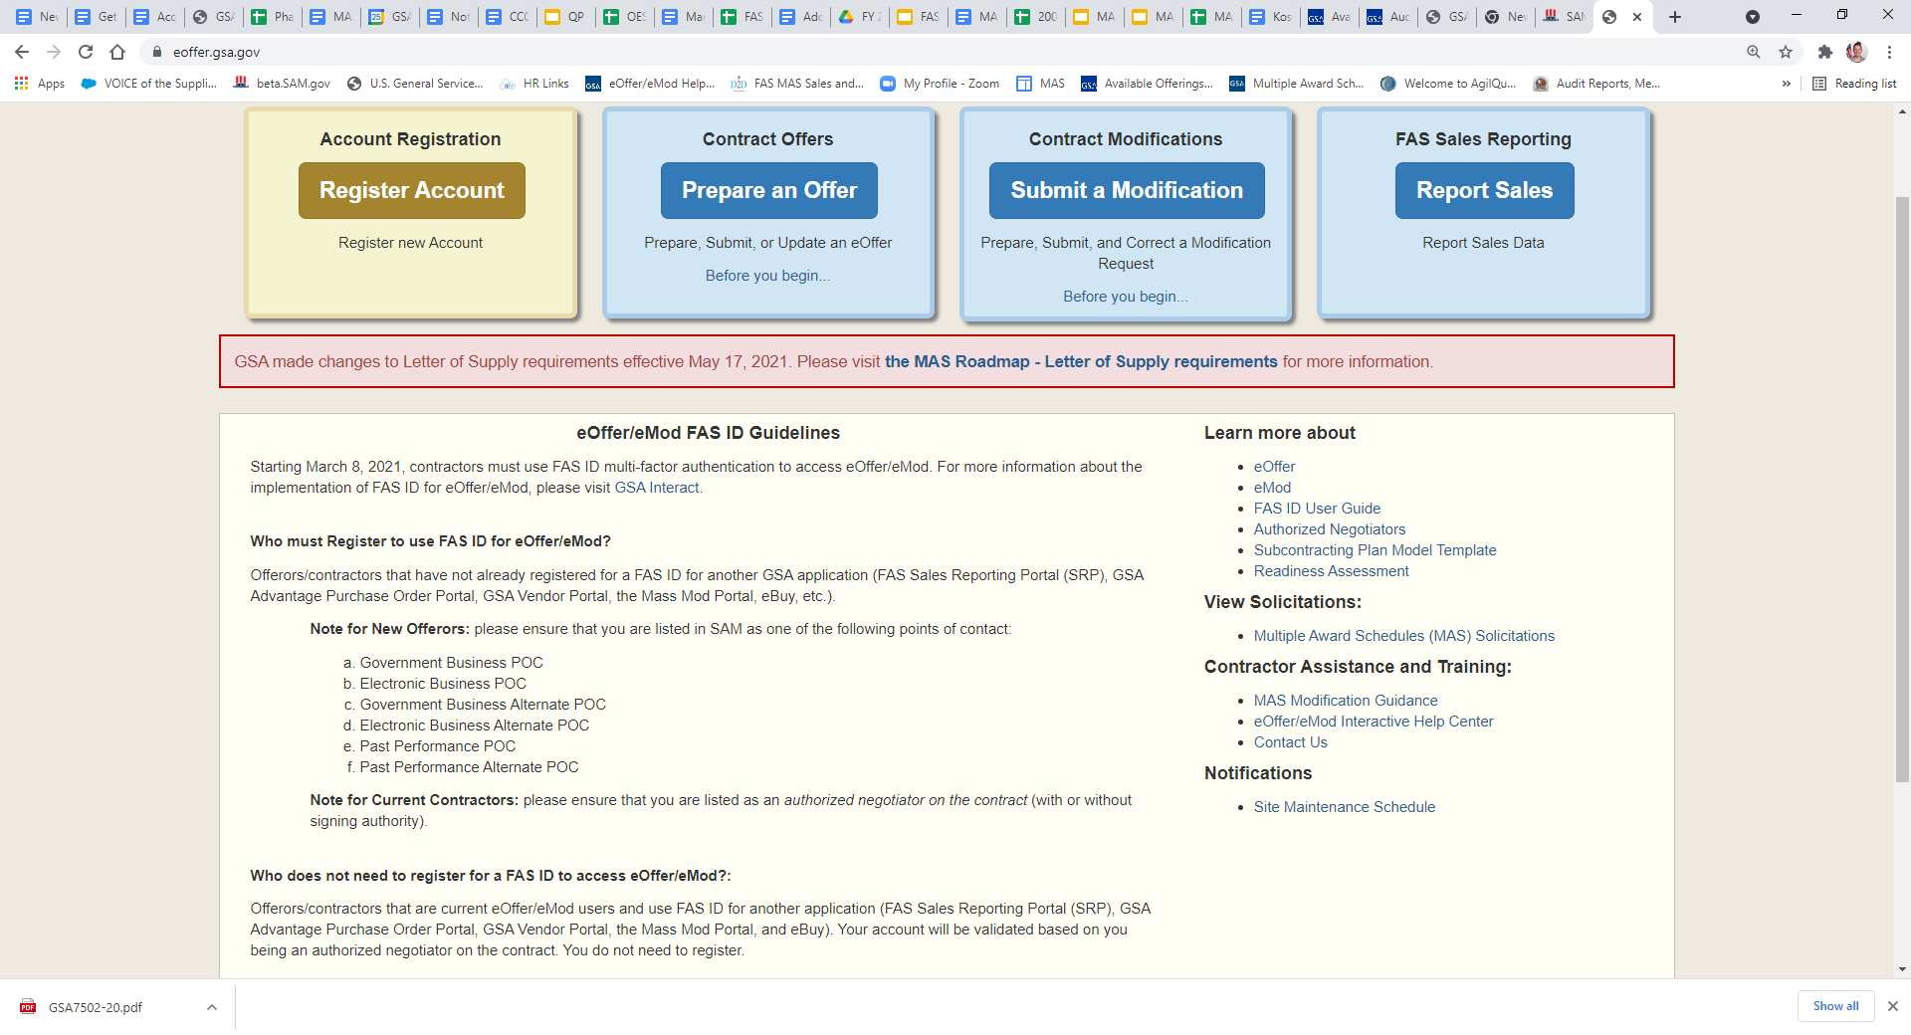
Electronic Offer Submission: eOffer
eoffer.gsa.gov
eOffer automates the MAS proposal process by allowing your organization to prepare and submit your offer electronically:
eOffer/eMod Interactive Help Center will walk you through all the screens
Notes:
Discuss what to expect after submission, e.g. offer will be assigned, reviewed, negotiated, awarded.
How does GSA evaluate a MAS offer?
Completeness
Scope
Responsibility
Subcontracting
Proposed MAS Pricing and Price-Related Terms & Conditions

Slide 16
How does GSA evaluate a MAS offer?
Completeness
Scope
Responsibility
Subcontracting
Proposed MAS Pricing and Price-Related Terms & Conditions
Notes:
Completeness - MAS offers are required to provide complete information, to conform to the MAS solicitation, and respond to all solicitation provisions. If your offer is incomplete, the Procurement Contracting Officer (PCO) may not award your organization a MAS contract.
Scope - PCOs will review your offer to ensure the products and/or services that your organization is offering are within the scope of the MAS solicitation.
Responsibility - One of the most important roles of the PCO in evaluating an offer is to determine whether or not a contractor is responsible in accordance with FAR Subpart 9.1. PCOs must make an affirmative responsibility determination. Three broad categories of responsibility are:
Integrity and Business Ethics
Financial Capability
Experience and Performance Capability
Subcontracting - Subcontracting Plans are required on MAS contracts if your organization is not a small business.
PCOs will review elements of the plan for acceptability
A sample of the subcontracting plan format is normally found as an attachment to the solicitation
Required Subcontracting Plan reports must be submitted in the Electronic Subcontracting Reporting System (eSRS) at www.esrs.gov
Must make “Good Faith” effort to meet subcontracting goals
Pricing - PCOs are required to:
Conduct Price Analysis
Make a Fair and Reasonable Pricing Determination
Seek Most Favored Customer (MFC) Pricing (excludes offers that accept Transactional Data Reporting (TDR) requirements)

Slide 17
MAS Contract Formation
Fact Finding and Clarifications
Decision of Award
04
Negotiations
01
03
Request for Final Proposal Revisions (FPR)
02

Slide 18
Learning Resources
MAS Roadmap: gsa.gov/MASRoadmap
eOffer Help Center: https://eoffer.gsa.gov/AMSupport/index.html
The Vendor Toolbox: vec.gsa.gov/MASTrainingHome
GSA.gov – GSA Schedules: gsa.gov/schedules
GSA Training Events: gsa.gov/events
GSA Interact: interact.gsa.gov/groups/multiple-award-schedules

Slide 19
Questions?

Slide 20
Contact us:
National Customer Service Center (NCSC)
  Phone: 1-800-488-3111
  E-mail: ncsccustomer.service@gsa.gov
MAS PMO:
  MASPMO@gsa.gov

Slide 21
Small Business Resources
U.S. General Services Administration (GSA) - https://www.gsa.gov
  Office of Small & Disadvantaged Business Utilization (OSDBU) - https://www.gsa.gov/osdbu
  Federal Acquisition Service (FAS) - Commercial Products & Services - https://www.gsa.gov/fas
  Public Buildings Services (PBS) - Construction, Architecture, Interior Design, and Real Estate - https://www.gsa.gov/pbs
Small Business Administration (SBA) - https://www.sba.gov
  SBA Size Standards - https://go.usa.gov/xFR9p
  Small Business Loans - https://go.usa.gov/xFRPD
Procurement Technical Assistance Centers (PTACS) - https://www.aptac-us.org/
System for Award Management (SAM) - https://go.usa.gov/xFNkS
Federal Agency Procurement Forecasts - https://go.usa.gov/xFRbn

Slide 22
Thank You!

