Slide 1
The GSA Schedules Program:
What You Need to Know!
Stacy Lowe
MAS PMO
maspmo@gsa.gov

Slide 2
Understanding the GSA
Multiple Award Schedule (MAS) Program

Slide 3
Agenda
The Structure
The Solicitation
The Roadmap
The Offer
The Resources

Slide 4
The Structure

Slide 5
What is a GSA Multiple Award Schedule?
Through the MAS Program, GSA establishes long-term, governmentwide contracts with commercial firms to provide ordering activities with access to a wide variety of commercial supplies or services.
    Multiple Award IDIQ (5-year award, three 5-year options)
    Fixed Price EPA (Economic Price Adjustment)
    Fair and reasonable pricing
    Price reductions may be applied at the order level
    Performance requirements established at the order level

Slide 6
12 Large Categories
Facilities | Furniture and Furnishings | Human Capital | Industrial Products and Services
Information Technology | Miscellaneous | Office Management | Professional Services
Scientific Management and Solutions | Security and Protection | Transportation and Logistics | Travel

Slide 7
MAS Subcategories
Facilities
Furniture & Furnishings
Human Capital
Industrial Products & Services
Information Technology
Miscellaneous
  Structures
  Facilities Services
  Food Service Equipment
  Facilities Supplies
  Facilities Solutions
  Facilities Maintenance and Repair
  Miscellaneous Furniture
  Office Furniture
  Flooring
  Fitness Solutions
  Signs
  Household, Dormitory & Quarters Furniture
  Packaged Furniture
  Healthcare Furniture
  Furniture Services
  Human Resources
  Background Investigations
  Compensation and Benefits
  Temporary Help Services
  Social Services
  Industrial Products
  Packaging
  Cleaning Supplies
  Fire / Rescue / Safety / Environmental Protection Equipment
  Hardware and Tools
  Fuel Management
  Machinery and Components
  Test and Measurement Supplies
  Industrial Products and Services Maintenance and Repair
  IT Hardware
  IT Software
  Telecommunications
  IT Solutions
  IT Training
  Electronic Commerce
  IT Services
  Apparel
  Complimentary Special Item Numbers (SINs)
  Personal Hair Care Items
  Musical Instruments
  Awards
  Flags

Slide 8
MAS Subcategories (cont)
Office Management
Professional Services
Scientific Management & Solutions
Security & Protection
Transportation & Logistics Services
Travel
  Printing and Photographic Equipment
  Office Supplies
  Audio Visual Products
  Media Services
  Media Products
  Records Management
  Document Services
  Office Services
  Audio Visual Services
  Mail Management
  Office Management Maintenance and Repair
  Marketing and Public Relations
  Financial Services
  Legal Services
  Technical & Engineering Services (non-IT)
  Business Administrative Services
  Logistical Services
  Language Services
  Environmental Services
  Training
  Identity Protection Services
  Laboratory Equipment
  Laboratory Animals
  Search and Navigation
  Medical Equipment
  Testing and Analysis
  Scientific Services
  Protective Equipment
  Security Services
  Security Systems
  Security Animals and Related Services
  Marine and Harbor
  Testing Equipment
  Motor Vehicles (non-Combat)
  Automotive Body Maintenance and Repair
  Packaging Services
  Package Delivery
  Transportation of Things
  Employee Relocation
  Lodging
  Travel Agent and Misc Services

Slide 9
What is a NAICS Code?
A NAICS (pronounced NAKES) Code is a classification within the North American Industry Classification System.
The NAICS System was developed for use by Federal Statistical Agencies for the collection, analysis and publication of statistical data related to the US Economy.

Slide 10
kk
What is a SIN?
A Special Item Number, referred to as a SIN, is a number that identifies products and services that GSA Schedule contract holders offer to government buyers through a Schedule contract.
SINs align with NAICS codes (North American Industry Classification System).
If a SIN doesn’t exist for the the product or service you are buying, it isn’t purchased through the GSA Schedule contract.

Slide 11
Special Item Number (SIN) Structure – Example 1
SINs are NAICS based
541614 - Process, Physical Distribution, and Logistics Consulting Services
Logistics Services
SINs | Title | Example Services
541614 541614SVC | Deployment, Distribution and Transportation Logistics Services Supply and Value Chain Management | Services include the following: Deployment Logistics such as contingency planning, identifying/utilizing regional or global resources, integrating public/private sector resources… Includes supply and value chain management, which involves all phases of the planning, acquisition, and management of logistics systems.

Slide 12
Special Item Number (SIN) Structure – Example 2
SINs will now be NAICS based
541519 - Other Computer Related Services
IT Services
SIN | Title | Example Services
54151S | Information Technology Professional Services | IT Professional Services and/or labor categories for database planning and design; systems analysis, integration, and design; programming, conversion and implementation support; network services, data/records management, and testing.

Slide 13
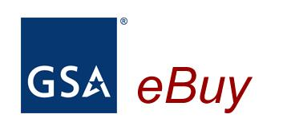
www.gsaelibrary.gsa.gov
_{eLibrary}
Category
Subcategory
SIN
Contractor Details
Size Status
Contract Clauses
eLibrary - The official online source for complete GSA and VA Schedules information – a great market research tool.
Notes:
GSA eLibrary is your one source for the latest GSA contract award information. GSA offers unparalleled acquisition solutions to meet today’s acquisition challenges. GSA’s key goal is to deliver excellent acquisition services that provide best value, in terms of cost, quality and service, for federal agencies and taxpayers.
www.gsaelibrary.gsa.gov

Slide 14
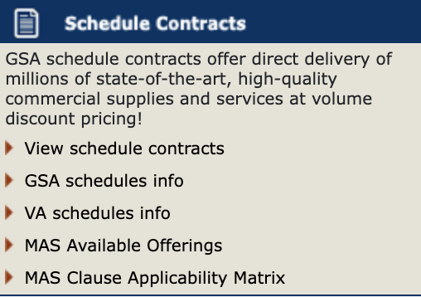
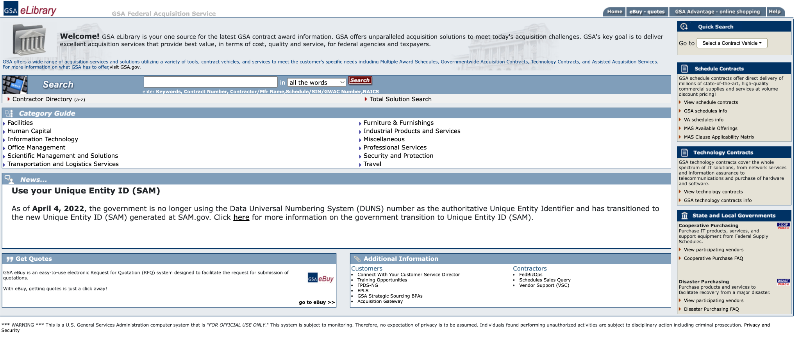
GSA eLibrary
www.gsaelibrary.gsa.gov
Notes:
●eLibrary again you will see 24 legacy Schedules and new Schedule until July 2020.
○Inventory tool
■Split into Large & Sub-categories, then down into SINs listing all the contractors.
○Any contractor who signs the mass mod will only show up under the new MAS
○Any contractors who have not signed the mass mod will show up under legacy Schedules until they are sunset in July 2020.
●This is no impact to FPDS because contract numbers are not changing (SINs are not in FPDS). FPDS will remain intact with the same preponderance NAICS already assigned in the system at the contract-level. The order-level NAICS will be overridden in FPDS by the contract-level NAICS code.

Slide 15
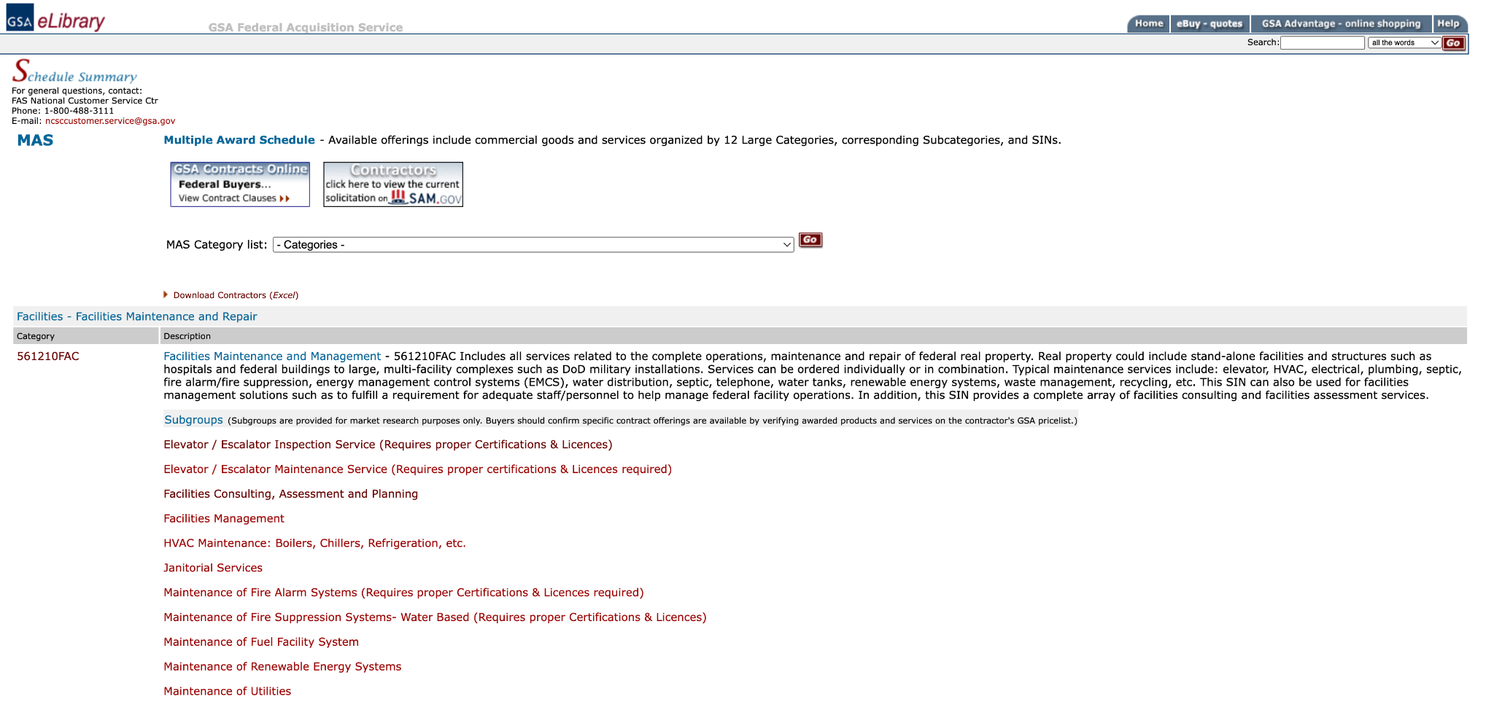
GSA eLibrary
www.gsaelibrary.gsa.gov
Notes:
●eLibrary again you will see 24 legacy Schedules and new Schedule until July 2020.
○Inventory tool
■Split into Large & Sub-categories, then down into SINs listing all the contractors.
○Any contractor who signs the mass mod will only show up under the new MAS
○Any contractors who have not signed the mass mod will show up under legacy Schedules until they are sunset in July 2020.
●This is no impact to FPDS because contract numbers are not changing (SINs are not in FPDS). FPDS will remain intact with the same preponderance NAICS already assigned in the system at the contract-level. The order-level NAICS will be overridden in FPDS by the contract-level NAICS code.

Slide 16
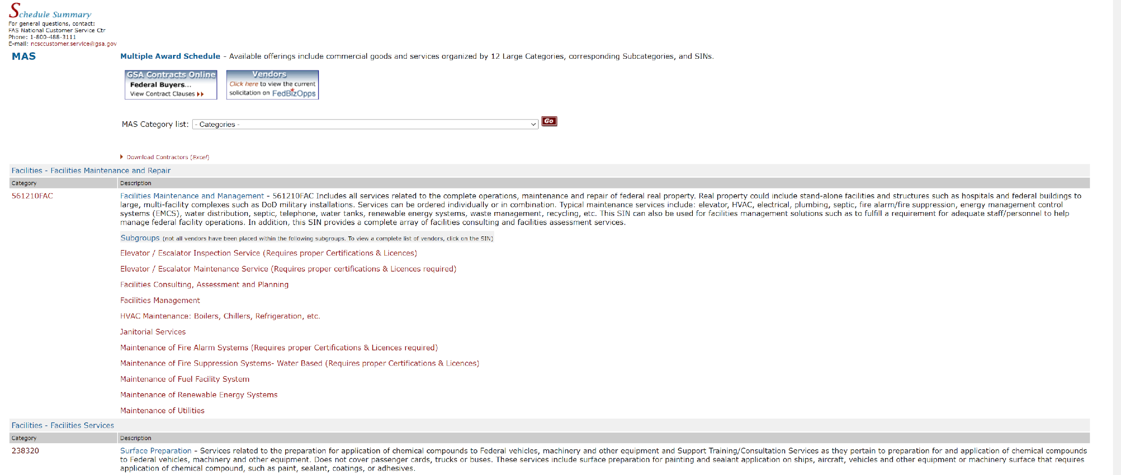
https://www.gsaelibrary.gsa.gov/ElibMain/scheduleSummary.do?scheduleNumber=MAS
Schedule Designation
Link to Solicitation
Category
(12 Total)
Category List
Subcategory
(82 Total)
NAICS Based SINs

Slide 17
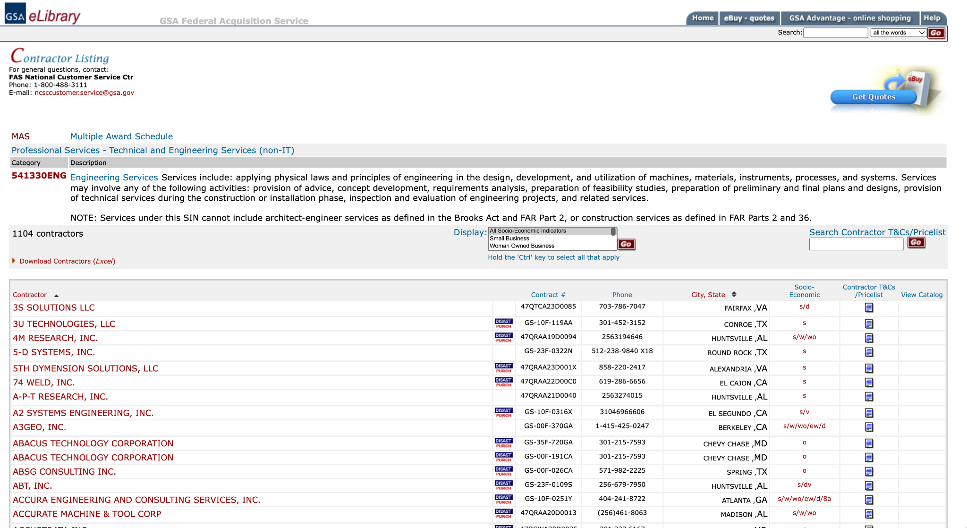
Contractor Listing by SIN
Category
Subcategory
SIN

Slide 18
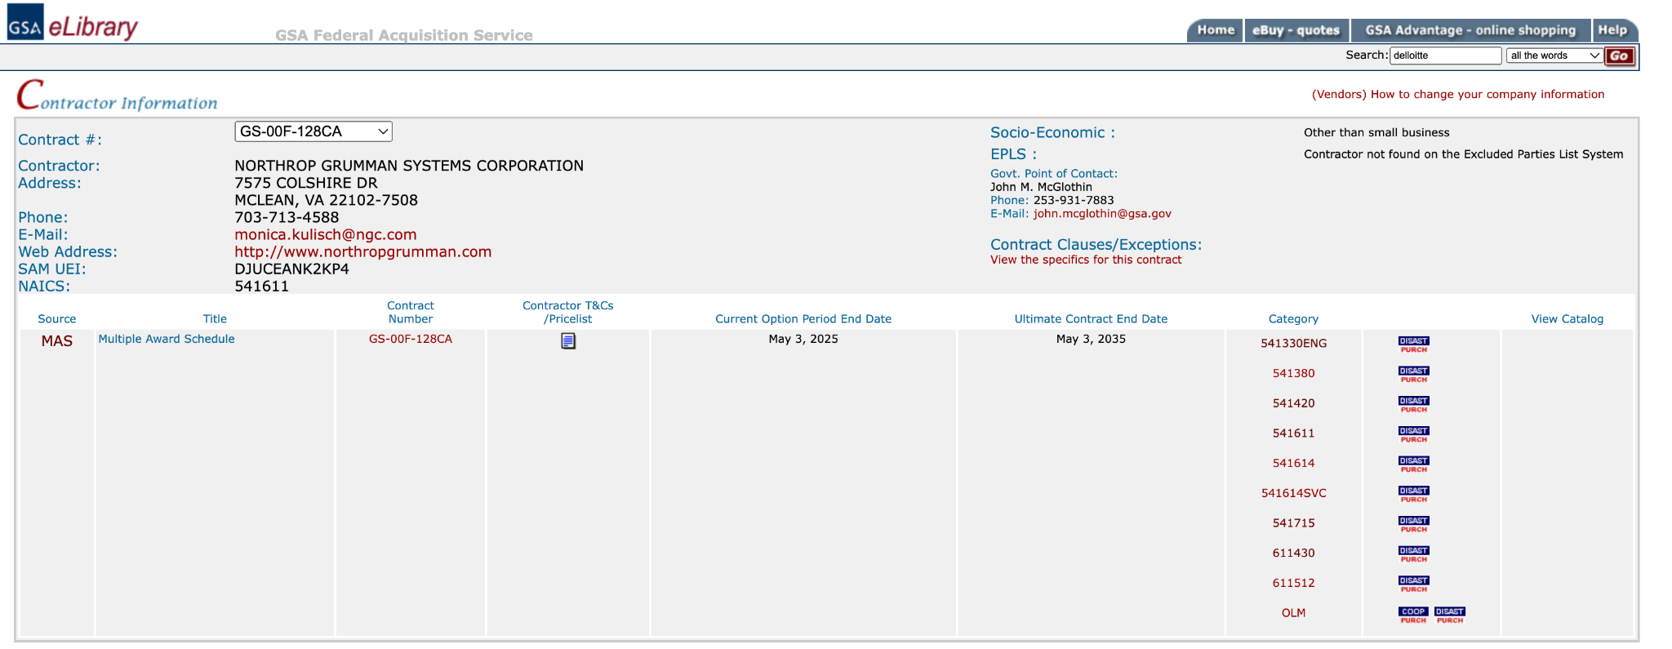
Contractor Detail Page
Change Contract
Contract Vehicle
SINs Awarded

Slide 19
The Solicitation

Slide 20
Training and Solicitation
Training: Complete the “Pathway to Success” and “Readiness Assessment” training located at https://go.usa.gov/xS5G7
Understand the solicitation: Download, read, and understand the solicitation and applicable category attachment(s) located at this link
To qualify for a GSA MAS contract, your company must have products or services that fit under a GSA Schedule category, i.e., Special Item Number (SIN). For more information on SINs, visit GSA eLibrary at www.gsaelibrary.gsa.gov

Slide 21
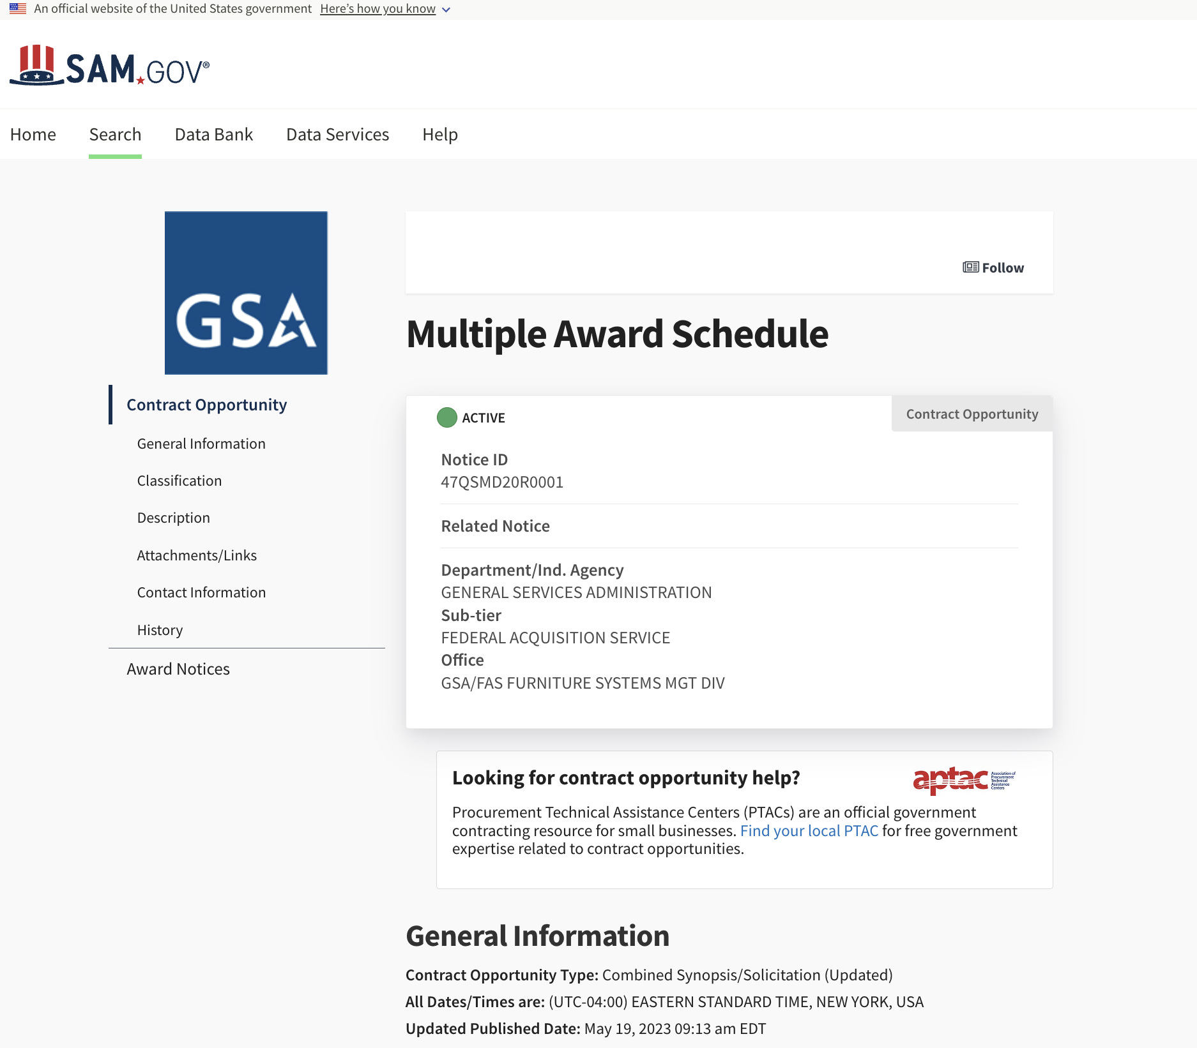
https://sam.gov/opp/c3621cd18404429498c811896a04f3d2/view
21

Slide 22
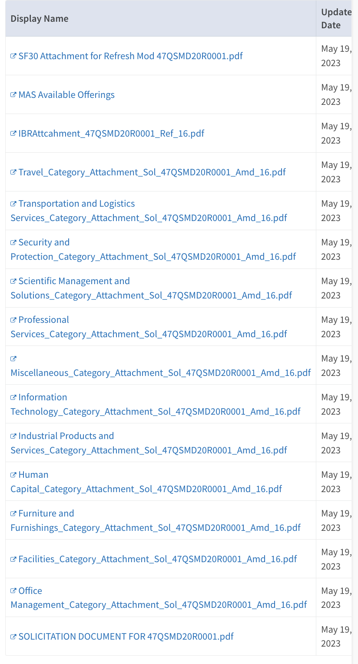
Base Solicitation
Significant Changes
Available Offerings
Excel Sheet
Regulations by Ref.
PDF File
Category Attachments
22

Slide 23
The Roadmap

Slide 24
MAS Roadmap
What is the MAS Roadmap?
Provides information on the contract award process to make it easier to do business with the government.
Why is this helpful?
Breaks down the offer process into easy to follow step-by-step instructions.
www.gsa.gov/masroadmap

Slide 25
Questions to Consider Up Front
Does market research show that Federal, state and local governments are buying the types of products and services that your company offers?
Have you been in business for at least two years and have two years of financial statements to support this?
Do you have evidence of successful past performance?
Can you comply with the MAS contract terms and conditions?
Are your items Trade Agreement Act (TAA) compliant?
Do you have the resources to market your commercial products and services after the award of the contract?

Slide 26
Items to Consider
Before Submitting an Offer
Minimum Sales Requirements: Acquisition Letter MV-2023-01,Supplement 1
This supplement amends FAS FSS clause I-FSS-639, Contract Sales Criteria by:
Changing the time period for consideration of sales FROM: 24 months and 12 months respectively TO: a standardized 60 months
Adjusting the dollar thresholds FROM: $25,000 within the first 24 months following contract award, and $25,000 in sales each 12-month period thereafter TO: a single $100,000 threshold for the first 60 months of the contract, and a $125,000 threshold for each 60 month option period thereafter
Make the consideration of sales a part of a FSS contracting officer’s determination to exercise (or not) an option to extend the term of the contract.

Slide 27
Items to Consider
Before Submitting an Offer
Lead Time: It may take up to 1 year to get a MAS contract, provided that the firm meets all evaluation criteria and has a successful negotiation.

Slide 28
Evaluation Criteria
Must be in business for two years and you must provide two years of financial statements
  Unless you are proposing under the Startup Springboard
Ability to demonstrate acceptable
  Corporate experience
  Past Performance
  Quality Control
  Relevant Project Experience, as required by SIN
Products or services must be commercially available
Products or services must be compliant with the Trade Agreements Act (TAA)
Proposed pricing is determined fair and reasonable

Slide 29
Startup Springboard
In lieu of the two-year corporate experience requirement, you may:
Use professional experience of executives and key personnel as a substitute
Use project experience of key personnel
Provide financial documentation that demonstrates the company’s financial responsibility in lieu of submitting two years of financial statements.
For more information visit: Startup Springboard

Slide 30
Transactional Data Reporting (TDR)
TDR was implemented as a pilot under specific SINs
Participation in TDR is voluntary
Commercial Sales Practices disclosures, identifying discounts, terms, and conditions offered to your most favored customer (MFC) are not required
Requires monthly reporting of line-item sales data
Requirement to monitor and report price reduction violations through the Price Reductions clause is removed.
For more information visit: Transactional Data Reporting

Slide 31
Trade Agreements Act (TAA) Compliance
The TAA, described in FAR Subpart 25.4, applies to all Schedule contracts and orders. The TAA, which provides a waiver to the Buy American Act, states that only U.S.-made or designated-country end products may be offered or sold under Schedule contracts.
For services, country of origin is determined by the country in which firm providing the services is established.
Please refer to the TAA clause in your contract for complete details, including relevant definitions and the list of designated countries.
Remember that it is the responsibility of each Schedule contractor to ensure that product information is accurately incorporated into the contract and displayed on GSA Advantage!® throughout the life of the contract.
For more information about the TAA, refer to FAR clause 52.225-5, Trade Agreements.

Slide 32

SAM Registration and Certification
In order to do business with the federal government:
  You must register for a Unique Entity Identifier (UEI) at the System for Award Management (SAM)
    https://sam.gov/content/entity-registration
  Registration must be renewed annually
Registration is 100% Free!

Slide 33
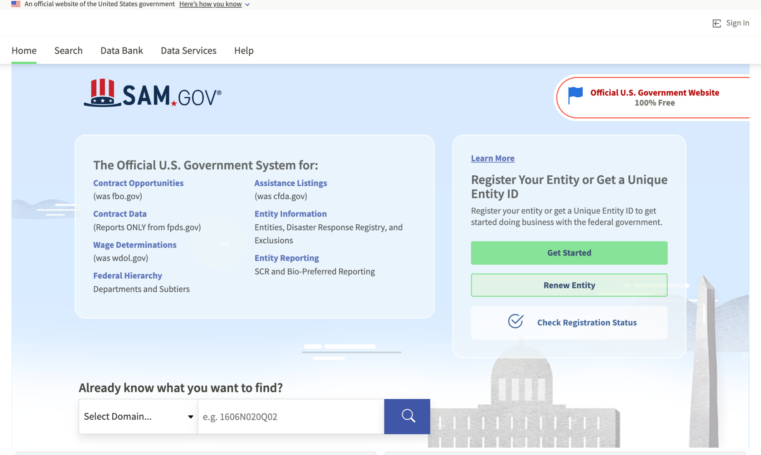
Registration and Certification

Slide 34
FAS ID
All contractors must register for the FAS ID multi-factor authentication to access the eOffer and eMod systems.
Please ensure that you are listed in SAM as one of the following points of contact:
  Government Business POC / Alternate POC
  Electronic Business POC / Alternate POC
  Past Performance POC / Alternate POC

Slide 35
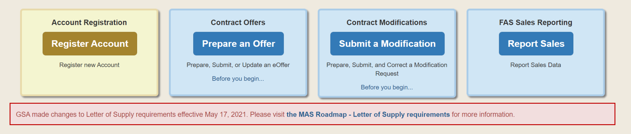
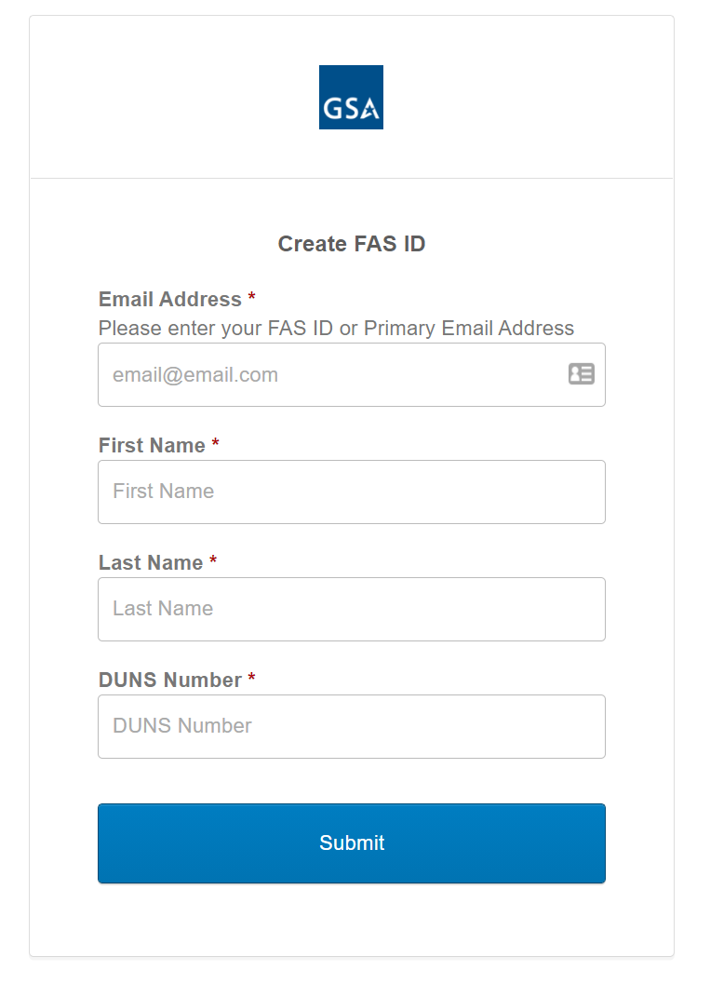
FAS ID
https://eoffer.gsa.gov/

Slide 36
The Offer

Slide 37
Offer Preparation
After you have completed the preliminary training, registered, and familiarized yourself with the solicitation, you will start developing your proposal to submit to GSA.
As part of assembling your offer, you must complete the following forms, which are located at the Available Offerings and Requirements page at www.gsa.gov/masscopeandtemplates under “Required Templates to Submit Through eOffer (as applicable).”
Agent Authorization Letter
Letter of Supply
Price Proposal Template

Slide 38
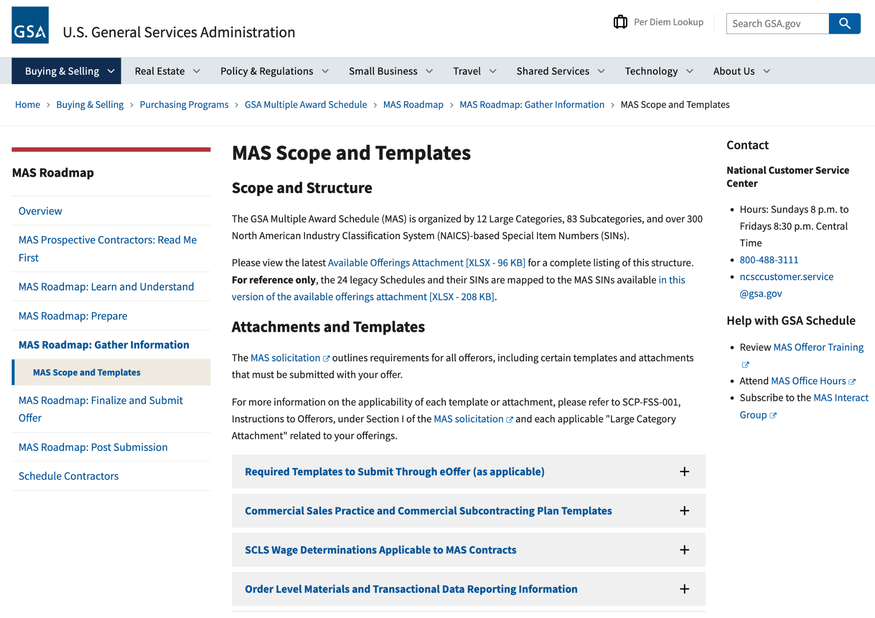
--
www.gsa.gov/masscopeandtemplates
38
Notes:
Rather than attach all requirements documents to FBO.gov, all required templates and information noted in the solicitation or in the category attachments is housed on the new GSA Available Offerings and Requirements page. This page contains documents that are part of the solicitation. They are organized by large category to make it easier for users to find information relevant to their offerings. Each document is also noted in the solicitation, so requirements are clear.

Slide 39
Offer Preparation (cont)
You will need to compile the information below and submit it through the eOffer system.
You can find the forms and their descriptions at https://go.usa.gov/xSUaA.
Financial statements
Subcontracting plan, not applicable to small businesses
Technical proposal
Commercial Sales Practice-1 (CSP-1), not applicable to TDR
Professional compensation plan, not applicable to product only offers
Commercial price list
Previous cancellation and rejection letters, if applicable
Price narrative with supporting documentation, not applicable to TDR

Slide 40
Offer Submission
Submit your completed offer in eOffer at https://eoffer.gsa.gov.
After you submit your offer via eOffer, it will be assigned to one of our contracting professionals for review.
Work directly with your assigned representative to clarify any questions or issues and negotiate pricing or other elements of your offer, if necessary.
After review and negotiation, you will know whether you will receive a Schedule contract, based on the decision of the GSA Contracting Officer.
Learn more about finalizing your offer at https://go.usa.gov/xHssV.

Slide 41
The Resources

Slide 42
Schedules Sales Query Plus (SSQ+)
Designed to provide our suppliers with the data they want and need.
SSQ+ is a tool that depicts sales in both report and dashboard format.
SSQ+ replaces the SSQ and offers searchable and filterable information from FY 1991 to present, including sales dollars for TDR contracts.
https://d2d.gsa.gov/report/fas-schedule-sales-query-plus-ssq

Slide 43
Schedules Sales Query
Plus (SSQ+) (cont)
Key report features include:
Ability to build a custom report to view MAS sales by fiscal year and quarter based on various level of details: Product or Service, Government wide Category, Government wide Subcategory, Schedule Number, SIN, NAICs, Business Size, Contract Number etc.
Access to prebuilt dashboards that allow visibility into sales trends by the various levels, trends specific to contracts within the first two years, and overall success rate for new contracts.
https://d2d.gsa.gov/report/fas-schedule-sales-query-plus-ssq

Slide 44



Helpful Links
www.gsa.gov/masroadmap
www.gsa.gov/schedule
www.gsa.gov/events
www.gsa.gov/smallbizresources
https://interact.gsa.gov/groups/small-business-solutions
https://www.apexaccelerators.us/#/
Email: maspmo@gsa.gov

Slide 45

questions

