Slide 1

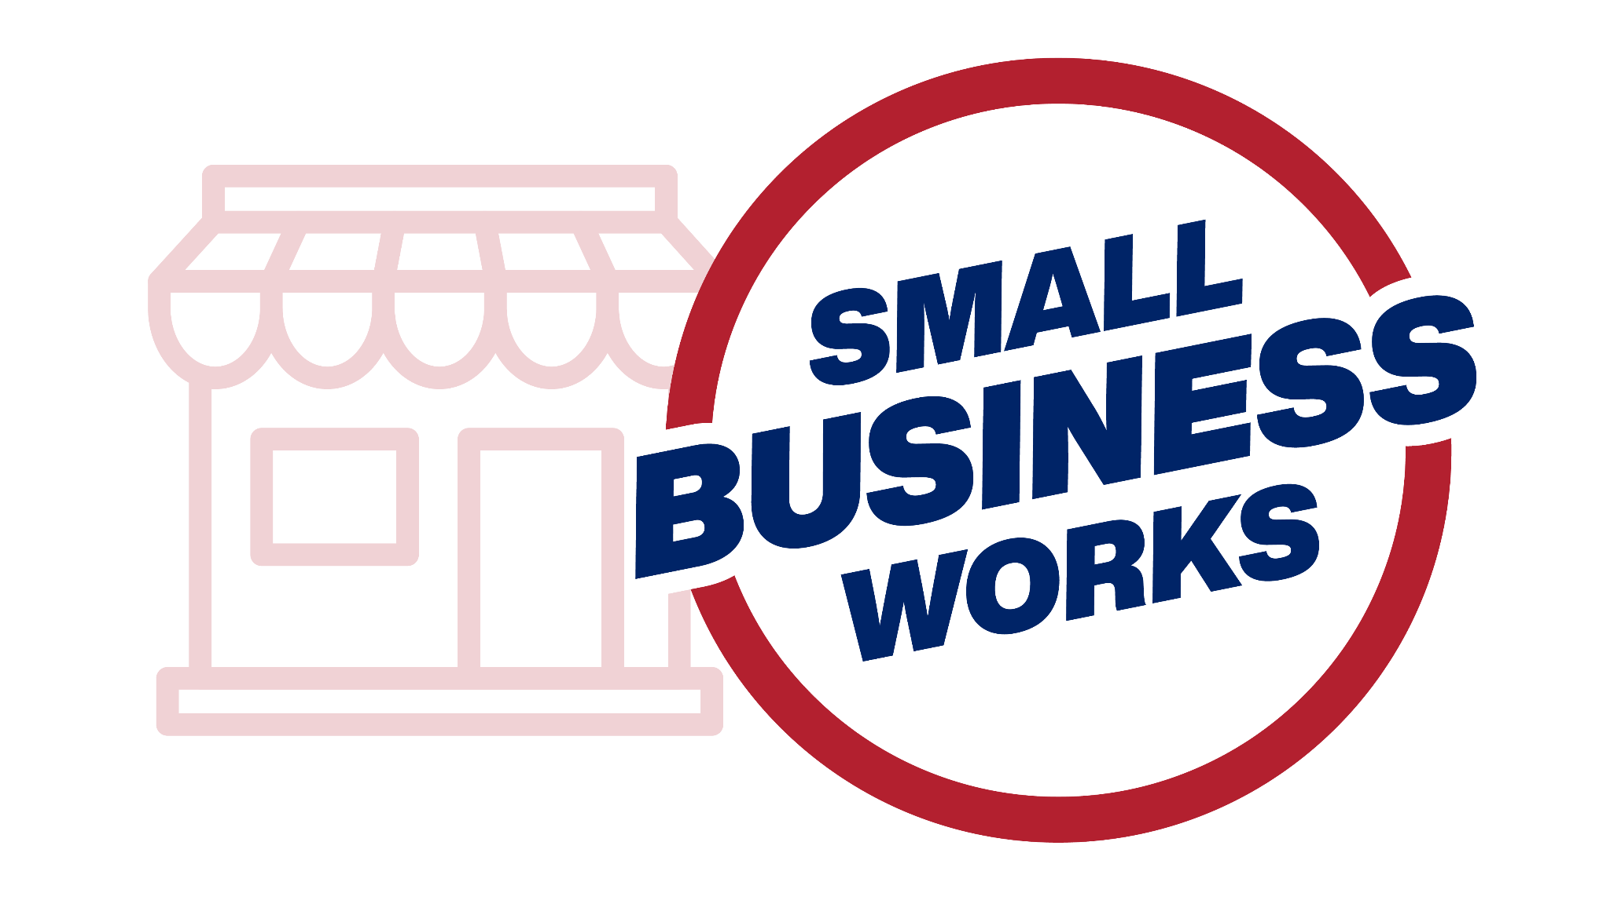
Small Business Works 2024
Subcontracting Strategies for Small Businesses
U.S. General Services Administration

Slide 2
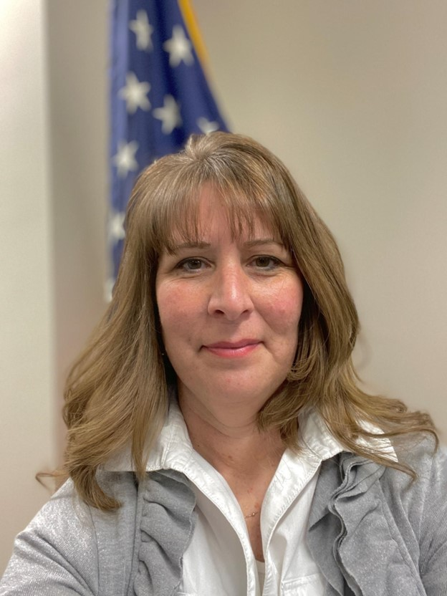
How to Become a Federal Government Small Business (SB) Subcontractor
Stephanie Lewis
National Program Manager: Subcontracting, Size, and Individual Nonmanufacturing Rule Waiver Program
U.S. Small Business Administration

Slide 3
Understanding Subcontracting
The Benefit of Subcontracting
Why are Subcontractors needed?
Understanding important Subcontracting Terms
Understanding the Subcontracting Federal Acquisition Regulation (FAR)
How does the Federal government ensure there are SB Subcontracting Opportunities?
Subcontracting Risk
Are you ready to be a Subcontractor?

Slide 4

Benefits of Subcontracting
Starting point for Federal contracting
Builds capacity
Creates past performance
Access to the Federal Government indirectly
Faster way to enter the Federal Marketplace

Slide 5

Why are Subcontractors Needed?
When a federal government contractor needs assistance fulfilling certain project components.
Contract requirements and business goals.

Slide 6
Important Subcontracting Terms
Federal Government Prime Contractor: A person/business who
has entered into a prime contract with the Federal Government to obtain supplies, materials, equipment, or services.
Federal Government Large Business (LB) Subcontractor: A person/business that doesn’t meet the qualifications of a small business that was awarded a subcontract to provide supplies or services necessary in the performance of someone else’s Federal Government’s contract.
SB Federal Government Subcontractor: A concern that does not exceed the size standard for the North American Industry Classification Systems (NAICS) code that the Federal Government contractor determines best describes the product or service being acquired by the subcontract.
NAICS: Economic classification system used to classify economic activity.

Slide 7
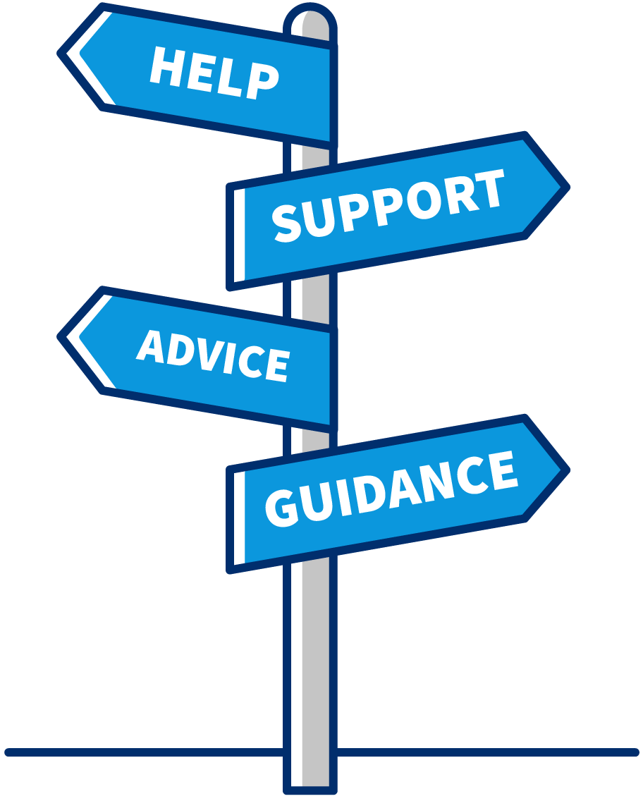
Additional Subcontracting Terms
Subcontract: A contract for a company/person to do work for another company/person as part of a larger contractual project.
Notices of Sources Sought (NSS): A notice to gain information about an industry.
Subcontract Possibility: When a firm has identified a need for outside support, but they have not provided the opportunity to bid on any requirement.
Subcontract Opportunity: A Subcontract Opportunity is when a Federal Government Contractor has identified a need and is seeking a subcontractor.

Slide 8

Understanding the Subcontracting
Federal Acquisition Regulation (FAR)
Small business subcontractors must:
Adhere to the FAR clauses in their contract
Be aware of all regulatory requirements
Subcontract regulation that governs the SB Subcontracting Program
FAR Subpart 19.7 SB Programs
FAR 52.219-8 Utilization of SB Concerns
FAR 52.219-9 SB Subcontracting Plan
13 CFR 125. Government Contract Programs

Slide 9

Small Business Subcontracting Opportunities
Locate a contractor who has been awarded a Federal government prime or subcontract that utilize what you supply
Locate a firm that is seeking a Federal Government contract and establish a Team Arrangement

Slide 10

Small Business Subcontracting Programs
Regulations Require
✔
Utilization of small business concerns
✔
Subcontracting plans
✔
Compliance reviews

Slide 11
Subcontracting Risk
1
Bait and Switch
Providing information on a proposal but not being given the work once the contract has been awarded
Federal Regulation prohibits and addresses what a SB shall do when they are a victim of Bait and Switch
2
Untimely Payments
Federal Regulation prohibits untimely payments and addresses what is acceptable for late payment and what a SB shall do when they are a victim of Untimely payments
3
Delay
No control over the delay caused by dependency (work that must be done prior to you starting your work
Project Performance
Federal Government contractor’s overall contract performance assessment is dependent on all subcontractors’ performance. A subcontractor’s poor performance can give them a bad name in the industry
4
11

Slide 12
How Do I Become a Federal Government SB Contractor
Meet Federal Government requirements
Identify your target market
Federal Government systems that provide promotional marketing assistance
Become familiar with the Federal Government contractors in your market and their suppliers
Identify subcontracting possibilities and opportunities
Submit a bid with an SB self-certification
Review and accept contract terms
12

Slide 13
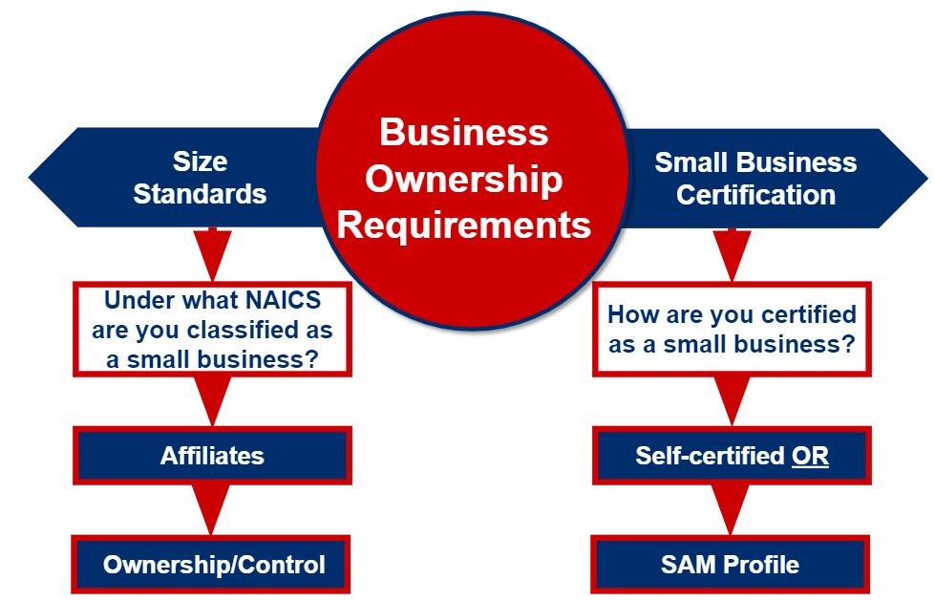
Requirements for a Small Business Subcontractor
13

Slide 14
Identify Your Target Market
Subcontracting could be your starting point into the Federal Government marketplace
The simpler, faster, and less burdensome way to get into the Federal Government marketplace is through subcontracting
Subcontracting allows an SB to work with the Federal Government indirectly
Subcontracting builds capacity and creates past performance
Allows more opportunities for small businesses
YOUR TARGET MARKET
14
Notes:
Understand how the government marketplace works:
Federal government contractors utilize the NAICS to publish subcontract opportunities and to determine the size of a subcontractor’s business. Therefore, understanding how the government marketplace works help you identify where you fit in, prevents the waste of resources and gives you a better return on investment
Do research to identify
The NAICS that best describes your firm’s products and services. You’ll need to match your products and services to a NAICS. NAICS codes classify businesses based on the particular product or service they supply. A business will generally have a primary NAICS code, but it can also have multiple NAICS codes if it sells multiple products and services. To find your NAICS code, view the NAICS code list at the U.S. Census Bureau.
Further identify your size under those NAICS
Are you a large or small business?
Identify what NACIS can use your business products or services
Industry Targeting
Market Segmentation
Potential New Market
Identify government-sponsored SB expos, trade shows, and other forums through FedBizOpps and other resources to meet and make contacts with other potential and existing Federal Contractors

Slide 15
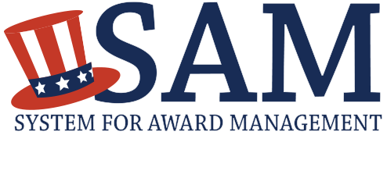
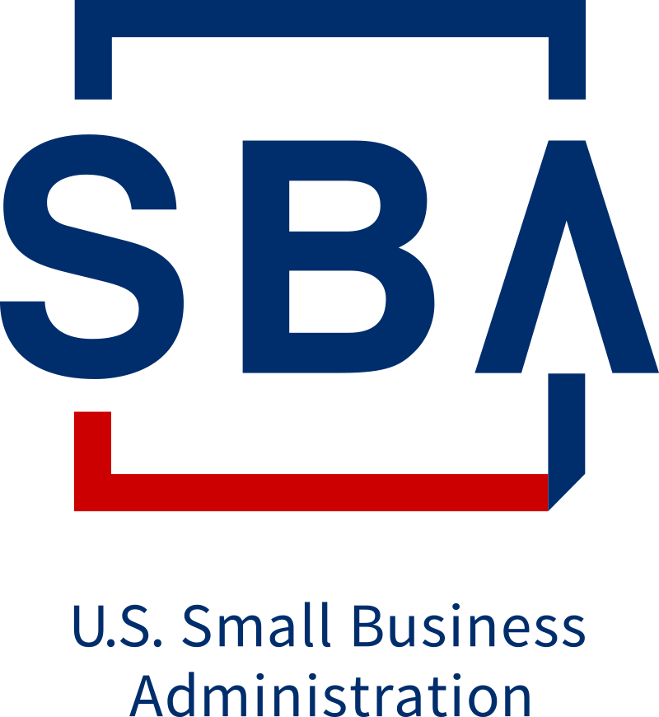
Promotional Marketing Assistance
DSBS displays a SB’s capability statements, bonding levels, insurance, certifications, security clearance levels and other pertinent business information
Searching for SB using DSBS is mandatory for all Federal government contractors needing to identify SB sources
SAM provides the size status for the entire NAICS Table
The valid SAM profile can be used as the self-certification
Business seeking SB can locate SB by searching both SAM and DSBS
Dynamic Small Business Search

Slide 16

Become Familiar
Get to know the NAICS code for what the
Federal Government needs and you can supply
Federal Contract Award Data
Federal Procurement Data System (FPDS-NG)
USA Spending
Federal Procurement Directories
Federal Agency: Office of Small Business Utilization (OSDBU)
List of major Federal Government contractors
Information on SB opportunities
Listing of agency’s acquisitions
Other Resources
Government and industry's events, matchmaking, expos and trade shows
Current and potential Federal Government suppliers
FedBizOpps
16

Slide 17
Gathering Information
R
Relationships always matter, and relationships with Federal government suppliers are no exception, and first impressions are lasting.
Conduct research on an organization’s processes, procedures and needs
Look to form long-term business relationships
Review subcontractor requirements and opportunities
Research existing suppliers
Use events to network and meet influencers

Slide 18

Tools to Help Identify
Subcontract Possibilities
Federal Procurement Data System – New Generation
Federal Directories
Subcontract Opportunities
SBA’s Subcontract Network System (SUBNet)
Solicitations
Firm’s Websites
Provide instruction on what they buy, how to become a partner, and outreach events
Is it a Subcontract Possibility or
Subcontract Opportunity?

Slide 19




Consider the Pricing Factors
Subcontract pricing history
Work with a local PTAC to get pricing data
Special requirements
Consider all costs associated with special requirements
Quality requirements
Know all costs associated with certifications and fees
Overhead and profit
Consider all overhead costs to ensure you are making a profit

Slide 20
Submit a Bid with a SB Self-Certification
1
2
Follow the Bid instructions.
Do not deviate.
Attach a self-certification for the NAICS code identified in the solicitation.

Slide 21

Review Contract Terms Before Signing the Subcontract
Make sure you understand the subcontract agreement terms and conditions, including payment terms.

Slide 22




Are You Ready to Be a Subcontractor?
Do you have the capacity, capability and capital to perform a subcontract?
Do you have the proper qualifications, certifications and experience to support your capability statement?
Have you identified your target market?
Are you prepared to agree to the terms and conditions of a subcontract?

Slide 23
Other Federal Government Resources

Slide 24
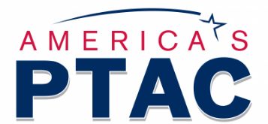
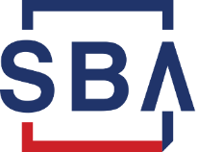

Procurement Assistance
Procurement Technical Assistance Centers (PTACs)
Government prime and subcontract assistance
Consulting and workshops
Information and resources
SBA Resources
SBA’s Learning Center
SBA Commercial Market Representative (CMRs)
Other Resources
Federal Agency Procurement Directory
SBA’s Federal Government Prime Contractors with Subcontracting Plan
GSA Subcontracting Directory
DoD Prime Contracting Directory

Slide 25
Questions?

Slide 26
Thank You!

