Slide 1
GSA eTools
Dr. Shana Nicholson
Thursday, October 19, 2023
2pm ET

Slide 2
AGENDA
Introduction
eTools
GSA Advantage
GSA eBuy
GSA eLibrary
Resources
Q&A

Slide 3


Presenter Introduction
Dr. Shana Nicholson

Slide 4
Introduction
What are GSA's eTools?
Why are GSA's eTools important?
Benefits of using GSA's eTools

Slide 5



GSA eTools Preview
An online marketplace where buyers can search for and purchase products and services from GSA-approved vendors.
A web-based procurement system that helps buyers create and manage purchase orders.
A repository of government contracting resources, including policies, procedures, and templates.
Notes:
GSA's eTools are a suite of online tools that help buyers and sellers connect and transact business. The three main eTools are:
GSA Advantage: An online marketplace where buyers can search for and purchase products and services from GSA-approved vendors.
https://www.gsaadvantage.gov/advantage/ws/main/start_page?store=ADVANTAGE
GSA eBuy: A web-based procurement system that helps buyers create and manage purchase orders.
https://www.ebuy.gsa.gov/ebuy/?returnUrl=%2Fbuyer%3Ffrom%3Delibrary
GSA eLibrary: A repository of government contracting resources, including policies, procedures, and templates.
https://www.gsaelibrary.gsa.gov/ElibMain/home.do

Slide 6

Why are GSA’s eTools Important?
GSA eTools are important because they make it easier and more efficient for buyers and sellers to do business with the government.
The eTools provide a centralized platform for businesses to find and purchase products and services, and they also offer a variety of resources to help businesses comply with government regulations.

Slide 7




Benefits of GSA’s eTools
Convenience
Efficiency
Compliance
Value
Businesses can search for and purchase products and services online, 24 hours a day, 7 days a week.
The eTools can help businesses save time and money by streamlining the procurement process.
The eTools provide businesses with the resources they need to comply with government regulations.
The eTools offer a wide range of products and services at competitive prices.
Notes:
Convenience: Businesses can search for and purchase products and services online, 24 hours a day, 7 days a week. This is especially beneficial for small businesses with limited resources. Efficiency: The eTools can help businesses save time and money by streamlining the procurement process. For example, GSA Advantage allows businesses to create and manage shopping carts, compare prices from different vendors, and place orders with just a few clicks. Compliance: The eTools provide businesses with the resources they need to comply with government regulations. For example, GSA eLibrary provides access to a variety of government contracting resources, including policies, procedures, and templates. Value: The eTools offer a wide range of products and services at competitive prices. This is because GSA has negotiated favorable pricing with vendors on behalf of the government

Slide 8
GSA Advantage

Slide 9
GSA Advantage Discussion
What is GSA Advantage?
How to use GSA Advantage
Types of products and services available on GSA Advantage
Benefits of using GSA Advantage for buyers and sellers

Slide 10
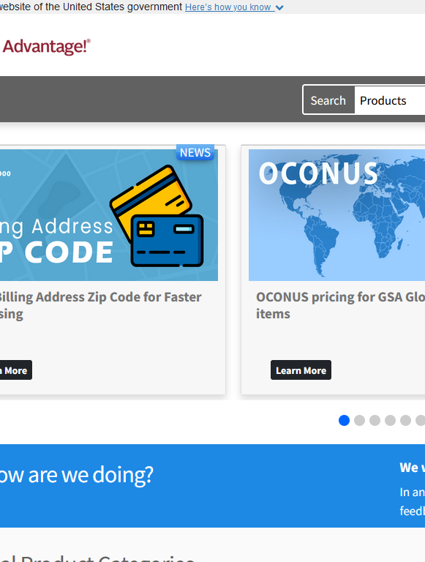
What is GSA Advantage
GSA Advantage is the government's premier online shopping and ordering system. It provides access to millions of products and services from thousands of GSA-approved vendors.
GSA Advantage is a convenient and efficient way for buyers to search for and purchase products and services, and it offers a variety of benefits for sellers as well.

Slide 11
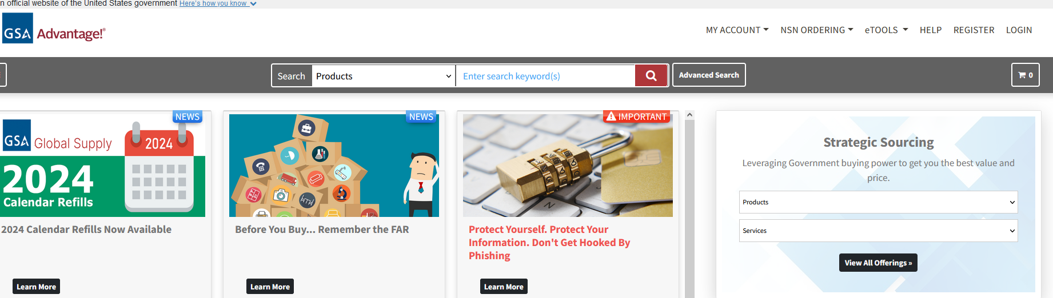
How to Use GSA Advantage? Step 1:
Buyers must first create an account.
Notes:
To use GSA Advantage, buyers must first create an account. Once an account is created, buyers can search for products and services by keyword, category, or vendor. Buyers can also compare prices from different vendors and add items to a shopping cart. Once buyers are finished shopping, they can place an order and pay with a credit card or government purchase card.

Slide 12
How to Use GSA Advantage? Step 2
Once an account has been created, buyers can search for products and services by keyword, category, or vendor.
Notes:
To use GSA Advantage, buyers must first create an account. Once an account is created, buyers can search for products and services by keyword, category, or vendor. Buyers can also compare prices from different vendors and add items to a shopping cart. Once buyers are finished shopping, they can place an order and pay with a credit card or government purchase card.

Slide 13
How to Use GSA Advantage? Step 3:
Buyers can also compare prices and place orders with a credit card or government purchase card.
Notes:
To use GSA Advantage, buyers must first create an account. Once an account is created, buyers can search for products and services by keyword, category, or vendor. Buyers can also compare prices from different vendors and add items to a shopping cart. Once buyers are finished shopping, they can place an order and pay with a credit card or government purchase card.

Slide 14
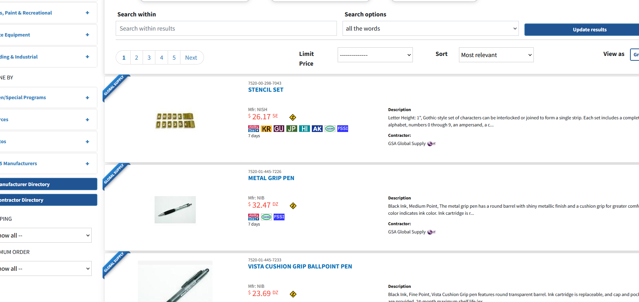
GSA Advantage- Types of Products and Services
GSA Advantage offers a wide range of products and services, including:
Office supplies
Furniture
Electronics
Software
IT services
Professional services
Construction services
And much more

Slide 15
Benefits of GSA Advantage
Buyers
Sellers
Convenience
Efficiency
Compliance
Value
Increased Market Reach
Reduced Sales Costs
Streamlined contracting
Simplified payments
Notes:
Benefits for buyers:
Convenience: Buyers can search for and purchase products and services online, 24 hours a day, 7 days a week.
Efficiency: GSA Advantage can help buyers save time and money by streamlining the procurement process.
Compliance: GSA Advantage helps buyers to comply with government contracting regulations.
Value: GSA Advantage offers a wide range of products and services at competitive prices.
Benefits for sellers:
Increased market reach: GSA Advantage gives sellers access to a large government market.
Reduced sales costs: GSA Advantage can help sellers to reduce their sales costs by automating the procurement process.
Streamlined contracting: GSA Advantage helps sellers to streamline the contracting process by providing standard contracts and terms and conditions.
Simplified payments: GSA Advantage makes it easy for sellers to receive payments from government buyers.
Overall, GSA Advantage is a valuable resource for both buyers and sellers. It offers a convenient and efficient way to do business with the government, and it offers a variety of benefits to both parties.

Slide 16

GSA eBuy

Slide 17
GSA eBuy Discussion
What is GSA eBuy?
How to use GSA eBuy
Types of products and services available on GSA eBuy
Benefits of using GSA eBuy for buyers and sellers

Slide 18
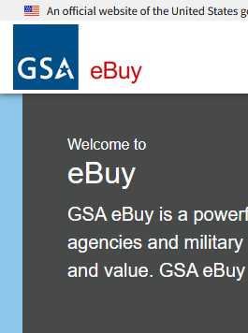
What is GSA eBuy
GSA eBuy is a web-based procurement system that helps buyers create and manage purchase orders (POs). It is a convenient and efficient way for buyers to purchase products and services from GSA-approved vendors.
GSA eBuy also helps buyers to comply with government contracting regulations.
Notes:
GSA eBuy is also a valuable tool for small businesses. It can help small businesses to compete for government contracts by making it easier for them to create and manage POs. GSA eBuy also provides small businesses with access to a large government market.

Slide 19
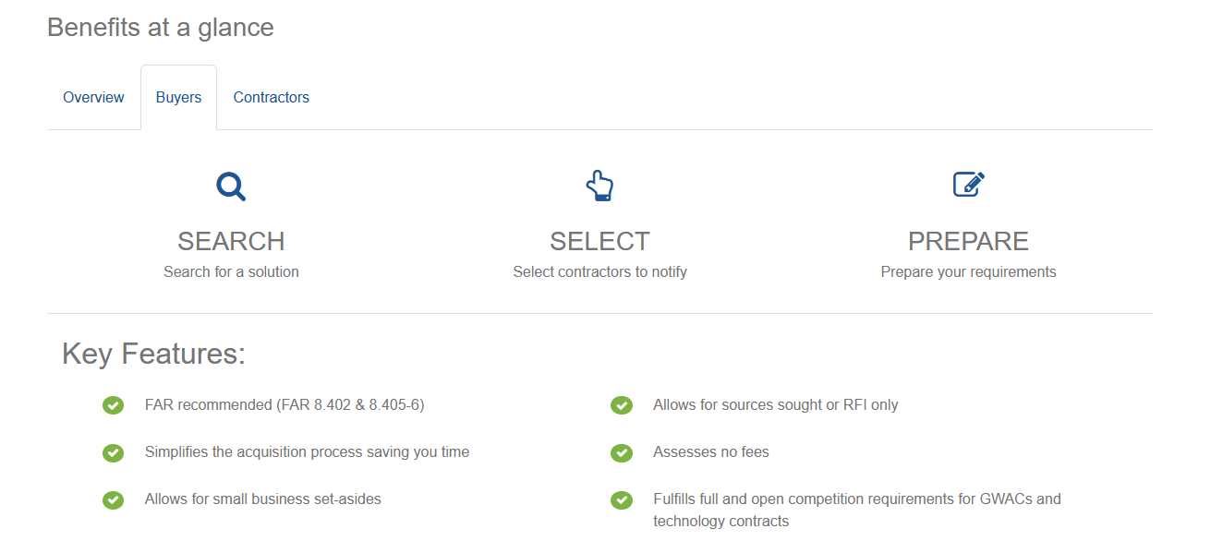
How to Use GSA eBuy? Step 1: Registration
Vendors must register with GSA Vendor Support Center (VSC) with a contract award (i.e. GSA MAS, STARS). Once your contract is registered you will then be able to create an eBuy account.
Buyers must create an account to search for products and services.
Government entities wishing to post solicitations, must be registered with GSA using their Personal Identity Verification (PIV)/Common Access Card (CAC).
Notes:
To gain access to eBuy as a vendor, you must first register your contract with the GSA Vendor Support Center (VSC). You can do this online at https://vsc.gsa.gov/vsc/app-registration. Once your contract is registered, you will be able to create an eBuy account.
To create an eBuy account as a vendor, go to https://ebuy.gsa.gov/ and click on the "Sign in as a Contractor" button. You will be prompted to enter your contract number and password. If you do not have a password, you can request one by clicking on the "Forgot Password?" link.
Once you have created an eBuy account, you will be able to log in and access the eBuy system. You can use eBuy to view solicitations, submit bids, and manage your contracts.
To gain access to eBuy as a buyer, you must first create an account. You can do this online at https://ebuy.gsa.gov/ and clicking on the "Sign in as a Buyer" button. You will be prompted to enter your email address and password. If you do not have a password, you can create one by clicking on the "Create an Account" link.
Once you have created an eBuy account, you will be able to log in and access the eBuy system. You can use eBuy to search for products and services, create and manage purchase orders, and track the status of your orders.
Additional information:
Federal civilian and military customers can login to eBuy (Buyer) using their Personal Identity Verification (PIV)/Common Access Card (CAC) cards.
If you are a vendor, you can register your contract with the VSC by phone at 1-800-488-3116.
If you are a buyer, you can get help creating an eBuy account by contacting the eBuy Customer Support Center at 1-877-418-8015.

Slide 20
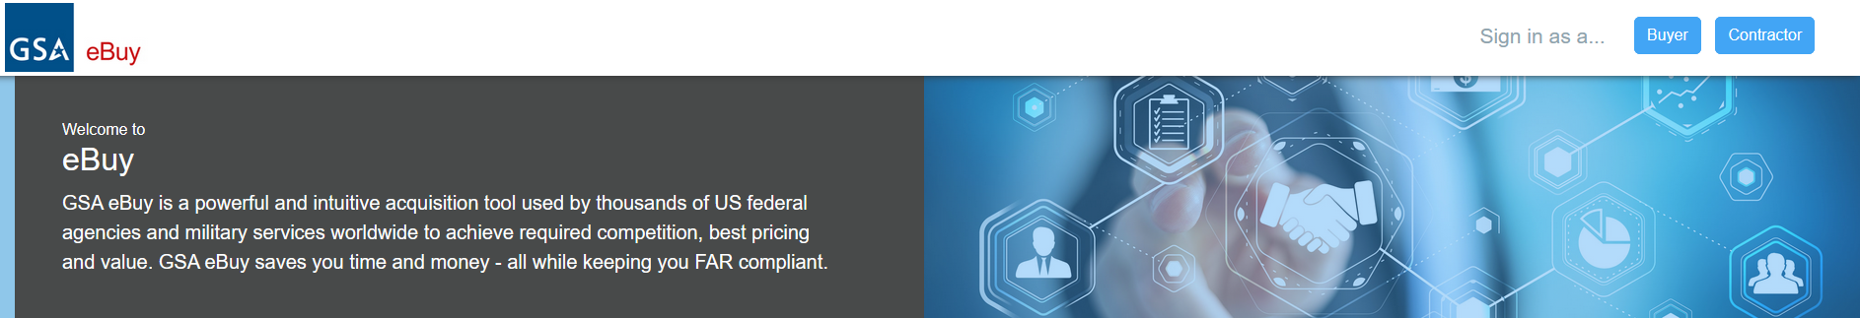
How to Use GSA eBuy? Step 2
Once an account has been created, buyers can search for products and services by keyword, category, or vendor.
Notes:
To use GSA eBuy, buyers must first create an account. Once an account is created, buyers can search for products and services by keyword, category, or vendor. Buyers can also create and manage POs, track PO status, and view PO reports.
To create a PO in GSA eBuy, buyers must first select the products or services they want to purchase. Buyers can then add the products or services to a shopping cart and proceed to checkout. At checkout, buyers will need to enter the vendor's GSA contract number and the PO information. Once the PO is created, buyers can submit it to the vendor.

Slide 21
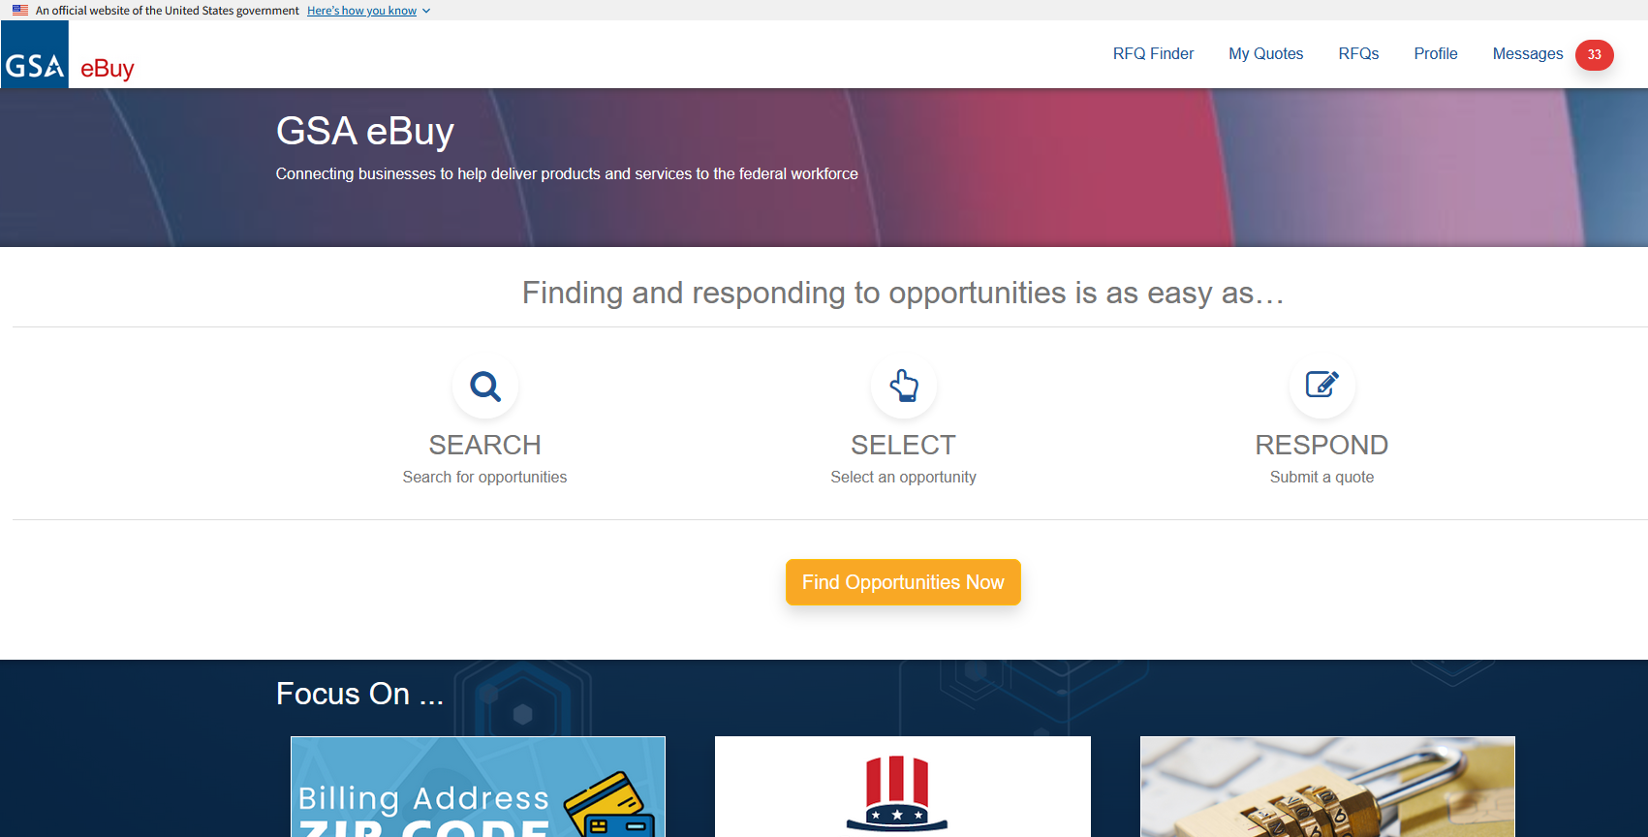
How to Use GSA eBuy? Step 3:
Contractors with active GSA contract vehicles (i.e. Stars, GSA MAS) can explore solicitations in eBuy.
Notes:
Vendors with GSA schedules and contracts will log into eBuy to review solicitations and respond to opportunities.

Slide 22
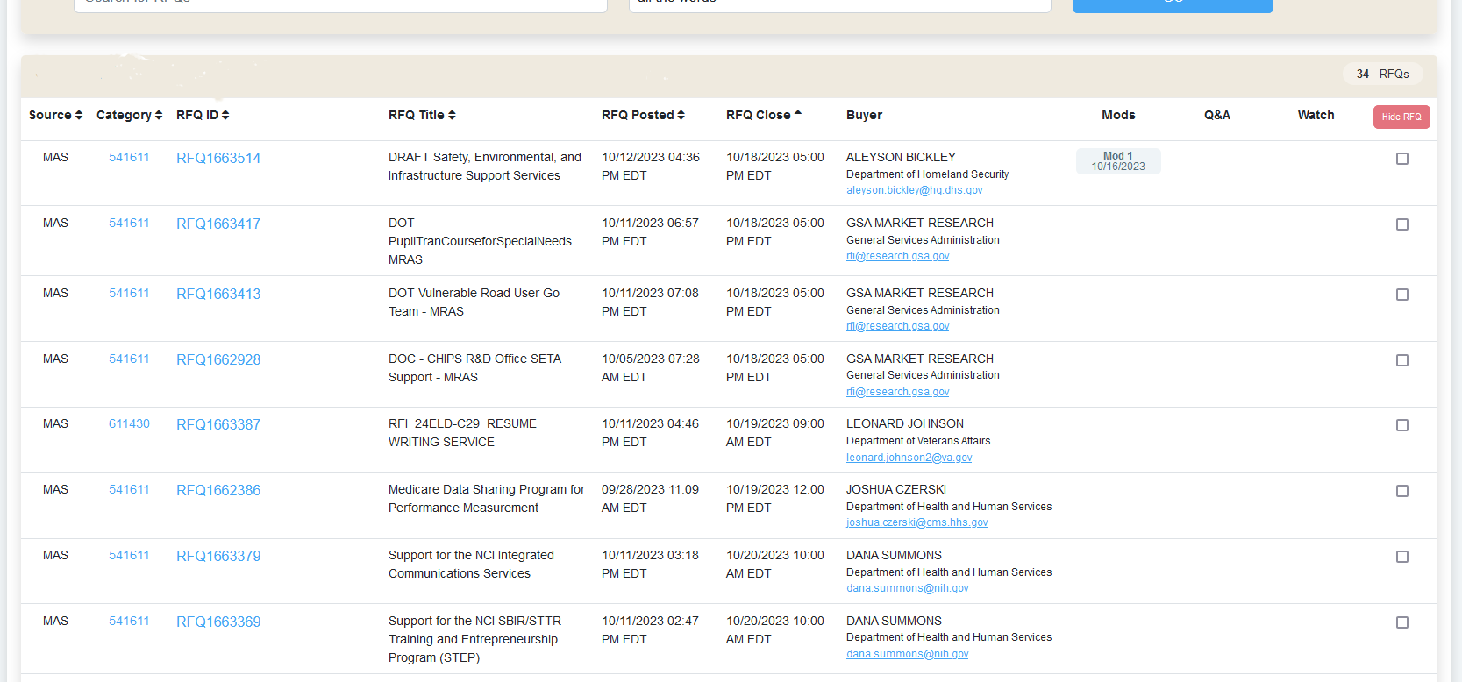
How to Use GSA eBuy? Step 4:
Contractors with active GSA contract vehicles (i.e. Stars, GSA MAS) can respond to solicitations in eBuy.
Buyers can post their specific acquisition requirements for bid here as well.
Notes:
Vendors with GSA schedules and contracts will log into eBuy to review solicitations and respond to opportunities. These opportunities are only accessible by vendors with active GSA Schedules. Just like sam.gov solicitations, contractors are responsible for amendments and modifications.

Slide 23
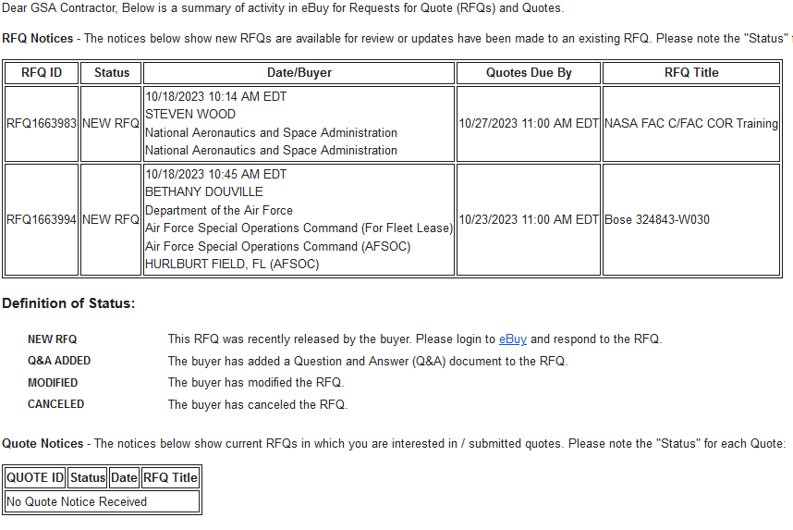
GSA eBuy- Types of Products and Services
GSA eBuy offers a wide range of products and services, including:
Office supplies
Furniture
Electronics
Software
IT services
Professional services
Construction services
And much more
Notes:
GSA contract holders will receive email updates for solicitations and buys can issue solicitations. Each vendor and contractor will receive a log in aligned with their account to search and/or respond to solicitations.

Slide 24
Benefits of GSA eBuy
Buyers
Sellers
Convenience
Efficiency
Compliance
Visibility
Increased Market Reach
Reduced Sales Costs
Streamlined contracting
Simplified payments
Notes:
Benefits for buyers:
Convenience: Buyers can create and manage POs online, 24 hours a day, 7 days a week.
Efficiency: GSA eBuy can help buyers to save time and money by streamlining the procurement process.
Compliance: GSA eBuy helps buyers to comply with government contracting regulations.
Visibility: GSA eBuy provides buyers with visibility into their POs, including PO status and tracking information.
Benefits for sellers:
Increased market reach: GSA eBuy gives sellers access to a large government market.
Reduced sales costs: GSA eBuy can help sellers to reduce their sales costs by automating the procurement process.
Streamlined contracting: GSA eBuy helps sellers to streamline the contracting process by providing standard contracts and terms and conditions.
Simplified payments: GSA eBuy makes it easy for sellers to receive payments from government buyers.
Overall, GSA eBuy is a valuable resource for both buyers and sellers. It offers a convenient and efficient way to do business with the government, and it offers a variety of benefits to both parties.

Slide 25

GSA eLibrary

Slide 26
GSA eLibrary Discussion
What is GSA eLibrary?
How to use GSA eLibrary
Types of resources available on GSA eLibrary
Benefits of using GSA eLibrary for buyers and sellers

Slide 27
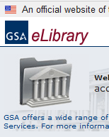
What is GSA eLibrary?
GSA eLibrary is a repository of government contracting resources, including policies, procedures, and templates.
Notes:
GSA eLibrary is a repository of government contracting resources, including policies, procedures, and templates. It is a valuable resource for both buyers and sellers who do business with the government.

Slide 28
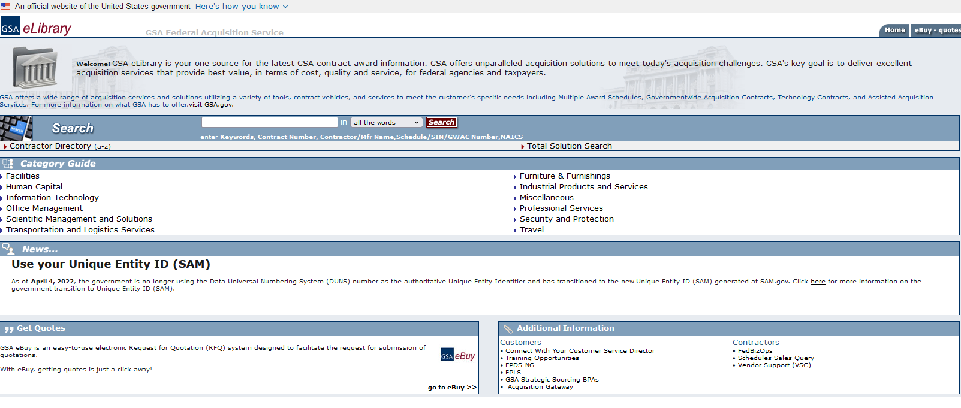
How to Use GSA eLibrary?
Visit the GSA eLibrary site.
https://www.gsaelibrary.gsa.gov
Notes:
To use GSA eLibrary, simply visit the website and search for the resources you need. You can search by keyword, category, or document type. GSA eLibrary also offers a variety of tools to help you find the resources you need, such as a search engine, a topic index, and a list of frequently asked questions.

Slide 29
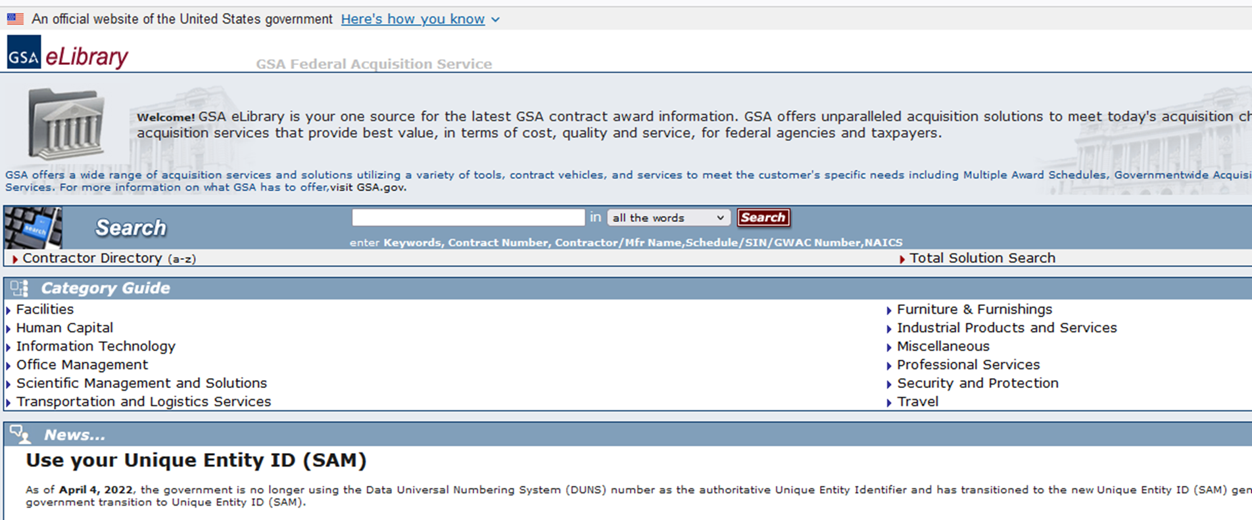
Searching GSA eLibrary
You can search by keyword, category, or document type.

Slide 30
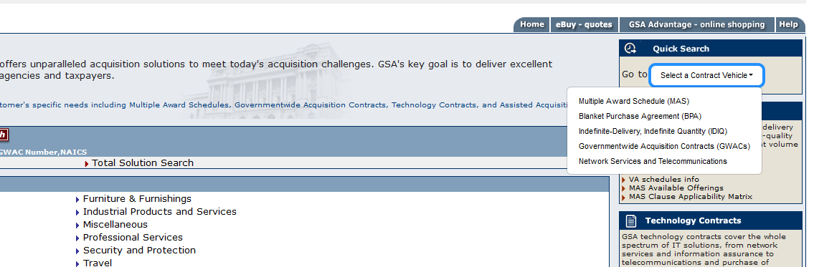
Searching by contract vehicle.
You can search for partners and vendors based on contract vehicle.
Notes:
You can search by contract vehicle. This is a great means of market research, partner identification, and networking.

Slide 31
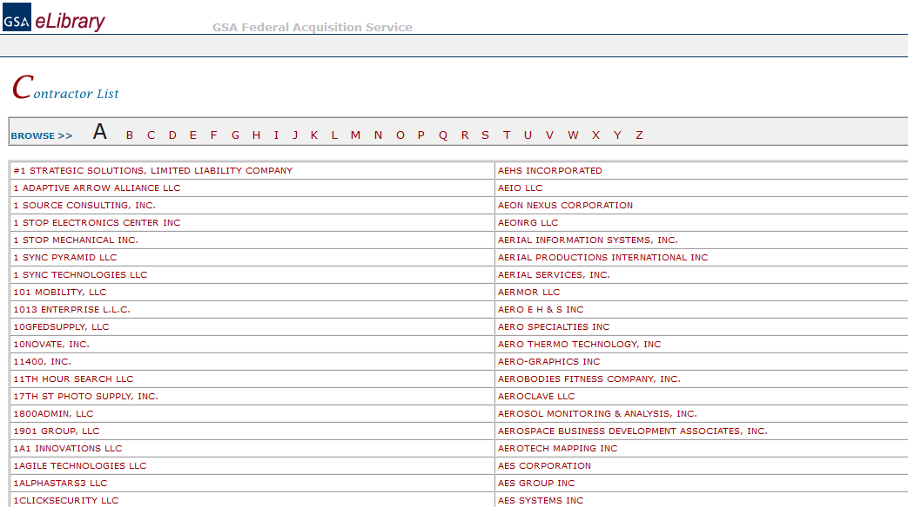
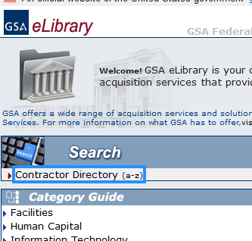
Searching for partners.
You can search for partners and vendors based on name, UEI, or services.
Notes:
You can search by vendor name, services, and UEI.

Slide 32
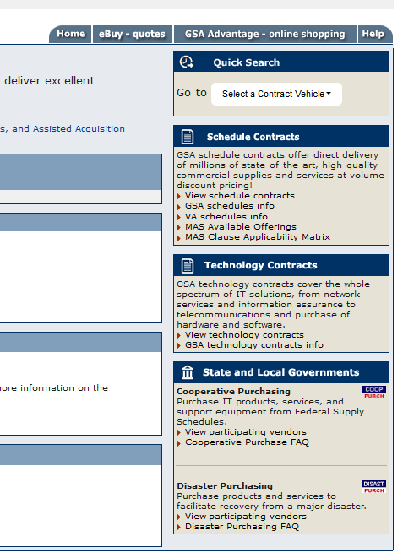
Research tools in eLibrary
Market research can be conducted utilizing the GSA eLibrary.
All contracts are public information and searchable.
Disaster resource information is also public and available on eLibrary.
Notes:
GSA eLibrary has extensive resources for both buyers and contractors to conduct market research, identify partners, locate resources for purchase, and for state and local government solicitations and purchases.

Slide 33
Other GSA eLibrary Resources
GSA eLibrary offers a wide range of resources, including:
Policies and procedures: GSA eLibrary provides access to the latest government contracting policies and procedures. This is essential information for both buyers and sellers who want to comply with government regulations.
Templates: GSA eLibrary offers a variety of templates for common contracting documents, such as purchase orders, contracts, and solicitation documents. These templates can help buyers and sellers to save time and reduce errors.
Other resources: GSA eLibrary also offers a variety of other resources, such as training materials, FAQs, and case studies. These resources can help buyers and sellers to learn more about government contracting and to stay up-to-date on the latest developments.

Slide 34
Benefits of GSA eLibrary
Buyers
Sellers
Access to up-to-date information
Time Savings
Reduced Errors
Increased sales opportunities
Reduced Sales Costs
Streamlined contracting
Simplified payments
Notes:
Benefits for buyers:
Access to the latest information: GSA eLibrary provides buyers with access to the latest government contracting policies and procedures. This is essential information for buyers who want to comply with government regulations.
Time savings: GSA eLibrary can help buyers to save time by providing them with templates for common contracting documents.
Reduced errors: GSA eLibrary can help buyers to reduce errors by providing them with accurate and up-to-date information.
Benefits for sellers:
Increased sales opportunities: GSA eLibrary can help sellers to increase their sales opportunities by providing them with access to a large government market.
Reduced sales costs: GSA eLibrary can help sellers to reduce their sales costs by automating the procurement process.
Streamlined contracting: GSA eLibrary helps sellers to streamline the contracting process by providing standard contracts and terms and conditions.
Simplified payments: GSA eLibrary makes it easy for sellers to receive payments from government buyers.

Slide 35

Resources

Slide 36

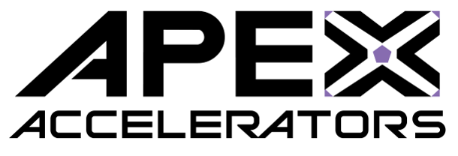

Resources for GSA eTools Support
Small Business Administration (SBA): The SBA offers a variety of resources to help small businesses learn about and use GSA schedules. These resources include a dedicated GSA website, training courses, and counseling services.
Link: www.sba.gov
APEX Accelerators: APEX Accelerators is a program that helps small businesses to sell to the government. The program offers a variety of resources, including training on GSA schedules.
Link: https://www.apexaccelerators.us
GSA Vendor Support Center (VSC): The VSC is a resource for vendors who do business with the government. The VSC can help vendors with a variety of tasks, including answering GSA schedule questions.
Link: https://vsc.gsa.gov/vsc/

Slide 37
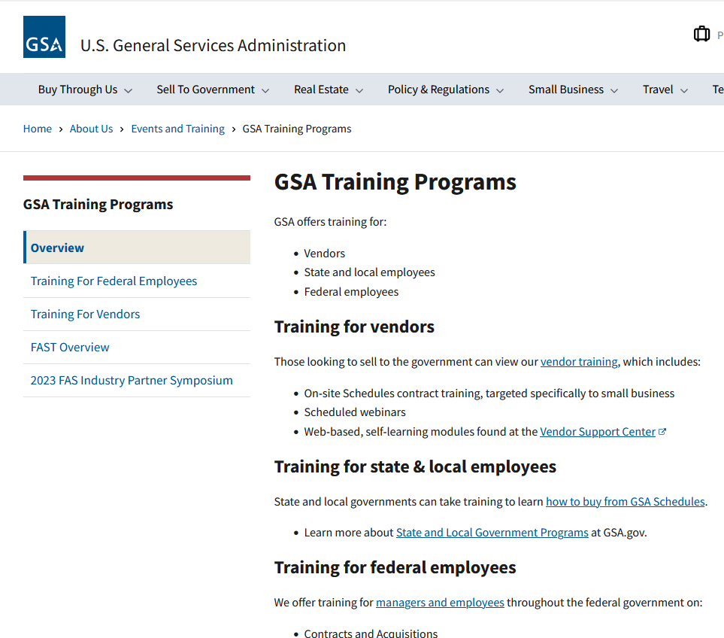
GSA Training Program
GSA offers ongoing training for vendors, state and local employees, and federal employees, free of charge.
Link: https://www.gsa.gov/about-us/events-and-training/gsa-training-programs

Slide 38
Contact Information
Dr. Shana Nicholson
WV-Northern Regional Procurement Counselor
APEX Accelerator (formerly PTAC)
Email: snicholson@rcacwv.com
Personal: shananicholson@gmail.com
Office: (304) 344-2546 ext. 5
Cell: 304-695-7769
LinkedIn: www.linkedin.com/in/drshananicholson

Slide 39
Q&A

Slide 40
Conclusion

