Slide 1
U.S. Small Business Administration SBA

Slide 2
Women-Owned Small Business Federal Contracting Program (WOSB Federal Contracting Program)

Slide 3
Set-Asides for Certification Programs and Socioeconomic Categories
Targeted set-asides and acquisition goals:
Women-Owned Small Businesses (5%)
Small Disadvantaged Businesses (including 8(a) certified) (12%)
HUBZone Businesses (3%)
Service-Disabled Veteran-Owned Small Businesses (3%)
Set-asides are reserved for small businesses between $3,500 (Micro- purchase Threshold) to $250,000 (Simplified Acquisition Threshold).
Notes:
The federal government has specified annual prime contracting goals for designated small businesses.
Targeted Set-asides and Acquisition Goals
Women-owned small businesses–(5%)
Small disadvantaged businesses including 8(a) certified–(5%)
HUBZones (historically underutilized business zones)–(3%)
Service-disabled veteran-owned small businesses–(3%)
Overall small business goal of 23%
Set-asides are reserved for small business between the Micro-purchase Threshold and the Simplified Acquisition Threshold.
Every federal government purchase with an anticipated value above the micro-purchase threshold of $3,500, and up to the Simplified Acquisition Threshold (SAT) of $150,000, is required to be automatically and exclusively set-aside for small businesses.

Slide 4
Women-Owned Small Business (WOSB) Certification

Slide 5
Certification Changes
As of October 15, 2020, businesses competing for WOSB Federal Contracting Program set-aside contracts will have to be certified either through:
SBA’s new, free online certification process; or
An approved Third-Party Certifier (TPC), at a cost.
Small businesses will still be able to utilize an approved TPC, at a cost, to obtain WOSB or EDWOSB certification.
Notes:
The SBA is making it easier for qualified small businesses to participate in the WOSB Federal Contracting Program by improving the customer experience. At the same time, the SBA is strengthening oversight and maintaining the integrity of the certification process.
The changes will make it easier and more efficient for COs to set aside contracts for, and make awards to, firms certified as WOSBs and EDWOSBs.
These regulations state that as of October 15, 2020, businesses competing for WOSB Federal Contracting Program set-aside contracts will have to be certified either through:
SBA’s new, free online certification process; or
An approved Third-Party Certifier (TPC), at a cost.
Please note that the current self-certification process will remain available for firms until October 15, 2020, in certify.sba.gov.

Slide 6
WOSB Federal Contracting Program Changes
Program changes:
Program applicants will apply via the new platform, WOSB.Certify.sba.gov.
Applications are reviewed by an SBA analyst for in-depth analysis of whether business documents meet program eligibility criteria.
When an application is approved, SBA will incorporate program participant’s WOSB/EDWOSB certification status onto the company’s profile on Dynamic Small Business Search (DSBS).
COs will no longer need to request access to review a firm’s documents. However, a CO may contact SBA to verify a firm’s status.
Declined applicants may reapply after 90 days if it has corrected the initial defect. There is no formal appeal process for applications.
Notes:
Talking points:
Requirements listed on this slide are not complete, be sure to visit the Federal Register.gov and the update to 13 CFR 127.
SBA still intends to accept third-party certification from all approved TPCs and will allow all firms with TPC certificates dating back to [date] to be eligible for WOSB
An updated notice [will be or has been] issued to all active WOSBs/EDWOSBs currently within Certify.sba.gov.

Slide 7
Certification Changes Resources
To stay up to date with changes to the WOSB Federal Contracting Program, please visit sba.gov/wosbready.
You also can contact your local SBA regional and district office, SBA resource partner, or Procurement Technical Assistance Center (PTAC/APEX) with questions.
Please review SBA’s latest FAQs for WOSBs/EDWOSBs (sba.gov) and WOSB and EDWOSB Certification Options for more information about the certification changes.

Slide 8






Is the WOSB Certification Appropriate for You?
Managerial experience
51% ownership requirements
Highest officer position
Management of daily operations
Proper NAICS codes
No minimum time in business
Notes:
Presenter tip: Depending on the audience, provide some information on when this may be an appropriate certification.
Must be a small business concern for the primary NAICS code or contract (not all NAICS codes are authorized for use under the WOSB Federal Contracting Program).
Must be at least 51% owned and controlled by one or more women who are U.S. citizens. The 51% ownership must be direct and unconditional.
There is no minimum amount of time for the business to have been operational.
A woman must manage daily business operations. This means:
A woman must hold the highest officer position within the business;
The woman must work at the business full-time during normal working hours;
The woman must have managerial experience required to run the business; and
Women must make long-term decisions for the business.

Slide 9

Economically Disadvantaged Requirements to Qualify
Personal net worth (assets minus liabilities) less
than $850,000
Three-year average income is $450,000 or less
Fair market value of all assets is $6.5 million or less
Notes:
Presenter tip: Discuss the requirements and information required to qualify as economically disadvantaged.
Small businesses seeking EDWOSB certification will have to submit additional information demonstrating economic disadvantage.
Effective July 15, 2020, SBA has adjusted the standards for determining economic disadvantage for participants in the 8(a) Business Development and WOSB Federal Contracting Programs. They include:
The net worth of an individual claiming economic disadvantage must be less than $750,000.
The adjusted gross income of the individual, averaged over the three preceding years, must be less than $350,000.
The fair market value of all the individual’s assets (including primary residence and the value of the individual’s firm) must be less than $6 million.
Funds invested in an Individual Retirement Account (IRA) or other official retirement account will not be considered in determining the individual’s net worth.
Note: SBA will look at a spouse’s finances if the spouse has a role in the WOSB/EDWOSB, has lent money to, or provided financial support (including credit or guarantee of loan) to the business. SBA may also look at a spouse’s finances if both spouses are in the same or similar line of business and their businesses share names, websites, equipment, and employees.

Slide 10
Application Process

Slide 11

WOSB Eligibility Process
Register in SAM.gov
Visit WOSB.Certify.sba.gov
New site makes it easy for you to understand the changes in the certification process and remain eligible

Slide 12
WOSB.Certify.sba.gov
On the homepage, you can:
Access checklists that provide guidance prior to applying
Verify eligibility
Find answers to questions regarding your firm’s ability to participate in a program
Request information from SBA by submitting the Help form
Create an account and proceed with your application

Slide 13
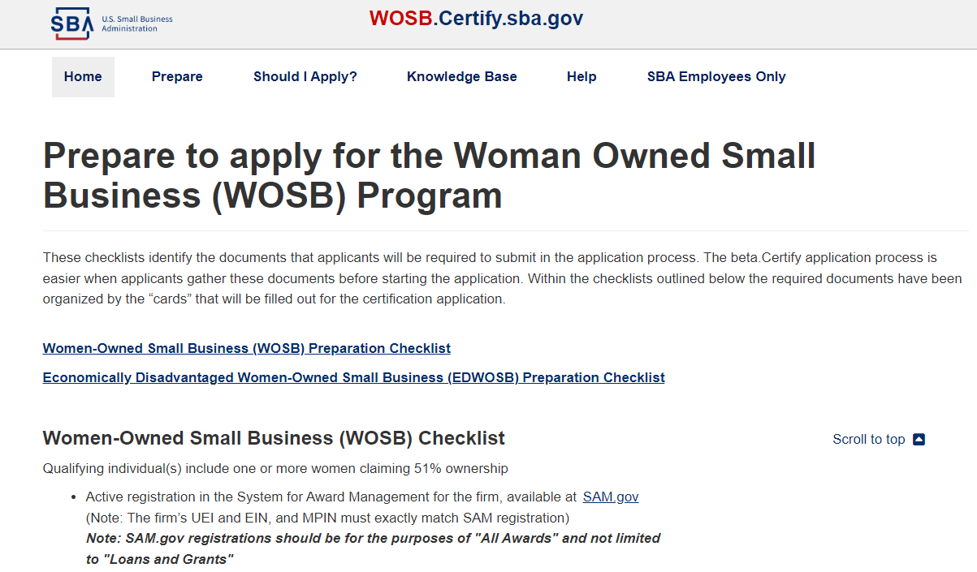
WOSB.Certify.sba.gov- Resources
Prepare tab - Updated checklists that provide guidance prior to applying

Slide 14
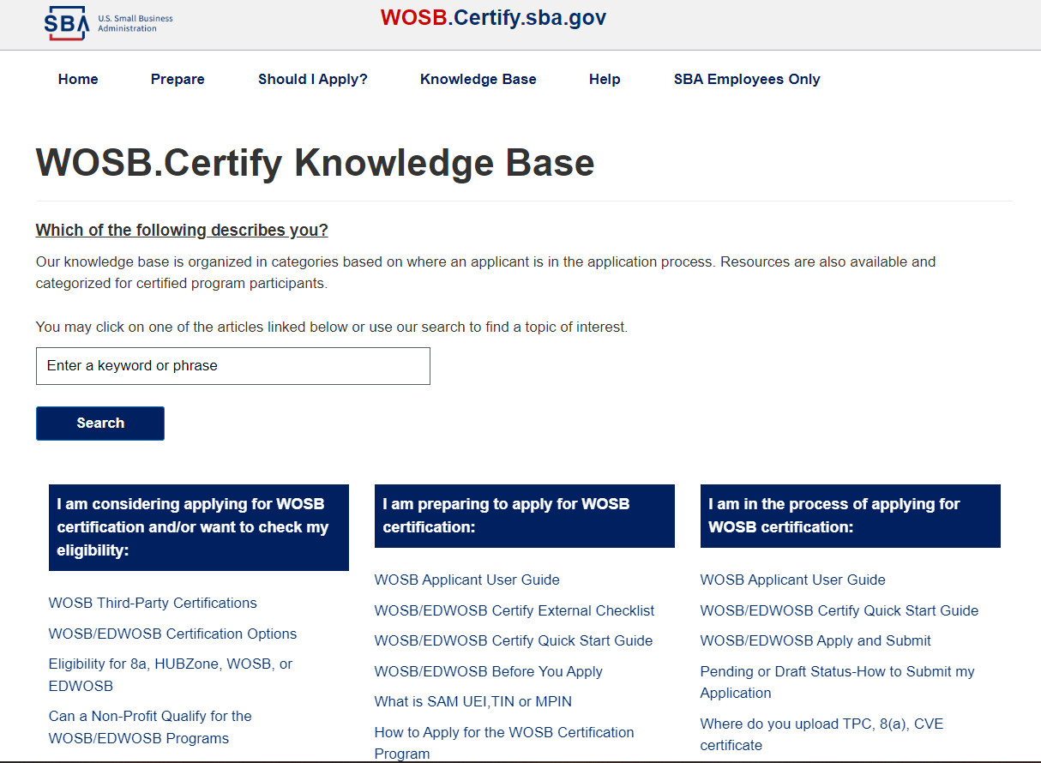
WOSB.Certify.sba.gov - Resources
Access the Knowledge base on WOSB.Certify.sba.gov which includes training videos, user guides, and more!

Slide 15
Issuing Decisions on Certification
Application Submitted – Dashboard will update
SBA will notify you of a complete, sufficient application package within 15 days.*
SBA will make determination within 90 calendar days after a receipt of a complete application, when applicable.
*An SBA representative may reach out if additional information or documentation is required.
Notes:
In order to ensure all necessary documents are uploaded to the portal, carefully review the documentation checklists on beta.certify.sba.gov prior to applying and collect the necessary documents in advance.
These steps detail the typical process for a complete and sufficient application package. If there are issues with an application package the timeline may take longer due to requests for additional information in order to fully process the application.

Slide 16
WOSB Application Process
Firm registers in SAM.gov
Firm registers in beta.certify.sba.gov and claims business
Firm completes application on beta.certify.sba.gov and uploads appropriate documents for EDWOSB or WOSB
SBA receives submission & conducts a “check” of all documents
If valid, proceeds to next step, notifies firm of a complete application.
If invalid document(s), screener issues a deficiency letter returning the application or submits request for information (RFI).
Reviews eligibility, ownership, and control – 90-day process begins
Reviews financials for EDWOSB
May conduct request for information (RFI)
Submits a final recommendation
Makes final decision to approve or deny
Issues signed and dated letter to firm
Letter marks official date of entry into WOSB program
Submission of Application
Screening
Analyst Review
Director Decision
Notes:
This slide details the stages of the application process:
Submission of Application
Pre-screening
Analyst Review
Director Decision

Slide 17
Contracting

Slide 18




WOSB and EDWOSB Sole-Source Contracts
1
2
Eligible NAICS Code
Fair and Reasonable Price
WOSB/EDWOSB-eligible NAICS code
Awarded at a fair and reasonable price
3
4
Contract Value
Sole-Source
$7M for manufacturing or $4.5M for all others
Only 1 WOSB/EDWOSB that can perform
Notes:
To make a sole-source award to a WOSB or EDWOSB, the following conditions must be met:
Is the contract in a WOSB/EDWOSB-eligible NAICS code?
Can the contract be awarded to the WOSB/EDWOSB at a fair and reasonable price?
Is the contract (including options) valued at $6.5 million or less for manufacturing contracts or $4 million or less for all other contracts?
In the determination of the contracting officer (CO), is there a reasonable expectation that there is only 1 WOSB/EDWOSB that can perform?
The WOSB Federal Contracting Program is a business development program without authority to make a direct award. Agencies are required to prepare and approve justification and approval.

Slide 19
Michigan District Office of SBA Contact information
Thomas Vargo
Lead Business Opportunity Specialist
Michigan District Office
U.S. Small Business Administration
Thomas.Vargo@sba.gov
313-324-3617
Gabrielle Coner
Business Opportunity Specialist
Michigan District Office
U.S. Small Business Administration
Gabrielle.Coner@sba.gov
202-941-8129

