Slide 1

Capability Statements
Jerry Smith & Michelle Simoes
Small Business Specialists
Office of Small Disadvantaged Business Utilization (OSDBU)
U.S. General Services Administration

Slide 2

Today’s Agenda
GSA OSDBU Overview
What is a Capability Statement?
Tools to create your Capability Statement
Examples of Capability Statements
Tips for Marketing Literature

Slide 3

GSA Overview
GSA’s mission is to deliver value and savings in real estate, acquisition, technology and other mission support services across the Federal government.
GSA is the Federal government’s procurement expert, helping other agencies acquire space, products, and services needed from commercial sources.
The Public Buildings Service, (PBS), provides real estate space, architecture, interior design, and construction to Federal agencies.
Our Federal Acquisition Service (FAS) delivers a vast number of commercial goods and services, at the best value, across government.

Slide 4
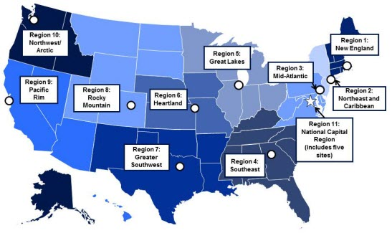
GSA OSDBU OVERVIEW
GSA’S Regional Offices
Region 1: Boston, MA
Region 2: New York, NY
Region 3: Philadelphia, PA
Region 4: Atlanta, GA
Region 5: Chicago, IL
Region 6: Kansas City, MO
Region 7: Ft. Worth, TX
Region 8: Denver, CO
Region 9: San Francisco, CA
Region 10: Auburn, WA
Region 11: Washington, DC

Slide 5
What is a Capability Statement?
A Capability Statement is a critical marketing tool to help you look your best during your initial outreach
A Capability Statement could be referred to as a “Business Resume”
You can have more than one Capability Statement

Slide 6
What is a Capability Statement?
A Capability Statement helps you be as successful as possible, no matter what size company you represent. Successful firms use their Capability Statement for a number of purposes:
  Required in many government registration processes
  A door-opener to new agencies
  Proof of qualification
  Proof of past performance
  It will set you apart from your competitors

Slide 7
Capability Statements
Primary purpose is for marketing outreach
Helps Contracting Officers (CO) drill down to your key areas of expertise quickly and efficiently
Adding information about awards, certifications & current/past clients, your capability statement will help you to:
    Establish a level of expertise
    Show business maturity
    Create a sense of trust

Slide 8
A Capability Statement is NOT…
A PowerPoint presentation
More than two sides of one page
.jpg or .tif file
A large file over 1MB
A personal resume
A Capability Brief

Slide 9
Keep It Simple
Use bullet points
Short sentence fragments
No long narratives
Simple language
No “trade” language or jargon
Call the document a “Capability Statement”
Show branding and logo elements

Slide 10
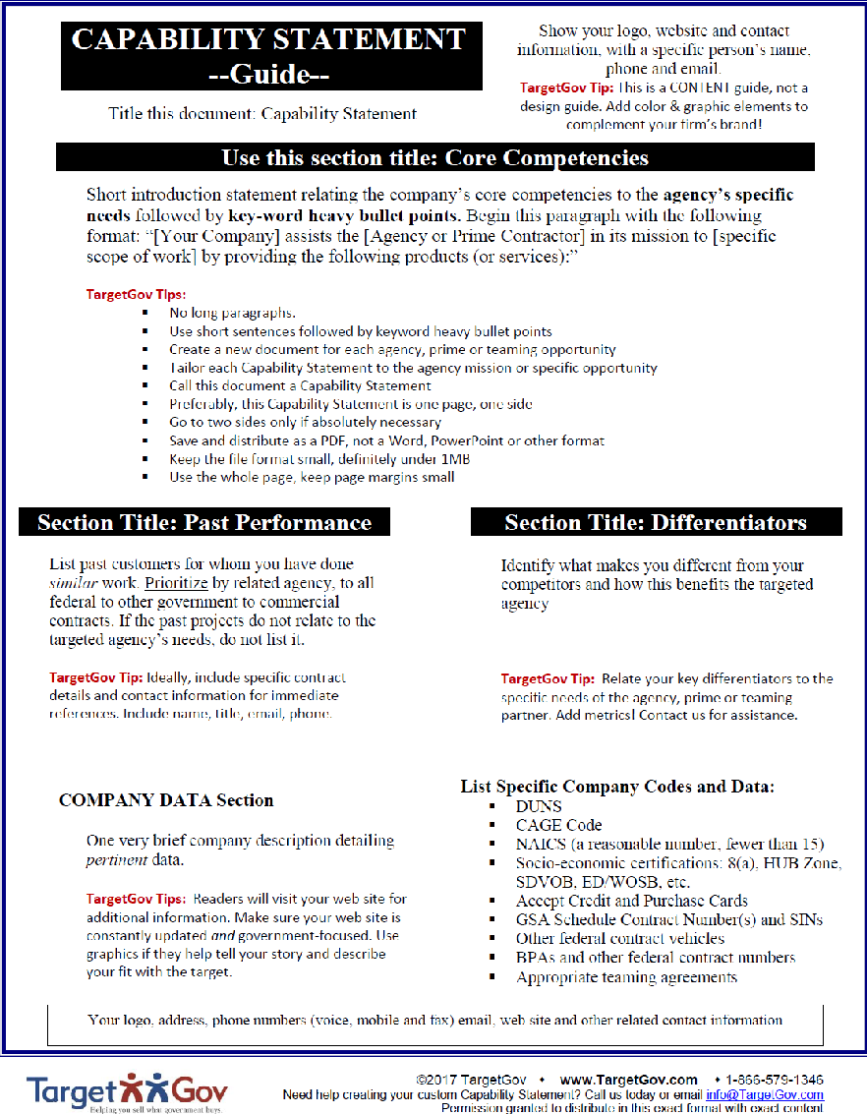
Examples of Capability Statements
  Template (G Larkin - TargetGov)

Slide 11
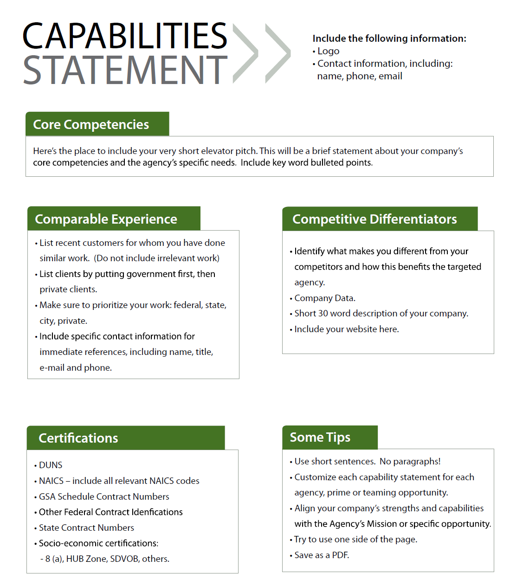
Examples of Capability Statements

Slide 12
Marketing Literature Tips
One Page Capabilities Statement (can be 2-sided*)
Core Competencies
Differentiators
Past Performance
Company Data

Slide 13
Marketing Literature Tips
Additional important info:
  UEI
  CAGE
  Socioeconomic status (if applicable)
  Certification(s) (industry specific)
A Crystal Clear description of the business
  Avoid jargon
  Don’t be vague

Slide 14
Marketing Literature Tips
Limited simple, clear text
Engaging pictures
Simple graphics
Ample white space
Think of this as an “Elevator Speech”
Stay focused – don’t “stretch”

Slide 15




Additional Resources:
www.gsa.gov/events
www.gsa.gov/smallbizresources

Slide 16
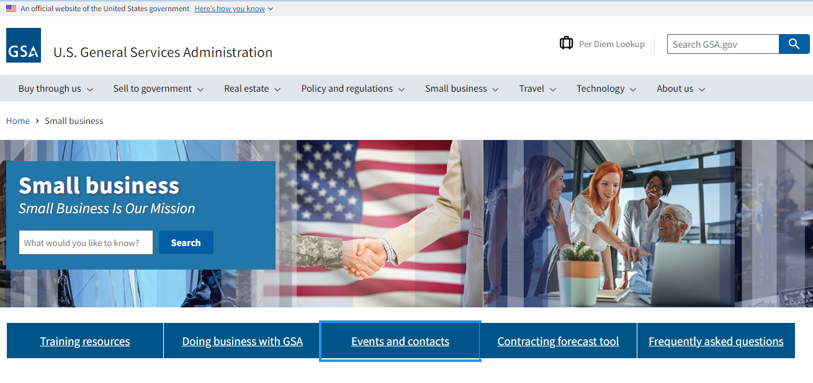
Contact Our Regional Staff
Still Have Questions?
www.gsa.gov/osdbu - Events and contacts
www.gsa.gov/smallbizsupport

Slide 17
QUESTIONS ?
Jerry Smith: Jerry.D.Smith@gsa.gov
Michelle Simoes: Michelle.Simoes@gsa.gov

