Slide 1
FAST 2025: Information Technology Category
June 26, 2025, 1 pm ET

Slide 2
Agenda
TechAcq CoP
MAS IT
MRAS
Hardware / Software / OneGov Panel
Break
GWAC

Slide 3
Poll

Slide 4
TechAcq Community of Practice
Supports federal IT acquisition professionals- membership is federal government only
A safe space that shares resources, promotes best practices, and fosters interagency collaboration
The community hosts events and forms working groups to address specific IT acquisition topics
Join the Listserv to engage with the 500+ in the community!
Email TECHACQ-COP-subscribe-request@LISTSERV.GSA.GOV with an empty subject line.

Slide 5
MAS IT: Accelerating Government IT Acquisition
Brian Gladney & Tyrees Jones
5

Slide 6


Session Presenters:
Brian T. Gladney
Division Director
Tyrees P. Jones, II
Division Director
Office of Acquisition Operations (QT2)
Information Technology Category (ITC)
Federal Acquisition Service (FAS)

Slide 7
GSA IT Category Executive Team
Lawrence Hale, Acting Assistant Commissioner
Cheryl Thornton-Cameron, Deputy Assistant Commissioner for Acquisition
Joel Lundy, Acting Deputy Assistant Commissioner for Category Management
Everlean Rutherford, Acting Executive Director for Enterprise Technology Solutions
“The GSA Information Technology (IT) Category provides a wide range of IT and telecommunications products, services, and solutions to government agencies through various acquisition vehicles, primarily the Multiple Award Schedule (MAS) program.”

Slide 8
Session Agenda
01
MAS IT Background
02
Top MAS IT Initiatives For Smarter Spend
03
Keeping Up Pace While Making IT Easier

Slide 9
MAS IT Background

Slide 10
What is the Multiple Award Schedule (MAS)?
A program compiled of long-term, pre-vetted contracts that give government buyers access to commercial products, services, and solutions at pre-negotiated pricing
Over 13,000 vendors, including strong participation from small businesses and original manufacturers
More than 30 million products, services and solutions available
Accessible to state, local and tribal agencies
A MAS contract is a fixed-price, with economic price adjustment, Indefinite Delivery Indefinite Quantity (IDIQ) contract. The ordering period is continuous, and contract periods begin on the date of award and expire after five years (exclusive of any option periods). Acceptable task order types include firm-fixed-price, time-and-materials, and labor-hour.

Slide 11
MAS Information Technology (IT) Features and Benefits
Access over 7.5 million innovative commercial IT products, services, and solutions from pre-qualified vendors
Encourages competitive and flexible pricing structures as well as tailored terms and conditions
FREE training and support from subject matter experts, including scope reviews, to get you started!
Locating a specific vendor or solution?
Market research services (MRaS) are available.
Ask about hands-on support to onboard high-priority vendors!

Slide 12
Special Item Numbers (SINs) and Subcategories
MAS offerings are represented by Special Item Numbers, or SINs, which can be combined to meet your requirements. IT SINs fall within the following subcategories:
Electronic Commerce
IT Hardware
IT Services
IT Software
IT Solutions
IT Training
Notes:
A stakeholder or vendor may download the IT Category attachment of the current MAS Solicitation for a list of all MAS IT subcategories. If you get redirected, search SAM.gov for Solicitation number 47QSMD20R0001.

Slide 13
Tips On Ordering From MAS
Follow the streamlined process under FAR Subpart 8.4
Issue a Request for Quote (RFQ), not a Request for Proposal (RFP)
Should include a statement of work (SOW)
Leverage GSA Advantage, buy.gsa.gov, or eLibrary
Remember to ask for additional discounts!
Unlike FAR Part 15, MAS orders do not require:
A formal source selection evaluation board
A FAR 15.404 cost analysis, because you get commercial pricing at the MAS level
Extensive documentation, because this process is less formal
A debrief, but you may provide a brief explanation. See FAR 8.405-2(d) for details.
You can set aside MAS orders for small business, but it’s not required.

Slide 14
Top MAS IT Initiatives
For Smarter Spend

Slide 15
Bringing Maximum Value to Federal IT Procurement!
Right-sizing MAS IT is top priority!
Increased focus on original manufacturer participation
Significant participation in OMB’s Best in Class program to support spend under management (SUM)
IT Hardware
IT Software
Wireless Mobility Solutions (SIN 517312)
Commercial Satellite Communication (COMSATCOM) Program including SIN 517410
Notes:
Under OMB’s Best in Class program, the 4 MAS IT SINs are BIC (or Tier 3) while the other MAS IT SINs are Tier 2.

Slide 16
SCRIPTS BPA Program
Supply Chain Risk Illumination Professional Tools and Services blanket purchase agreements, also known as SCRIPTS BPAs, are a suite of tools and services designed to identify and reduce risks in supply chains by:
Providing business intelligence and analytic support to help government agencies understand their supply chain, assess supplier health, and manage potential risks, and
Empowering agencies to acquire vetted solutions that screen and ensure suppliers are reliable and secure.
“SCRIPTS as a powerful resource that enables agencies to make smarter, safer buying decisions—faster.”
Notes:
Supply Chain Risk Illumination Professional Tools and Services blanket purchase agreements, also known as SCRIPTS BPAs, offer:
Secure supply chain risk illumination tools and services to identify and mitigate risks.
A full suite of subscription-based business intelligence tools and professional analytic support to assess findings and inform risk management strategies.
Identification and assessment of potential supplier risks associated with foreign ownership, control, and influence.
This effort helps agencies achieve the goals of Executive Order 13873, Securing the Information and Communications Technology and Services Supply Chain. The BPAs will improve how agencies deliver outcomes, provide excellent customer services, and save taxpayer dollars.
There are a total of eight SCRIPTS BPAs: four SCRIPTS Small Business BPAs and four SCRIPTS Unrestricted BPAs . The eight SCRIPTS BPAs provide agencies with full support service offerings for subscription access to business intelligence data analytics dashboards, which will allow users to run supply chain risk reports. SCRIPTS BPAs also provide professional data analytics support services.

Slide 17
SCRIPTS Details at a Glance
SCRIPTS BPAs are readily available for use!
Five year base period with one five-year option period, for a total of ten years. Performance period: 3/31/2025 to 3/30/2030 (with option to extend to 2035)
Eight awards made, including one Contractor Teaming Arrangement (CTA) with two vendors (for a total of nine BPA awardees)
SCRM Tools: Platform access, maintenance, support, training, and risk assessment reports included
Available for governmentwide use to include DoD and other federal, state, local, tribal, and territorial government entities
SCRIPTS Website & Ordering Guide:
Located at www.gsa.gov/SCRIPTS

Slide 18
Keeping Up Pace
While Making IT Easier

Slide 19
Optimizing IT Procurement: Right-Sourced, Right Now
Startup Springboard
Makes it easier for companies with fewer than two years of experience or financial statements to submit for a Multiple Award Schedule (MAS) contract
Formally unique to MAS IT, now open to all MAS categories
FASt Lane
Eligible vendors get shorter processing times for contract actions that directly support federal agency requirements.
Agency customers get fast access to emerging technologies and innovative offerings.

Slide 20
More About Startup Springboard
Startup Springboard makes it easier for companies with less than two years of corporate experience or financial statements to submit an offer for a Multiple Award Schedule contract. This lets offerors get your supplies and services to federal, state, local, and tribal governments faster.
Even if your company is more than two years old, you still qualify for Startup Springboard if you have fewer than two years of corporate experience providing the products or services described in the MAS solicitation.

Slide 21
How does FASt Lane work?
Based on solicitation requirements, the assigned Information Technology Category contracting officer will review new offers and modifications in eOffer and provide you with any necessary feedback.
Vendors applying for FASt Lane must be prepared to respond to any inquiries from GSA contracting officers within the time frames laid out in the eOffer and eMod submission guidelines, which may be contingent on approval of a technical evaluation and commercial supplier agreements:
Less than 48 hours for contract eMods
As quickly as 45 days for new eOffers

Slide 22
Who is eligible for FASt Lane?
To participate in FASt Lane, you must be a Multiple Award Schedule offeror or existing schedule holder assigned under the Information Technology Category (ITC) and assigned an ITC contracting officer.
Only those assigned under ITC are eligible for FASt Lane. No other categories are eligible.
Only ITC Special Item Numbers can be submitted in eOffer/eMod. No other MAS categories or non-ITC SINs are FASt Lane eligible.
The ANCILLARY SIN under the Miscellaneous Category may be included on your offer and still be eligible for FASt Lane.
FASt Lane participants must be supporting GSA-sponsored IT initiatives.

Slide 23
GSA IT Initiatives for FASt Lane Eligibility
Second Generation Information Technology IT (2GIT) Blanket Purchase Agreement
Defense Health Agency Enterprise IT Services
Supply Chain Risk Illumination Professional Tools (SCRIPTS) Blanket Purchase Agreement
Other IT initiatives that arise (such as contract modification initiatives)
For non-GSA IT initiatives: Vendors must have a written request from the federal agency ordering activity stating that the vendor should participate in FASt Lane to support the agency’s IT requirement(s). This written request must be included in the eOffer submission package.
All participants must complete and submit the FASt Lane Eligibility Checklist [DOCX - 28 KB] as part of their eOffer or eMod package.

Slide 24
Key MAS IT Resources
Websites and Tools for MAS Buying
MAS Information Technology Category GSA Webpage
MAS Information Technology Category eLibrary
Making IT Easier: FASt Lane Webpage
For questions or more information on FASt Lane, please email FAStLane@gsa.gov.
Please Follow Us!
ITC on LinkedIn
ITC Blog
Email updates

Slide 25
855-482-4348 or ITCSC@gsa.gov

Slide 26
Market Research As a Service (MRAS)
Click HERE and submit your request NOW!
MRAS uses the latest research techniques to help agencies visualize the competition and socioeconomic responses that they can expect if they use GSA’s acquisition vehicles.
Available Services
Request for Information
Streamlines the RFI process and consolidates the results into one market research report
Product Market Research
Pricing data for up to 20,00 GSA Advantage products
Rapid Review
Identifies if your requirement fits the scope of existing GSA acquisition solutions in 48-72 hours
MRAS Value Added Benefits
Reduces acquisition time by streamlining market research
Identifies the business size appropriate for the requirement
Aligns Agencies needs with GSA contracts and solutions
FAR Part 10 Compliant
For Assistance
Email: RFI@Research.GSA.gov
Visit: Buy.GSA.gov/MRAS
Contact: ncsccustomer.service@gsa.gov or 1-844-472-4111
Effective Market Research Training
1:00 - 2:00 pm ET
June 26th July 31st
August 28th September 25th
Register HERE or visit www.gsa.gov/events
Notes:
I wanted to share some information with you about GSA’s Market Research As a Service or MRAS program. They offer market research services for all federal, state and local agencies. They can help save you time with your market research by posting RFIs on your behalf, providing you with reports that identify the right GSA contracts and solutions, and provide GSA advantage pricing data.You can click the link on the top right to submit your request for their GSA market research services. With the recent rewrite of the market research portion of the FAR, come learn how we can assist acquisition professionals research GSA solutions and pricing for government contracts by joining the MRAS team on their monthly training. The link to register is provided on the bottom right. If you have any questions refer to the links on the bottom left. Thank you.

Slide 27
Hardware, Software, OneGov Panel
Birgit Smeltzer, Otis Frazier, Skip Jentsch, & Dan Hallee (Host)
27

Slide 28
OneGov Strategy for IT
Description:
The idea behind the OneGov Strategy is simple: the federal government should act as a single, coordinated enterprise when it comes to buying. That means:
Reducing duplication
Leveraging shared standards
Driving greater value for taxpayers
The OneGov Strategy takes that same spirit of collaboration and scales it across the broader procurement landscape. Software is just the beginning. Over time, this strategy will guide how we approach hardware, platforms, infrastructure, cybersecurity, and more.
For more information:
OneGov on the IT Vendor Management Office Website
April 29 press release
April 30 announcement
Adobe discount announcement
Google discount announcement
Salesforce discount announcement

Slide 29
2nd Generation Information Technology BPA
Description:
2GIT includes pre-competed commercial hardware, software, and ancillary services such as:
Purchase of New Equipment
Maintenance of Equipment, Repair Services and/or Repair/Spare Parts
Software License - Term Software & Perpetual
Software Maintenance Services
Order-Level Materials
Access to mission-critical, best-value IT from a diverse pool of more than 70 industry partners including more than 50 small businesses.
Solutions that meet current procurement policies, incorporate best practices (like collecting prices paid data), and track savings.
Options that support the FY19 SECURE Technology Act and other federal cybersecurity efforts.
For more information:
2GIT website
2GIT ordering guide
2GIT GSA Advantage! ordering portal
2GIT GSA eBuy RFI/RFQ portal

Slide 30
GSS Desktop & Laptop BPA
Description:
The GSS Blanket Purchase Agreements (BPAs) allow all government agencies to buy pre-configured laptops, desktops, tablets, and monitors with option upgrades and services with a faster, more-efficient business model that provides cost savings for the government with next-generation technology customer-service capabilities without additional procurement requirements.
Single-award BPAs include brand-name or equal laptops and desktops that meet current GSS standard configurations.
For more information:
GSS Desktop & Laptop BPA website
GSS GSA AdvantageSelect portal

Slide 31
Printer BPAs
Description:
Our Governmentwide Printer BPAs offer:
Integrated, enhanced, NIST-based SCRM requirements and operational controls to significantly improve your supply chain security.
Simplified buying process with quick “click and buy” on our AdvantageSelect platform.
A solution that meets current procurement policies, incorporates best practices (like collecting prices paid data), and tracks savings.
For more information:
Printer BPA website
Printer GSA AdvantageSelect ordering portal

Slide 32
Cloud Special Item Number 518210C
Description:
The GSA Schedule Cloud Special Item Number (SIN) 518210C is the subset of the Schedule that contains only cloud offerings. It also contains cloud-focused labor hours for any cloud project.
For more information:
Contact the GSA Cloud Team at cloudinfo@gsa.gov They are available to answer any questions about the:
Use of the Cloud SIN
Review of your requirements documents at no charge
Market Research as a Service (MRAS), to have GSA publish an RFI for your agency at no charge
Options you have regarding your choice of a contract type for cloud computing

Slide 33
GSA Information Technology Category website.

Slide 34
Break

Slide 35
An Overview of GSA GWACs
Amanda Willis & Victoria Kisekka McFarland
35

Slide 36
Table of contents
Understanding GWACs
GWAC Program Responsibilities
Accessing a GWAC
GWAC Scope
GWAC Ordering
Tools for Ordering Offices
Basic Contract Information
Summary and Questions

Slide 37

TRIVIA
In this trivia style presentation, we will provide an overview of the small business GWACs with an emphasis on what a GWAC is, GWAC features, and what is within scope.

Slide 38

Who We Are
GWAC Programs
Small Business GWAC Acquisition Division
Manages a diversified portfolio of socioeconomic set-aside contracts including 8(a) STARS III and VETS 2
Enterprise GWAC Acquisition Division
Manages GSA’s Unrestricted Alliant 2 GWAC

Slide 39

Trivia Time!
What is a GWAC?
Established by one agency for Governmentwide use
A task or delivery order contract for information technology
Operated by an Executive Agent designated by the OMB
All of the above

Slide 40

What is a GWAC?
A Governmentwide Acquisition Contract (GWAC) is defined as a task or delivery order contract for information technology. GSA GWACs are specifically for information technology (IT) services-based solutions. A GWAC is:
Established by one agency for Governmentwide use
Operated by an Executive Agent designated by the OMB
Not subject to the Economy Act

Slide 41
GWAC Program Responsibilities
GWAC Program Responsibilities

Slide 42
GSA Responsibilities
Establish and manage GWACs
Advise customers and contractors on proper use of GWACs
Conduct Delegation of Procurement Authority (DPA) training and issue DPA’s to Ordering Contracting Officers (OCOs)
Conduct program meetings with industry partners
Maintain resources on GWAC websites
Perform risk mitigation and contractor oversight
Conduct pre-award scope reviews upon request
Monitor subcontracting at the Basic/Master Contract level

Slide 43
GSA Responsibilities (continued)
Manage contract compliance
Conduct post award scope reviews
Report annually to Office of Management and Budget
Assessment of client satisfaction
Competition on orders
Cumulative number and total dollar value of orders
Number and value of performance based orders
Complete basic contract closeout

Slide 44
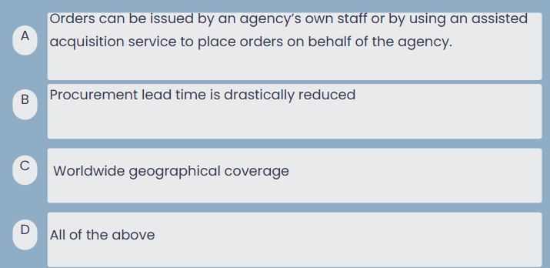
Trivia Time!!
Which of the following statements are true regarding GWACs?

Slide 45




And the answer is….
D. All of the Above
Assisted Acquisitions -Orders can be issued by an agency’s own staff or by using an assisted acquisition service to place orders on behalf of the agency.
PALT —The contracts are already fully competed; projects become task orders issued against an existing GWAC contract. Procurement action lead time is drastically reduced compared to conventional contracting methods.
Worldwide Geographic Coverage — GWACs may be used for solutions needed anywhere in the world.
Socioeconomic Credit — The Small Business GWACs provide agencies with access to qualified small businesses and associated socioeconomic credit. The Alliant 2 unrestricted GWAC sets small business subcontracting goals and provides socioeconomic credit to agencies at the Task Order lev

Slide 46



Why use a GWAC?
Best-in-Class- All GSA GWACs are designated as “Best-In-Class” by the Office of Management and Budget (OMB). OMB memo 19-13 (March 2019) encourages use of BIC solutions for agency requirements.
Wide Range of Contract Types — GWACs provide a full range of contract types, i.e., fixed price, cost reimbursement, time and material, and labor hour (contract type availability varies by contract). In addition, Alliant 2 allows for requirements-type task orders.
Low Fee – The contract access fee (CAF) is only ¾ of one percent (.0075) to be applied to the total price for contractor performance as billed to the government. Payment is made by the contractor to GSA.
Notes:
46

Slide 47

Additional GWAC Features
Highly Qualified Industry Partners — GWACs provide access to a premier industry partner pool which has undergone a stringent selection process. Our industry partners offer innovative technology solutions and expertise on federal agency requirements.
Limited Protestability — Protests are not authorized on task orders under $10 million except on the grounds that the order increases the scope, period of performance, or maximum value of the GWAC.
Notes:
47

Slide 48
Accessing a GWAC
Accessing a GWAC

Slide 49


Options for Accessing a GWAC
ASSISTED ACQUISITION
Servicing Agency conducts acquisition and administers the order on behalf of the Funding Agency for a fee
DIRECT ACQUISITION
Requesting/Funding Agency conducts acquisition and administers the order

Slide 50
GWAC Scope
GWAC Scope

Slide 51
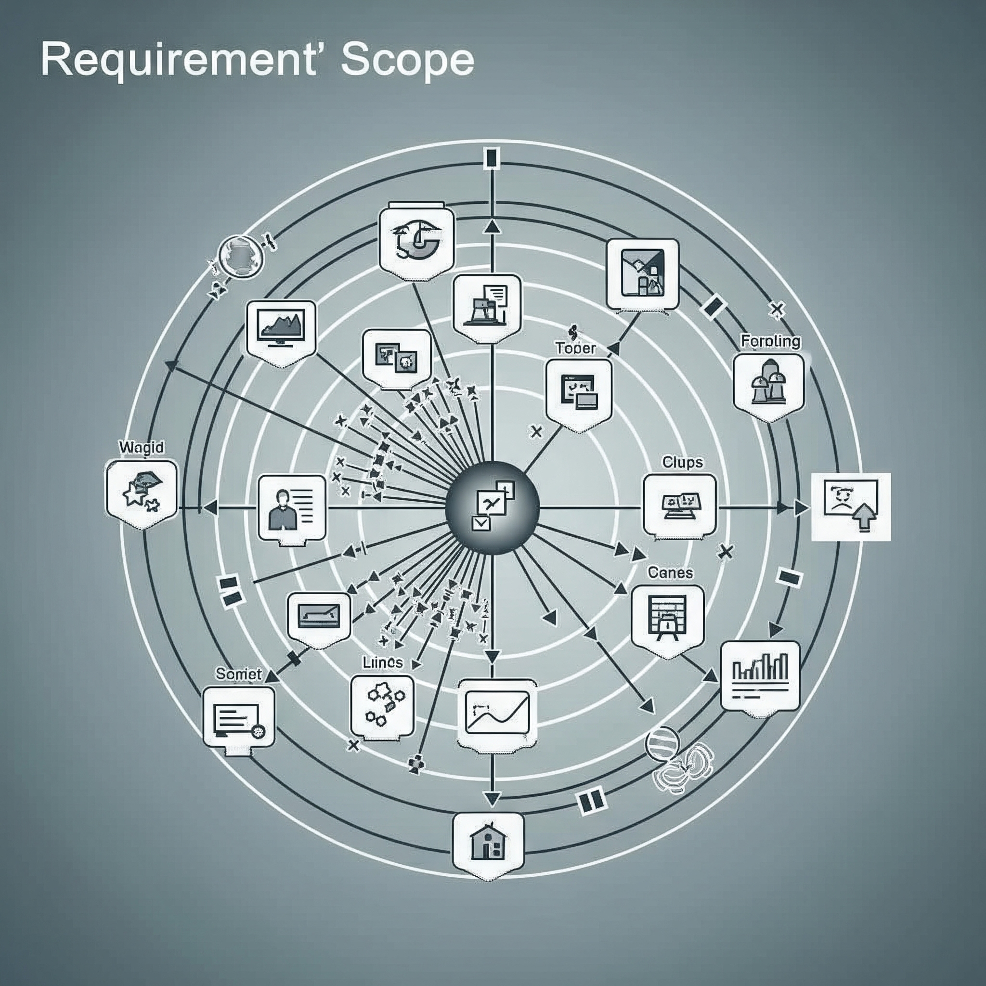
GWAC Scope
Task orders may be customized to meet the full range of IT services-based solutions
Regardless of which GWAC that is used, IT services-based solutions may include ancillary IT and non-IT components if integral and necessary
The sole purpose of the requirement may not be for a commodity (e.g., laptop computers) or non-IT related service (e.g., legal consulting).

Slide 52
GWAC Scope (continued)
Ancillary Support- must be integral and necessary to the IT services-based solution
Ancillary Services (i.e. clerical support; training; construction, alteration and repair, etc.)
Ancillary Equipment (hardware, software, licenses, racks, mounts, etc.)
Telecommunications, Wireless, and Satellite products and services
IDIQs/Blanket Purchase Agreements are not allowed

Slide 53
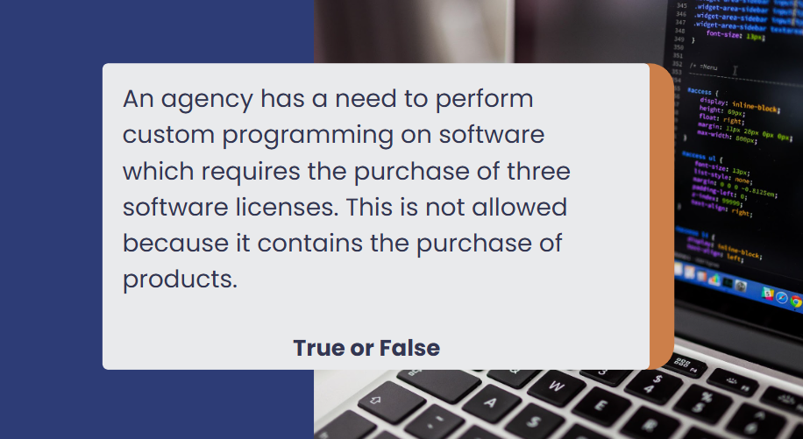
Trivia Time!!!

Slide 54
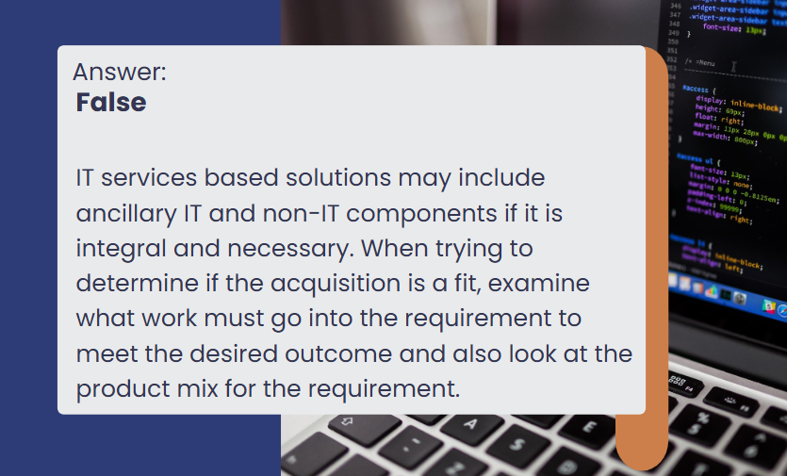
And the answer is…

Slide 55

Trivia Time!!!!
True or False:
An agency has a requirement to purchase 500 servers with $20,000 of the requirement going towards integration services. This is not allowed because it is predominantly IT services.

Slide 56
And the answer is……
True
The requirement is predominantly for IT products.

Slide 57

Trivia Time!!!!!!
True or False
You have a requirement to expand your data center. This requirement will require updating the office space (tearing down walls, pulling electrical wire, replacing carpet, etc.) The construction portion would have to be competed as a separate contract.

Slide 58
And the answer is…….
False
The office space updates are considered an integral and necessary ancillary service for the IT Service based solution and are therefore within scope.

Slide 59

Pre-Award Scope Review
GSA offers a free & optional scope review to determine if your requirement is a good fit for the selected GWAC
The review team is:
Comprised of technical & contracting professionals
Provides a written response (5 business days or less)
The written response is beneficial for your acquisition files

Slide 60

Trivia Time!!!!!
Is this requirement within scope?
An agency has identified a requirement for national security systems, which includes a need for security services such as testing, software development, and IT operations and maintenance.
The requirement packet has been submitted; however, the Performance Work Statement (PWS) offers limited information and lacks clearly defined specifications, aside from the indication that this requirement will heavily involve both hardware and software.
Additionally, the Independent Government Cost Estimate (IGCE) was not included in the submitted documentation.
NAICS code is 99999

Slide 61
And the answer is…..
Given the limited information provided in the initial submission, we strongly recommend resubmitting the pre-award scope review with the following:
A clearly defined Performance Work Statement (PWS)
The Independent Government Cost Estimate (IGCE) with a detailed breakdown of work allocations, labor categories, and associated costs
An IT service-related North American Industry Classification System (NAICS) code
Providing this comprehensive information will help expedite the review process.

Slide 62
GWAC Ordering

Slide 63
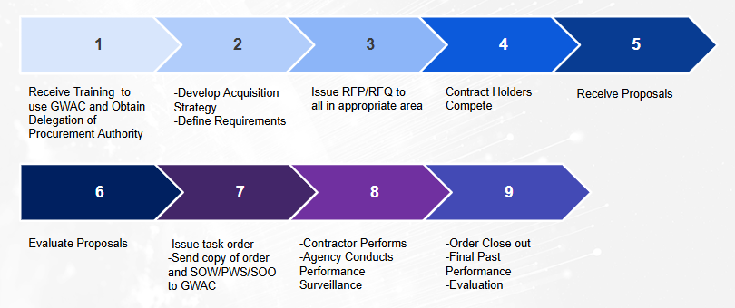
Competitive Ordering Process

Slide 64
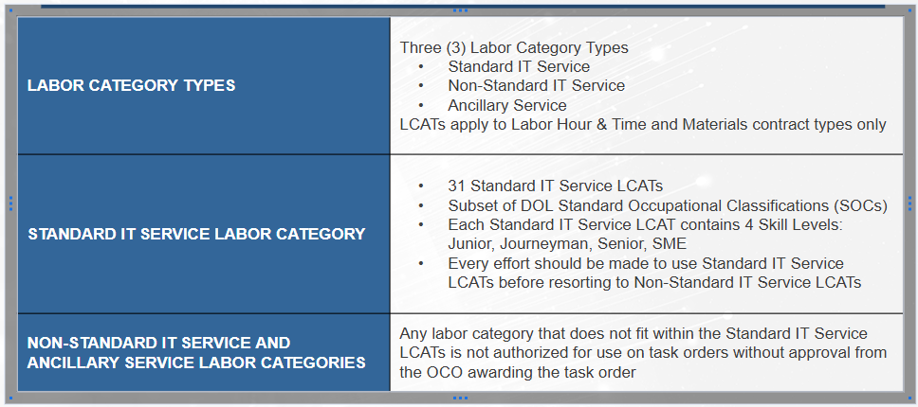
GWAC Labor Categories (LCATs)

Slide 65
Tools for Ordering Offices

Slide 66
Tools for Ordering Contracting Officers
GSA GWAC Online Resources
Full contract copy
GWAC ordering guide
Ceiling pricing for Labor Hour/T&M tasks
GWAC dashboard
GSA e-Buy-www.ebuy.gsa.gov
Online RFQ tool
RFQ handled electronically
Ensures transmittal of requirements
Each contract has a group email address for all awardees:
Alliant 2: alliant2awardees@gsa.gov
VETS 2: vets2awardees@gsa.gov
8(a) STARS III: stars3awardees@gsa.gov

Slide 67
Tools that will bring value to your efforts:
TOOLS | WEBSITE
GWAC Websites | www.gsa.gov/gwacs www.gsa.gov/starsiii www.gsa.gov/alliant2 www.gsa.gov/vets2 www.gsa.gov/alliant3 www.gsa.gov/polaris
GWAC Dashboards – Open to the public | www.gsa.gov/gwacdashboards
Scope Review - Free | www.gsa.gov/gwacscopereview
GWAC Contract & Ordering Guide | www.gsa.gov/alliant2 - select “Resources” on left side www.gsa.gov/starsiii - select “Resources” on left side www.gsa.gov/vets2 - select “Resources” on left side
Sample Statement Works & Acquisition Templates | https://acquisitiongateway.gov/ and https://acquisitiongateway.gov/documents
DPA Training | www.gsa.gov/events
DAU – for 24/7 Online GWAC DPA Training | www.dau.mil/training
Acquisition Gateway | https://acquisitiongateway.gov/ (industry has limited access)
GWAC Prices Paid Tool (Govt access only) | https://buy.gsa.gov/pricing/
Centralized Mailing List Service (CMLS) | www.gsa.gov/cmls (Download PDFs available)

Slide 68
Center for GWAC Program Resources
Small Business GWAC Acquisition Division:
Center Email: sbgwac@gsa.gov
STARS III Email: s3@gsa.gov
VETS 2 Email: vets2@gsa.gov
Center Website: www.gsa.gov/gwacs
Enterprise GWAC Acquisition Division:
(877) 534-2208
Alliant 2 Email: alliant2@gsa.gov
Center Website: www.gsa.gov/gwacs
Available videos to learn more about GSA GWACs:
8(a) STARS III
Alliant 2
VETS 2

Slide 69
Basic Contract Information
Basic Contract Information

Slide 70
GWAC Comparison
PROGRAM | ALLIANT 2 (UNRESTRICTED) | 8(a) STARS III | VETS 2
Website | www.gsa.gov/alliant2 | www.gsa.gov/8astars3 | www.gsa.gov/vets2
Contract Ceiling | $82.5B | $50B | $6.1B
Key Features | Best-In-Class Designation | Best-In-Class Designation Provides 8(a) small disadvantaged business credit Directed task order awards for orders at or below $4.5 million Sub-areas for Emerging Tech and OCONUS | Best-in-Class Designation Only GWAC set aside exclusively for Service-Disabled, Veteran-Owned Small Businesses (SDVOSB)
# of Awardees | 38 | 1098 | 45
Place of Performance | Global | Global | Global

Slide 71
GWAC Comparison Cont
PROGRAM | ALLIANT 2 | 8(a) STARS III | VETS 2
Task Order Types | Fixed price (all types) Cost reimbursement (all types) Labor hour Time and materials Combination Requirements Contracts | Fixed price (all types) Labor hour Time and materials Combination | Fixed price (all types) Cost reimbursement (all types) Labor hour Time and materials Combination
Primary NAICS Code | 541512 – Computer Systems Design Services, task order scope is not limited to this NAICS Code | 541512 – Computer Systems Design Services, task order scope is not limited to this NAICS Code | 541512 – Computer Systems Design Services, task order scope is not limited to this NAICS Code
Period of Performance | 10 Years (5 year base term through June 30, 2023 plus a 5 year option period through June 30, 2028) Orders performance may extend up to five years beyond the ordering period | 8 Years (5 year base term through July 1, 2026 plus 3 year option through July 1, 2029) Order performance may extend up to five years beyond the ordering period | 10 years (5 year base term through February 22, 2023 plus 5 year option period through February 22, 2028) Order performance may extend up to five years beyond the ordering period
Fee for using this vehicle | .75% CAF CAP $150K per year for direct orders and $100K per year for GSA Assisted Acquisition Service | .75% | .75%

Slide 72
GWAC Comparison Cont.
PROGRAM | ALLIANT 2 | 8(a) STARS III | VETS 2
Key Features | Pre-competed, easy-to-use contract with streamlined ordering procedures based on FAR 16.505 | Pre-competed, easy-to-use contract with streamlined ordering procedures based on FAR 16.505 and 19.8 | Pre-competed, easy-to-use contract with streamlined ordering procedures based on FAR 16.505
 | Limited Protestability on orders $10M and under; Minimizes protest risk | Limited Protestability on orders $10M and under; Minimizes protest risk | Limited Protestability on orders $10M and under; Minimizes protest risk
 | Integrated solutions for Products and Services allowing ancillary services and unlimited Products/IT Equip as long as part of solution | Integrated solutions for Products and Services allowing ancillary services and unlimited Products/IT Equip as long as part of solution | Integrated solutions for Products and Services allowing ancillary services and unlimited Products/IT Equip as long as part of solution

Slide 73
Latest GWAC Stats
STATISTICS | ALLIANT 2 | 8(a) STARS III | VETS 2
Total # of Task Orders Awarded | 766 | 1252 | 253
Total Obligations | $39.1B | $3.84 | $2.3 B
Average Proposals Received | 3 | 6.6 (competitive tasks) | 3
Top 5 Agencies | DoD Homeland Security Air Force Army Treasury | Health and Human Svcs Homeland Security Treasury Air Force DoD | Army Homeland Security Air Force DoD Treasury

Slide 74


Coming Soon!
Polaris
Set aside GWAC with four socioeconomic pools and no ceiling
SB Pool awarded, other pools planned for 2025
Alliant 3
Unrestricted GWAC with no ceiling
RFP closed in April of 2025
Award expected in FY26

Slide 75
Summary
GWACs offer:
Comprehensive IT services-based solutions
Pre-qualified pools of premier contractors
Pre-competed, flexible, easy-to-use contract vehicles that reduce procurement lead times
A full spectrum of contract types
Socioeconomic credit under the Small Business GWACs (prime) and Alliant 2 (Task Order level)
Limited protestability up to $10M (FAR 16.505(a)(10))
Contract training and exceptional client support from the knowledgeable and experienced GSA team

Slide 76
Upcoming DPA Trainings
Alliant 2 DPA Training 6/25/25
11:00 AM ET - 1:00 PM ET
Learn how Alliant 2 can support agency IT project initiatives. Warranted contracting officers must complete this training before requesting a Delegation of Procurement Authority (DPA).
GSA GWACs for IT Services-Based Solutions- DPA Training 7/1/25
1:00 PM ET - 3:00 PM ET
This is Delegation of Procurement (DPA) Training for all active GWACs
8(a) STARS III GWAC DPA Training 7/8/25
2:00 PM ET - 3:00 PM ET
Delegation of Procurement Authority Training for GSA’s 8(a) STARS III Governmentwide Acquisition Contract (GWAC) for IT services.
VETS 2 DPA Training 7/15/25
2:00 PM ET - 3:00 PM ET
Learn how the VETS 2 GWAC can support your agency IT project initiatives. Warranted contracting officers must complete this training before requesting a Delegation of Procurement Authority (DPA).

Slide 77
Questions?

Slide 78
Small Business GWAC Acquisition Division:
Center Email: sbgwac@gsa.gov
STARS III Email: s3@gsa.gov
VETS 2 Email: vets2@gsa.gov
Center Website: www.gsa.gov/gwacs
Enterprise GWAC Acquisition Division:
(877) 534-2208
Alliant 2 Email: alliant2@gsa.gov
Center Website: www.gsa.gov/gwacs

Slide 79
Poll.

Slide 80
Thank You!

