Slide 1

GSA Fleet Customer Focus Group
August 24, 2022

Slide 2
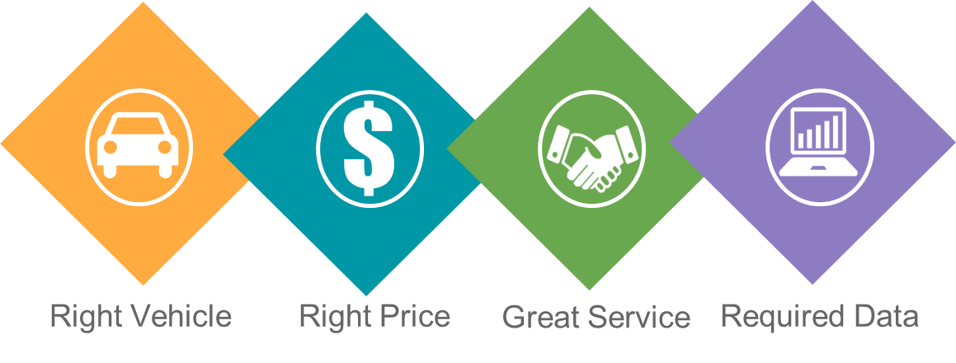
GSA Fleet Value Proposition
Notes:
GSA Fleet’s Mission
Fleet provides safe reliable low cost vehicle solutions to assist federal agencies to effectively and efficiently meet their mission and federal mandates
GSA Fleet Value Proposition
Right Vehicle, Right Price, Great Customer Service and the Data Required to Effectively and Efficiently Manage a Fleet

Slide 3
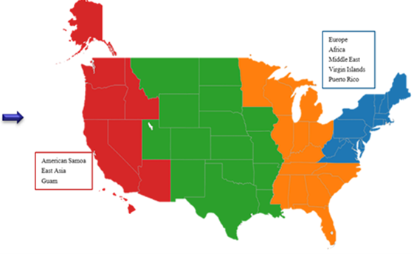




GSA Fleet Geographic Structure
Notes:
Thank you for choosing GSA Fleet to meet your transportation requirements! You are being served by one of the largest non-tactical fleets in the federal government.
GSA Fleet is organized into four Zones. There are over 35 Fleet Management Centers across the United States that provide service to over 210,000 vehicles worldwide.
2 Accident Management Centers (Kansas City and Atlanta)
3 Maintenance Control Centers (Lompoc, Ft. Worth, Atlanta)

Slide 4
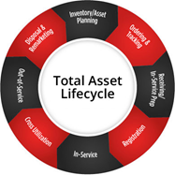
GSA Fleet Leasing Services
A monthly and mileage lease rate that covers:
  Vehicles & Replacements
  GSA Fleet Drive-thru
  Maintenance & Accident Management
  Fuel & Fleet Services Card
  Disposal of Replaced Vehicles
  National Safety Program and
  Recall Management
Visit GSA’s website for more program information
and current lease rates: www.gsa.gov/gsafleet
Notes:
GSA.GOV is where you find us on the web! GSA Fleet provides full-service vehicle leasing to federal agencies. We handle vehicle acquisition and disposal services. We have an annual procurement cycle and replace vehicles meeting our established replacement standards. We provide advice to our customers on vehicle selection. We have a national Maintenance Control Center (MCC) and a national Accident Management Center (AMC).
Our leasing rates INCLUDE:
● authorized fuel (lowest priced fuel available)
● routine maintenance (i.e. oil changes, fluids, filters, tire repairs, etc.)
● most mechanical repairs , brake jobs and tire replacements (if not abuse, neglect or unauthorized)
● other vehicle related purchases (i.e. quart of oil, wiper blades, windshield fluid, car washes)
● depreciation AND, of course,
● New replacement vehicles through rotation or procurement!

Slide 5
Fleet Service Representative
Allow you to focus time & resources on the performance of your core agency mission by relieving many administrative, management, and functional responsibilities of total fleet asset management.
Ordering vehicles
Utilization
Managing expenses
Billing
Vendor Mgmt
Maint & Repair Assistance
Notes:
For customer service and for help with day-to-day fleet management services, your first line of communication regarding your GSA fleet vehicles is with your agency’s assigned Fleet Service Rep (FSR). Every vehicle in GSA’s fleet is “assigned” to an FSR. They can help you:
Determine appropriate vehicles and insure requirements are met to the best of their ability.
Order new vehicles and facilitate the receipt of new vehicles.
Monitor use / make utilization suggestions
Facilitate vehicle maintenance.
Utilization: Follow VAM guidelines. GSA asking questions about co-utilization, rightsizing, additional vehicles…etc.

Slide 6
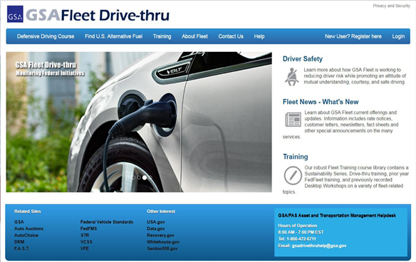
GSA Fleet Drive-thru
Unique User ID Access
Agency Guidance
Multiple Accounts per user ID
Reports Carryout
HQ Permission Level Settings
CAM
Vehicle Dispatch Reservation Module
Direct link to VCSS
Speedpay
http://drivethru.gsa.gov
Notes:
GSA’s Fleet Drive-thru website contains A LOT of customer-related fleet applications. Our Fleet Drive-thru website contains a WEALTH of information related to your agency’s assigned GSA vehicles.
CRASH: is a powerful tool that can be used by our customers to retrieve accident data on their GSA Fleet leased vehicles.
Customer-Driven Data: Customers can update physical/”garaged” locations of each of their GSA fleet vehicles within this module.
Mileage Express: Mileage Express is the required module for agency contacts to use to report any missing mileages each month. (more below) GORP is preferred method
GORP stands for “Get Odometer Readings at the Pump” and for the majority of our agencies, GSA “automatically” obtains vehicle odometer readings monthly from the entries drivers make at the pump when purchasing fuel or whenever the card is otherwise used.
This data is collected once a month (on or about the 20th of every month and is only collected for the previous 30 days). To ensure reporting, we suggest fueling vehicles prior to the 15th of each month.
Since the mileages obtained via GORP are reported as the vehicles’ monthly mileage reports and are the basis for the number of miles billed for during that month, drivers need to ensure they are entering pump mileages ACCURATELY.
Any mileages not obtained or not accepted (for whatever reason) are reported to the agency’s GSA contact person via email on an “exception report”. This email is sent on or about the 21st of each month. For the vehicles listed on the “exception report”, the agency must manually enter a current odometer reading IN MILEAGE EXPRESS (via GSA Fleet Drive-thru) BY THE LAST BUSINESS DAY of the month.
PM Express This module can be used by agency contacts to report completed oil changes and to also view oil change data for all of
their GSA vehicles.
Reports Carryout: Reports carryout can be used by customers to obtain vehicle inventory reports.
Speed Pay: Used by military customers to “automatically” pay their monthly GSA Fleet bills.
for registration is your agency’s customer number and the driver’s email address. (More information later on in this presentation).

Slide 7




Vehicle Replacement
Customer planning
Replacement Criteria
  New Sedan Criteria
Customer Acquisition Module (CAM)
Approval Process: Local/Mid/Headquarter
Vehicles
delivered
Guidance,
Ordering begins
Orders reviewed and placed
Notes:
GSA Fleet makes decisions in the best interest of the government / tax payers, replacement criteria is a MINIMUM threshold.
**Please note that the Sedan minimum replacement criteria has changed to 5 years or 60,000 miles, whichever comes first.
ANNUAL NOTIFICATION: CAM is the process for requisitions. Your agency’s GSA contact person will receive notification from their FSR when GSA vehicles MEET or are PROJECTED TO MEET GSA’s vehicle replacement standards. Generally, this notification occurs every fall - with new vehicle deliveries beginning in the spring. GSA Fleet places new vehicle orders once a year. Please communicate your needs to your agency’s GSA contact person. Actual vehicle replacement always depends on funding received.
Explain Approval Process. Headquarters determine actual end use vehicle.
GO GREEN: GSA Fleet’s Role is to offer your agency vehicle selections to help your agency meet the mandates outlined below. The mandates related to vehicle procurement are many. There are Executive Orders, Policies and Environmental Rules that impact FEDERAL FLEET VEHICLE ACQUISITIONS AND IMPACT our customers and their vehicle leasing decisions. GSA Fleet’s Role is to help your agency make the right vehicle selections to help your agency meet these mandates. The mandates are explained further in the next two slides.
Energy Independence and Security Act (EISA) of 2007: Acquire ONLY LOW-GHG emitting vehicles (agency HQs participating in the order review process will be asked to certify they have received valid exceptions/exemptions from YOUR AGENCY for ANY NON low-GHG vehicles we are ordering for you). So, your agency at your local level needs to have valid agency HQ-approved exceptions for any requested NON low-GHG vehicles.
• EPA Guidance for Section 141 (published February 23, 2010)
Section 141 addresses Federal Vehicle Fleets and supports the goal of reducing greenhouse gas (GHG) emissions.
Prohibits Federal agencies from acquiring “light and medium duty passenger vehicles that are NOT low GHG-emitting vehicles.”
EPA provides an annual list of vehicles that are considered low greenhouse gas vehicles on its website: http://www.epa.gov/greenvehicles (the relevant number is the Greenhouse Gas Score (now termed “GPM”-the maximum Grams Per Mile CO2 emissions, not the Air Pollution Score or any other number).
(For specific information about exceptions/exemptions, see the next slide)
The Energy Policy Act of 2005: Requires fleets to acquire alternative fuel vehicles (AFVs) and GSA Fleet to surcharge all customer agencies to recover AFV incremental costs. Exemptions from the Energy
Policy Act of 2005: Exemptions are automatically allowed for vehicles greater than 8,500 lbs, law enforcement, emergency vehicles and military tactical vehicles. Other exemptions are granted when alternative fuel is not available within five miles or 15 minutes from the vehicle’s garage zip code or if the cost of alternative fuel is more expensive than gasoline. These exemptions require 701 waiver requests which must be filed annually with DOE FAST system each June. (must be certified by the head of the agency or a designated individual):
“FUNCTIONAL NEEDS” Exception: No low GHG-emitting vehicle is
available that meets the “functional needs” of the agency.
“ALTERNATIVE MEASURES” Exception: Agency is able to offset
the purchase of a non-low greenhouse gas vehicle via some other
means (i.e.: acquiring a PEV; acquiring a high scoring vehicle)
Exception certifications are to be approved and maintained by the agency. EPA recommends maintaining these records for at least five years.

Slide 8
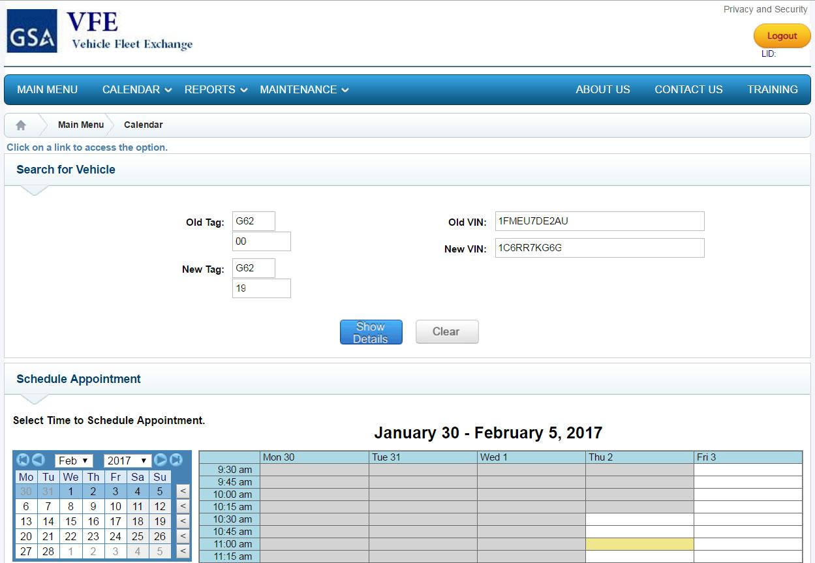
Vehicle Fleet Exchange (VFE)
Automatic vehicle pickup notifications
Electronic vehicle
exchange scheduling
Schedule Exchange
within 8 Days
Notes:
If you are not currently receiving these notices, contact your FSR on how you can begin.
When your new vehicle arrives at the GSA Marshalling Site from the OEM it receives a Pre Delivery inspection and is loaded into GSA’s Fleet Management System. When your new vehicle is available for pick-up, you will be notified via email from the VFE system to schedule an appointment for the vehicle's exchange. This applications allows you the option of self-scheduling an appointment through an embedded link contained within the email. This system also allows you the option of contacting your assigned Fleet Service Representative (FSR) or designated Marshaling Site to schedule an appointment for the vehicle exchange.
Once the appointment has been scheduled, you will receive a confirmation email confirming the scheduled appointment. The confirmation email contains a dynamic link that allows you to modify or cancel the appointment should the need arises. If and when an appointment is modified, a carbon copy of the modified appointment is sent out to the customer, FSR, and MSR
Please exchange your vehicle within 8 business days of notification

Slide 9
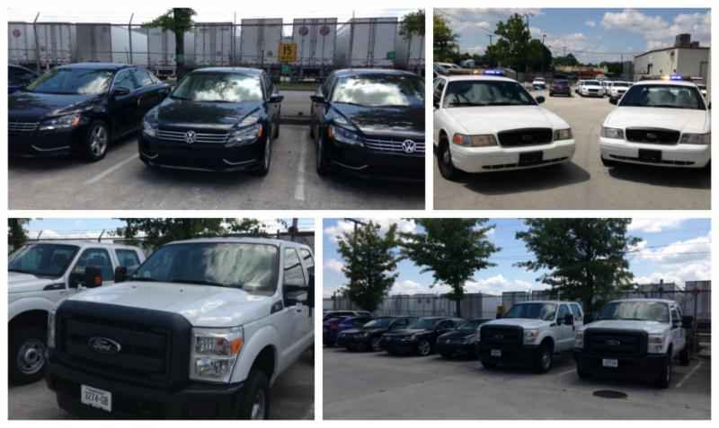

Vehicle Exchange Process
Before appointment
Service Lights
Rock Chips
Recalls
Wash
Remove items
After the Exchange
Old Vehicle will be detailed
Sold at Auction
Damage Recovery
Day of Appointment
Both sets of Keys
Fleet Card
Both License Plates
Walk Around
Notes:
Here are a few things to keep in mind when preparing your vehicle for exchange.
Before the appointment for exchange remember to:
· Have any service lights (check engine light, low tire pressure etc.) remedied before you turn in the vehicle.
· If there are any rock chips or cracks in the windshield have them filled or replaced (it will cost less for the agency to do this before they turn the vehicle in, as opposed to the marshalling site replacing it).
· Make sure recalls have been completed before turning it in. Recalls can be found in Fleet Drive Thru or searched by VIN number at https://vinrcl.safercar.gov/vin/.
· Please make sure your vehicle has been washed and all agency and personal equipment and supplies have been removed from the vehicle. (You do not need to have your vehicle detailed; this will be done at the marshalling facility).
On the day of your appointment:
· Be sure to have both sets of keys, the WEX card, and both license plates with you when you turn it in.
· Walk around the vehicle with the marshalling site representative as they assess the condition of the vehicle you’re turning in and with the vehicle you are picking up.
What happens with the old vehicle?
· The vehicle will be detailed and prepared for sale.
· The vehicle will be sold at auction.
· If, when your old vehicle is sold at auction, it does not get fair market value due to damages, your agency will be billed back the lesser of the estimated cost to repair damage that exceeds normal wear and tear, or the difference between vehicle proceeds and returns on the sale of comparable vehicles.
Working with your FSR before the sale can help offset the cost of damage and excessive wear and tear on your vehicle at the marshalling facility and increase the overall resale value of the vehicle. Please contact your FSR with any specific questions or concerns to ensure a seamless exchange process for your agency.

Slide 10
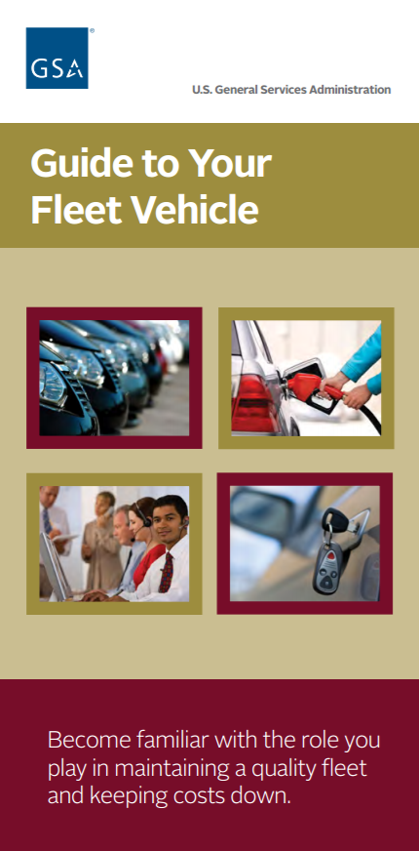
How You Can Help Minimize Cost
Practice safe driving
Call MCC/AMC before service or repairs
Comply with all state/local driving laws
Day-to-day care
Safeguard all Gov’t property
Report Accidents to GSA within 5 days
No Smoking (including e-cigarettes)
Notes:
As a driver of a GSA vehicle, your responsibilities are:
Day-to-Day Care/Appearance: You drive your GSA vehicle every day, so you are most familiar with it. Ensure you keep your vehicle in good shape - - both cosmetically AND mechanically. Review zonal car wash guidance (mention cappuccino/coffee spills).
Walk Around Inspection: We recommend this be done before each trip. Check for: body or glass damage, fluid levels/fluid leaks, tire pressure/condition/tread wear.
Touch on AIE policy and what is covered / not covered
The national car wash policy is $25 per vehicle per month. If you feel you need to exceed this contact your FSR.
SAFEGUARD ALL VEHICLES, KEYS AND CREDIT CARDS, LICENSE PLATES (please do NOT leave keys or credit cards in vehicles when not in use).
There is NO SMOKING ALLOWED in ANY GSA vehicle.
The driver is responsible for following all federal, state and local laws and IS responsible for paying parking tickets or any fines incurred.
Please always enter accurate mileages at the pump when purchasing fuel (to avoid GORP exceptions) (make sure to exclude the “tenths”).
Report Accidents and Incidents: Within 5 days to GSA’s Accident Management Center. (mention that we will more fully cover reporting accidents on a different slide in this presentation)
FSR Communication, prolonged vehicle down-time. Recall completion

Slide 11
Customer Do’s
👍
Complete all recalls timely
Pickup new vehicles within 8 business days
Complete preventive maintenance on the vehicle when notified or when the OLS light prompts you
Update mileage
Register in VCSS and pull bills monthly
Perform operator checks and inspections
Only use the fleet services card for authorized fuel and services
Secure and safeguard vehicle at all times
Only use vehicles for official purposes
Review the Customer Leasing Guide and Guide to your Fleet Vehicle
Pay tolls and toll violations
Notes:
CUSTOMER LEASING GUIDE: Is a reference for your leasing relationship with GSA Fleet.
PROPER CARE/MAINTENANCE: Vehicles should be maintained in a safe and presentable (clean) condition. Minor repairs should not be allowed to accumulate AND any accidents or incidents should be promptly reported and repaired.
PROPER OPERATION: Ensure all drivers have valid state driver’s licenses and that they are licensed appropriately for the types of vehicles they drive.
OFFICIAL USE: Ensure drivers are aware of what constitutes “official use” (as defined by your agency) and that they follow all federal, state and local laws (i.e. local cell phone use laws)
PROTECTION OF THE VEHICLE: Secure vehicle and all keys and credit cards DAILY. Protect against negligence, vandalism, theft and Acts of Nature (mention AIE’s: sale vehicles: hail, flood, etc).
GSA FLEET BILLS (VCSS): Ensure that GSA Fleet bills are paid in a timely manner. It is the agency’s responsibility to register in the VCSS system and to pull a copy of the monthly bill to process for payment every month. VCSS will be further explained in a later slide.
FUNCTIONAL NEEDS EXEMPTION: Agency responsibility to be held at the agency HQs for further reporting

Slide 12
Customer Don’ts
👎
DON’T- Authorize any vendor to work on vehicles without:
  GSA Fleet Approved modification / accessory form
  MCC / AMC approval for maintenance and repairs for anything over $100 including any tire, battery or glass repair regardless of cost
Obligate any government funds
Purchase food, beverages or other items for personal use
with the Fleet Services Card
Install exterior vehicle
markings without authorization from GSA Fleet
Leave the Fleet Services card with a vendor
Forget to Pay your Fleet bills!
Notes:
Drivers, operators or agency POC’s are not allowed to authorize work to be performed. Only GSA MCC or AMC technicians are allowed to authorize work to be performed. If someone from your agency authorizes work to be performed on a GSA vehicle your agency may be liable for those costs.
Installation of ANY accessory equipment or any modification on your GSA vehicle requires prior approval from GSA. Items such as: hitches, toppers, winches, grill guards, running boards, radios, light bars, lift gates and in particular any type of INTERIOR CARGO CAGES.
The WEX card issued with each GSA vehicle is to be used for fuel and maintenance for the designated GSA vehicle (PLEASE DO NOT use it for any other vehicle or any agency-owned equipment,)
Decorative Items
In accordance with 41 CFR 101-39.304, the addition of any decorative items to GSA Fleet vehicles must be approved by the Director, GSA, Office of Fleet Management. Contact your FSR for information. Requests should be submitted to your FSR or local Fleet Management Center for proper routing.

Slide 13


Preventive Maintenance
PM Schedules
Types of Oils
  Conventional
  Re-Refined
  Synthetic
Notifications
  Automatic
  PM Express
Reporting Completed PMs
Unscheduled PM
Emissions Testing and State Safety Inspections
Notes:
Timely Preventive Maintenance ensures that GSA Fleet vehicles are safe, reliable, and effectively serve the customer’s transportation needs. The customer is responsible for making sure that their GSA Fleet vehicle receives a PM as scheduled. Failure to perform a timely PM may void the warranty on the GSA vehicle and/or lead to future costly repairs.
Preventive Maintenance Schedules
Most new vehicles come equipped with an oil life monitoring system (OLS), which is a light notification displayed on the dashboard.
If the vehicle has an OLS, the customer must have the engine oil changed when the dashboard light illuminates, regardless of whether GSA has notified the customer of the need for an oil change. If a year has passed since the vehicle’s last oil change, GSA Fleet will send an email notification to perform a PM. GSA’s recommendations for PM schedules may vary slightly from the manufacturer’s guidance.
If the vehicle is not equipped with an OLS, GSA Fleet will send an email notification to have the oil changed, based on the number of miles driven or time elapsed since the last oil change. The email notification will list all the services that are required at the time. The driver must ensure that the vendor closely follows all instructions. If the services will exceed $100, the vendor must call the MCC for authorization.
Types of Oils
Conventional Petroleum-Derived Engine Oils and Re-Refined American Petroleum Institute (API) Certified Oils are preferred by GSA Fleet
Dexos, synthetic oils, and synthetic blends are not authorized for use in GSA Fleet vehicles unless they are comparatively priced to conventional or re-refined oils.
Section 6002(c)(1) of the Resource Conservation and Recovery Act (RCRA) requires each Federal agency to procure items composed of the highest percentage of recovered materials practicable unless they are not reasonably available, fail to meet performance standards, or are only available at an unreasonable price.
Customer Notification of Due and Overdue PMs
GSA Fleet utilizes the following two methods to notify customers of due and overdue PMs
A. Automated notifications will be generated by GSA Fleet to the vehicle POC that one or more vehicles needs a PM. Automated notifications will be sent for vehicles on all PM schedules, with appropriate intervals determined by the vehicle’s schedule (both time and mileage based schedules).
B. Notification through PM Express on the Fleet Drive-thru website. PM Express will show all vehicles assigned to each customer with their respective date of last completed PM as well as the estimated date of the next required PM.
Reporting Completed PMs
GSA Fleet automatically captures PMs that were purchased using the GSA Fleet Service Card or were authorized by the MCC.
In addition to the automated procedures, customers have the ability to manually report PMs through PM Express in GSA Fleet Drive-thru. The automated methods decrease the need to report PMs, helps expedite those that do need to be reported manually, and increase the accuracy of GSA Fleet’s data.
When a PM is not coded correctly by a vendor or is completed without using the Fleet Service Card or through the MCC it will need to be manually updated. If manual reporting is needed, you may do so by entering the date of completion next for the vehicle, identified by license plate number, through PM Express.
Unscheduled PM
GSA Fleet may charge agencies for unscheduled PMs (completed earlier than necessary) as it represents a behavior that unnecessarily increases costs to taxpayers.
Emissions Testing
In compliance with the Clean Air Act of 1990, some states have implemented mandatory emissions testing programs. GSA leased vehicles are subject to the requirements of the jurisdiction where the vehicles are regularly housed or garaged.
Safety Inspections
IAW FMR 102-34.280 Government vehicles that display official U.S. Government license plates do not require motor vehicle safety inspections. If your mission is such that you must have a State Safety inspection then your agency will be billed for the inspection. If your state combines the safety and emissions inspection then GSA will cover the cost.

Slide 14
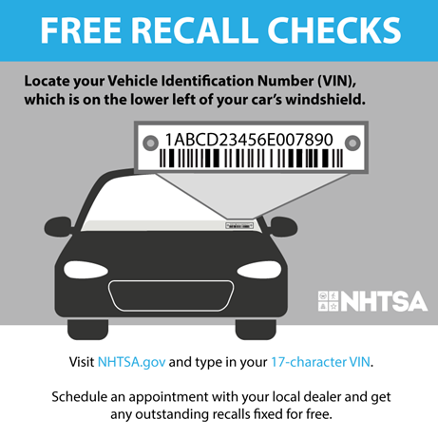
Recalls
GSA Fleet Recall Team
Notification
  Paper Notification
  Fleet Drive Thru
NHTSA
  www.safecar.gov
Take Immediate Action!
Notes:
When manufacturers or regulators discover defects in vehicles which potentially can lead to the death or injury of occupants, a safety recall is initiated by the manufacturer.
GSA Fleet maintains close contact with manufacturers and regulators to receive the best and most recent information on safety recall campaigns affecting GSA Fleet vehicles. The GSA Fleet recall team updates recall records weekly and tracks recall trends across the fleet and down to the individual vehicle.
The manufacturer is legally required to send paper notifications to the vehicle owner on record, detailing the nature of the safety recall, as well as steps owners must take to remedy the defect. GSA Fleet Management is the owner on record of all leased GSA Fleet vehicles. All recall information can also be found in Fleet drive thru
After a manufacturer announces a safety recall, the National Highway Transportation Safety Administration (NHTSA) initiates an investigation of the defect and assigns a tracking number to the manufacturer initiated recall. NHTSA posts information on all active safety recall campaigns at www.safercar.gov
Customers must take immediate action if they receive notifications, electronically or via mail, alerting them of open safety recalls on fleet vehicles in their custody. Upon receipt of a safety recall notice, customers must contact their local OEM dealer location to ensure that parts are on hand and make an appointment to have the recall remedied in a timely manner. Failure to respond promptly to safety recall notifications potentially could lead to the death and/or injury of Federal Employees, contractors, and the general public.
Customers with questions or concerns about safety recalls should contact their FSRs and OEM service providers, as well as check the online resources from GSA Fleet and its Federal motor vehicle safety counterparts - GSA Drive-thru and NHTSA’s SaferCar.gov.

Slide 15
GSA Fleet Assistance Centers
1-866-400-0411
Customers & Operators can not obligate GSA Fleet (government) funds to any vendor.
Trained GSA Fleet technicians :
  Access maintenance and repair history
  Authorize maintenance and repair over $100
  Assist customer in filling out accident reports – must notify the accident center within 5 business days of accident
  We ensure vehicles get to the correct repair shop at the best price
📱
Notes:
GSA Fleet Vehicle Assistance Center cards are provided with every GSA vehicle. This is a handy card that all drivers should keep stored with their WEX card.
Drivers, operators or agency POC’s are not allowed to authorize work to be performed. Only GSA MCC or AMC technicians are allowed to authorize work to be performed. If someone from your agency authorizes work to be performed on a GSA vehicle your agency may be liable for those costs.
Vendors MUST call MCC for PRIOR authorization for any repair OVER $100 AND for ANY tire or battery replaced (regardless of cost).
If you have a maintenance or repair question Contact MCC! MCC does not solely exist to authorize repairs to vendors, they are also there for YOU! Call them FIRST for any and all repair advice. (Remember, MCC’s # is also found on the back of every WEX card).
If you have an emergency repair during non working hours please notify MCC next business day,
Contact FSR for any lengthy down time (10 days or more)

Slide 16

Unauthorized Commitments
An unauthorized commitment occurs when authorizing a vendor to work on vehicles without:
  MCC / AMC approval for maintenance and repairs for anything over $100 including any tire, battery or glass repair regardless of cost
  GSA Fleet Approved modification / accessory form
If agency authorizes work on a GSA vehicle without approval,
your agency may be liable for those costs
Notes:
Drivers, operators or agency POC’s are not allowed to authorize work to be performed. Only GSA MCC or AMC technicians are allowed to authorize work to be performed. If someone from your agency authorizes work to be performed on a GSA vehicle your agency may be liable for those costs.
Situations arise when a driver for a leasing agency customer incorrectly makes an unauthorized commitment and enters into a contract with a Third Party Maintenance Vendor without having the authority to do so.
In such cases, the obligation falls to the leasing customer agency to make payment for the repairs that were authorized by their driver. However, there are instances where said agency cannot or will not make said payment - or do so in a timely manner. In such instances, GSA Fleet vendors, having provided a service from which the Government has derived a benefit (the repair of the vehicle), are left disadvantaged. At times, these vendors may illegally hold the GSA Fleet vehicle in an effort to get payment or refuse service to future GSA Fleet vehicles.

Slide 17
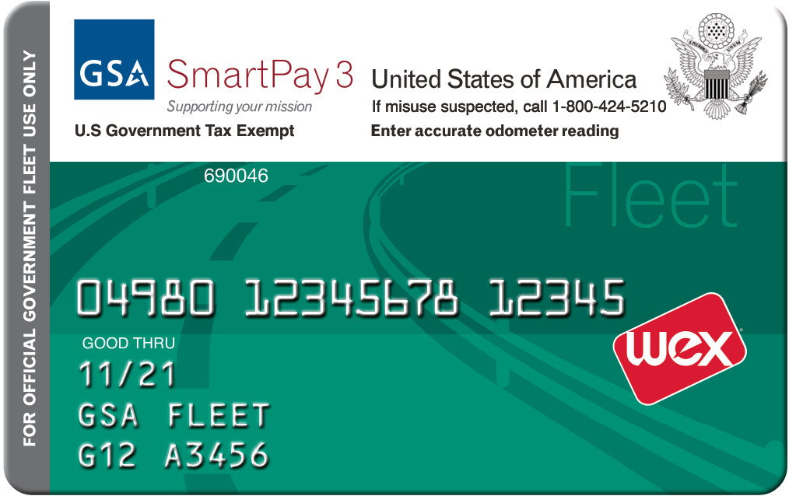
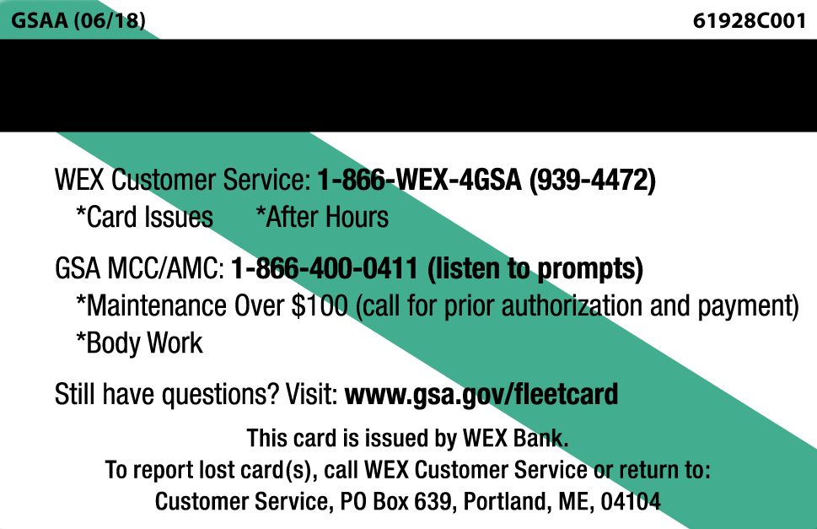


Fleet Service Card
Issued to every GSA leased vehicle for fuel and maintenance
  All work Over $100 requires GSA’s PRIOR approval. Call the MCC/AMC
  Maintenance under $100 AND after-hours call WEX support (on back of card)
  Accurate pump mileage entries (GORP)
WEX Acceptance refer to WEX connect APP
Notes:
When GSA vehicles are issued to your agency, they are issued with all keys and a WEX fuel card that MATCHES the license plate number. The following items are also issued (in the glove box): “A Guide to Your GSA Vehicle”, a reference card with our toll-free assistance line numbers and an accident packet.
• The WEX card issued with each GSA vehicle is to be used for fuel and maintenance for the designated GSA vehicle (PLEASE DO NOT use it for any other vehicle or any agency-owned equipment, i.e. snowmobiles, four wheelers, “extra” gas cans).
• The PIN or “Driver ID” is the first 6 numbers of the plate # (in the example on the screen: G10-0011S = 100011).
• Please always enter accurate mileages at the pump when purchasing fuel (NO TENTHS) (to avoid GORP exceptions).
• Make sure the station accepts WEX before making any purchase.
• Certain gas stations have certain “cut-offs” for the amount of fuel purchased in a single transaction - - which GSA does not control.
• For maintenance, bodywork and glass replacement OVER $100, as well as ANY TIRE OR BATTERY regardless of cost - the vendor needs prior authorization from GSA at 1-866-400-0411 (this number is shown on the back of every WEX card).
1. Drivers are required to use self-service pumps (where allowed depending on state requirements) AND ensure that regular unleaded gasoline (or the lowest price gasoline option at the pump) is used. In the rare instances where unleaded "PLUS" fuel is the lowest priced option and it is your prerogative to purchase the "PLUS" option , that is fine, just be aware that those purchases may show up in audit reports.
Whenever GSA pays more for fuel than necessary, your agency could be billed.
SPECIAL NOTE: Vehicle operators driving alternative fuel vehicles should use alternative fuel in bi-fuel / flex-fuel vehicles as a first choice when such fuels are available.
2. The National car wash policy is $25 per vehicle per month
3. You may purchase items for the GSA vehicle such as wiper blades, washer fluid and tire repairs at any location that accepts the WEX card. Please also note that we do not allow the “stockpiling” of ANY items – please purchase only what you need AS you need it.
WEX card purchases are monitored. GSA monitors purchases for wrong fuel type, premium fuel, back-to-back, over-tank-capacity, food/misc/general merchandise, excessive car washes, possible roadside, odd and duplicate odometer entries, “excessive fuel use”/excessive idling, etc.
Please respond to any questionable charges in a timely manner (we usually allow customers 10 days to research and reply to us). To avoid having to pay for legitimate charges, please reply to us.
We recommend that whenever an item other than fuel is purchased that you note on the receipt precisely what was purchased and retain those slips for 3 months. If your agency has its own
requirements, please also follow their protocols.
Cases of fraud, waste or abuse are reported to the GSA OIG for possible investigation.
DO NOT leave the card at a repair shop while repairs are being made. The credit card should remain in the driver’s possession at all times.

Slide 18
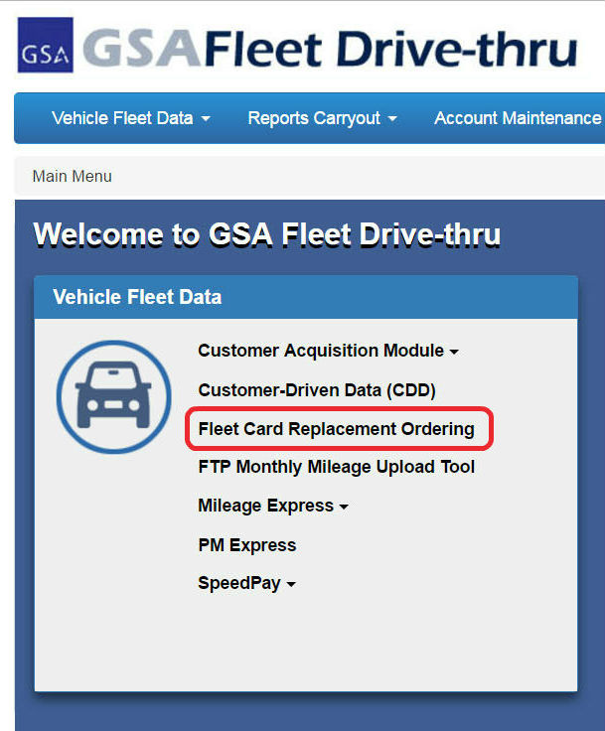
Fleet Service Card Replacement
Customers can order replacement Fleet Service Cards through GSA Fleet Drive-Thru
Next Day Service if ordered prior to 2:00 PM (EST)
Notes:
HOW TO ORDER REPLACEMENT CREDIT CARDS:
If your GSA Fleet “WEX" card is STOLEN, LOST, DAMAGED or if the magnetic strip is WORN OUT, please order a new WEX card through GSA’s *NEW* “WEX Replacement Card Ordering” module in GSA Fleet Drive-thru. Only agency personnel with access to GSA Fleet Drive-thru can order new cards.
• You can expect to see your new card within 3 business days of your request.
Special Note: Whenever a new card is ordered (regardless of the reason), the existing card is cancelled, so drivers need to ensure they have enough fuel to get “back home” OR they can call the WEX Customer Service # on the back of the card (1-866-WEX-4GSA - which translates to 1-866-939-4472) and they will approve fuel under the *new* card number OR they will issue the gas station a "one-time use Mastercard #" to process the transaction.
Mailing address required via UPS/FEdex
The WEX Replacement Card Ordering system has edits in place so that customers are only allowed to order replacement cards for vehicles assigned to their agency (this makes it unlikely for typo errors to occur). You can order more than one new card at a time and can type in different address “ship to” addresses if you choose.

Slide 19

Roadside Assistance/Warranties
Manufacturer Basic Warranty Provisions:
Call MCC or your FSR for additional powertrain or component warranties provided by the manufacturer
Manufacturer Roadside Assistance:
Please see the link for details
Roadside Assistance
Notes:
QUESTION: When do you call roadside assistance?
ANSWER: If your GSA vehicle is less than 3 years old AND has less than 36,000 miles on it, it is STILL UNDER WARRANTY and the manufacturer’s roadside assistance program will help in the following situations (AT NO CHARGE):
…if you break-down on the road OR if your vehicle is not running right (if the vehicle needs to be towed, roadside assistance will arrange to have the vehicle towed to the nearest dealer).
…if you need a jump start.
…if you run out of gas.
…if you lock your keys in your vehicle.
…if you have a flat tire. (Remember, most new cars do not have a spare tire and only have an inflation kit)
Roadside Assistance phone #s are found in the owner's manual in the glove box of your GSA vehicle. If you are driving a NEWER GSA vehicle (is less than 3 years old and has less than 36,000 miles on it), agencies are REQUIRED to call the manufacturers' Roadside Assistance # whenever they have a problem with that GSA vehicle (so that the manufacturer “picks up the tab” and not GSA).
All GSA vehicles are STILL UNDER WARRANTY if they are less than 3 years old AND have less than 36,000 miles on them.
DID YOU KNOW that most manufacturers also have Powertrain, Paint and “Goodwill” warranties? If you are noticing an engine or transmission problem on your older GSA vehicle, call MCC and maybe GSA can obtain some help under a power train warranty.
Paint peeling? Call MCC to have them possibly pursue warranty help on fixing it.
As a “fleet” customer of the manufacturers, GSA can quite often receive AFTER-WARRANTY or “Goodwill” warranty from them for various issues. Whenever you have a question or issue, call MCC or your FSR.
One important side note regarding roadside tows: TOWS needed for vehicles still under warranty must be called in to the manufacturers’ Roadside Assistance #s in order to be paid for BY the manufacturer. If GSA incurs tow charges due to Roadside Assistance NOT being called, GSA will recover those expenses from your agency. Please do not call WEX in these situations as they will send out the National Automobile Club and GSA will incur the fees (and subsequently your agency will incur the fees).

Slide 20

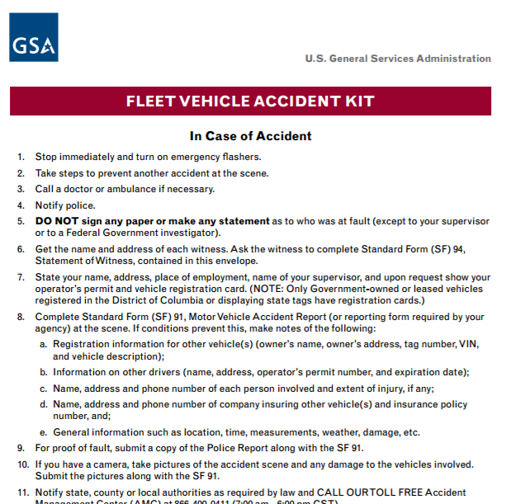
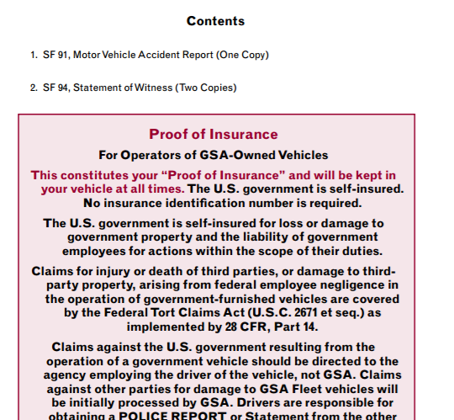
Reporting Accidents
Call AMC within 5 days of accident, 1-866-400-0411, option 2
Accident Reporting Kits:
In vehicle packet
SF91 Accident Report
SF94 Statement of Witness
Proof of Insurance
Notes:
Accident reporting kits are found in the glove box of every GSA vehicle. Instructions are found on the front of the packet and on the back of the packet, is a statement about “Proof of Insurance” (should your drivers ever be asked to provide this information). You can also print vehicle identification and proof of insurance cards in FMVRS https://fmvrs.fas.gsa.gov/fmvrs/fmvrs/
Once reports are completed the preferred method of submission is by emailing the reports and estimates to kc.amc@gsa.gov or atl.amc@gsa.gov (Presenter just mention the appropriate email for your location)
Within one (1) business day after the crash or incident, drivers should submit all reports and data to their supervisor. If the driver is injured, he/she should have the police notify a supervisor who will assume responsibility for reporting the crash or incident.
Within five (5) business days after the crash or incident, the driver or their supervisor must fax or email all documentation to the AMC.
The bottom of the kit also contains roadside assistance numbers…………..
IF at any time you require replacement accident packets, please contact your FSR.
After Hours Emergency for a disabled vehicle 1-866-939-4472 (see back of the assistance card)

Slide 21
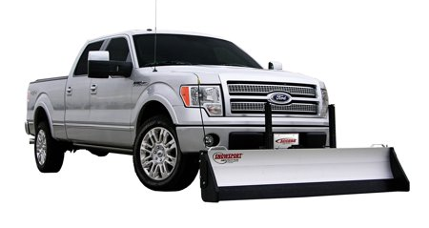
Accessory Equipment
Vehicle modifications require prior approval from GSA
Anything over $1,000 that is purchased by GSA will be capitalized as part of the vehicle
Decorative items, stickers, shrink wrap
Notes:
Installation of ANY accessory equipment or any modification on your GSA vehicle requires prior approval from GSA. Items such as: hitches, toppers, winches, grill guards, running boards, radios, light bars, lift gates and in particular any type of INTERIOR CARGO CAGES.
If agency desires to modify the vehicle, the agency is responsible for any damage that may occur and is also required to return the vehicle to its original condition.
Anything over $1,000 that is procured through GSA will become GSA owned equipment, and billed monthly (with optional equipment code).
Tire Upgrades or the purchase of snow tires are not considered accessory equipment and will be billed back to the customer.
Contact your FSR if you have any questions about what can or cannot be done to your GSA Fleet Vehicle.
Decorative Items
In accordance with 41 CFR 101-39.304, the addition of any decorative items to GSA Fleet vehicles must be approved by the Director, GSA, Office of Fleet Management. Contact your FSR for information. Requests should be submitted to your FSR or local Fleet Management Center for proper routing.

Slide 22
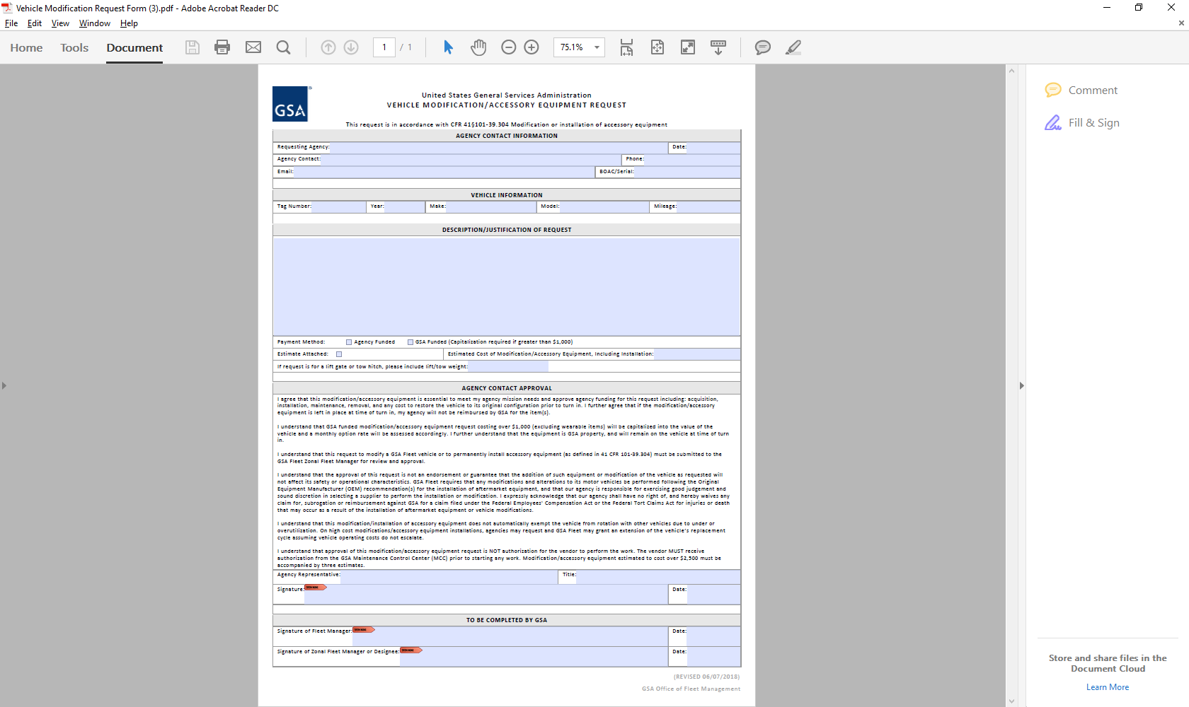

Vehicle Modification/Accessory Request Form
Description / Justification
Multiple vehicles if same
modification
Attach an estimate if possible
Tow hitch or Lift Gate
Digitally sign form
Not an authorization for work
Notes:
Here is the current Vehicle Modification / Accessory Equipment Form. Please contact your FSR for this form and for assistance in filling out this form.
Please completely fill out the top portion of the form to include a good description and justification of the modification or accessory equipment.
If you have multiple vehicles that are getting the same modification or accessory equipment (i.e. Three new pick up trucks all getting bed toppers) you can attach a listing of those vehicles and just do one form for several vehicles.
If you can, please obtain an estimate and attach it.
If you are requesting a tow hitch or a lift gate please include the tow or lift weight.
For ease of use, please digitally sign the form.
If this form is approved, it is NOT an authorization for the vendor to perform the work. The vendor MUST receive authorization from the GSA Maintenance Control Center (MCC) prior to starting any work. Modification/accessory equipment estimated to cost over $2,500 must be accompanied by three estimates.

Slide 23
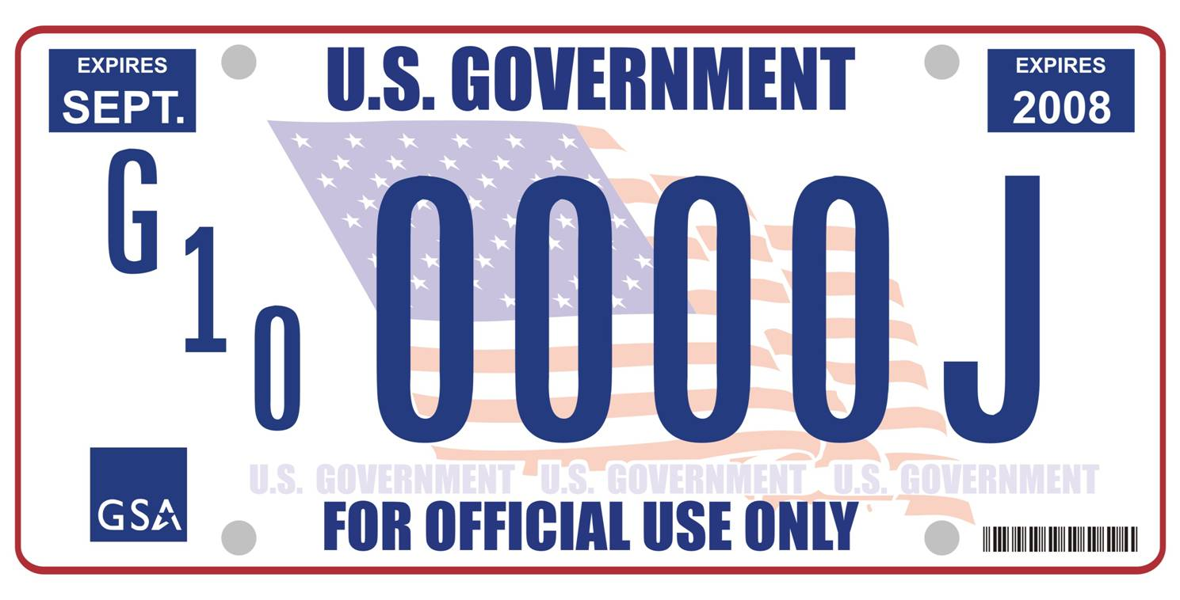
License Plates
Lost, Stolen or damaged license plates
  National security
  Contact FSR as soon as possible
  New plates and credit card will be issued
State Plates
  Must be requested in writing
  Return government license plates for destruction
Notes:
MISSING LICENSE PLATES are a matter of national security. Please check your vehicle frequently to make sure both plates are secured to the vehicle. If you discover your vehicle is missing a license plate, please report this to your FSR IMMEDIATELY. Your FSR will replace your existing plate(s) with a new set of plates and credit card. Also in the event of an accident, ensure both license plates are secured (i.e.: attached to vehicle or in your possession)
The process to register vehicles with state plates varies by state. In most cases the customer agency is required to perform the steps necessary for state plate registration and to pay the applicable fees assessed by the applicable state's department of motor vehicles. Agencies should check with their local FSR to verify each state’s requirements. Agencies are responsible for any costs associated with state plates.
Government license plates for a vehicle with state plates must be returned to GSA for destruction as they are a controlled item with national security implications. Exemptions for retaining Government license plates must be submitted and approved by the assigned FMC.

Slide 24
Accounts Receivable
All GSA Fleet Lease bills are due 30 or 45 days after bills are issued for non-federal or federal customers, respectively.
View and print bills from VCSS
Payment Options: Pay.gov, IPAC and SpeedPay easiest and most efficient way to pay Fleet bills!
Notes:
If there are no longer vehicles assigned to a Billing Office Address Code (BOAC), the agency remains responsible for payment to GSA to past bills, regardless of age.
In situations where GSA has agreed to bill a third party contractor directly and the contractor has failed to pay, the agency is still obligated to pay GSA Fleet the full amount due, including interest, penalties and administrative fees, regardless of current vehicle assignment and irrespective of the current status of the contract.
Effective immediately, GSA Fleet will not fund additional vehicles for any BOAC with bills outstanding for more than 90 days.
In accordance with Federal Property Management Regulation (FPMR) Subpart 101-39.3, GSA may withdraw issued vehicles when the using agency has not reimbursed GSA for vehicle services.
Access to STR and ability to order additional vehicles will be impacted if customer has outstanding bills as well.
Benefits of using pay.gov. check method.
- Instantaneous electronic transmittal and no need for snail mailing checks
- No chance at getting lost in the mail or encountering delays
- Payments don't pass through multiple hands
- No chance of a check getting misplaced
- Confirmation Email for accountability and record keeping
- Payment applied within 3-5 days of receipt
- Reduced chances of additional IP&A charges being applied while "the check is in the mail"

Slide 25
More Services & Solutions
AFV Guide
Dispatch Reservation Module
FedFMS
Short Term Rental (STR) Program
Law Enforcement Upfit Packages
Telematics
Vehicle Consolidations
VCSS
Notes:
Utilize this slide to interact / engage the audience. Select links where interest / more information is expressed. Each slide that is linked to will have a back button to return to this slide.

Slide 26

AFV Guide & Tool
Alternative Fuel Vehicle (AFV) Guide
  Searchable listing of all AFV and low
GHG configurations
  Includes summary of all current AFV
laws/mandates
www.gsa.gov/afv click “AFV Guides and Helpful Links”
Back
Notes:
AFV Guide: Listing of all AFV and low GHG configurations.
AFV Acquisition Tool:
It is an interactive tool that allows you to select and compare AFVs by SIN, fuel type, location, and other parameters. It lays out all of the acquisition costs versus leasing costs, provides fuel efficiency and emissions data, and the regulatory compliance position for each selected configuration.
You can select and compare up to 3 vehicles at a time in a very user friendly and appealing format.

Slide 27


FedFMS
Free online fleet management system
Available to all federal agencies
Agency owned vehicles
Meets FMR 102-34.340 requirement for federal
agencies to have a fleet management information system
Back
Notes:
FedFMS is designed to assist in the management of federal, agency-owned vehicles. Offered to federal agencies at no additional cost, this fleet management tool allows you to better control:
Cost;
Establish utilization criteria;
Manage fleet resources for maximum effectiveness and efficiency.
FMR 102-34.340 states that, a federal agency must have a fleet management information system at the department or agency levels that identifies and collects accurate:
Inventory;
Cost; and
Use data to cover the complete lifecycle of each motor vehicle.
GSA's FedFMS is a web-based fleet management system that identifies, collects, and analyzes motor vehicle data with respect to all costs incurred for the:
operation;
maintenance;
acquisition; and
disposition of motor vehicles.
FedFMS is open to all federal fleets and imports data from fleet card systems, thereby ensuring consistency across programs, while reducing redundant manual entry efforts. And to ensure a maximum level of data integrity, the system avails itself of automated data feeds directly from other GSA systems that house agency-owned vehicle data.
The FedFMS management tool provides you all the information necessary to satisfy regular reporting requirements such as the Federal Automotive Statistical Tool, Vehicle Allocation Methodology, and annual data calls from OMB. FedFMS is open now to all federal fleets at no additional cost. If you have agency-owned vehicles and a need for a fleet management system, FedFMS is the ideal solution.

Slide 28

Dispatch Reservation Module (DRM)
Online vehicle reservation system
Leased and agency owned (FedFMS) pool
Fleet management tool
Increased fleet utilization
Back
Notes:
The purpose of the DRM is to provide customer agencies with a fleet tracking system that will increase efficiency and productivity.
The Vehicle Dispatch and Reservation Module is a web-based application, meaning it’s accessed over a network connection, rather than existing within a device’s memory.
This system is accessible using any of the major web browsers (i.e., Google Chrome, Internet Explorer, etc.).
The look and feel resembles that of FedFMS, the FMVRS, and GSA Fleet Drive-thru; allowing the user to quickly become familiar with the various functionalities of the system.
More importantly, the DRM extracts and merges data from two different sources. For Agency-Owned assets the system pulls vehicle records and certain data elements from FedFMS, and for GSA Leased records, FMS and GSA Fleet Drive-thru. This process ensures the consistency and accuracy of data, while eliminating duplicate manual data entry to the greatest extent possible.

Slide 29


Short Term Rental
Vehicle & Equipment Rentals
  70+ types of vehicles
  500+ types of equipment
Vehicle & Equipment Offerings
  Utility trucks, scaffolding, new trailers, etc.
  Supply equipment at the project level
STR OnDemand
  Offers more flexibility
  Reserve at vendor’s website
gsa.gov/str
Back
Notes:
GSA Fleet has a Short Term Rental (STR) program available to our customers for short term needs for vehicles AND various equipment. The STR program was initially designed to provide temporary vehicles to agencies to temporarily replace vehicles down due to accident or mechanical repairs OR to temporarily fill the need for additional vehicles but has been expanded to also include various equipment.
To request a STR, simply register in our online system, WebSTR. You must know your assigned BOAC to register and make requests. You can also use the WebSTR system to track requests, accept quotes and view rental histories.
In FY ‘20, STR has an expanded range of pickup trucks including maintenance utility, and diesel, 1 tons designed specifically for towing. A new, expanded equipment BPA was awarded. Highlights include extended range boom lifts, an entire catalog of concrete tools and a range of trailer options.
“STR On-Demand” is an innovative product that allows customers to interact directly with a vendor’s website to schedule rentals. On-Demand will allow customers to name a generic period of performance and allow them to schedule vehicle rentals in real time at the vendor’s website, eliminating the need to cancel STR awards when dates change.
More information is available at www.gsa.gov/str
Please note: the STR program CANNOT be used for travel (TDY) purposes (TDY as defined by your agency).

Slide 30
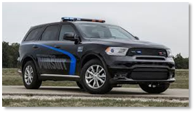
Law Enforcement Upfit Packages
Available on a range of vehicle types
Combination of upfit and special options provide multiple configurations
Equipment is factory installed
Meet Federal Motor Vehicle Safety Standards
Back
Notes:
Detailed information on each package available on Drivethru, under the customer guides drop down (“Law Enforcement Upfit Summary Fact Sheets”).
To simplify the process of ordering law enforcement vehicle upfit (LU) options, we created more pre-engineered packages. Agencies may select any compatible LU options (previously known as PUF packages) available from the manufacturers when ordering new vehicles. No substitution or deletion of equipment with an upfit package will be allowed. LU options will be published annually to assist agencies with making law enforcement upfit determinations. All LU options must be authorized by the leasing agency’s headquarters prior to the new vehicle being ordered. Please note that GSA Fleet will not purchase base or hand-held radios or laptops for customers. The responsibility for purchasing and installing these items lies solely with the customer agency.
All costs associated with the acquisition and installation of law enforcement equipment will be capitalized by GSA Fleet. An additional monthly lease rate for the LU will be charged to the customer using an optional equipment rate code. The optional equipment rate shall be applied to the vehicle for the entire duration of the vehicles assignment. This is the only option for paying for the LU Option packages obtained through GSA Fleet. Lump sum payments will not be accepted, either upfront or via an Agency Incurred Expense (AIE).
Asset Management: GSA Fleet-owned law enforcement equipment will be part of GSA Fleet assets. Maintenance will be handled by GSA Fleet through the Maintenance Control Center.
Damage to the vehicle and/or equipment due to installation, removal, or equipment malfunction will be GSA Fleets responsibility. Any mechanical or body damage to the vehicle or equipment as a result of abuse or neglect, as well as any missing GSA Fleet-owned equipment as defined in GSA Fleets Customer Leasing Guide and Agency Incurred Expense (AIE) Guide, will be the leasing agencies’ financial responsibility and handled via an AIE. As with the vehicle, agencies must be aware of the equipment’s warranty and utilize vendors that can repair the equipment under warranty. If agencies are uncertain about the warranty coverage, or where to take vehicles for repair, agencies should contact the Maintenance Control Center to determine available coverage and which vendors can provide the warranty work.
Agency-Owned Upfits: As an alternative to GSA Fleet acquiring the LU upfit, agencies will still be able to upfit GSA Fleet-leased vehicles with agency-owned aftermarket law enforcement equipment. The equipment would be owned by the agency and must be treated as an agency asset. Agencies will need to follow internal agency procedures for determining if capitalization is appropriate. As has been the case, prior authorization from GSA Fleet is required to modify any vehicle. Agencies must submit a written request describing the requested equipment and installation to the servicing Fleet Management Center.
Prior to installation, agencies must ensure that any aftermarket upfit meets the following criteria:
● Is performed in accordance with the manufacturers technical guide(s) for aftermarket upfit procedures;
● Is performed by a qualified shop, whether a local upfitter or an agency facility, after vehicle delivery occurs;
● Does not void the vehicle’s warranty; and
● Does not impact the safety or operation of the vehicle.
Maintenance will be the physical and financial responsibility of the owning agency, and done in accordance with the agency’s operational procedures. Agency-owned law enforcement equipment is an agency asset and damage to the equipment for any reason is the agency’s responsibility. Any mechanical or body damage to the vehicle as a result of the installation, use, or removal of agency-owned law enforcement equipment will be agency’s financial responsibility and handled via an AIE.
Equipment owned by the agency must be removed from the vehicle prior to turn-in. If a vehicle is turned in with agency-owned law enforcement equipment, GSA Fleet may determine that the equipment has been abandoned and handle the situation pursuant to existing regulations and the best interests of the taxpayer. Any costs incurred by GSA Fleet are the financial responsibility of the agency and handled via an AIE.

Slide 31

Telematics
GSA Fleet Telematics Is The Only Fully-integrated, FedRAMP Approved, Cradle-to-grave Managed, Shared Government Service, Telematics Program In The Federal Government
Dual subscription, multi-stream model
  GSA Fleet receives its data and customer agency receives their data from same device
Customer agency opt-in for expanded data, standard service provided with leasing rate
Authorization (Moderate)
New vehicles will have devices installed at vehicle exchange sites
Retrofit process possible for existing leased inventory
Visit www.gsa.gov/telematics for latest updates
Back
Notes:
Telematics has quickly become the standard for fleet management within the industry. Private and public sector fleets have widely adopted telematics to their fleets in order to receive accurate reporting data, better utilization rates, and vehicle engine diagnostics. For this reason, GSA Fleet has created the only fully-integrated, FedRAMP approved, cradle-to-grave managed, shared government service, telematics program in federal government.
Additionally, to ensure data integrity and compliance with OMB mandated FedRAMP certification for cloud based services, we are no longer approving modification requests for 3rd party telematics services for GSA leased vehicles. We ask existing contracts for telematics services be closed out and future inventory not be ordered as FY21 orders will arrive with GSA Fleet telematics devices pre-installed. Any detected removal of these devices could cause the issuance of agency incurred expenses.
This unique BPA was structured to allow GSA Fleet leased customers to opt-in to their own telematics subscription with the provider. While GSA Fleet is the primary user, the multi-stream functionality of the service allows for customers to have their own databases on leased vehicles. GSA Fleet will only see the automated mileage and engine diagnostic data, while customers will receive the full suite of services this program offers. GSA Fleet will not receive any location data on customer vehicles. Only customers can activate GPS features on their own subscriptions. Please see the Telematics Fact Sheet at GSA.gov/telematics for a full listing of what the subscription covers.
GSA Fleet’s primary use for telematics will be automated mileage data for FAST reporting purposes, and engine diagnostics for creating better maintenance schedules for vehicles. Additional uses will be for receiving better post-accident data for GSA Fleet Accident Management Centers, and potentially identifying areas for increased efficiency and utilization for customers. This standard service is included in the leasing rate for the vehicle. The advanced data service subscription will always be optional for leasing customer agencies.
The service has received and is maintaining FedRAMP Moderate cybersecurity certification. The service also hold the highest Data at Rest/Data in Rest standard, and cryptologic modules in the industry.
All eligible FY21 new orders will have the devices installed at marshaling network locations. Our marshalling network has been provided training resources to conduct these installations and informed of any previously decided exemption decisions.
Finally, retrofit orders for existing inventory without telematics can be entertained. If you have any questions/concerns, please reach out to us at fleetsolutions@gsa.gov

Slide 32

Consolidating Vehicles
Transfer agency owned vehicles to GSA Fleet
No capital requirement & smoother budgeting
Vehicles are typically replaced over a 5 year period
Safer, more reliable fleet
Reduce agency fleet administrative costs/burden
Enjoy the benefits of being a GSA full service customer
Back
Notes:
The ownership of the vehicles are transferred to GSA Fleet leasing and the consolidating agency immediately being paying the applicable lease rates for those vehicles.
As those vehicles become eligible for replacement, based on the GSA Minimum Replacement Criteria, they will be replaced during the normal GSA Fleet acquisition cycle.
The standard arrangement is a 5 year replacement cycle, replacing roughly 20% of the vehicles each year as the become eligible. This is highly dependent on the fleet profile of the vehicles that are being consolidated, and a mutually agreeable timeline will be discussed and agreed upon prior to the start of the consolidation.
Acquisition:
We handle vehicle acquisition during our annual procurement cycle. We have a large selection of vehicles available to meet your mission and provide advice to our customers on vehicle selection. We have knowledgeable engineers for technical questions along with strong relationships with the OEM manufacturers and industry expertise .
Financial:
Our leasing rates INCLUDE:
● authorized fuel (lowest priced fuel available)
● routine maintenance (i.e. oil changes, fluids, filters, tire repairs, etc.)
● most mechanical repairs , brake jobs and tire replacements (if not abuse, neglect or unauthorized)
● other vehicle related purchases (i.e. quart of oil, wiper blades, windshield fluid, car washes)
● depreciation AND, of course,
● brand new replacement vehicles!
Allows for more predictable budget planning with no large capital outlays and lower financial risks.
Administrative:
Reduced overhead and administrative burden.
Remarketing:
At the end of the leased vehicle’s life, GSA Fleet sells the used vehicle at commercial public auctions.

Slide 33

Vendor and Customer Self Service (VCSS)
Registered users receive monthly e-mail notifications to download bill.
Registration or password issues,
contact the VCSS helpdesk.
Training available, ask your FSR!
Back
Notes:
*PLEASE remember the following about VCSS access:
1. Your GSA Fleet Svc Rep cannot help you with your access issues, these must be resolved by the OCFO Service Desk.
2. Please log in EVERY MONTH to pull your bill copy.
3. Passwords expire every 90 days, so please pay attention to notices on the VCSS home page.
4. Your security questions MUST be set-up in order to maintain access.
Ensure at least two people in your organization have access to VCSS (just in case of personnel turnover).
If at any time you have VCSS access, username or password issues, you must contact the following: GSA OCFO Service Desk at 1-866-450-6588. This number is found on the Contact Us tab on the VCSS home screen.
FOR MORE SPECIFIC, TARGETED VCSS TRAINING, your FSR can provide this service as needed and upon request.

Slide 34

Fleet Electrification Updates
E.O. 14057: Catalyzing America’s Clean Energy Economy Through Federal Sustainability
  100% light-duty acquisitions by 2027 must be zero-emission
  100% all acquisitions by 2035 must be zero-emission
  E.O. Fact Sheet, Official Release, & Memo.
Bipartisan Infrastructure Investment & Jobs Act directs $7.5B of public or private investment in electric vehicle charging infrastructure to states. Pushes for station standards (link).
Notes:
These are acquisition goals, this doesn’t mean that 100% of your inventory will be ZEVs by these dates. GSA will continue to replace vehicles according to the established timelines.
As we are all aware, supply chain issues are severely impacting the vehicle industry right now, and ZEV models are not yet available for every vehicle type. While GSA and our partners at the White House are working with suppliers to increase availability, the immediate focus is on replacing those vehicle types where ZEV models are available and can meet your agency missions.

Slide 35

FY2022 Progress
GSA is providing a path for E.O. 14057 ZEV goals to be achieved
By End of FY22:
Increased the number of ZEV offerings available
Increased the number of ZEVs acquired by the federal fleet
Provided a streamlined solution for ZEV charging stations and ancillary services
FY22: 62
FY21: 34
82% Increase
3,427 ZEVs Ordered
432% Increase*
16 awarded BPAs
1,165 products
30 EVSE brands
Current Achievements:
*YTD as of 7/31/22 as compared to total FY21 Governmentwide Purchases

Slide 36
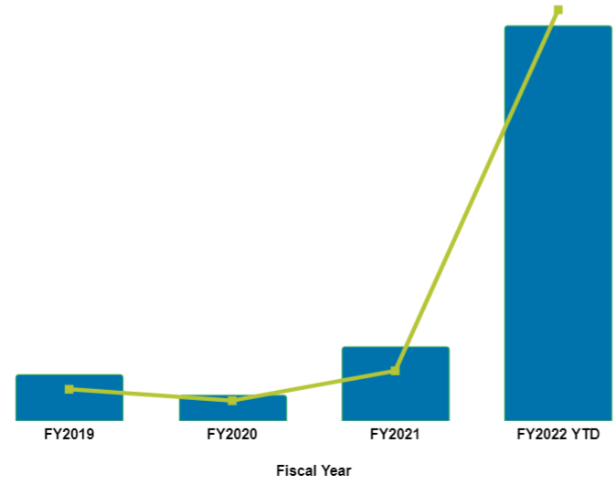
ZEV Acquisitions
3,427
11.16%
more than 3,400 orders for zero-emission vehicles have been placed as of July 31
that’s over 11% of all new acquisitions
these ZEV’s will require support for acquiring charging infrastructure
643
397
1.36%
0.86%
222
0.55%

Slide 37
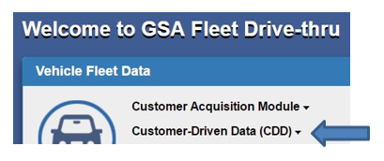
Planning for Charging Stations
Please update your full and complete vehicle garage addresses
in GSA Fleet Drive-thru!
Log in to GSA Fleet Drive-thru
Click “Customer-Driven Data (CDD)” and “Report Customer-Driven Data (CDD)”
Enter your Vehicle Tag Number and select “Search”
Verify or add the street address, city and state of where the vehicle parks and select “Update”
Use the “CDD Upload Tool” feature under the “Customer-Driven Data (CDD)” menu to update multiple vehicles at once.

Slide 38
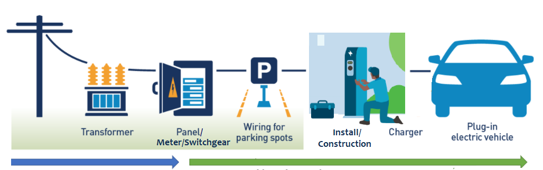
Infrastructure Development
Government-wide Offerings
GSA provides contract for make-ready EV charging stations, services and upgrades
GSA PBS provides contracts for installation & policy on requesting stations
GSA Fleet provides electric vehicles and contracts for EV charging stations
Utility-side EVSE make-ready
Agency or GSA-side EVSE make-ready
(PBS manages install GSA controlled facilities)
See local electrification incentives available to federal drivers at gsa.gov/evse

Slide 39
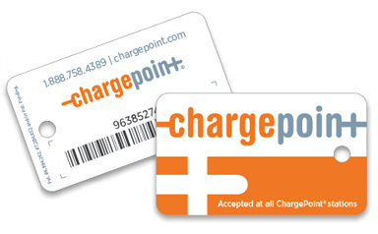

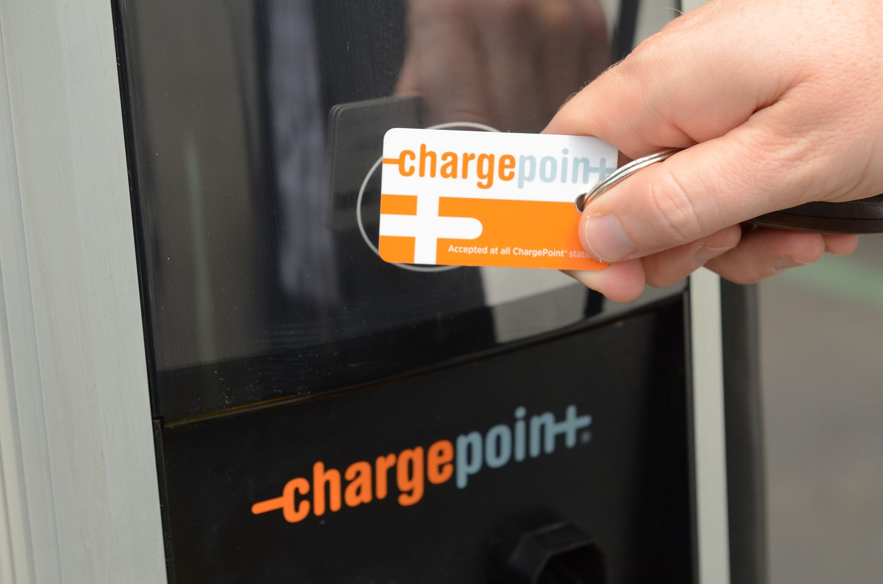


Public Charging
ChargePoint RFID cards can be connected to WEX cards for use at public ChargePoint stations or any of ChargePoint’s roaming partners including EVBox, EVgo, flo, evconnect, and greenlots/Shell Recharge.
Costs are covered in lease rates
Agencies that lease from GSA can request a WEX connected ChargePoint card from GSAFleetAFVTeam@gsa.gov

Slide 40
Fleet Electrification Resources
For questions about zero-emission vehicles, the EVSE BPAs, or general fleet electrification questions, contact GSAfleetAFVteam@gsa.gov
For questions about EVSE installation projects, contact PBS-EVSE-solutions@gsa.gov
More information and resources available at gsa.gov/ElectrifyTheFleet

Slide 41

THANKS!
We value your feedback and appreciate your continued support.

