Slide 1
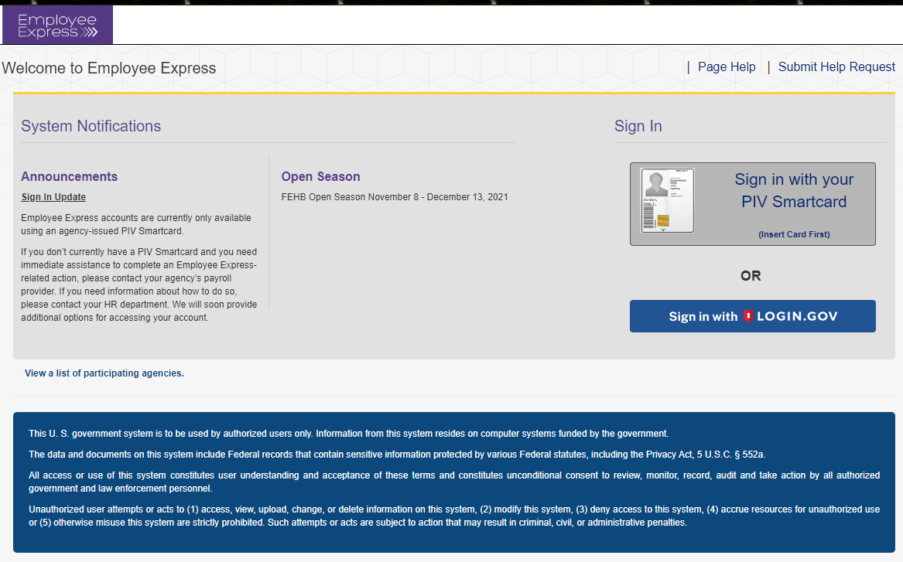
EEX/LOGIN.GOV
EMPLOYEE EXPRESS
THE NEW WAY OF SIGNING IN
You will have two methods to sign into EEX
Sign in with PIV Card
Sign in with Login.gov

Slide 2
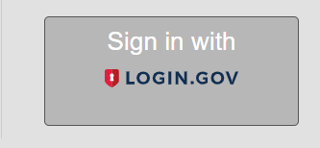
Signing in with Login.Gov
This method will require Two Security Codes from Login.gov
If you select Login.gov ……..

Slide 3
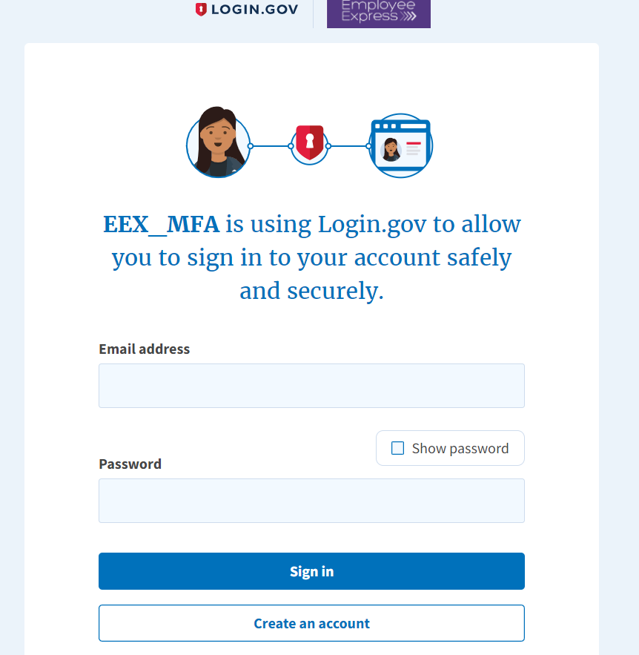
If YOU have an EXISTING Login.gov YOU can use that account and do not have to create a new account. Simply enter that account and sign in.
You will be directed to the “Create An Account” page
Enter your email address
Click create an account

Slide 4
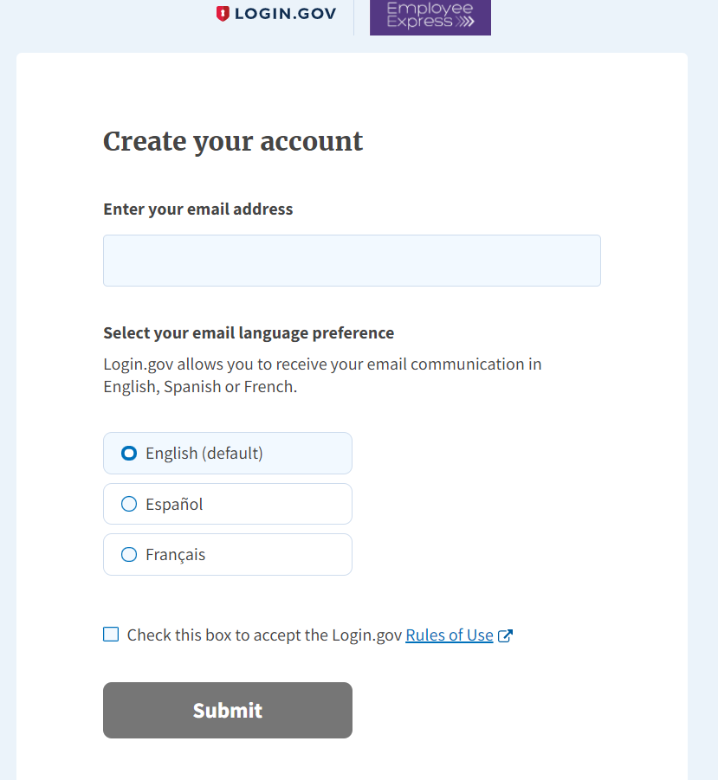
Enter you Email Address
Select your Language Preference
Be sure to check the box “Accept the Login.gov Rules of Use”
Then click “Submit”
Enter you email address
Select your email language
You must check this box
Click “Submit”

Slide 5
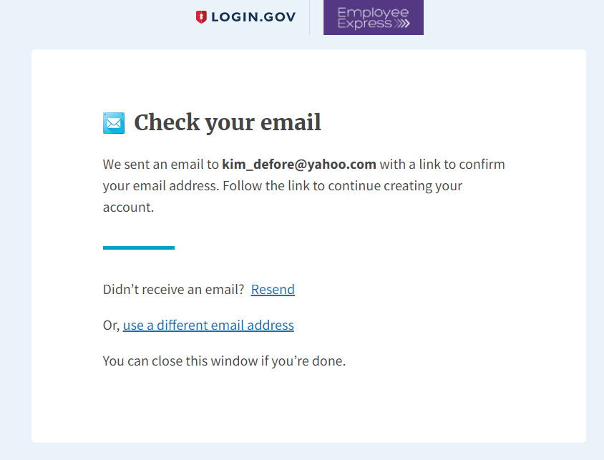
You will receive an email to the email address you entered for your account set-up

Slide 6
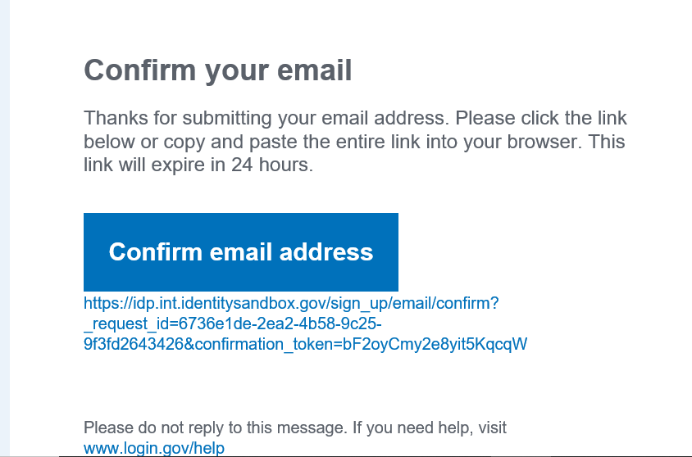


This link is only good for 24 hours
You will need to confirm your email by clicking on the blue “Confirm Your Email” box

Slide 7
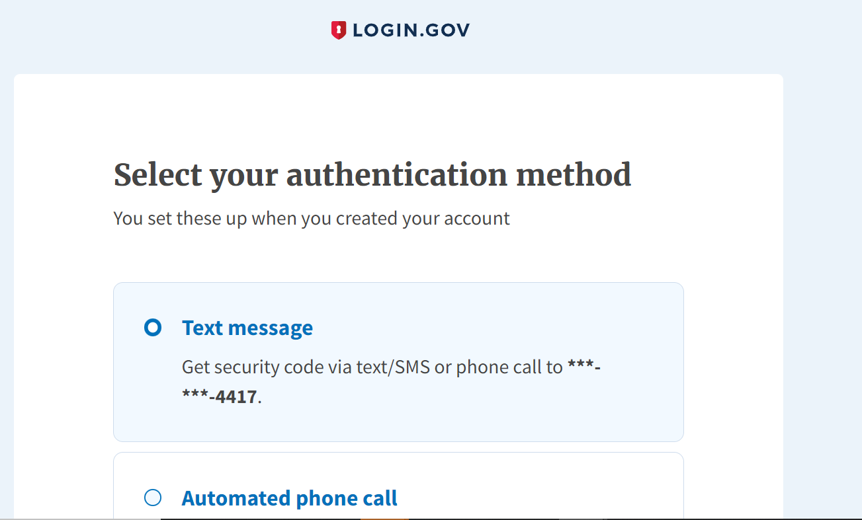
You can choose 1 of the 4 authentication methods

Slide 8
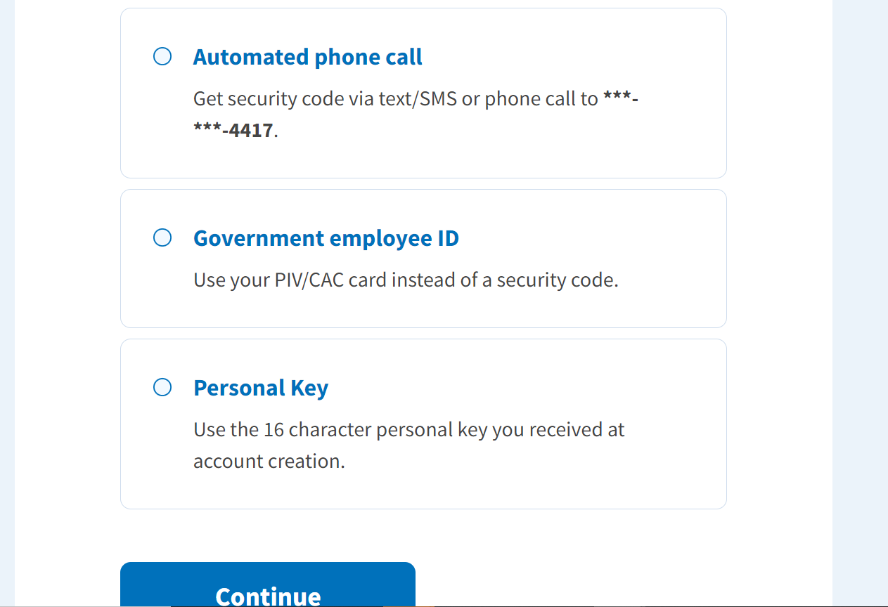
Then click the “Continue” button

Slide 9
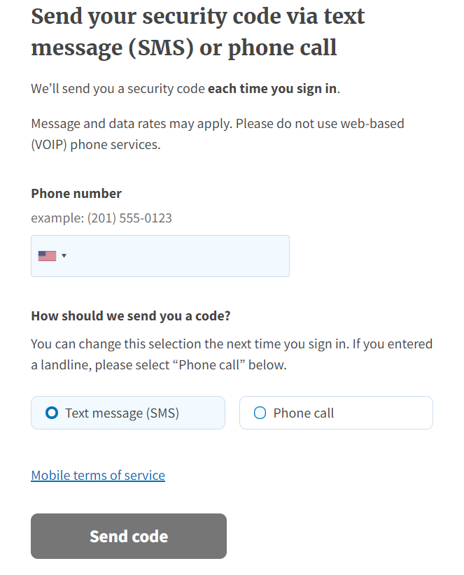
Type in phone number
Click Text Message
Click “Send Code”

Slide 10
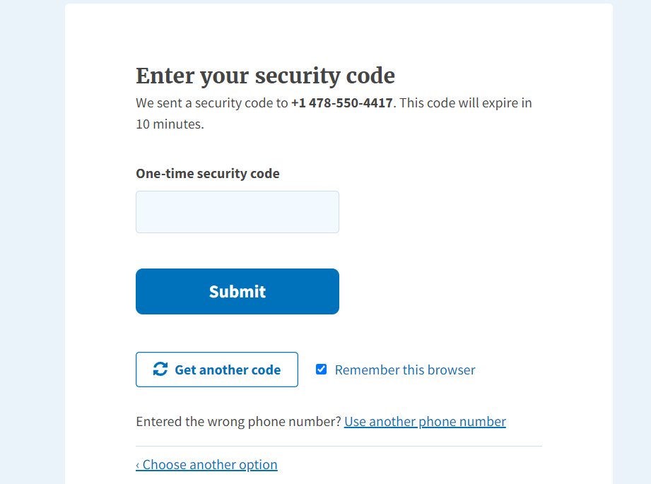
Type in One Time security Code -1st Security Code
Click Submit

Slide 11
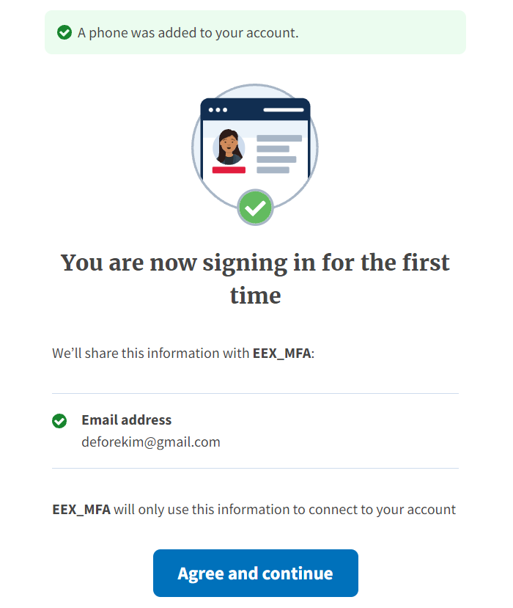
Click “Agree and Continue”

Slide 12
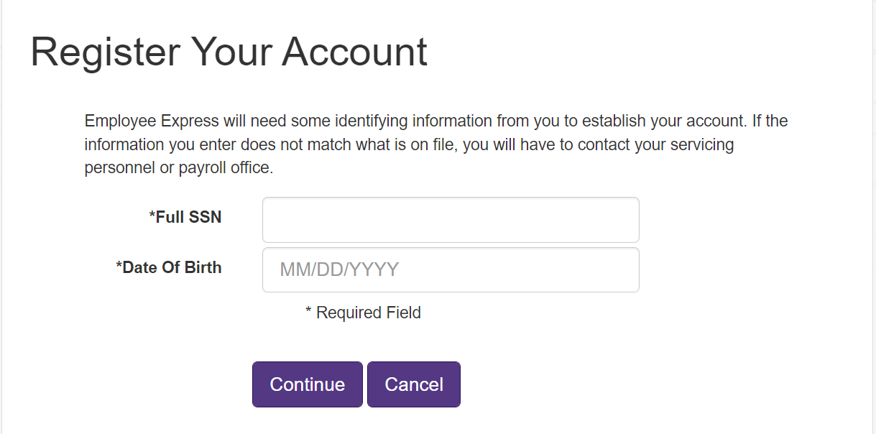
Enter your full SSN
Enter DOB as Shown

Slide 13
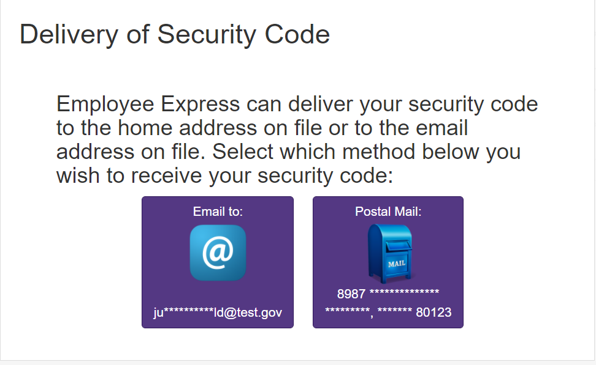
A Security code will be generated and sent to you to confirm your identity
Make your selection
I selected email

Slide 14
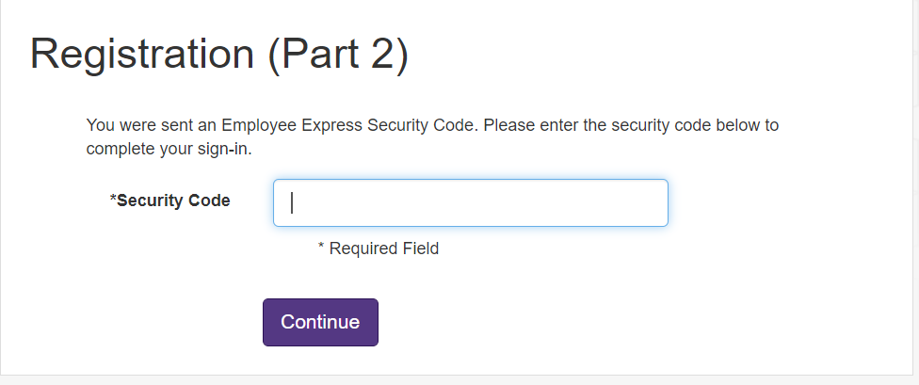
EEX will detect that you have not entered your 2nd security code to display this screen.
Enter the Security Code sent via mail or email – 2nd Security Code

Slide 15
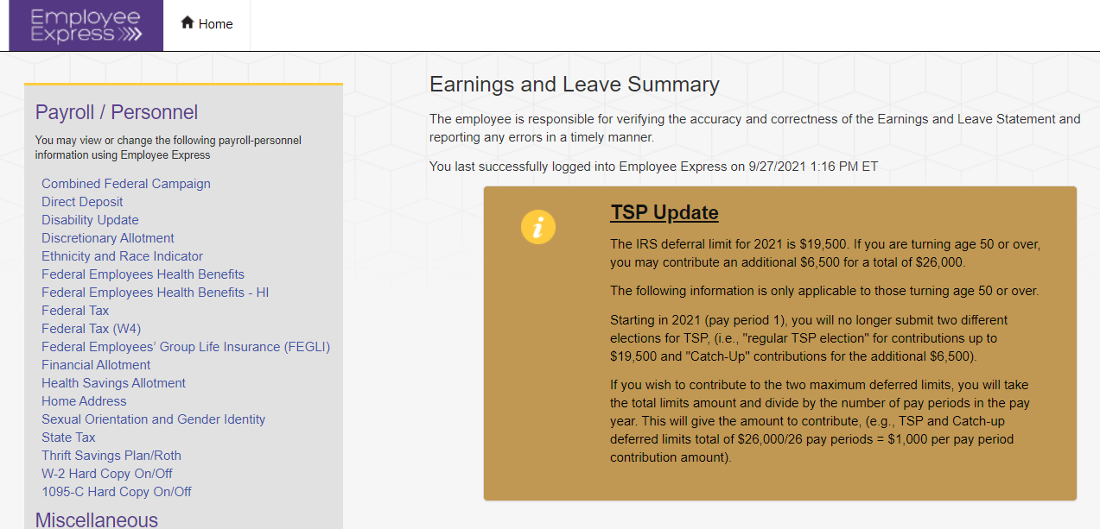
You are in your Employee Express Account
You are now in your account using Login.gov

Slide 16
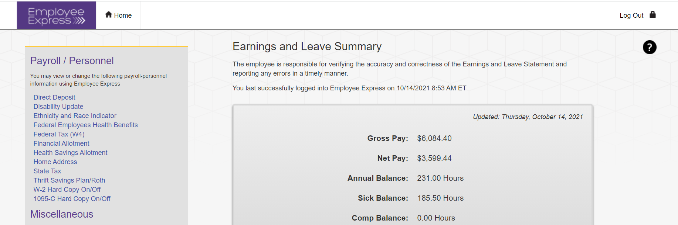
Always click the log out link to close your Session and Protect your data

