Slide 1

Welcome
DOD Cybersecurity Maturity Model Certification (CMMC): What Every Small Business Needs to Know
Welcome
DOD Cybersecurity Maturity Model Certification (CMMC): What Every Small Business Needs to Know

Slide 2


INTRODUCING TODAY’S PRESENTERS
Melinda Woods, Director of Industry, Innovation & Analysis, Eccalon
Kareem Sykes, Program Manager, Project Spectrum

Slide 3
What is Project Spectrum?
Project Spectrum is a DOD-sponsored initiative that provides companies, institutions, and organizations with a comprehensive, cost-effective platform of cybersecurity information, resources, tools, and training. Our mission is to improve cybersecurity readiness, resiliency, and compliance of small/medium-sized businesses and the Defense Industrial Base (DIB) manufacturing supply chain through:
Policy guidance
A customized dashboard for monitoring cybersecurity progress
Expert analysis and intelligence from senior cyber advisors
Educational courses and materials
Tool and platform reviews
Customized cybersecurity compliance plans
Cybersecurity Maturity Model Certification (CMMC) preparedness training

Slide 4
Federal Policy Compliance
2019 National Defense Authorization Act (NDAA)
  Section 1644: Assistance for small manufacturers in the defense industrial supply chain and universities.
2021 National Defense Authorization Act
  Section 1724: Responsibility for cybersecurity and critical infrastructure protection of the defense industrial base.
  Section 1738: Assistance for small manufacturers in the defense industrial supply chain on matters relating to cybersecurity.
We offer compliance with existing Defense Federal Acquisition Regulation Supplement (DFARS) regulations
  2019-D041 Interim Rule and its associated clauses (252.204-7008, 252.204-7012, 252.204-7019-21).
  Regulations require compliance with National Institute of Standards and Technology (NIST) Special Publication (SP) 800-171 for the safeguarding of defense-relevant information and cyber incident reporting. ​
Notes:
NDAA Language:
SEC. 1724. RESPONSIBILITY FOR CYBERSECURITY AND CRITICAL INFRASTRUCTURE PROTECTION OF THE DEFENSE INDUSTRIAL BASE. (a) CRITICAL INFRASTRUCTURE DEFINED.—In this section, the term ‘‘critical infrastructure’’ has the meaning given such term in section 1016(e) of the Uniting and Strengthening America by Providing Appropriate Tools Required to Intercept and Obstruct Terrorism (USA PATRIOT ACT) Act of 2001 (42 U.S.C. 5195c(e)). (b) DESIGNATION.—The Secretary of Defense shall designate the Principal Cyber Advisor of the Department of Defense as the coordinating authority for cybersecurity issues relating to the defense industrial base. (c) RESPONSIBILITIES.—As the coordinating authority for cybersecurity issues relating to the defense industrial base, the Principal Cyber Advisor of the Department of Defense shall synchronize, harmonize, de-conflict, and coordinate all policies and programs germane to defense industrial base cybersecurity, including the following: (1) The Sector Specific Agency functions under Presidential Policy Directive-21 the Department of Defense has assigned to the Under Secretary of Defense for Policy for implementation. (2) The Under Secretary of Defense for Acquisition and Sustainment’s policies and programs germane to contracting and contractual enforcement as such relate to cybersecurity assessment and assistance, and industrial base health and security. (3) The Under Secretary of Defense for Intelligence and Security’s policies and programs germane to physical security, information security, industrial security, acquisition security and cybersecurity, all source intelligence, classified threat intelligence sharing related to defense industrial base cybersecurity activities, counterintelligence, and foreign ownership control or influence, including the Defense Intelligence Agency and National Security Agency support provided to the Department of Defense – Defense Industrial Base Collaborative Information Sharing Environment and cyber intrusion damage assessment analysis as part of defense industrial base cybersecurity activities. H. R. 6395—725 (4) The Department of Defense Chief Information Officer’s policies and programs for cybersecurity standards and integrating cybersecurity threat intelligence-sharing activities and enhancing Department of Defense and defense industrial base cyber situational awareness. (5) The Under Secretary of Defense for Research and Engineering’s policies and programs germane to protection planning requirements of emerging technologies as such relate to cybersecurity assessment and assistance, and industrial base health and security. (6) Other Department of Defense components’ policies and programs germane to the cybersecurity of the defense industrial base, including the policies and programs of the military services and the combatant commands. (d) ADDITIONAL FUNCTIONS.—In carrying out this section, the Principal Cyber Advisor of the Department of Defense shall— (1) coordinate or facilitate coordination with relevant Federal departments and agencies, defense industrial base entities, independent regulatory agencies, and with State, local, territorial, and Tribal entities, as appropriate; (2) facilitate or coordinate the provision of incident management support to defense industrial base entities, as appropriate; (3) facilitate or coordinate the provision of technical assistance to and consultations with defense industrial base entities to identify cyber or cyber-physical vulnerabilities and minimize the damage of potential incidents, as appropriate; and (4) support or facilitate the supporting of the statutorily required reporting requirements of such relevant Federal departments and agencies by providing or facilitating the provision to such departments and agencies on an annual basis relevant critical infrastructure information, as appropriate. (e) DEPARTMENT OF DEFENSE ROLES AND RESPONSIBILITIES.— No later than 180 days after the date of the enactment of this Act, the Secretary of Defense shall brief the Committees on Armed Services of the Senate and the House of Representatives on the following issues: (1) A plan for implementation of this section, including an assessment of the roles and responsibilities of entities across the Department of Defense and mechanisms and processes for coordination of policy and programs germane to defense industrial base cybersecurity. (2) An analysis of the feasibility and advisability of separating cybersecurity Sector Specific Agency functions under Presidential Policy Directive-21 from non-cybersecurity Sector Specific Agency functions. (3) Regarding the non-cybersecurity Sector Specific Agency functions the Department has assigned to the Under Secretary of Defense for Policy for implementation, the implications of reassigning such responsibilities to the Under Secretary of Defense for Acquisition and Sustainment.
SEC. 1738. ASSISTANCE FOR SMALL MANUFACTURERS IN THE DEFENSE INDUSTRIAL SUPPLY CHAIN ON MATTERS RELATING TO CYBERSECURITY. (a) IN GENERAL.—Subject to the availability of appropriations, the Secretary of Defense, in consultation with the Director of the National Institute of Standards and Technology, may award financial assistance to a Center for the purpose of providing cybersecurity services to small manufacturers. (b) CRITERIA.—If the Secretary carries out subsection (a), the Secretary, in consultation with the Director, shall establish and publish on the grants.gov website, or successor website, criteria for selecting recipients for financial assistance under this section. (c) USE OF FINANCIAL ASSISTANCE.—Financial assistance under this section— (1) shall be used by a Center to provide small manufacturers with cybersecurity services, including— (A) compliance with the cybersecurity requirements of the Department of Defense Supplement to the Federal Acquisition Regulation, including awareness, assessment, evaluation, preparation, and implementation of cybersecurity services; and (B) achieving compliance with the Cybersecurity Maturity Model Certification framework of the Department of Defense; and (2) may be used by a Center to employ trained personnel to deliver cybersecurity services to small manufacturers. (d) BIENNIAL REPORTS.— (1) IN GENERAL.—Not less frequently than once every two years, the Secretary shall submit to the congressional defense committees, the Committee on Commerce, Science, and Transportation of the Senate, and the Committee on Science, Space, and Technology of the House of Representatives a report on financial assistance awarded under this section. (2) CONTENTS.—To the extent practicable, each report submitted under paragraph (1) shall include the following with respect to the years covered by each such report: (A) The number of small manufacturers assisted. (B) A description of the cybersecurity services provided. (C) A description of the cybersecurity matters addressed. (D) An analysis of the operational effectiveness and cost-effectiveness of such cybersecurity services. (e) TERMINATION.—The authority of the Secretary to award financial assistance under this section shall terminate on the date that is five years after the date of the enactment of this section. (f) DEFINITIONS.—In this section: H. R. 6395—743 (1) CENTER.—The term ‘‘Center’’ has the meaning given such term in section 25(a) of the National Institute of Standards and Technology Act (15 U.S.C. 278k(a)). (2) SMALL MANUFACTURER.—The term ‘‘small manufacturer’’ has the meaning given such term in section 1644(g) of the John S. McCain National Defense Authorization Act for Fiscal Year 2019 (Public Law 115–232; 10 U.S.C. 2224 note).

Slide 5
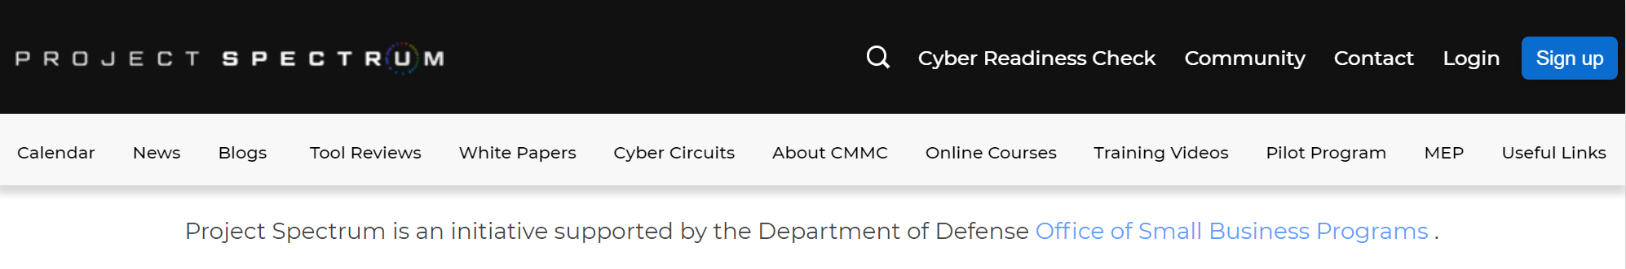
Journey to CMMC Level 1 Compliance
1
2
3
4
5
6
Register for Project Spectrum
Participate in a CMMC Level 1 webinar
Watch training videos for CMMC Level 1 domains
Complete CMMC Level 1 online course
Take the CMMC Level 1 Readiness Check
Apply for CMMC Level 1 certification
5
1
2
6
4
3

Slide 6
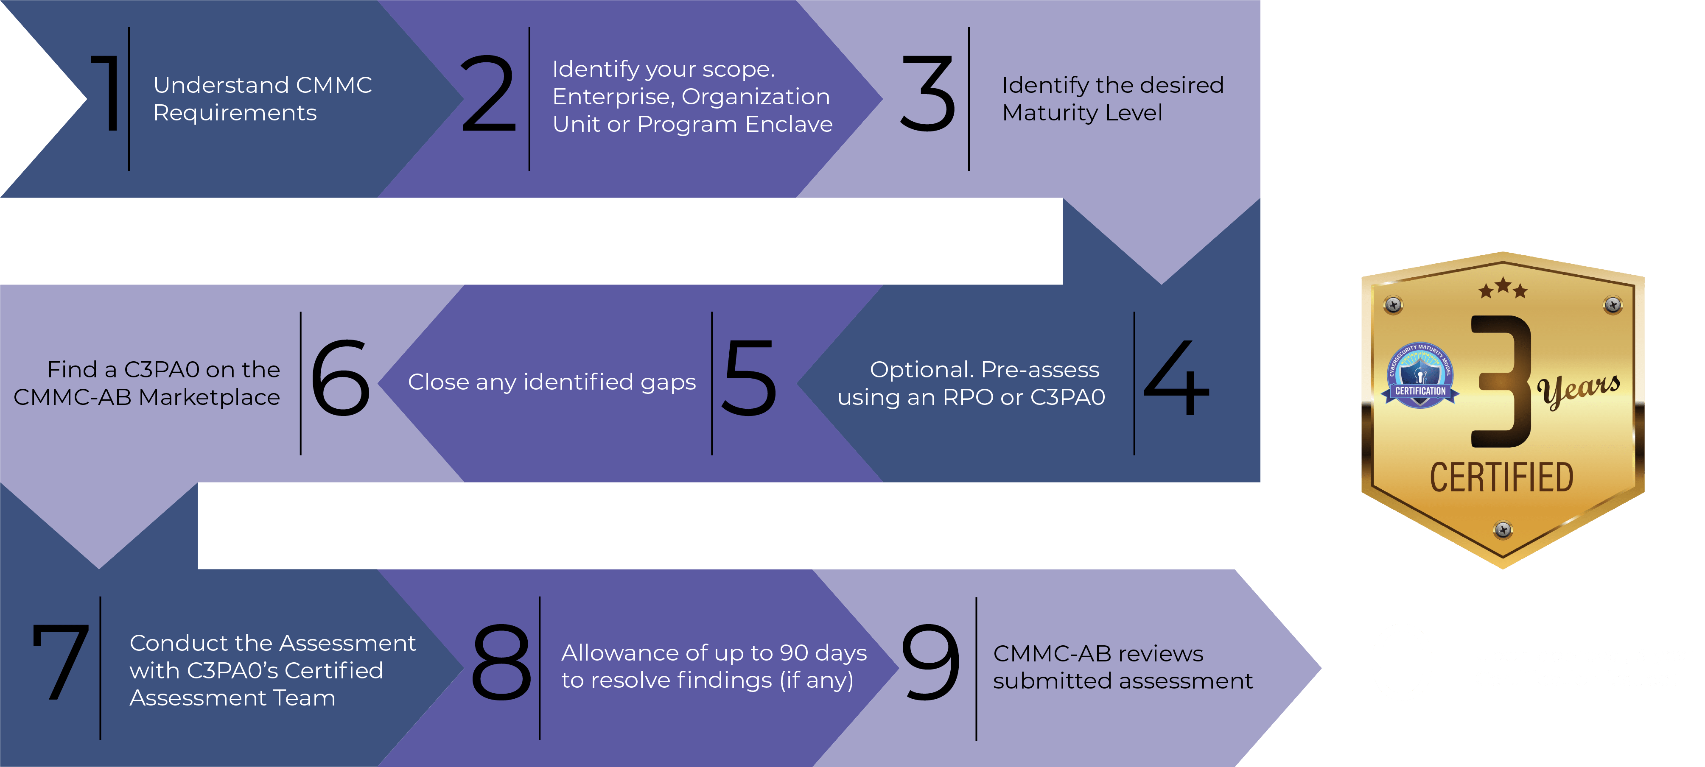

Project Spectrum CMMC Preparedness Training & Self Assessment
Project Spectrum prepares small businesses to engage in the CMMC process.
Source: www.cmmcab.org/osc-lp

Slide 7
Partnerships & Collaborations
Project Spectrum shares information and collaborates with military services, agencies and programs. We provide direct industrial base cybersecurity support to businesses specializing in the following:
  Advanced manufacturing
  Ship maintenance
  Data and analytics
  Education and training
  Weapons system integration
  Radars and sensors
  Information systems engineering
  Application development

Slide 8



Project Spectrum Collaborations
CYBERSECURITY HYGIENE AND TRAINING
SELF-DIRECTED CYBERSECURITY PLATFORM FOR MANUFACTURERS
UPCOMING:
FOR ALL SMALL BUSINESS

Slide 9
Mentor-Protégé Program
The U.S. Department of Defense (DoD) Mentor-Protégé Program (MPP) helps small businesses (Protégés) successfully compete for contract awards by partnering with large companies (Mentors) under individual, project-based agreements lasting two years or less.
Mentor-Protégé Agreements (MPAs) provide business infrastructure developmental assistance and technology transfer.
Examples of developmental assistance include human resources training, business development initiatives, capture management and proposal development training, or DCAA-compliant accounting system implementation training.
Technology transfer can include implementation of specific technology that will provide a benefit to a DoD program, such as quality management systems or certifications.

Slide 10
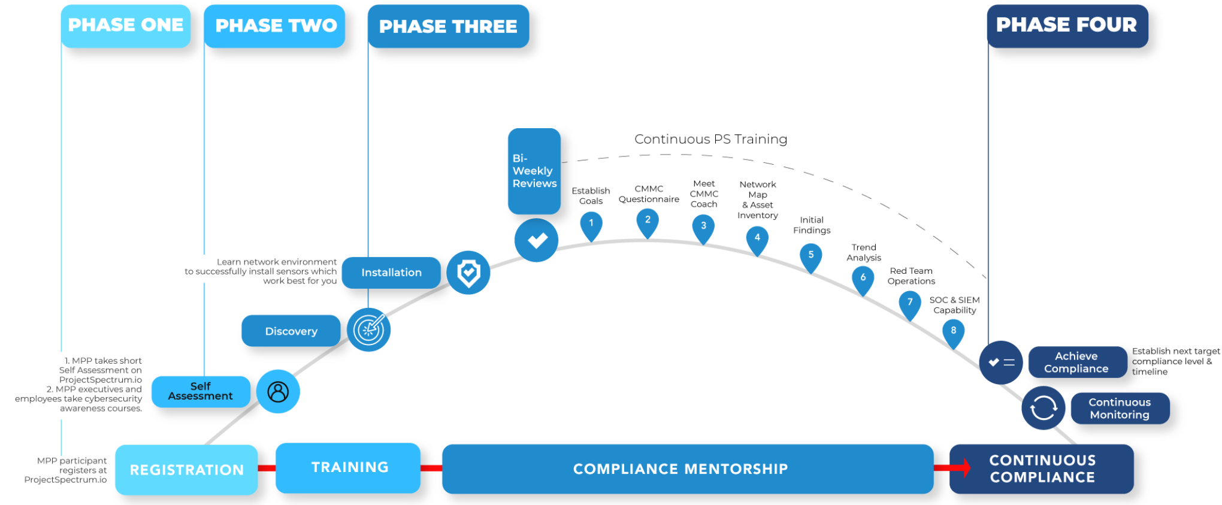
Cybersecurity for Defense Industrial Base MPP Pilot Program

Slide 11
MPP Cybersecurity Pilot Program Objectives
Enroll DoD MPP participants and other select companies.
Target the Research and Development, Manufacturing, and Knowledge-based Service sectors.
Accept companies that possess the necessary commitment and capital to respond to vulnerabilities identified by the program.
The OSD Office is strongly considering expanding the Pilot program to those with agreements from prior years or otherwise designated by DoD through sponsoring components and agencies.
The Pilot Program will:
Increase MPP participants’ compliance and cyber incident reporting.
Foster measurable growth in cybersecurity awareness and hygiene.
Provide exclusive access to educational materials, tools, and advisory resources.

Slide 12
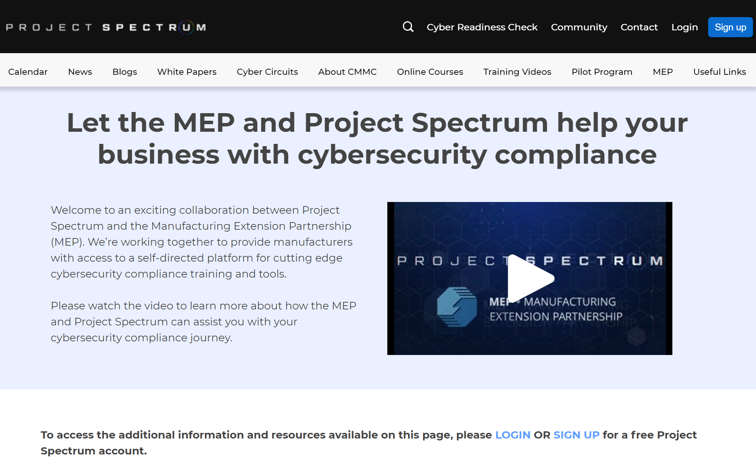
Manufacturing Extension Partnership

Slide 13
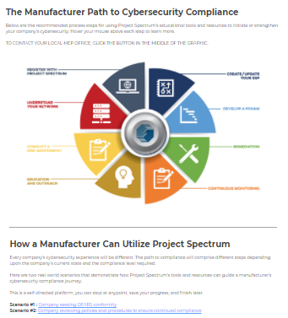
Manufacturing Extension Partnership

Slide 14
Small Business Support
Procurement Technical Assistance Centers (PTACs)
Cyber Circuits
CMMC Preparedness Training
13 events – 2,100+ attendees
Speakers from the Office of the Secretary of Defense, Defense Contract Management Agency, U.S. Small Business Administration
Level 1 & Level 3 webinars – 3,000+ attendees
Level 1 online course – 500+ participants
Training Videos
Videos are posted to projectspectrum.io and YouTube
VOLTS | Cybersecurity Tips – 9,000+ views
Spoke at APTAC conferences
Collaborated with 49 PTACs – 1,900+ attendees

Slide 15
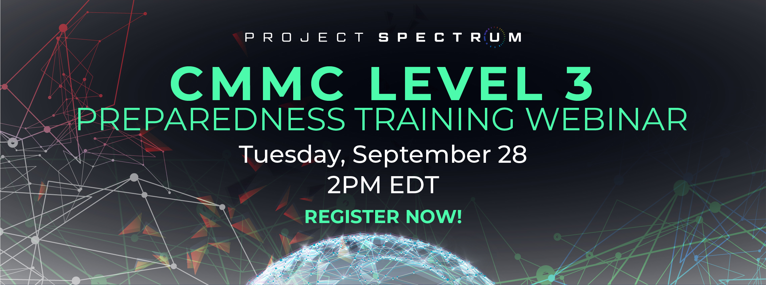
Small Business Support

Slide 16
Steps Required To Compete For Defense Contracts

Slide 17
DFARS Interim Rule
“The new DFARS provision 252.204-7019 advises offerors required to implement the NIST SP 800-171 standards of the requirement to have a current (not older than three years) NIST SP 800-171 DoD Assessment on record in order to be considered for award.”
Basic: Self-assessment identifies how many NIST SP 800-171 security requirements a contractor has implemented and not implemented and results in a score; requirement to have Basic self-assessment to be phased in over three years
“The new DFARS clause 252.204-7020 requires a contractor to provide the Government with access to its facilities, systems, and personnel when it is necessary for DoD to conduct or renew a higher-level Assessment.”
Medium/High: DoD may perform at its discretion post-award, based on criticality of program, nature of information; finite number of assessments each year
“A new DFARS clause 252.204-7021, Cybersecurity Maturity Model Certification Requirements, is prescribed for use in all solicitations and contracts or task orders or delivery orders, excluding those exclusively for the acquisition of COTS items. This DFARS clause requires a contractor to: Maintain the requisite CMMC level for the duration of the contract; ensure that its subcontractors also have the appropriate CMMC level prior to awarding a subcontract or other contractual instruments; and include the requirements of the clause in all subcontracts or other contractual instruments.”
Source: Federal Register / Vol. 85, No. 189 / Tuesday, September 29, 2020 / Rules and Regulations

Slide 18

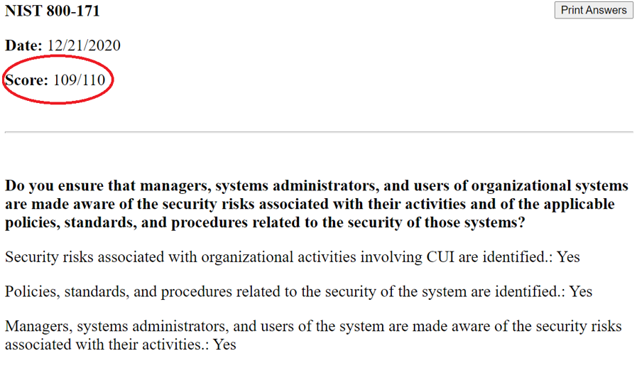
How to Enter Your Project Spectrum NIST SP 800-171 Score into SPRS

Slide 19
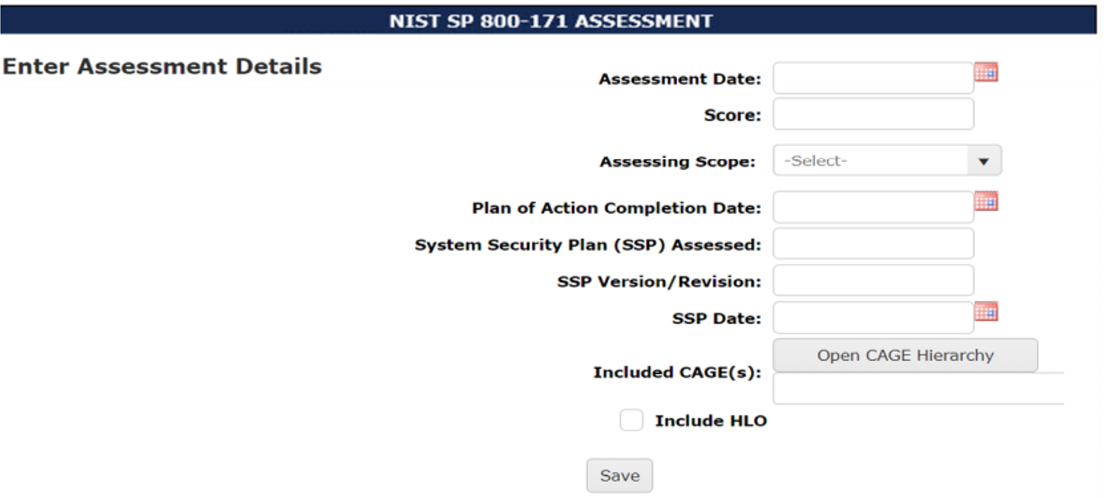
How to Enter Your Project Spectrum NIST SP 800-171 Score into SPRS

Slide 20
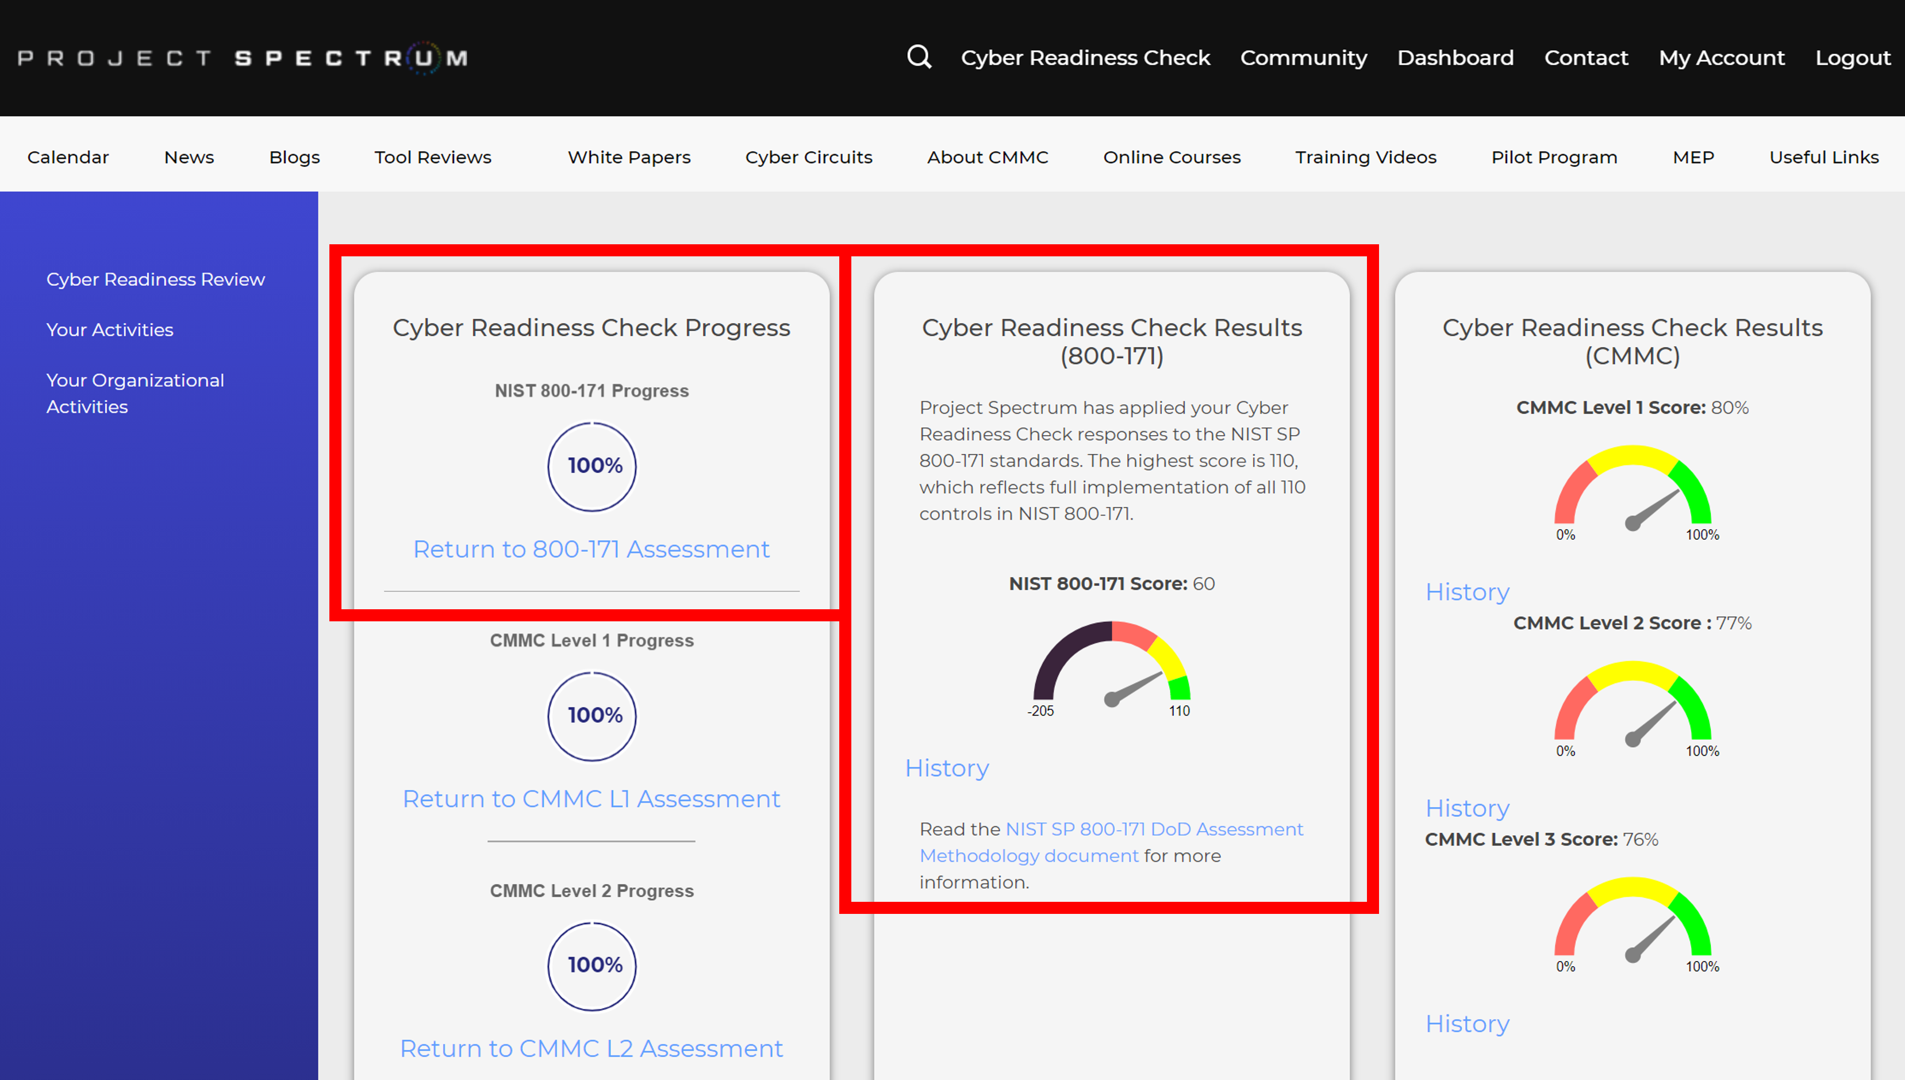
How to Enter Your Project Spectrum NIST SP 800-171 Score into SPRS

Slide 21
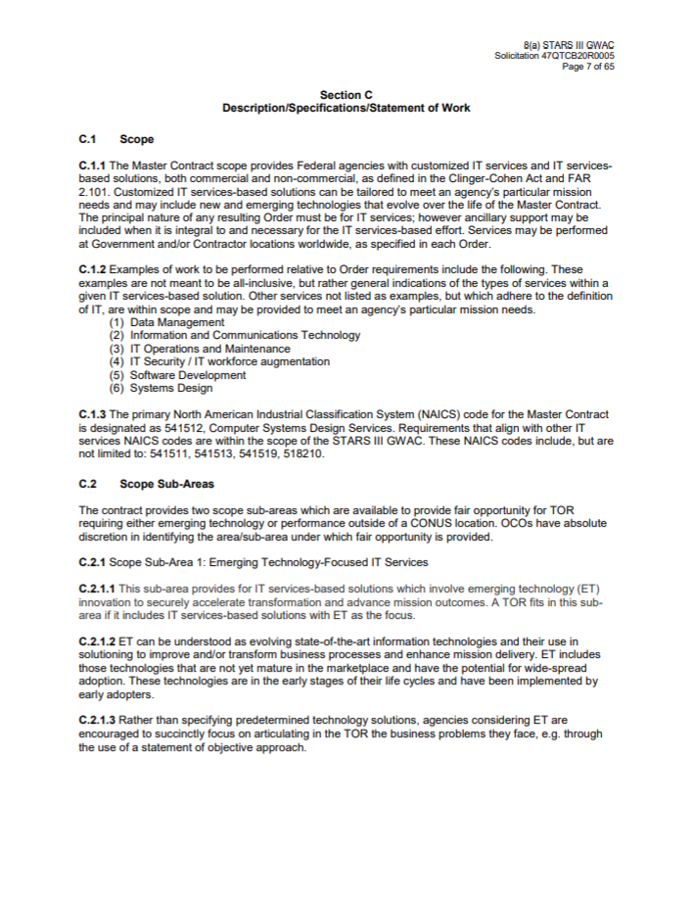
Request for Proposal (RFP)
When a contract requires CMMC certification, it will be listed in the RFP in sections C and L.

Slide 22








Connect with Us
project
spectrum.io
MENTOR PROTÉGÉ PILOT PROGRAM
MONTHLY WEBINARS
SOCIAL MEDIA
EMAIL
outreach@
projectspectrum.io
Project Spectrum
@Proj_Spectrum
Project Spectrum

Slide 23
Questions?

Slide 24
Thank You!

