Slide 1

An Overview of the CUI Program
Updated 01/21

Slide 2
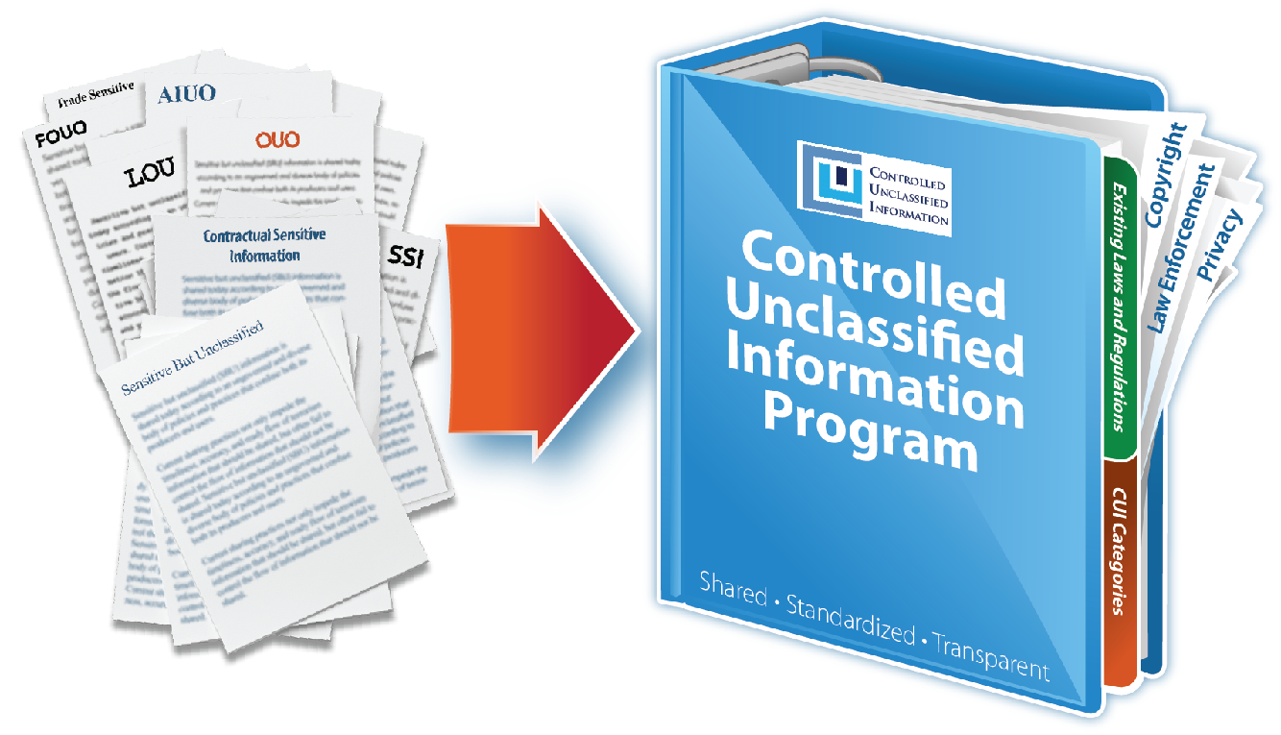
What is CUI?
CUI is Information that needs protection and is not classified.
The Controlled Unclassified Information (CUI) Program standardizes the way the Executive branch handles information that requires protection and is not classified.
CUI ensures safeguards employed while information is being stored or used by the agency and the controls involving how the information is disseminated.
The CUI Program replaces hundreds of different agency policies and associated markings with one shared system of markings.

Slide 3



Leadership
CUI Executive Agent: NARA’s Information Security Oversight Office (ISOO)
CUI Advisory Council: Lead by the Executive Agent; Membership from Executive Branch agencies
GSA Leaders:
Senior Agency Official - Beth Killoran, Deputy CIO
Program Managers (PMs) - Karen Overall and Andy Riordan, Enterprise Data and Privacy Management Office (IDE)

Slide 4
Implementation Plans
The CUI Program is under development. Estimated timeline towards implementation:
CUI Policy updated | April 2021
CUI Course - mandatory for employees | Jan-April 2021
CUI Guide published | April 2021
Begin implementation at GSA | July 1, 2021
FAR rule focused on CUI | 2021
Implementation across the Executive Branch | by Dec 31, 2021

Slide 5
Examples of CUI
PII - SSNs, personnel files, health info…
SBU - PBS Building drawings/blueprints with sensitive info…
Contract data – Bids, source selection info, customer data…
IT Operation Info – Network diagrams, IP addresses….
Legal – Administrative proceedings, Witness Protection…

Slide 6
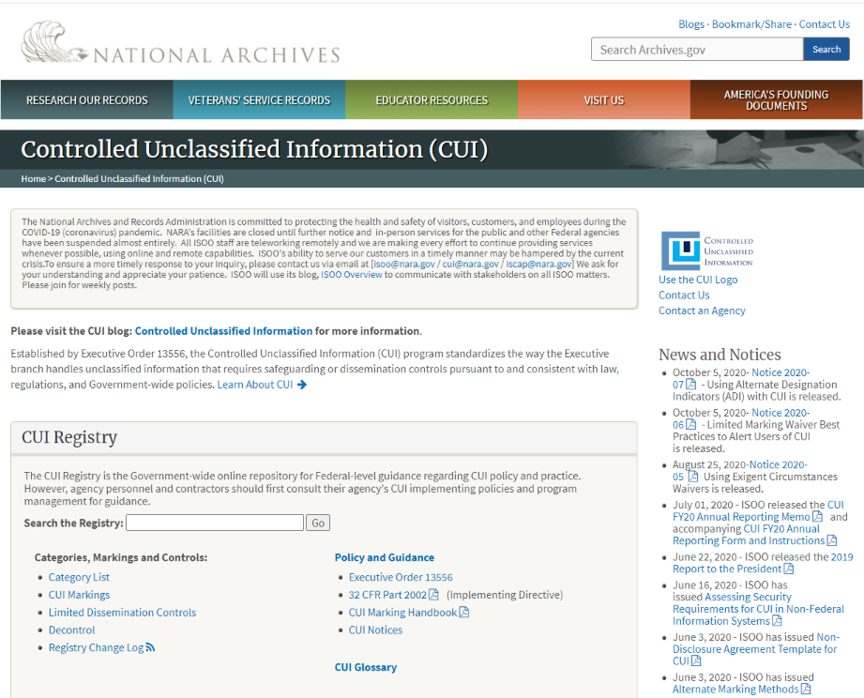
The CUI Registry
NARA’s repository that contains info, guidance, training, and requirements for handling CUI.
Identifies 100+ approved Categories.
Lists the applicable authorities for each category that says the information should be protected.
Establishes CUI markings for each category.
www.archives.gov/cui

Slide 7
CUI Categories
The CUI Categories that GSA will likely use:
Critical Infrastructure
Emergency Management
General Critical Infrastructure Information
Information Systems Vulnerability Information
Physical Security
Financial
Budget
Comptroller General
Electronic Funds Transfer
General Financial Information
Legal
Administrative Proceedings
Collective Bargaining
Legal Privilege
Legislative Materials
Protective Order
Natural and Cultural Resources
Historic Properties
Privacy
Contract Use
General Privacy
Inspector General Protected
Personnel Records
Procurement and Acquisition
Source Selection
Proprietary Business Information
Entity Registration Information
General Proprietary Business Information

Slide 8
Types of CUI
CUI Basic
CUI Basic is when the applicable authority says the information should be protected and nothing else is required. Therefore, only the standard CUI marking and protection procedures must be followed. This is the most common type of CUI.
CUI Specified
CUI is specific when the applicable authority includes specific or additional guidance for that type of information. That could mean additional markings, extra protection, limited dissemination, or some other specific direction. Therefore, more protections are required of CUI Specified than of CUI Basic.

Slide 9
Safeguarding
Safeguard CUI at all times in a manner that minimizes the risk of unauthorized disclosure while allowing timely access by authorized holders.
Controlled environments
Physical: At least 1 physical barrier such as a locked cabinet
General: Be aware of surroundings; do not review or discuss in common areas
Electronic: Protect IT systems from unauthorized access

Slide 10
Marking
Marking of CUI documents is required in order to show that the document contains sensitive information.
Printed copy - Banner marking on the top of each page
IT Systems - Must have splash screens, banners, or other forms of notification that the system contains CUI
IT Systems printout - Either automatically print banners or the holder must write the banner marking on each page
First page - Indicate the agency of designation and a contact person/organization

Slide 11
Banner Markings
For CUI Basic the only required banner marking is CUI in Capital letters (other agencies may use the word Controlled instead) at the top of every page of the document.
For CUI Specified, the marking must also include the category or categories, in alphabetical order, separated by 1 slash.
Example: CUI//SP-BUDG/SP-PRVCY
Either banner marking may also include limited dissemination information at the end of the marking.
Example: CUI//SP-PRVCY//NOFORN
The CUI Registry has more information on markings.
CUI Coversheets may also be used to protect printed docs.

Slide 12
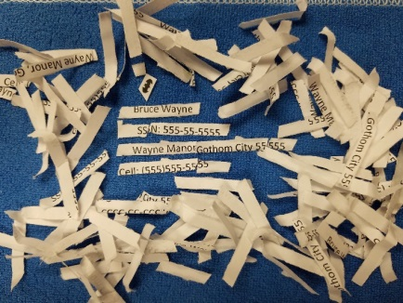
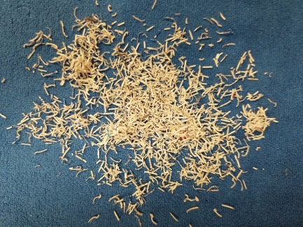
Destroying
Destruction must make CUI unreadable, indecipherable, and irrecoverable.
Shredders and Shredding Services must comply with NIST 800-88. Destroy to 1mm x 5mm particles.
Do NOT put CUI in trash cans or recycle bins
X
Cross cut shredders
1x5mm shredders

Slide 13
Reporting CUI Incidents
Incidents involving CUI must be reported immediately to the IT Service Desk who will work with the OCISO Incident Response team. Report incidents such as:
Improper storage
Mishandling
Unauthorized individuals gaining access
Unauthorized release of CUI
Mismarked or unmarked CUI

Slide 14
Resources
Implementing Directive: 32 CFR part 2002
The CUI Registry: archives.gov/cui
NARA’s training videos: archives.gov/cui/training
NARA’s CUI Blog: isoo.blogs.archives.gov
NIST 800-171 Rev 2: Protecting CUI in Non-Federal systems
GSA's CUI Policy
For more information contact the CUI Team at cui@gsa.gov

