Slide 1
Civilian Services Acquisition Workshop (CSAW)
Facilitated by:

Slide 2
Civilian Services Acquisition Workshop (SAW):
Civilian Services Acquisition Workshop (SAW):
A facilitated workshop built around a specific acquisition and its multi-functional integrated project team (IPT). The workshop walks the complete team through the performance-based acquisition (PBA) process from beginning to end.
Notes:
The Civilian SAW (CSAW) initiative was proposed by a member of the the Professional Services Interagency Team who had experienced the benefits of the approach. As a result, GSA (in partnership with OFPP) began research into CSAWs.

Slide 3
Workshop Purpose:
Develop the vision, mission, measurable objectives, requirements, performance standards and performance-based strategies for the {Name of Requirement} and a roadmap to complete it.
{Name of Requirement} CSAW

Slide 4
CSAW Objectives:
Understand and Apply the Performance-Based Acquisition (PBA) process and the Steps to PBA
Utilize the tools, resources, techniques, innovations and best practices to successfully execute this requirement
Collaborate as a team through facilitated activities to develop draft documentation for this requirements
Develop a high-level roadmap for successful implementation of this performance-based acquisition
Gain consensus on critical decisions and the path ahead

Slide 5
Introductions
Your Name
Position & Organization
30sec work background
What is one thing you are hoping to accomplish this week?

Slide 6
Performance Based Acquisition (PBA) Overview

Slide 7

What is PBA?
"Performance-based Acquisition" (PBA) means an acquisition structured around the results to be achieved as opposed to the manner by which the work is to be performed. - FAR 2.101

Slide 8

Performance Based Acquisition
Performance Based Acquisition is the preferred method for acquiring services
Agencies must use PBA methods to the maximum extent practicable
FAR 37.102(a)(1)

Slide 9




4 KEY ELEMENTS OF PBA
Uses a Performance Work Statement (PWS) or Statement of Objectives (SOO)
Includes measurable performance standards for all performance requirements
Provides appropriate incentives to drive higher performance and/or promote innovation
Utilizes a Quality Assurance Surveillance Plan (QASP) to define how the contract will be monitored (see FAR 46.4)

Slide 10
Definition of SOW, PWS & SOO

Slide 11
Definition of SOW, PWS & SOO
Statements of Work (SOW), Performance Work Statements (PWS), and Statements of Objectives (SOO) are different types of requirement documents or generically “work statements,” that explain the needs of the government.
Notes:
Presenter
2020-03-12 14:26:25
--------------------------------------------
Difference between the SOW SOO, and PWS
SOW = defines exactly how and when the contractor will carry out the requirement and tasks within
PWS = describes work in terms of “required outcomes” measurable results, using clear, precise, and objective terms
SOO = provides the objectives that the gov’t is looking to achieve but does not address the required tasks the contractor is to perform

Slide 12
Definition of SOW
STATEMENT OF WORK (SOW)
A SOW specifies the processes and methods the contractor must use when executing the planned work. This type of requirement document is designed to describe not only what must be done, but also how it must be done. An SOW is prescriptive and restrictive by nature.
The SOW is incorporated into the contract.

Slide 13
Definition of PWS
PERFORMANCE WORK STATEMENT (PWS)
A PWS describes the work in terms of required results rather than either “how” the work is to be accomplished or the number of hours to be provided and gives the contractor flexibility to devise the best method to accomplish the required result.
The PWS is incorporated into the contract.

Slide 14
Definition of SOO
STATEMENT OF OBJECTIVES (SOO)
A SOO establishes a broad description of the government's overall goal(s) for the requirement as well as High Level Objectives and performance objectives. It focuses on the outcomes rather than on how the work is to be done. It is used when the Government intends to provide the maximum flexibility to each offeror to propose an innovative approach.
The SOO is NOT incorporated into the contract.

Slide 15








THE STEPS
STEPS TO PERFORMANCE BASED ACQUISITION
STEP 1
Form the Team
STEP 2
Identify Objectives
STEP 3
Market Research
STEP 4
Develop Work Statement
STEP 5
Define Measures
STEP 6
Source Selection
STEP 7
Manage Performance
STEP 8
Complete Closeout
PURPOSE: Establish the team and conduct high-level project planning. POTENTIAL OUTPUTS: - Project Vision, Mission & Success Factors - Stakeholder ID & Analysis - High-Level Comms Plan - Risk ID - IPT Charter | PURPOSE: Identify why we’re doing this in the first place and what are the high-level objectives (HLO). POTENTIAL OUTPUTS: - Review/analyze current approach - Tie project into Agency Mission / Strategy - Establish HLOs | PURPOSE: A team approach to market research using available tools and innovative resources. POTENTIAL OUTPUTS: - ID MR Topics - Team market research assignments - Draft MR document - Draft IPT Master Schedule | PURPOSE: Well-written requirements statements and identifying the appropriate work statement type. POTENTIAL OUTPUTS: - Draft Performance Requirements Statements - Draft Work Statement Template Selection - ID Solicitation Requirements | PURPOSE: What constitutes successful performance and how does the team measure this? POTENTIAL OUTPUTS: - Develop performance standards and possible incentives - Review acquisition strategy alternatives | PURPOSE: Review options for evaluation criteria and think through the source selection process. POTENTIAL OUTPUTS: - Explore innovative source selection approaches - ID Tech Eval criteria | PURPOSE: Managing the contract to ensure performance objectives are met. POTENTIAL OUTPUTS: - Draft Risk Management Plan - QASP vs. QAP - Performance tracking approach - Roles & Responsibilities - Change & Transition Management | PURPOSE: Considerations for closing out the contract and concluding the project. POTENTIAL OUTPUTS: - Lessons Learned - Celebrate Success - Document in CPARs
Notes:
https://pba.app.cloud.gov/app/#/pba

Slide 16

Ground Rules
Respect the Speaker
Deefur Judgmynt
Headline First….
Timeliness (Start & end on time)
Mindfulness / 100% Focus
Consensus (5FCC)= Can live with & support it
All have a Voice & CSAW IPT has a Vote
Cameras On & Mute On
Use the Virtual Tools
Always Ask Questions
If you DON’T see something SAY something

Slide 17
Right Solution x Commitment to Solution =
Effectiveness of the Solution

Slide 18
Requirement Background
{PM Name}
{title}

Slide 19
Background Notes

Slide 20
Current Approach

Slide 21
Current State Analysis
QUESTIONS:
What is working well today that you want to keep doing?
What is working well today that you want to do more of?
What are you doing today that you want to do less of, or stop doing?
What would you like to do differently moving forward?

Slide 22
Current State Analysis Table
Doing Well…Revisiting “E-Discovery” aspect; front office being more open to purchase more tools | Do More…
Do Less or Stop… | Do Differently…
-
-
-
-
-
-
-
-
-
-
-
-
-
-
-
-
Notes:
- What is working well today that you want to keep doing?
- What is working well today that you want to do more of?
- What are you doing today that you want to do less of, or stop doing?
- What would you like to do differently moving forward?

Slide 23
Vision – Mission – Objectives
Notes:
CHATTERFALL –
Mission
Vision
Objectives
Success Factors

Slide 24
VISION
Future desired end-state or idealistic result. Assumes we have met our Mission & all Objectives. (Future Tense)

Slide 25
Example Vision Statements
One brief & typically “catchy” statement.
Providing high quality logistics mission support services for NASA anytime, anywhere
Providing stakeholders with technical writing services of the highest quality, while meeting Department of Transportation mission, goals, and objectives.
Building agile, efficient, and effective communications that connect the World to NASA
Providing professional services across OAR that are easily accessible, flexible, inclusive of small business and cost efficient.

Slide 26
MISSION
Defines WHAT the acquisition will do, WHY we’re doing it, for WHOM it’s being done, and what the BENEFIT is.
Notes:
MISSION:
Defines WHAT the acquisition will do, WHY we’re doing it, for WHOM it’s being done, and WHAT the benefit is.
VISION:
Key measures of your team’s effort and performance throughout the project.
Future desired end-state or idealistic result. Assumes we have met our Mission & all Objectives. (Future Tense)
SUCCESS FACTORS:
Key measures of your team’s effort and performance throughout the project.

Slide 27
Example Mission Statements
One brief statement (fits on back of a business card)
A contract vehicle that provides the NASA Enterprise a world class logistics solution that effectively and efficiently enables stakeholders to achieve their mission.
To provide a flexible contracting vehicle that efficiently supports a wide range of Technical Writing services for all OAs within DOT.
Establish a sustainable, adaptable agency-wide solution for NASA and its stakeholders that provides agile, impactful, innovative and cost-effective strategic communications products and services.
To provide a consolidated, administratively efficient, and fiscally responsible OAR-wide contract vehicle for professional services to improve efficiency for OAR Program Offices and OAS.

Slide 28
HIGH-LEVEL OBJECTIVES
Broad, long-term contract aims that define accomplishment of the mission.
(Infinite or continuous verbs)

Slide 29
High-Level Objective Examples...
For Data Analysis & Modeling, OAR seeks the highest scientific integrity in its data analysis and modeling to support OAR programs and EPA's mission.
For Media and Entertainment Relations, NASA seeks to transparently provide an accurate representation of NASA's work that earns positive media coverage in a timely manner.
For Enterprise Service Desk Support, USMS HQ OPS seeks timely resolution of issues; a one-stop shop for IT user support regardless of staff location or technology boundaries.
For Transition Support, NTIA seeks a smooth transition of the contract to the next provider at the end of the contract period of performance (POP) with no loss in capability or data to avoid negative developmental or operational impact.
For Policy & Regulation Support, EPA seeks high quality, unbiased, and cost-effective policy and regulatory support for effective rulemaking and public hearings, to support EPA’s mission.
For Digital Media & Oversight, NASA seeks to grow agency audiences using innovative technologies, creating a continuous cycle of engagement and feedback consistent with agency messaging.

Slide 30
High-Level Objectives (HLOs)
For _____ (task area), _____ (organization) seeks…
  some questions to ask include:
    why are you doing this?
    why is it important?
    what is the potential benefit?
    what are you aspiring to?
For Media and Entertainment Relations, NASA seeks to transparently provide an accurate representation of NASA's work that earns positive media coverage in a timely manner.
“transparently provide an accurate representation” answers WHY are they doing this
The task area: “Media and Entertainment Relations”
“earns positive media coverage” answers the potential benefits of doing the work
“timely manner” may be something they are aspiring to achieve

Slide 31
PRODUCT VISION
High level definition of scope of the project.

Slide 32
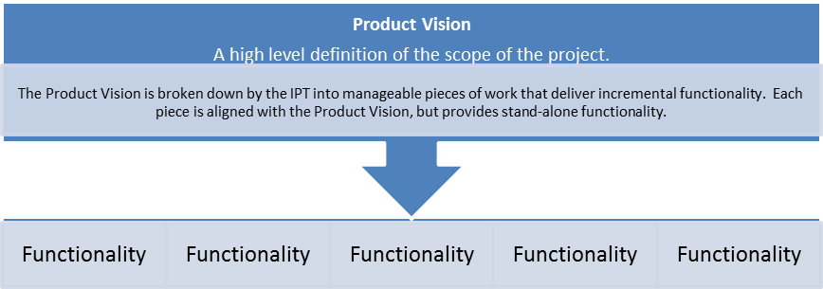
Product Vision
References:
https://techfarhub.cio.gov/handbook/requirements/
https://playbook.cio.gov/#introduction

Slide 33
Product Vision Statement
For (target customer)
Who (statement of the need or opportunity)
The (product name) is a (product category)
That (key benefit, compelling reason to buy/use)
Unlike (primary alternative)
Our product (statement of primary differentiation)
EXAMPLE:
For government acquisition professionals who are seeking guidance, resources and tools to support them through all steps of the performance-based acquisition process, the Steps to Performance Based Acquisition (SPBA) application will allow users to easily navigate, search and interact with SPBA content. Unlike the previous, legacy version of Seven Steps to PBA on acquisition.gov, this new and dynamic application provides a modern design and easy to use interface, which will be easily navigated and searchable.
This slide is not optimized for those who are color blind

Slide 34
Vision - Mission - High Level Objectives
VISION:
HIGH LEVEL OBJECTIVES:
MISSION:

Slide 35
Market Research
Notes:
Andrea
Two/three breakout rooms
Checkpoint goes here! Summarize the thing we just did and explain what we are doing next.
We worked on high-level objectives, and started to identify stakeholders and how they impact and influence this project.
Now we’re going to keep those objectives and stakeholders in mind as we move to the next topic-market research.
P_
D_
Q_
Starting question: Imagine this-you’re working and your phone rings. Something compels you to answer it. A potential vendor found out about your need and spontaneously called you today. You actually have some free time to talk to them. What would you want to know about that company? What information would you need? Who would you need it from?

Slide 36
Instructions
Break into 4 teams - select a scribe - brainstorm questions
You will have 8min
Two prizes up for grabs!
Be prepared to present your questions
If you could have an answer to any question that would lead to the best possible procurement, what would you ask?

Slide 37
Questions
Questions
Questions
Notes:
If you could have an answer to any question that would support your decisions with this requirement, what would you ask?

Slide 38
Market Research Questions
Notes:
Four breakouts, eight minutes.
You are going to brainstorm as many questions as you can possibly think of. There are no wrong questions. Later on, you can decide which questions you will actually ask industry. This is a brainstorming exercise. Whoever comes up with the most questions wins a prize (bragging rights for the rest of the day).
One idea from each group. Keep going, or Chat dump depending on the energy.

Slide 39
Who will you ask each question? What method will you use?
Market Research Questions
Our Agency | Other Agencies
Industry | Other Sources
-
-
-
-

Slide 40
Myth Busting
Market Research Edition

Slide 41
Myth Busting
We can’t meet one-on-one with a potential offeror.
FACT – Government officials can generally meet one-on-one with potential offerors as long as no vendor receives preferential treatment.
Prior to issuance of solicitation
Prohibit preferential treatment of one vendor over another

Slide 42
Myth Busting Continued
A protest is something to be avoided at all costs - even if it means the government limits conversations with industry.
FACT – Restricting communication won’t prevent a protest, and limiting communication might actually increase the chance of a protest – in addition to depriving the government of potentially useful information.
At least 99 percent of procurements are never protested
Restricting communication for fear of protests may actually increase the likelihood of a protest

Slide 43
Myth Busting Continued
If the government meets with vendors, that may cause them to submit an unsolicited proposal and that will delay the procurement process.
FACT – Submission of an unsolicited proposal should not affect the schedule. Generally, the unsolicited proposal process is separate from the process for a known agency requirement that can be acquired using competitive methods.
Receipt of unsolicited proposals should not cause delay in an acquisition.

Slide 44
Myth Busting Continued
Industry days and similar events attended by multiple vendors are of low value to industry and the government because industry won’t provide useful information in front of competitors, and the government doesn’t release new information.
FACT – Well-organized industry days, as well as pre-solicitation and pre-proposal conferences, are valuable opportunities for the government and for potential vendors – both prime contractors and subcontractors, many of whom are small businesses.
Promoting a common understanding of the procurement requirements, the solicitation terms and conditions, and the evaluation criteria
Benefit industry – especially small businesses – by providing prime contractors and subcontractors an opportunity to meet and develop relationships or teaming agreements

Slide 45
Myth Busting Continued
The program manager already talked to industry to develop the technical requirements, so the contracting officer doesn’t need to do anything else before issuing the RFP.
FACT – The technical requirements are only part of the acquisition; getting feedback on terms and conditions, pricing structure, performance metrics, evaluation criteria, and contract administration matters will improve the award and implementation process.
Industry needs information about any unique terms and conditions, small business set-aside requirements, subcontracting goals, and other matters about which the contracting officer is the expert

Slide 46
Myth Busting Continued
Getting broad participation by many different vendors is too difficult; we’re better off dealing with the established companies we know.
FACT – The government loses when we limit ourselves to the companies we already work with. Instead, we need to look for opportunities to increase competition and ensure that all vendors, including small businesses, get fair consideration.

Slide 47
Myth Busting Continued
The best way to engage with industry during the planning phase is through a written request for information.
FACT – Requests for Information (RFIs), while useful, can result in a static, one-way exchange where agencies do not have the resources to respond and vendors do not have the opportunity to demonstrate their capabilities. However; agencies can conduct virtual meeting sessions (live RFIs) and can schedule separate virtual presentations for potential offerors to demonstrate solutions with contracting officers, program managers, and others.

Slide 48
Myth Busting Continued
DO meet one-on-one with potential offerors as long as no vendor receives preferential treatment.
DON’T Restrict communication with vendors - it won’t prevent a protest, and limiting communication might actually increase the chance of a protest – in addition to depriving the government of potentially useful information.
DO organize Industry Days, as well as pre-solicitation and pre-proposal conferences
FACT – The government loses when we limit ourselves to the companies we already work with.
DO look for opportunities to increase competition and ensure that all vendors, especially small businesses, get fair consideration.

Slide 49
Market Research Tools

Slide 50
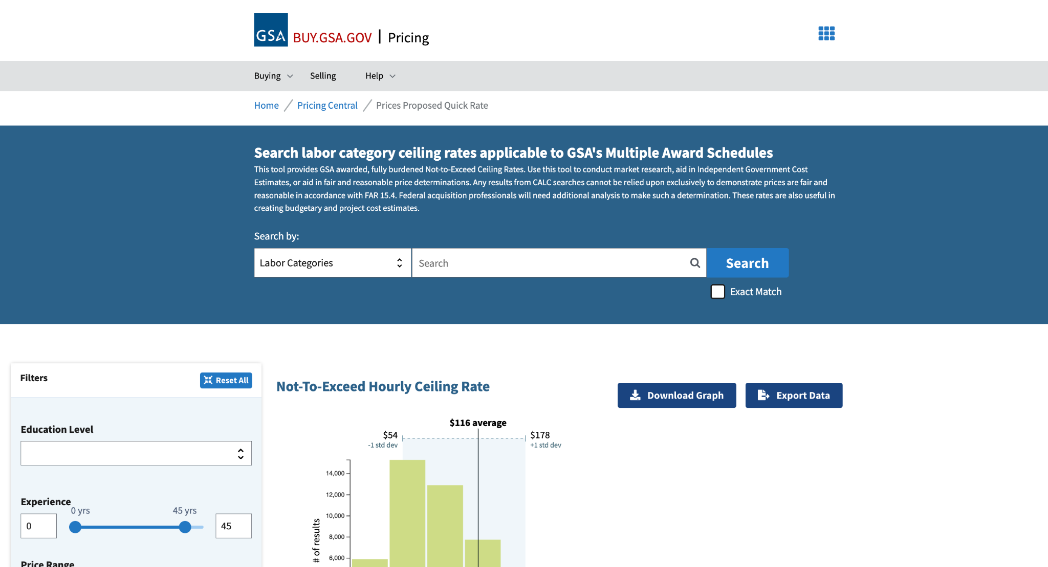
What’s a reasonable range for a given labor rate?
Just Google - GSA CALC OR
https://buy.gsa.gov

Slide 51
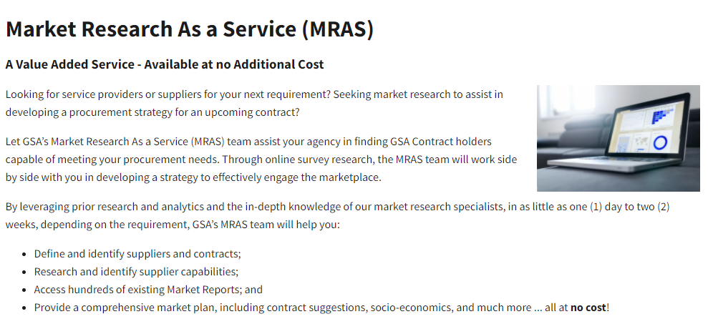
Market Research As a Service (MRAS)
https://www.gsa.gov/about-us/organization/federal-acquisition-service/customer-and-stakeholder-engagement/market-research-as-a-service-mras

Slide 52
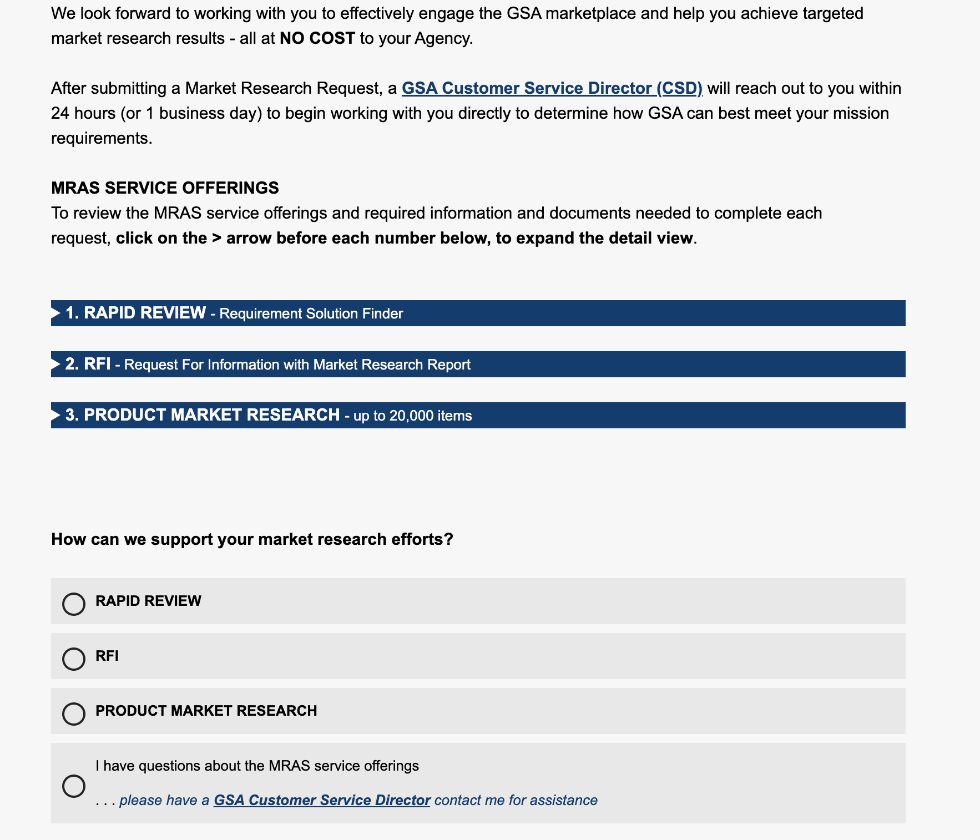
Market Research As a Service (MRAS) Continued
https://www.gsa.gov/about-us/organization/federal-acquisition-service/customer-and-stakeholder-engagement/market-research-as-a-service-mras

Slide 53
BEGIN STEP 4
Develop Work Statement

Slide 54
Performance Requirements

Slide 55
9 DOTS – 4 lines

Slide 56
9 DOTS – 3 lines

Slide 57
Refine the Requirements

Slide 58
ACTION – RESULT – CONTEXT
ACTION: What do you want the contractor to do? | RESULT: What result or outcome do you want? | CONTEXT: What is it for? What mission? What program?
ORIGINAL: The Contractor shall train system end-users on how to use the system REVISIONS: The contractor shall provide [A] training [R] to end-users on how to use the system The contractor shall deliver [A] a user manual [R] for all aspects of the system
The contractor shall deliver (A) on-demand training (R) so users can independently develop and deploy surveys using SaaS (C). There are multiple user types from basic users to system administrators and training will be needed for all functions of the system.
NOTE: Everything after a preposition is context… some prepositions: to, for, by, with, around, on, under, ‘so’ (“so” is a preposition when it would otherwise be combined with “that”), after, through, of, at, in, between…
each requirement statement begins with The Contractor shall (or must)
Action verb
Result?
Context

Slide 59
ACTION – RESULT – CONTEXT
ACTION: What do you want the contractor to do? | RESULT: What result or outcome do you want? | CONTEXT: What is it for? What mission? What program?
The Contractor shall develop [A] meeting materials [R] for public safety stakeholder engagements. [C] Historically meeting materials have included agendas, presentations, talking points, and facilitator guides. This ARC statement has a clear action, result and context. The context may be limiting for other business units to be able to use it, is that ok?
Consider creating separate tasks with the “approved” dependency… Original: The contractor shall create and execute a ___ plan for ___ Revision The contractor shall create a ____ plan for _____ The contractor shall execute an approved ____ plan so that ____

Slide 60
ARC Method
BEWARE of AMBIGUITY!
The contractor shall assist in supporting Sprint Demos to ensure that the feature acceptance criteria were met at the conclusion of each sprint.
don’t use ambiguous words: assist, support, help, manage
- what kind of assistance?
- what is involved with support?
The contractor shall conduct a Sprint Demo with the Product Owner, key stakeholders, and development team to ensure that the feature acceptance criteria were met at the conclusion of each sprint.
WARNING: “at the direction of ___” , “as requested by ____”
ACTION [A] - RESULT [R] - CONTEXT [C]

Slide 61
ARC Method Continued
For example, instead of saying "Assistance shall be provided for the conduct of logistical support meetings," consider:
C.4.4.1 The Contractor shall schedule meetings to include all necessary stakeholders and a clear purpose and agenda.
C.4.4.2 The Contractor shall record meeting minutes for all logistical support meetings.
Minutes should include clear documentation of any action items and the assigned stakeholder
Historically, X Agency has conducted an average of # meetings per month
C.4.4.3 The Contractor shall draft meeting read-aheads that include inputs gathered from key government personnel.
C.4.4.4 The Contractor shall develop presentation materials to help guide logistical support meetings that reflect the approved topics and agenda.
C.4.4.5 The Contractor shall track and report weekly status of action items documented during logistical support meetings.
ACTION [A] - RESULT [R] - CONTEXT [C]

Slide 62
ACTION – RESULT – CONTEXT
ACTION: What do you want the contractor to do? - verb | RESULT: What result or outcome do you want? | CONTEXT: What is it for? What mission? What program?
ORIGINAL: The contractor shall be required to create or implement approaches to gather internal or external agency data through data collection, surveys, or questionnaires.
REVISION: C.4.7.1. The contractor shall develop (A) data collection methodologies (R) for internal or external data used in support of Agency Projects and Programs. C.4.7.2. The contractor shall gather (A) data (R) from internal or external sources using the approved data collection methodologies.
ORIGINAL: The contractor shall utilize the appropriate data collection or management approaches to prepare, process, and manage internal or external data utilized in analysis/modeling efforts. The contractor may utilize data collection equipment, such as Profile Analysis & Monitoring Systems (PAMS) and Portable Emissions Measurement Systems (PEMS), or database management systems (DBMS). The contractor may be responsible for data storage and reporting of all information utilized in the task area.
REVISION: C.4.7.3. The contractor shall prepare and process (A) internal and/or external data (R) using agency approved data collection and management methods to support analysis and modeling efforts. (C)

Slide 63
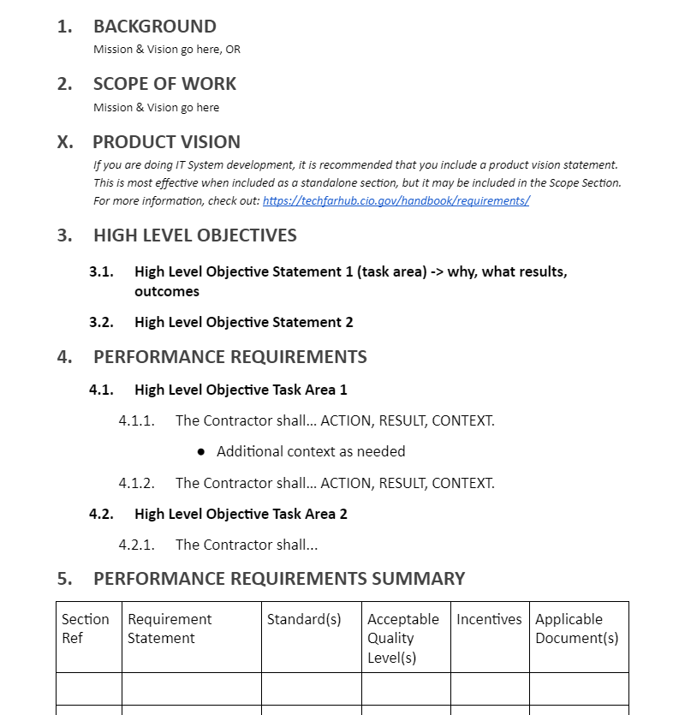
NO GIANT PARAGRAPHS
Use
  Short sentences & bullets
  Lists
  Tables
  Bold, Italics, Underline
Write for your specific audience
  Balance technical and plain language
  Write for the vendor you’ve never worked with before
Stop using government jargon!
Notes:
eBuy Open
RFQ1362167 Narcotic and Explosive Dog Services for Sierra Army Depot Herlong, CA Department of the Army
and RFQ1367416 AMIS, Zebra and Quagga Mussel Canine Detection

Slide 64
BEGIN STEP 5
Define Measures

Slide 65
Performance Standards
Examples include:
Timeliness: Response times, delivery times, timeliness (meeting deadlines or due dates), and adherence to schedules.
Quality: Error/Accuracy rates, plain language description of your expectations for a quality product or outcome.
Progress: Milestone completion rates (the percent of a milestone completed at a given date).
Cost control: (performing within the estimated cost), as applied to flexibly priced contracts, project cost control
https://www.dau.edu/tools/Documents/SAM/resources/Sample_Performance_Standards.html

Slide 66
INSPECTION TYPES
100 Percent Inspection
Expensive and time consuming
Inspection of services clause
Periodic Inspection
Planned and limited inspections
Less time consuming
Random Sampling
Assumes acceptable performance if specific number of inspections are acceptable
Appropriate for frequently occurring tasks
Trend Analysis
Monitor contractor's ongoing performance
Joint Government/contractor data base - very effective way to monitor
Customer Feedback
Actual user feedback
Users don't know contract requirements
Negative feedback plentiful, positive feedback limited
How will you collect the information
Third-Party Audit
Independent review by a third party
Government inspection standard for commercial services

Slide 67
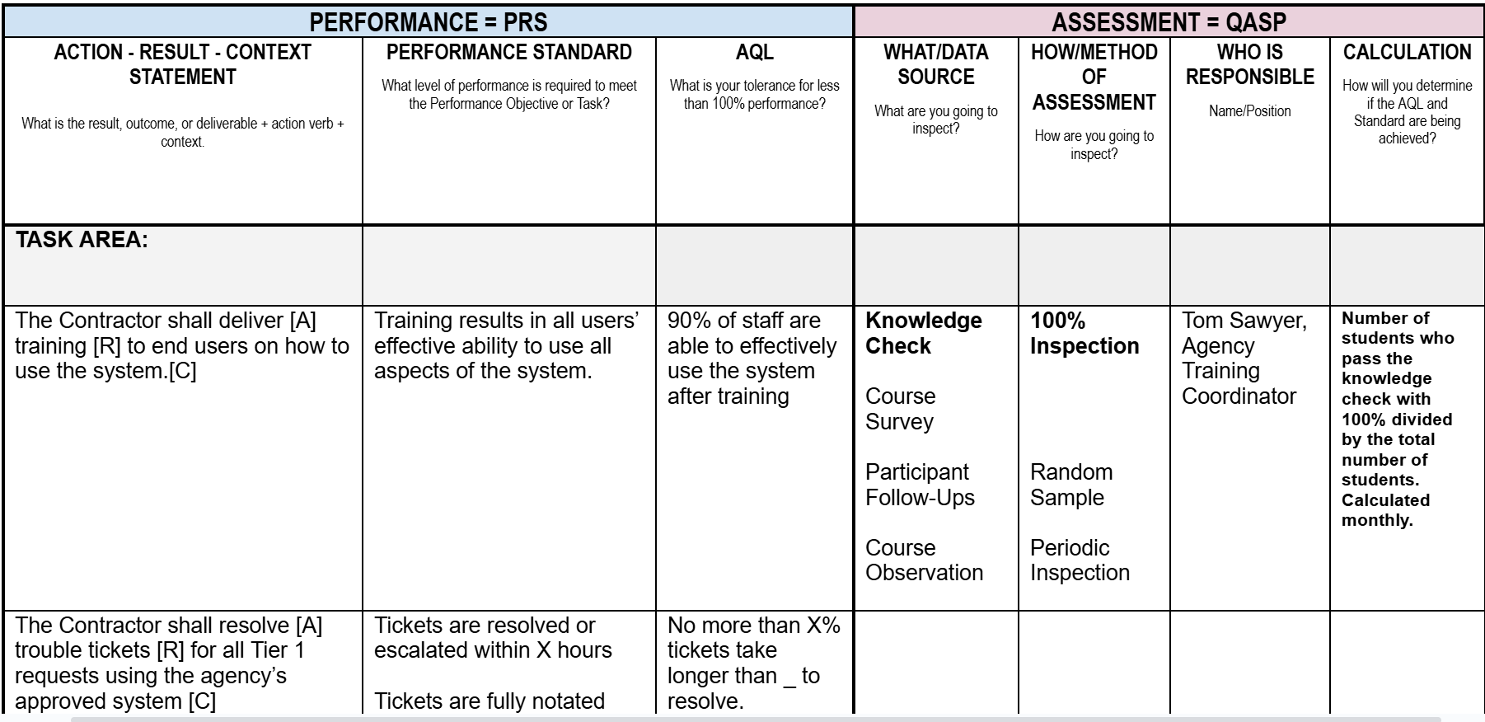
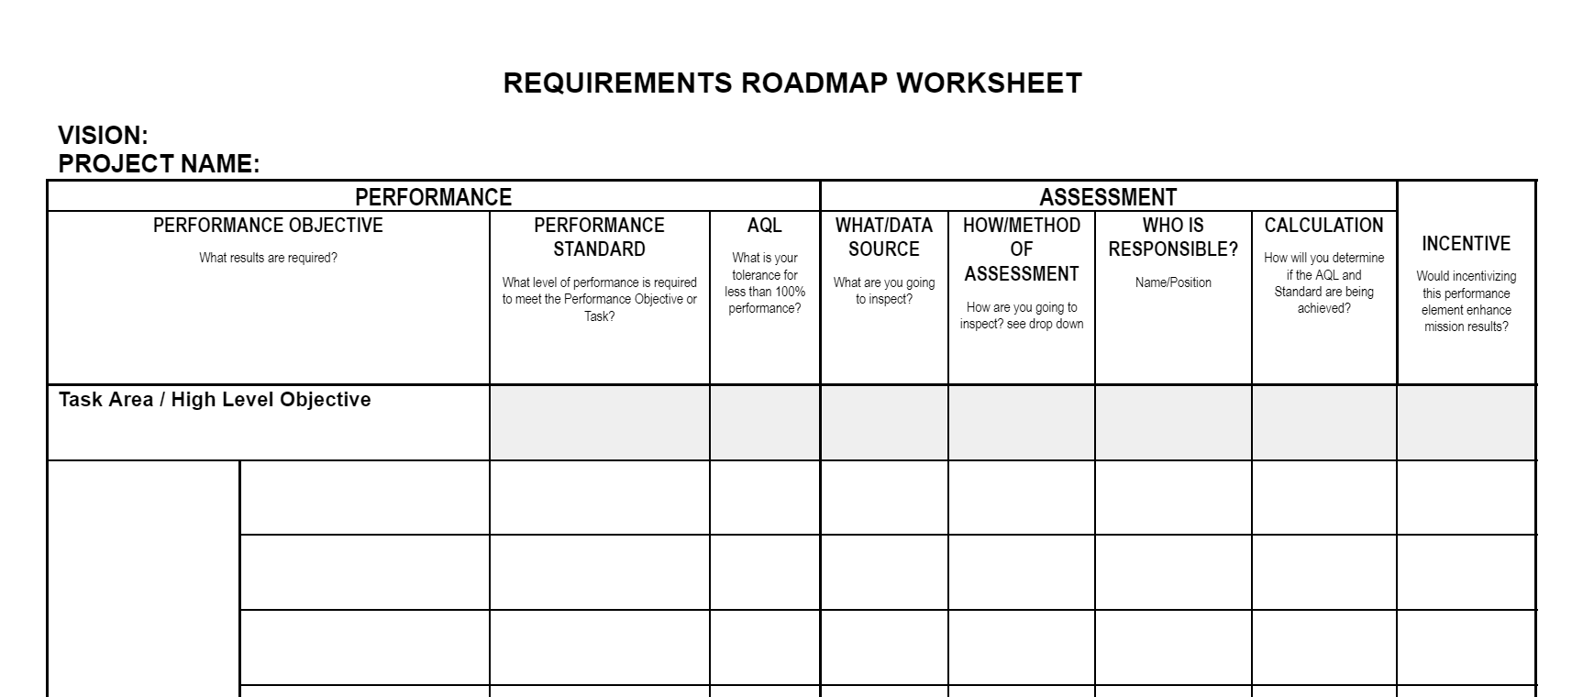
Requirements Roadmap Worksheet

Slide 68
QASP Language
1.X QASP Relation to the Contract
The Agency will retain the right to change the surveillance methods and Quality Assurance (QA) procedures, or to increase or decrease the degree of surveillance efforts at any time necessary to assure contract compliance. A copy of the QASP may be provided to the Contractor to enable the Contractor to enhance its Quality Control (QC) Program, performed in accordance with its Quality Control Plan (QCP).
1.X QASP Relation to the QCP
The QCP is a required element of the Contractor’s technical proposal in response to the solicitation. While the QCP represents the way in which the Contractor will ensure its quality and timeliness of services, as defined in the PWS, the QASP represents the way in which the Agency will evaluate the Contractor’s performance. The Contractor’s QCP and the Residual Organization’s QASP should be complementary programs that ensure successful Contractor performance.
1.X Revisions to the QASP
The QASP is a tool for use in Government administration of the contract and remains subject to revision
at any time by the Government throughout the contract performance period. Revisions to this surveillance plan are the responsibility of the Contracting Officer’s Representative (COR) or Designated Government Representative (DGR). Changes may be made unilaterally and need not be announced to the Contractor; the Government may provide informational copies to the Contractor if desired.

Slide 69
Brainstorm Incentives

Slide 70

Incentives to Consider
Monetary
Award fee (positive)
Money for early completion/delivery (positive)
Shared savings (positive)
Withhold money for late completion/delivery (negative)
Withhold money for late non-performance (negative)
Non-Monetary
Contract length (positive or negative)
  Award term/award options
  Exercise options
Past performance ratings (positive)
Recognition in publications (positive)
Letters of commendation (positive)

Slide 71
Why Use Incentives?
Pros of Incentives | Cons of Incentives
Incentives Promote excellent results and outcomes Promote internal quality control and remedies Encourage expertise, teamwork, partnering Encourage contractor satisfaction/pride in workmanship Monetary Incentives Promote upper management participation Promote cost savings Non-Monetary Incentives Promote workforce satisfaction & stability | Providers with market power can resist them They are difficult to use in contracts for experts Outside factors can influence performance More work to administer Conflicting incentives can drive sub-optimization Wrong incentives drive wrong behaviors

Slide 72
BEGIN STEP 6
Source Selection

Slide 73
Innovation in Source Selection

Slide 74

Advisory Down Select
Purpose: To narrow down the number of responses to review in each phase of a procurement, to only a few at the final phase
Reduces costs and burden to industry
Reduces amount of documentation for the Government to review
Reduces number of debriefings/protests
***ARE NOT COMPETITIVE RANGE DETERMINATIONS
Advisory Soft Voluntary or Firm Hard Involuntary
Example: Submit a video to show resources capability (footprint/building, vehicle fleet, etc.)

Slide 75
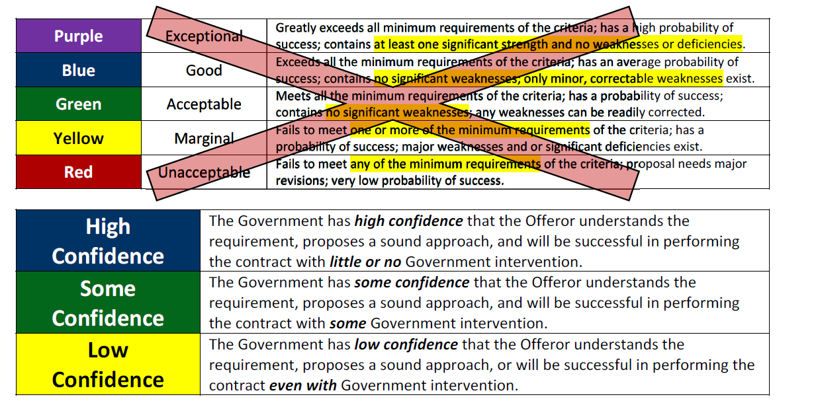
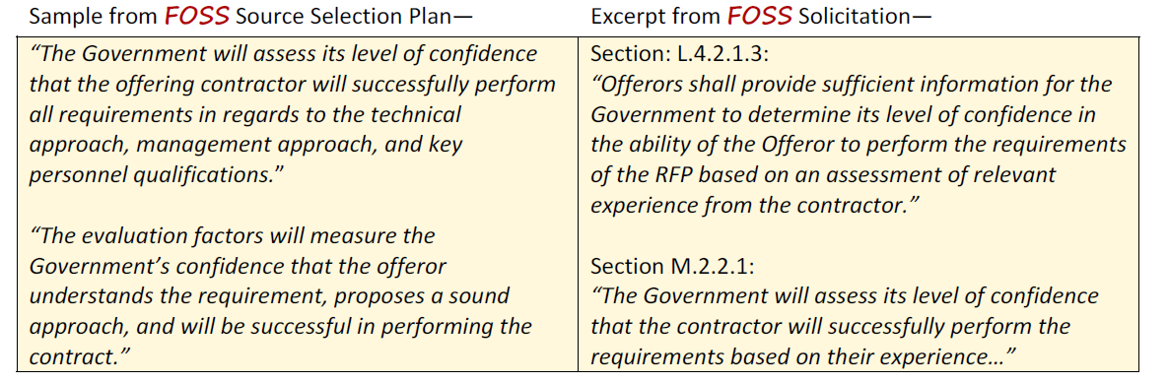
Confidence Rating
Purpose: Easier, Faster, and Smarter Way of Evaluating
Not complicated – no value matrix
Only requires a few bullets to support rating – No long drawn out paragraphs!
Example:

Slide 76

Oral Presentation / Tech Demo
Purpose: To bring in the actual technical staff to see and hear their proposed solutions)
No guarantee who wrote the content of the proposal, but you can specify key personnel or company executives to present an oral presentation
Gives evaluators greater confidence the company knows the technical requirement
FAR 15.102(c): “Information pertaining to areas such as an offeror’s capability, past performance, work plans or approaches, traffic resources, transition plans, or sample tasks (or other types of tests) may be suitable for oral presentations.
Don’t assume that you must videotape the presentation – FAR 15.102(e) lists several possibilities for record for the file (including videotaping).
You can do a twist – interrupt their pitch with a particular scenario
Example: Having offerors come in to discuss their change management approach on a similar project – ASK QUESTIONS!
Notes:
DHS FLASH Tech Demo - There were 110 bidders with no screening downselect. Bidders were given a time and location to show up. They were asked to develop an app for giving kudos to an employee. They had only four hours to work. Everything was filmed, and afterwards each team had 30 minutes to make a presentation about what they had done and what choices they had made.
DHS’s evaluation looked not only at the technical quality of the code but also their skills at user-centered design. “We gave each offeror a user in the room to interact with, and that showed us a lot in a very short amount of time," Palmer said. "There are people out there who are highly skilled at design, and we saw some of them on the teams that were proposing. They were not requirements managers or graphic artists simply re-branded as designers, which is something that frequently happens nowadays as companies attempt to demonstrate that they have design capabilities.”

Slide 77

On-the-Spot Consensus
Purpose: Streamlines evaluation process by having the evaluation team read the proposals (or attends the oral presentation) and then, as a group, evaluates the proposal and immediately documents the evaluation decision in real time before starting the evaluation of the next proposal.
Individual evaluator reports are not needed
Document decisions and not deliberations

Slide 78

Comparative Evaluation
Description
No ratings are assigned! The evaluators compare one offeror to another, factor by factor and then overall at the end. Ideal for task/delivery orders under FAR subpart 8.4 and 16.505, but also for part 13 simplified acquisitions (incl. subpart 13.5 for commercial items up to $7 Million). Not recommended for use under FAR part 15.
Problems Solved
We don’t get hung up on assigning and defending adjectival ratings
Recommended text for solicitation: The Government may perform a comparative evaluation (comparing offers to each other) to select the contractor that is best suited and provides the best value, considering the evaluation factors in this solicitation
Benefits of Use
Allows the source selection authority leeway in determining the method of evaluation
Puts the needs of the government above simple FAR part 15 procedure
This technique can be very powerful and very fast

Slide 79
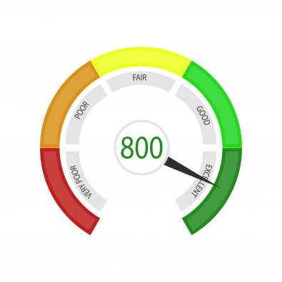
Self Scoring Model
Purpose: To narrow down the number of responses to review; sometimes used in concert with Down Select
Reduces costs and burden to industry
Helps the government narrow the field of competition
Provides objective information with which to base down select decision
Automated process scores the information provided by vendor
Possible Phase 1 approach
Questions give vendors good perspective on what is important
Example: Have interested vendors for this requirement self score their capability with the scope; use that response to support an advisory down select

Slide 80
Unique & Tailored Eval Factors
Mission Focused Evaluation Criteria
Should you always use:
  Technical Approach
  Management Approach
  Past Performance
  Price
What do you really care about? What matters to the mission?

Slide 81
BEGIN STEP 7
Manage Performance

Slide 82
Stakeholder Identification & Analysis
Notes:
CHATTERFALL –
Mission
Vision
Objectives
Success Factors

Slide 83
Stakeholder Analysis
Evaluate the level of power and interest for each stakeholder or stakeholder group: high, medium, or low
INFLUENCE (power) | IMPORTANCE (power)
Indicates a stakeholder’s relative power over and within a project. A stakeholder with high influence would control key decisions within the project and have strong ability to facilitate implementation of project tasks and cause others to take action. | Indicates the degree to which the project cannot be considered successful if stakeholder needs, expectations, and issues are not addressed. This measure is often derived based on the relation of the stakeholder need to the project’s goals and purposes. The users of the project’s product or service typically are considered of high importance.
COMMITMENT (interest) | ENGAGEMENT (interest)
Indicates the stakeholder's current level of commitment to the project's success. High commitment demonstrates a strong buy-in to the project, whereas low commitment is likely an indication of resistance to the project. | Indicates the level of involvement of the stakeholder in the project. High engagement may be indicated for stakeholders who are either regularly involved in project matters OR have a strong desire to be regularly involved in project matters.

Slide 84
High-Level Communications
Notes:
CHATTERFALL –
Mission
Vision
Objectives
Success Factors

Slide 85
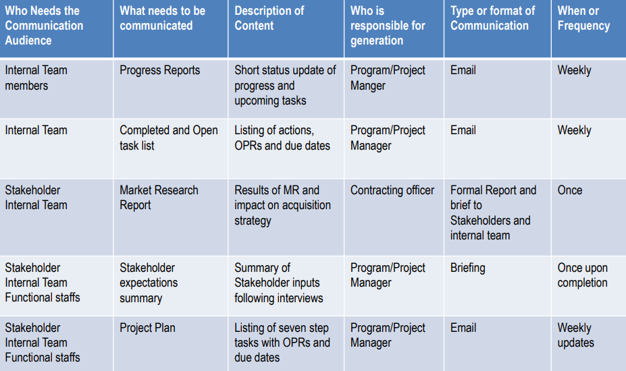
Communication Planning

Slide 86
Risk Identification & Analysis

Slide 87

Acquisition Risk Areas
Performance Risk: Is there an impact to technical performance and to what level? These risks generally have associated schedule and cost impacts, but should be carried as a performance risk.
Schedule Risk: Is there an impact to schedule performance and to what level? If the risk does not have a first order performance impact, then ask this question. If the risk does impact the critical path, then it impacts both schedule and cost, but should be carried as a schedule risk.
Cost Risk: Does the risk only impact life-cycle cost? If so, with no performance or schedule impacts, the risk is a cost risk.

Slide 88
RISK Management

Slide 89

Risk Analysis
Low Impact High
Low Likelihood High

Slide 90
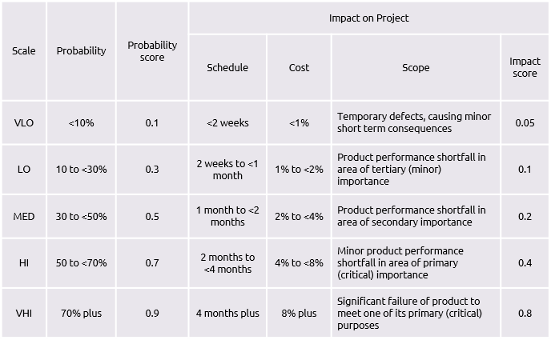
Risk Matrix Ratings

Slide 91
RISK STATEMENTS
RISK EVENT | CONSEQUENCES | Likelihood | Impact | Strategy
FORMAT: IF some event occurs, THEN some consequence is likely to result |  | 1 - 5 | 1 - 5 | Determine appropriate strategy based on risk rating (likelihood and impact)

Slide 92
Risk Strategies
Accept
When you simply accept that the negative impact of the risk is not worth the effort to take proactive steps to address.
Avoid
When you avoid the risk it means you change your plan to completely eliminate the probability of the risk occurring or the effect of the risk if it does occur.
Transfer
Risk transference occurs when the negative impact is shifted to a third party, such as through an insurance policy or penalty clause in a contract. The risk may still occur however the financial impact will be somewhat displaced.
Mitigate
Risk mitigation occurs when you proactively change the plan to minimize the impact or probability of the risk occurring. Risk mitigation does not eliminate the risk and as such there will be some residual risk remaining.
Amplify
Risk amplification occurs when you proactively change the plan to maximize the impact or probability of the risk opportunity occurring. Amplifying a risk is used when the consequences will benefit the team, stakeholders, the project or the organization.

Slide 93
CSAW Review

Slide 94
CSAW Review Assignments
TOPIC AREA | PRESENTER | TIMING
What we learned... |  | 2 min
What we did… (intro) |  | 2 min
Analysis of Current State |  | 2 min
Mission, Vision, High-Level Objectives |  | 2 min
Product Vision *** |  | 2 min
Market Research Questions |  | 2 min
Action - Result - Context & Performance Measures |  | 2 min
Path Ahead / Next Steps |  | 2 min
Program Perspective |  | 2 min
Contracting Perspective |  | 2 min

Slide 95
WHAT WE LEARNED

Slide 96
WHAT WE LEARNED
Steps to Performance Based Acquisition
Category Management Overview
Market Research Myths
Market Research Tools
Source Selection Innovations

Slide 97
Right Solution x Commitment to Solution =
Effectiveness of the Solution

Slide 98
WHAT WE DID...

Slide 99
PERFORMANCE BASED REQUIREMENTS
ROADMAP
Step 1 – Establish the Team
Learned Key Elements of PBA & Category Mgmt
Set Personal Objectives
Consensus on Mission, Vision, & Success
Consensus on Product Vision
Step 2 – Identify Objectives
Reviewed/Analyzed Current Approach
Consensus on High Level Objectives
1
2
Step 3 – Market Research
Developed Market Research Questions
Discovered Market Research Tools
Busted Market Research Myths
Learned about Market Research as a Service
3
Step 4 – Develop Work Statement
Discussed Work Statement Type
Brainstormed contract requirements
Began writing quality requirement statements (ACTION - RESULT - CONTEXT)
4
5
Step 5 – Define Measurement
Discussed writing effective performance standards for EACH performance requirement
Step 7 – Manage Performance
Began to assign roles and responsibilities
Briefly discussed resources for Stakeholder and Risk Management
7
8
6
Step 6 – Source Selection
Explored potential source selection innovations
Step 8 – Complete Closeout
Identified next steps and roadmap for completing the work
Document Lessons Learned
Celebrate Success!!!

Slide 100
ANALYSIS OF CURRENT STATE

Slide 101
Analysis of Current State Table
Doing Well… | Do More…
Do Less or Stop… | Do Differently…
Notes:
What are you doing now that you like doing and want to keep doing?
What doing now that you want to do more of?
What are doing now that you’d like to do less of or stop doing?
What would you like to differently moving forward?

Slide 102
MISSION – VISION – OBJECTIVES –

Slide 103
Vision - Mission - High Level Objectives
VISION:
HIGH LEVEL OBJECTIVES:
MISSION:

Slide 104
MARKET RESEARCH

Slide 105
Market Research Questions
Notes:
Four breakouts, eight minutes.
You are going to brainstorm as many questions as you can possibly think of. There are no wrong questions. Later on, you can decide which questions you will actually ask industry. This is a brainstorming exercise. Whoever comes up with the most questions wins a prize (bragging rights for the rest of the day).
One idea from each group. Keep going, or Chat dump depending on the energy.

Slide 106
A-R-C REQUIREMENTS & PERFORMANCE MEASURES

Slide 107
ACTION – RESULT – CONTEXT
ACTION: What do you want the contractor to do? | RESULT: What result or outcome do you want? | CONTEXT: What is it for? What mission? What program?
ORIGINAL: The Contractor shall train system end-users on how to use the system
REVISIONS: The contractor shall provide [A] training [R] to end-users on how to use the system The contractor shall deliver [A] a user manual [R] for all aspects of the system
NOTE: Everything after a preposition is context… some prepositions: to, for, by, with, around, on, under, ‘so’ (“so” is a preposition when it would otherwise be combined with “that”), after, through, of, at, in, between…
each requirement statement begins with The Contractor shall (or must)
Action verb
Result?
Context

Slide 108
PATH AHEAD – NEXT STEPS

Slide 109
NEXT STEPS
ACTIONS TO COMPLETE | Due / Timeframe | Responsible
Complete stakeholder ID and analysis
Identify the entire IPT and update roles & responsibilities
Identify Risks and develop high-level risk management plan

Slide 110
T&M/LH vs. FFP
FAR 37.102 Policy.
(a) Performance-based acquisition (see subpart 37.6) is the preferred method for acquiring services (Public Law106-398, section 821). When acquiring services, including those acquired under supply contracts or orders, agencies must-
(1) Use performance-based acquisition methods to the maximum extent practicable, except for-
(i) Architect-engineer services acquired in accordance with 40 U.S.C.1101 et seq.;
(ii) Construction (see part 36);
(iii) Utility services (see part 41); or
(iv) Services that are incidental to supply purchases; and
(2) Use the following order of precedence (Public Law106-398, section 821(a));
(i) A firm-fixed price performance-based contract or task order.
(ii) A performance-based contract or task order that is not firm-fixed price.
(iii) A contract or task order that is not performance--based.

