Slide 1


Welcome
Big and Small Benefits of Subcontracting &
the SBA Mentor-Protégé Program

Slide 2
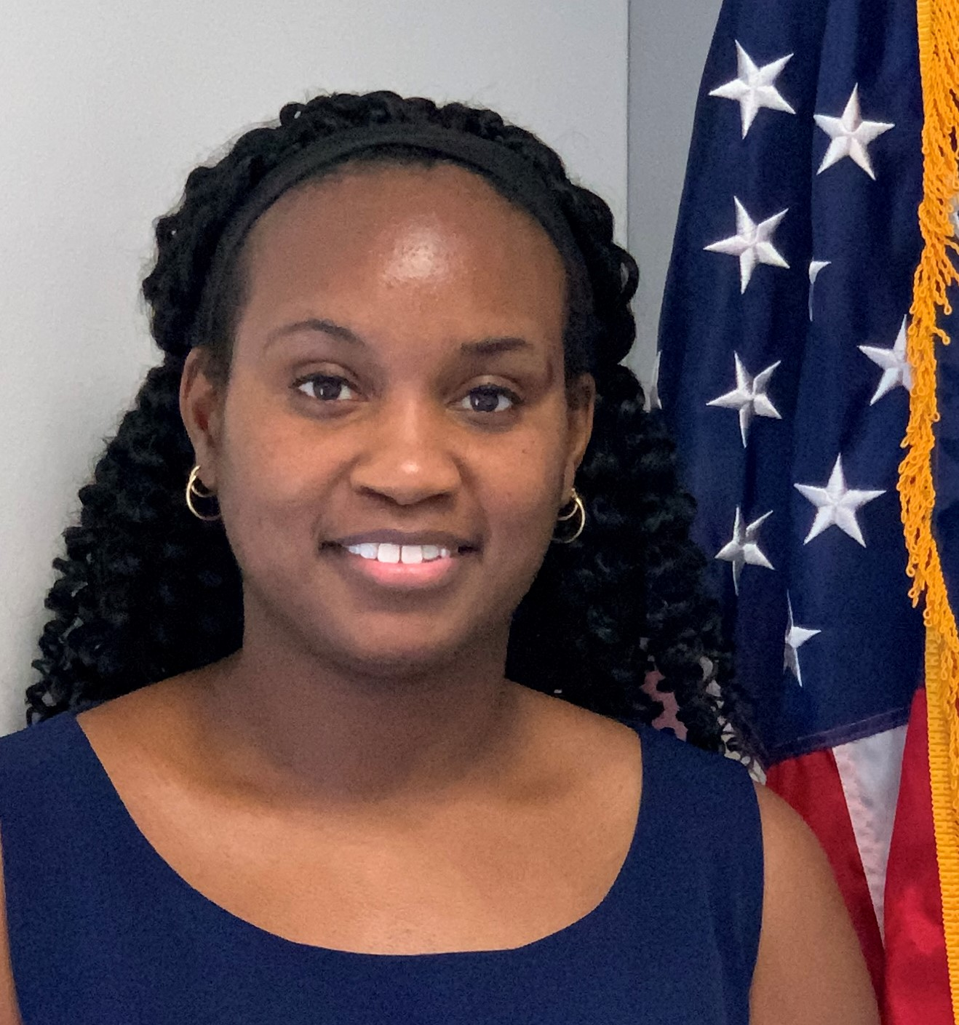


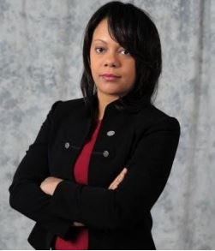
INTRODUCING TODAY’S MODERATOR & PANELISTS
Carena Jackson
Subcontracting Program Manager, GSA
Moderator
K.A. Perkins,
Deputy Director, Mentor - Protégé Program, SBA
Panelist
Paul Baumgartner,
Business Development Executive, GDIT
Panelist
Sheila Edmondson, Procurement Technical Assistance Specialist, DC PTAC
Panelist

Slide 3

SMALL BUSINESS WORKS 2021
SMALL BUSINESS WORKS 2021
QUESTION:
How does a Small Business get started building a relationship with a potential prime contractor?
Notes:
Sheila
Paul
Kanika

Slide 4
QUESTION:
SMALL BUSINESS WORKS 2021
What do primes look for in successful subcontractors?
How would a small business differentiate itself from other businesses that may compete for the same subcontracting positions?
Notes:
Sheila
Paul

Slide 5
QUESTION:
SMALL BUSINESS WORKS 2021
If a prime has won a large contract, what should a small business do to get involved?
What does it take to get on a team?
Notes:
Paul
Sheila

Slide 6
QUESTION:
SMALL BUSINESS WORKS 2021
What does it take to get into a Mentor-Protégé relationship with a prime?
Notes:
Kanika (2-3 minutes)
Paul (2-3 minutes)

Slide 7
QUESTION:
SMALL BUSINESS WORKS 2021
What can a new small business do to be procurement ready– being ready to support immediate and long term opportunities?
Notes:
Kanika
Paul

Slide 8
Questions?

Slide 9
Contact us:
Sheila Edmondson
Sheila.Edmondson@dc.gov
GDIT
smallbusiness@gdit.com
K.A. Perkins
sbampp@sba.gov
GSA Subcontracting
osdbusubcontracting@gsa.gov

Slide 10
Small Business Resources
U.S. General Services Administration (GSA) - https://www.gsa.gov
  Office of Small & Disadvantaged Business Utilization (OSDBU) - https://www.gsa.gov/osdbu
  Federal Acquisition Service (FAS) - Commercial Products & Services - https://www.gsa.gov/fas
  Public Buildings Services (PBS) - Construction, Architecture, Interior Design, and Real Estate - https://www.gsa.gov/pbs
Small Business Administration (SBA) - https://www.sba.gov
  SBA Size Standards - https://go.usa.gov/xFR9p
  Small Business Loans - https://go.usa.gov/xFRPD
Procurement Technical Assistance Centers (PTACS) - https://www.aptac-us.org/
System for Award Management (SAM) - https://go.usa.gov/xFNkS
Federal Agency Procurement Forecasts - https://go.usa.gov/xFRbn

Slide 11
Thank You!

