Slide 1



Welcome
Big Data for Small Businesses at SAM.gov!

Slide 2
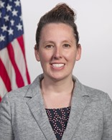
Training Overview
Today’s Presenter
Multiple Award Schedule (MAS) Program Overview
Is MAS a Good Fit
MAS Offer Process and Roadmap
Learning Resources & Technical Support
Stephanie Shutt
Director MAS PMO,
U.S General Services Administration

Slide 3

This Session will cover:
This Session will cover:
Provide you with a basic understanding of the Federal Procurement Data System (FPDS).
I want you feel comfortable with the terminology to understand how to access information in the system.
Understand what information can be provided in FPDS to help you conduct market research.
How to access basic information needed to run an Ad-Hoc Report.

Slide 4
POLL
POLL:
Do you currently use SAM.gov to conduct data analysis?

Slide 5
Steps to Developing Leads in the Federal Market
Steps to Developing Leads in the Federal Market
What contracts are set to expire that I can compete for in the future?
Who are my competitors? Who holds the current contract?
How much are they buying? Have they awarded any set-asides?
Which federal agencies are purchasing my product or service?

Slide 6
Let the Data Refine Your Strategy
Let the Data Refine Your Strategy:
Use Data to Develop a Targeted Strategy
Choose the Right Event to Attend
Maximize Time at Matchmaking Events
Know which Agency Forecast Tools to Use
Become More Efficient
And much more!

Slide 7

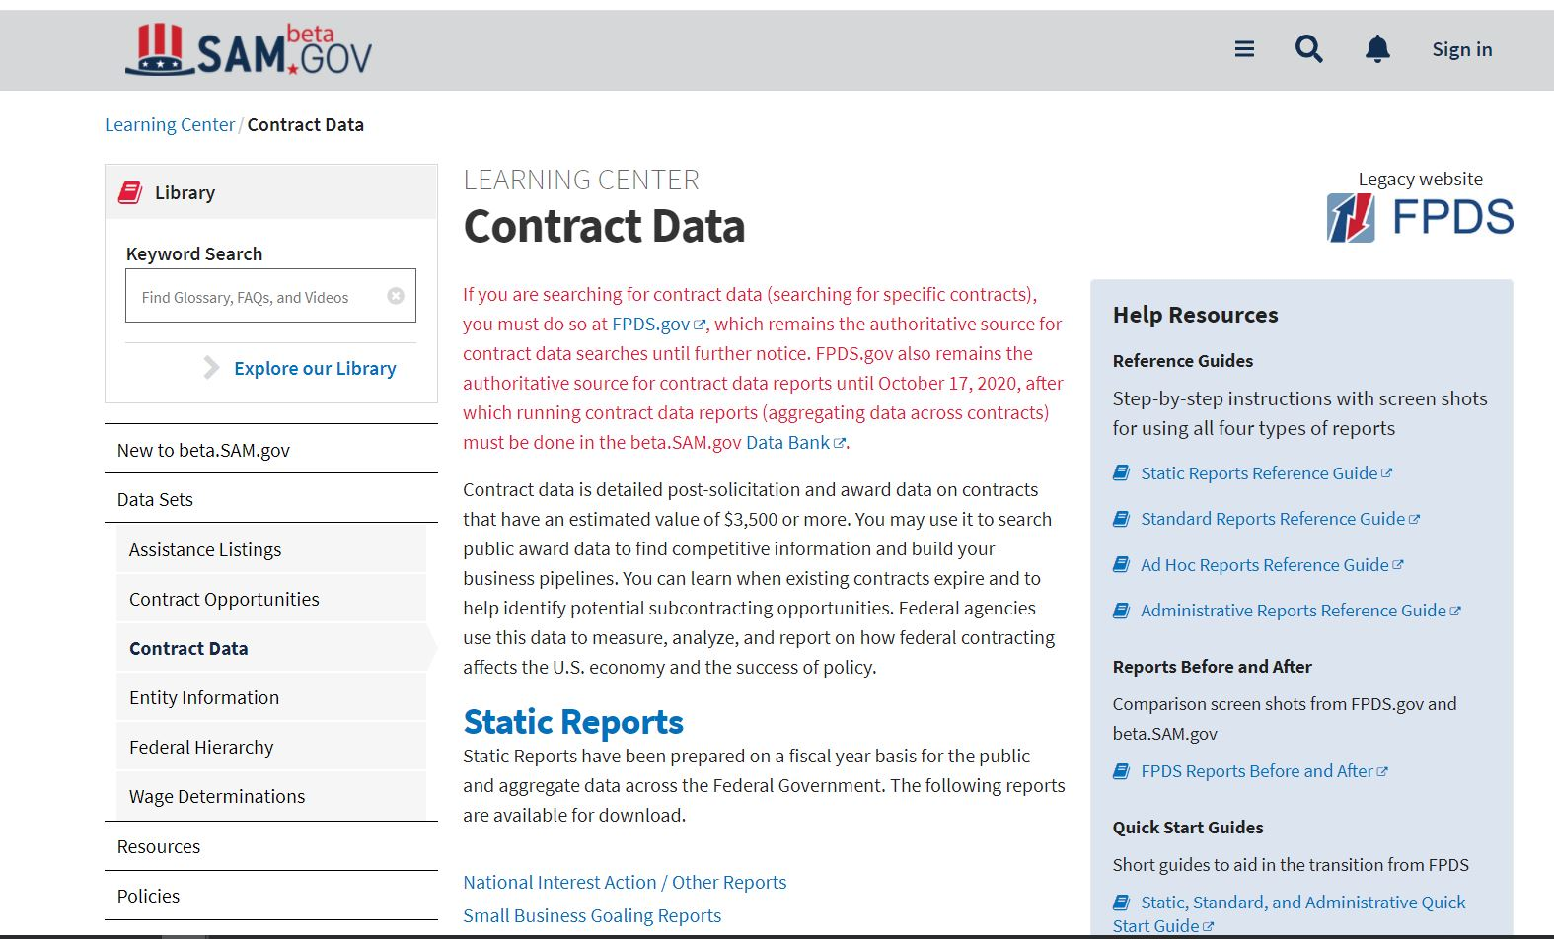
SAM.gov
What is reported to FPDS:
Contract actions valued at $10,000. Every contract modification is reported as well.
Where is the data from?
The data is fed from 90+ agency contract writing systems.

Slide 8
SAM.gov
Migrated the FPDS reporting function to SAM.gov on Oct 17th.

Slide 9
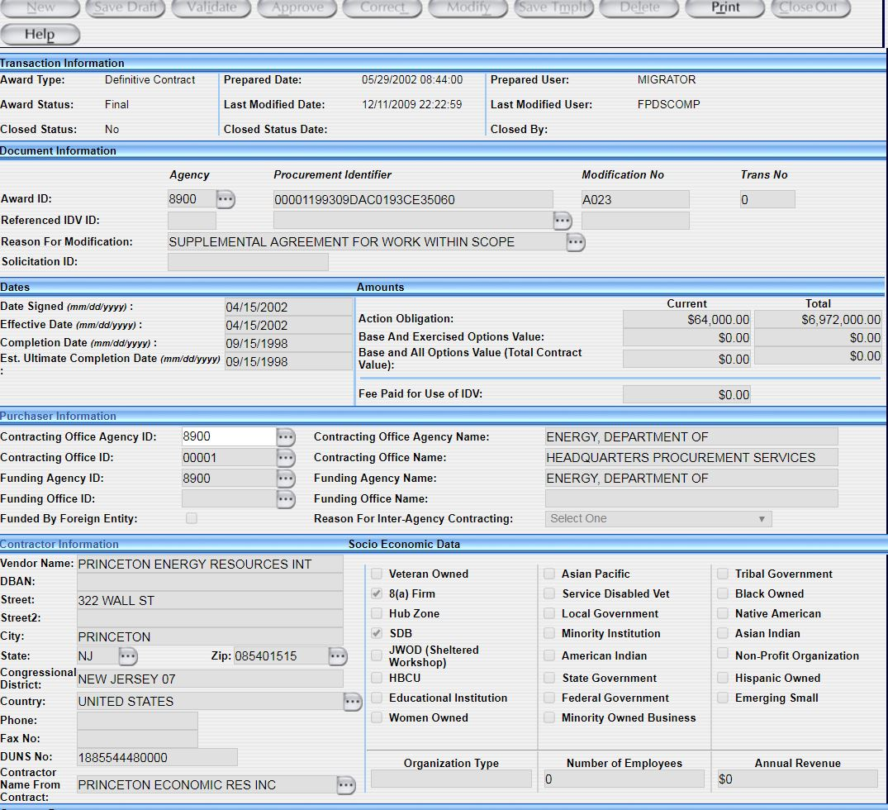
Contract Action Report (CAR)
ABC123
00000-0000-0000
Notes:
Some key areas of the CAR that are provided to FPDS:
Dates of when the Contract was Awarded, when it is in effect, and when does it end
Purchaser information: which agency is using this product or service
And the supplier, the company who has been awarded this contract and what type of business they are… in other words your competition.

Slide 10
POLL
POLL:
Do you know your Product Service Code (PSC)?

Slide 11
NAICS and PSC
1. Industry Classification used to identify specific types of industry.
2. NAICS is a broad classification
3. The NAICS is what you do
NAICS
1. PSC’s can help you narrow down what exactly your business does
2. PSC’s are specific and can yield better data for market research and analysis
3. Your PSC is how you are doing it
PSC

Slide 12
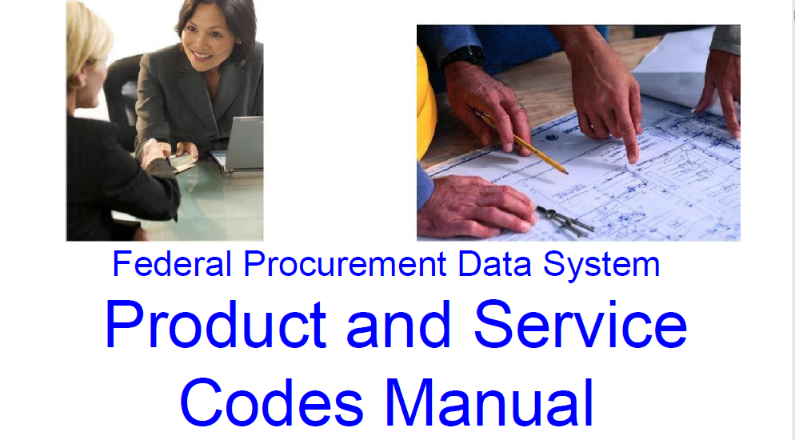

To Start: 3 Steps
Step 1
Locate your PSC
Step 2
Register in SAM.gov
Step 3
Conduct your research in SAM.gov

Slide 13
Live Demonstration

Slide 14
Questions?

Slide 15
Where to find help
Where to find help:
Help Desk: 866-606-8220
Website: www.fsd.gov

Slide 16
Small Business Resources
U.S. General Services Administration (GSA) - https://www.gsa.gov
Office of Small & Disadvantaged Business Utilization (OSDBU) - https://www.gsa.gov/osdbu
Federal Acquisition Service (FAS) - Commercial Products & Services - https://www.gsa.gov/fas
Public Buildings Services (PBS) - Construction, Architecture, Interior Design, and Real Estate - https://www.gsa.gov/pbs
Small Business Administration (SBA) - https://www.sba.gov
SBA Size Standards - https://go.usa.gov/xFR9p
Small Business Loans - https://go.usa.gov/xFRPD
Procurement Technical Assistance Centers (PTACS) - https://www.aptac-us.org/
System for Award Management (SAM) - https://go.usa.gov/xFNkS
Federal Agency Procurement Forecasts - https://go.usa.gov/xFRbn

Slide 17
Thank You!

