Slide 1



Basics of government contractors for beginners
Katey Sherrick Blair
OK APEX Accelerator
918-348-7940
Katey.blair@ictech.edu
Fabiela Kemble
OK APEX Accelerator
918-348-7938
Fabiela.kemble@ictech.edu

Slide 2
Webinar topics
What is an APEX Accelerator, formerly PTAC?
Services Offered
NAICS Codes
Documents to Gather for SAM Registration
SAM Registration By Section
Market Research – DSBS Profile

Slide 3
What is OK APEX Accelerator?
APEX Accelerator, formerly PTAC – Was established to increase the number and range of businesses capable of participating in government contracts. Provides technical assistance to businesses interested in selling products or services to federal, state, and local governments. Additionally, Apex Accelerators can help your small business determine if you’re ready for federal contracting. Click here for the PTAC Search Tool.
Our program is funded through a partnership with host sites like the Indian Capital Technology Center, the OK Dept. of Career & Technology Education, and a cooperative agreement with the Department of Defense.

Slide 4
services offered by OK APEX
One-on-One Counseling
Federal Registration Assistance
NAICS, Product/Service & Commodity Codes Identification
SBA Certification Applications
Bid Matching Service
Capabilities Statements
Solicitation Interpretation
Proposal Guidance & Review
Subcontracting Assistance
Free or Nominal Fee Workshops

Slide 5
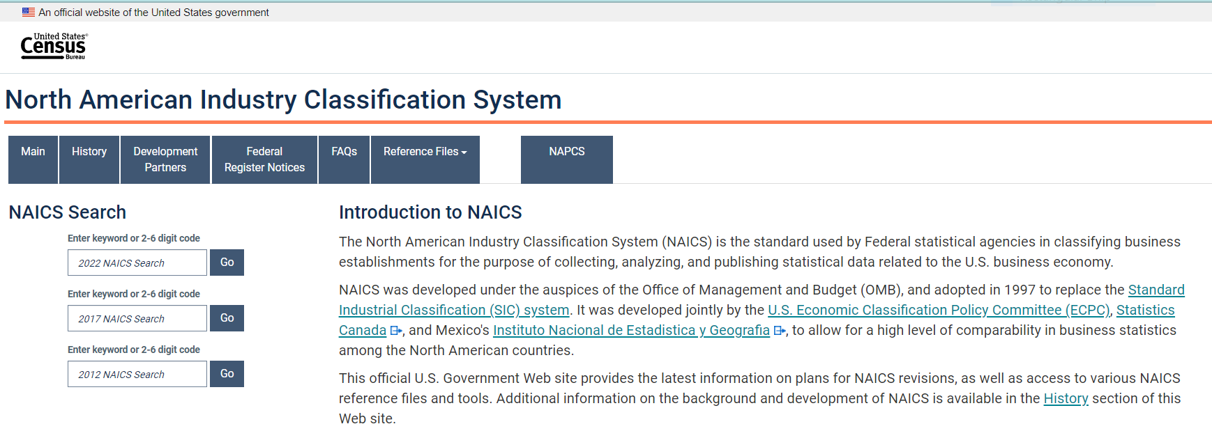
What is a naics code?
The North American Industry Classification System (NAICS) is the standard used by Federal statistical agencies in classifying business establishments to collect, analyze, and publish statistical data related to the U.S. business economy. - https://www.census.gov/naics/
NOTE: NAICS Code for your product or service designates your small business status.
Click here for a direct link.
Notes:
The census.gov/naics is the official site the federal government uses to identify the industry codes that fit the goods or services you offer for sale in the commercial and federal government market. A company must determine their primary NAICS but you may also have additional codes. DEMO USING THIS SITE

Slide 6
NAICS Codes – Small Business Administration (SBA) Size Standard – Small or Large Business Determination
Common terms
There are some common terms you should be familiar with to help you ensure that a business is classified correctly as small.
Affiliates: You must include the employees or receipts of all affiliates when determining the size of a business. Affiliation with another business is based on the power to control, whether exercised or not. The power to control exists when an external party has 50% or more ownership. It may also exist with considerably less than 50% ownership by contractual arrangement, or when one or more parties own a large share compared to other parties. Check the SBA’s compliance guide for size and affiliation for more detailed information.
The SBA determines affiliation in accordance with 13 CFR 121.103.
Annual receipts: This is the “total income” (or “gross income”) plus the “cost of goods sold.” These numbers can normally be found on the business’s IRS tax return forms. Receipts are averaged over a business’s latest three complete fiscal years or (except in the Business Loan and Disaster Loan Programs) five complete fiscal years to determine the average annual receipts. If a business hasn’t been in business for five years, multiply its average weekly revenue by 52 to determine its average annual receipts.
The SBA calculates annual receipts in accordance with 13 CFR 121.104.
Employee calculation: This is the average number of people employed for each pay period over the business’s latest 12 calendar months. Any person on the payroll must be included as one employee, regardless of hours worked or temporary status. The number of employees of a concern in business less than 12 months is the average for each pay period that it has been in business.
The SBA calculates number of employees in accordance with 13 CFR 121.106.
You can find the full definitions of these terms, and others, in 48 CFR 19.
Notes:
The number of employees for the past 12 months or the gross average receipts for the past 3-5 years determines if you are large or small according the SBA. This is important since contract opportunities in the federal marketplace are open to either large or small businesses. The Federal Acquisition Regulations and Code of Federal Regulations are the governing oversite for federal procurement. They define the eligibility requirements to be eligible for small business set asides like WOSB, EDWOSB, VOSB, SDVOSB & HUBZone.

Slide 7
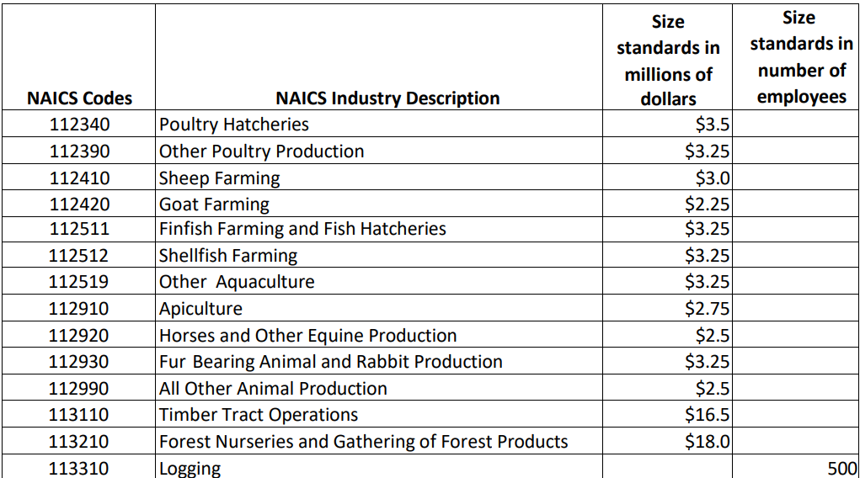
Click here for the table of size standards.
Notes:
Example of Size Standards Table

Slide 8
First Steps to Prepare for Contracting with Federal Government
The following items are needed:
  Legal Business Name
  Legal Evidence of Business Start Date
  Physical Address
  Your Federal EIN/TIN Number
  NAICS Codes
  Your Business Bank Routing & Account Number
  Average 3-5 Years Sales Figures
Notes:
The government marketplace awards contracts to established businesses The legal business name needs to be consistent: all legal documents, as registered with the SOS, the EIN with IRS, etc. If you have a DBA it must also be registered with the SOS.
The physical business address should also be consistent with legal documents, IRS-EIN, and the SOS.

Slide 9

What is sam registration?
The System for Award Management (SAM) is the official U.S. Government system that consolidates the capabilities of several registration processes into one database.
For more information about SAM, click on the image below.
Notes:
A business must be registered in SAM to be eligible to submit offers for consideration and be eligible for contract awards. Be sure you are on the website with the Uncle SAM hat – it isn’t necessary to pay a 3rd party vendor to enter this information on behalf of your company. This registration requires an annual update to stay in active status.

Slide 10
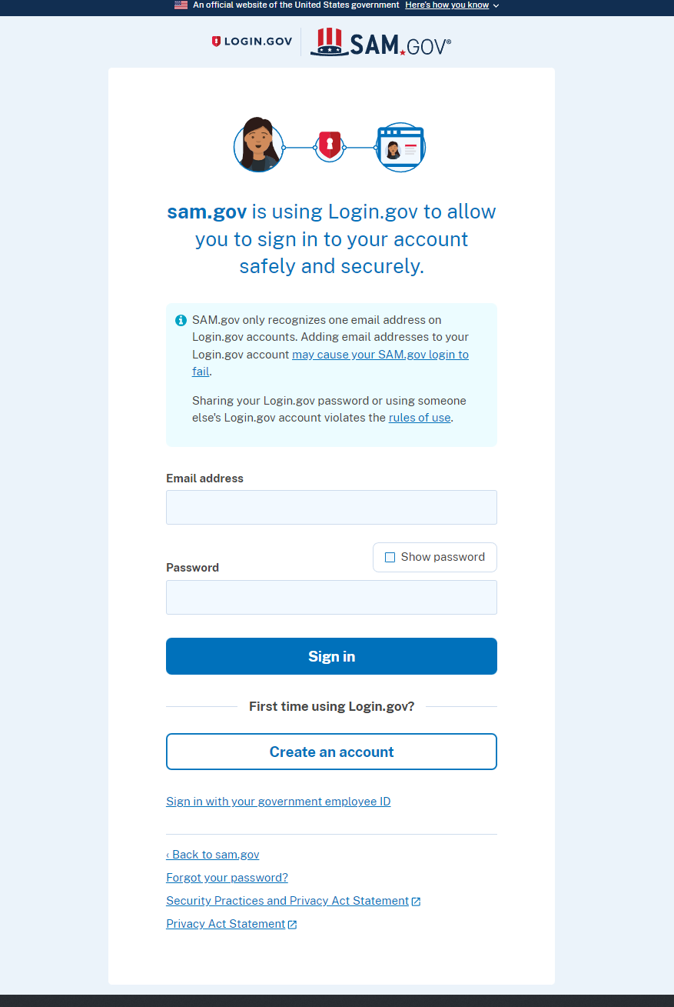

create login.gov account
For more information about LOGIN.GOV, click on the image below.
Notes:
The first step to prepare for SAM registration is to create a login.gov account. It is important to record the email address, password, and method of verification used in creating this account. Bring this information with you to your meeting with your OK APEX Accelerator.

Slide 11
SAM.gov – Workspace Section
  Complete your profile
    Name – Personal Legal Name
  Entity Administrator
    Owner/Officer Company
  Entity Users
    Create a User ID
      SAM.gov
      Create login.gov account
      Complete Personal Profile
      Request a Role with Company
Notes:
It is helpful to complete this step with your APEX Accelerator to help facilitate a successful result.
The Entity Administrator should be an owner/officer of the company. You may delegate the annual update process to a company employee.

Slide 12
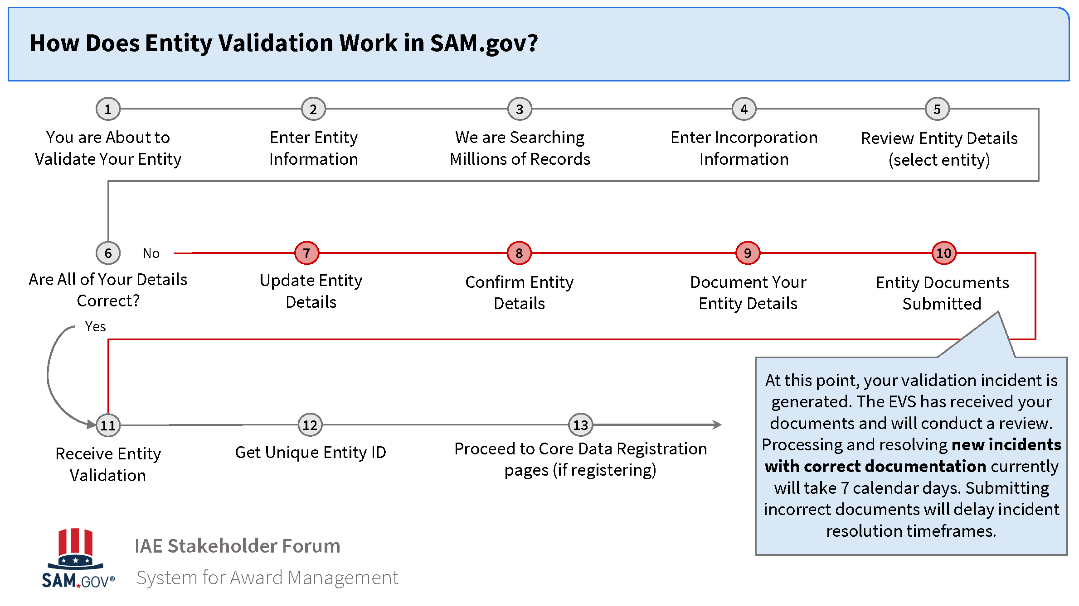
First STEP SAM Registration: Entity validation
Notes:
The SAM system has an Entity Validation process. This process requires verification documents to be uploaded into the portal that substantiate your legal business name, trade name if used, physical address of the business. If there has been a name change or a legal structure change evidence of these changes must also be provided.

Slide 13
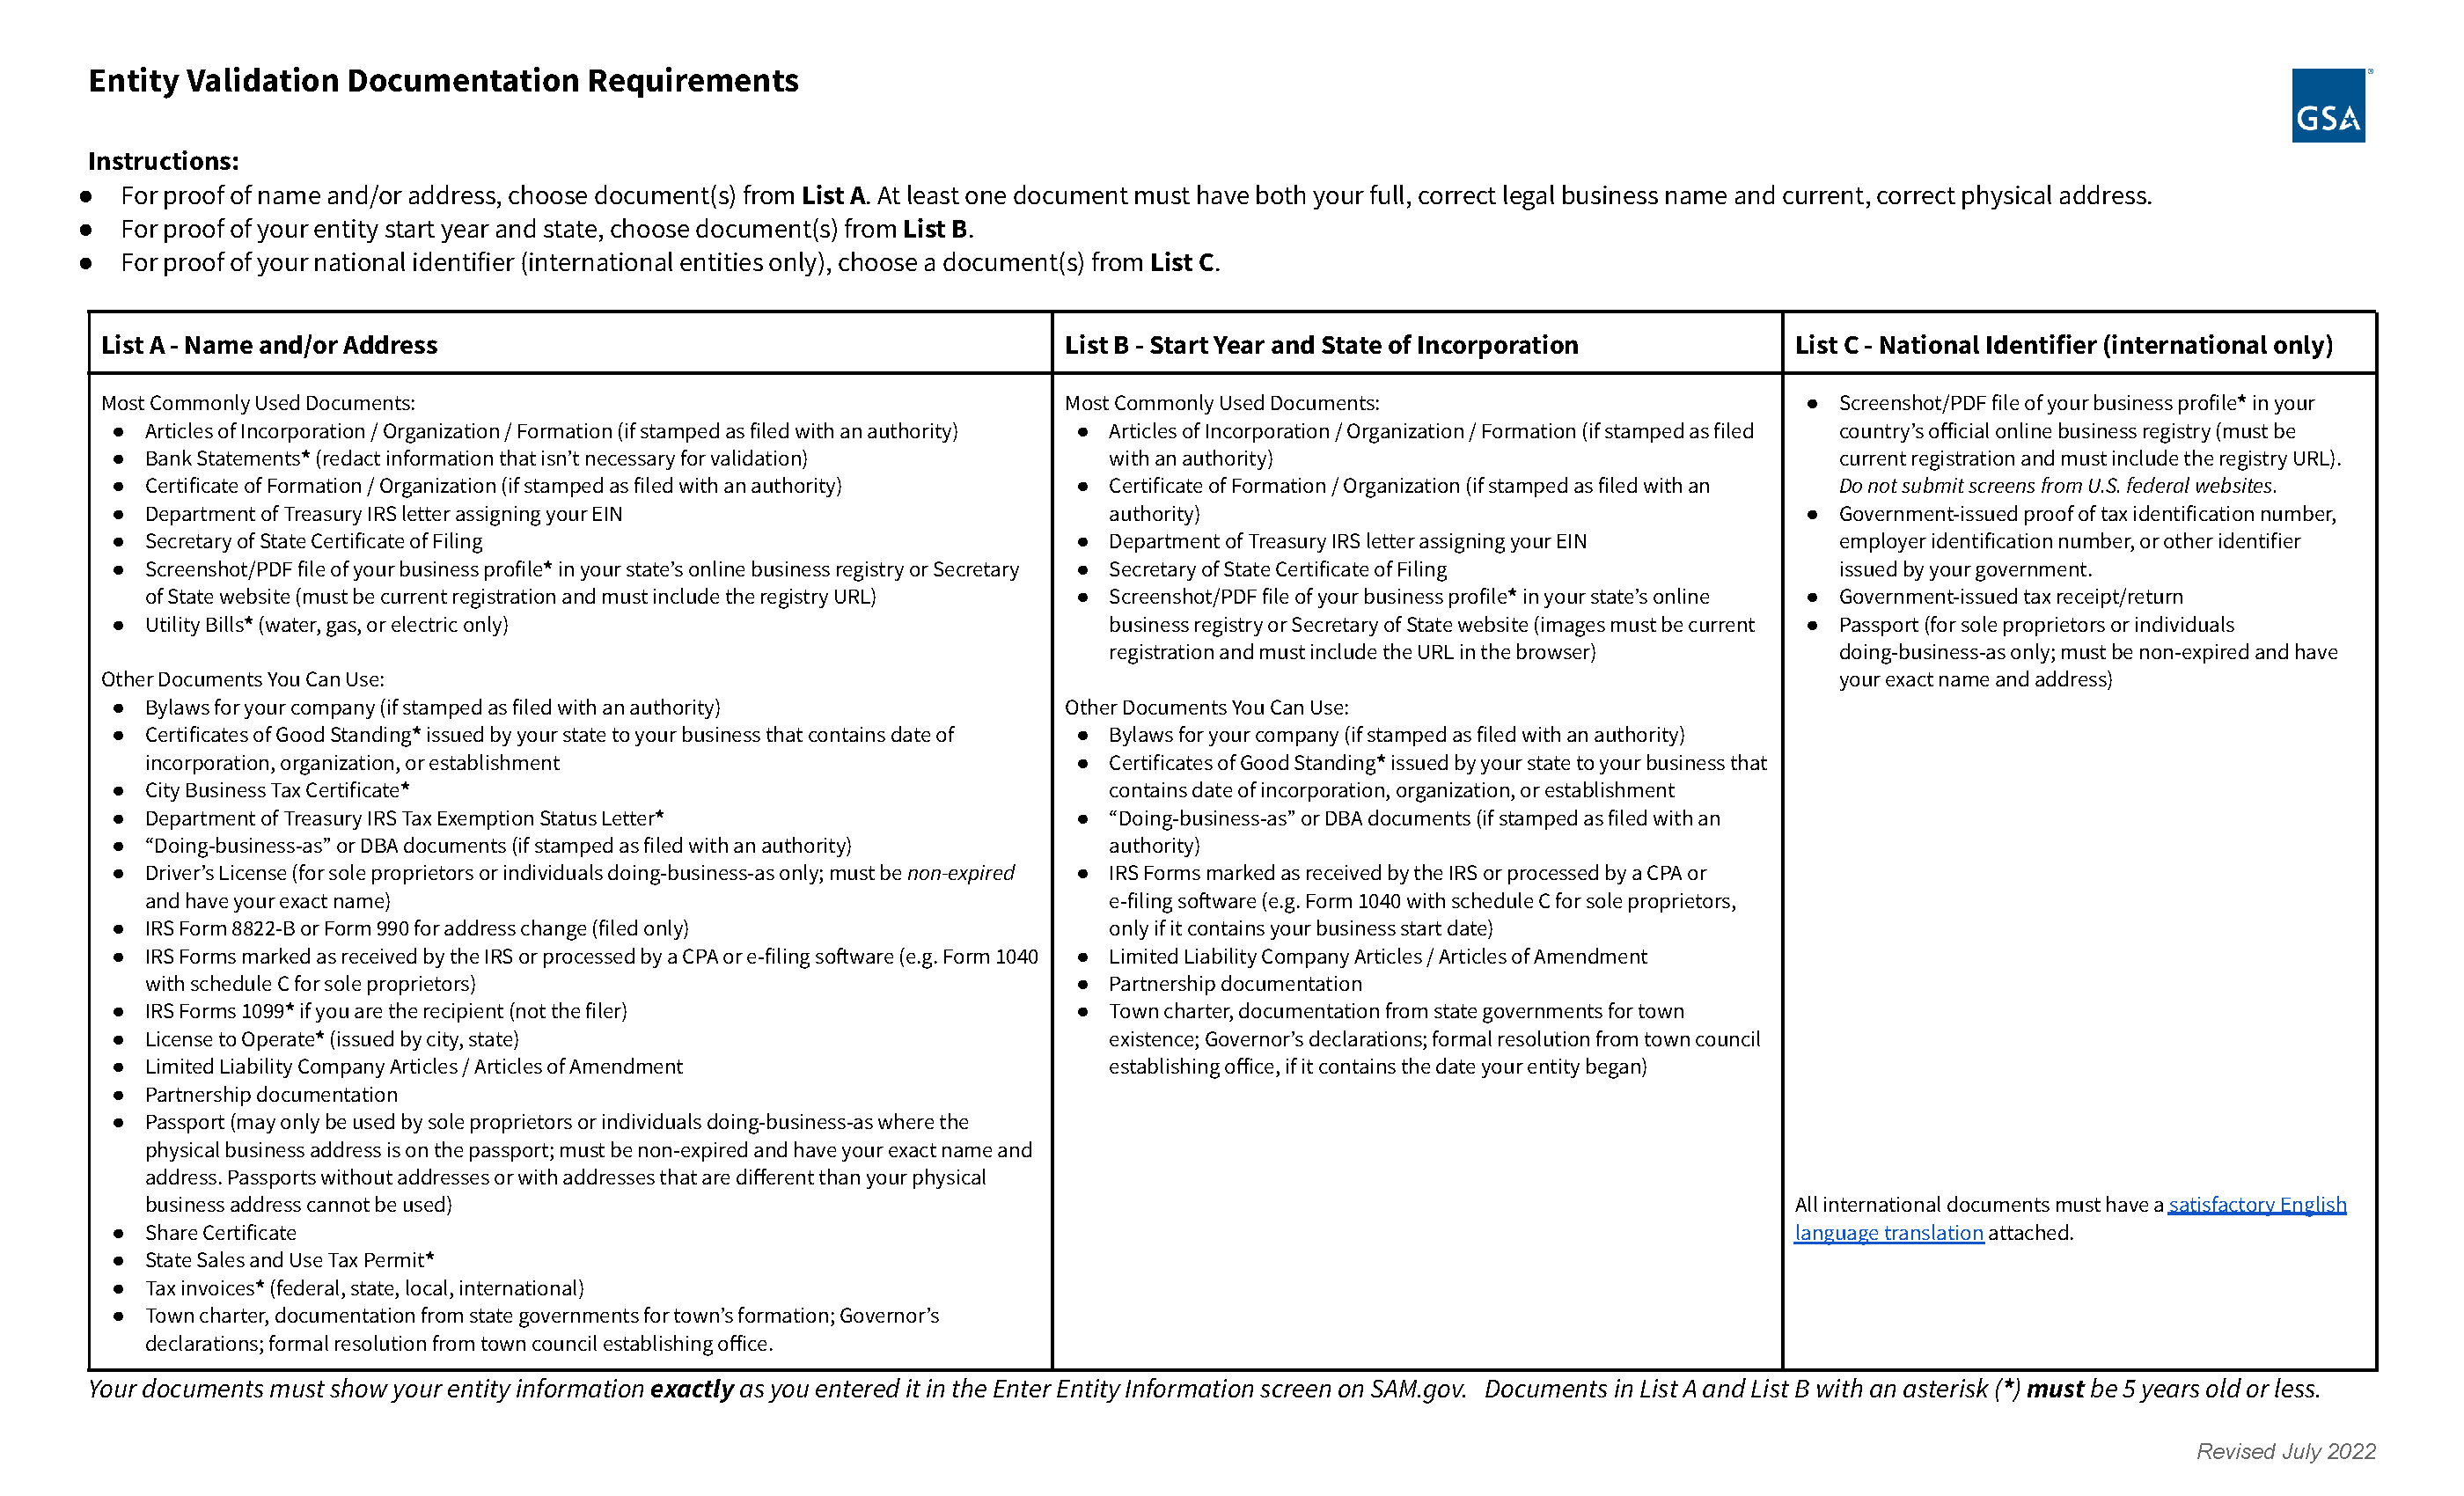
Click here for a direct link.

Slide 14
2nd Registering your business in sam
Core Data - information that will include:
  Start Date
  Business Website Address
  Your Email
  Your Phone #
  Legal Business Name
  Entity’s Physical Address
  UEI #
  Create MPIN – Do not lose this!
  Tax ID, Name and Address – Should match 1099 or W-2/W-4 forms

Slide 15
2nd Registering your business in sam
  Cage or NCAGE – One will be assigned if not already owned
  Ownership Details
  General Business Structure Information
  Bank Account Type
  Routing #
  Account #
  Bank Telephone #
  Total 3 – 5 Year Average Receipts – Must be $1 or more
  Average # Employees

Slide 16
2nd Registering your business in sam
Assertions
  NAICS Codes – One marked as primary
  PSC/FCS Codes - Optional
  Size Metrics
  Disaster Response Information
Representations and Certifications
  42 Questions – Reach out to your APEX for help!
Points of Contact
  Point of Contact for Accounting – who, email, phone
  Point of Contact for Electronic Business – who, email, phone, address
  Point of Contact for Government Business – who, email, phone, address
  SBA Profile Link – Submit registration first!
Notes:
Allow at least ten business days for your submitted registration to become active on SAM.gov. If your entity fails, you will receive an email with instructions. Check your spam or junk mail for emails.
Emails -

Slide 17
After submitting your SAM Registration
You will receive three emails from SAM.gov in the next few hours or days. They will not call or text you.
  Thank you for submitting your information.
  You have passed (or not) the IRS Validation.
  Congratulations; here is your CAGE Code.
Notes:
You will have to verify your identity before the submission is complete. The last email may take up to 10 days or longer to receive.

Slide 18
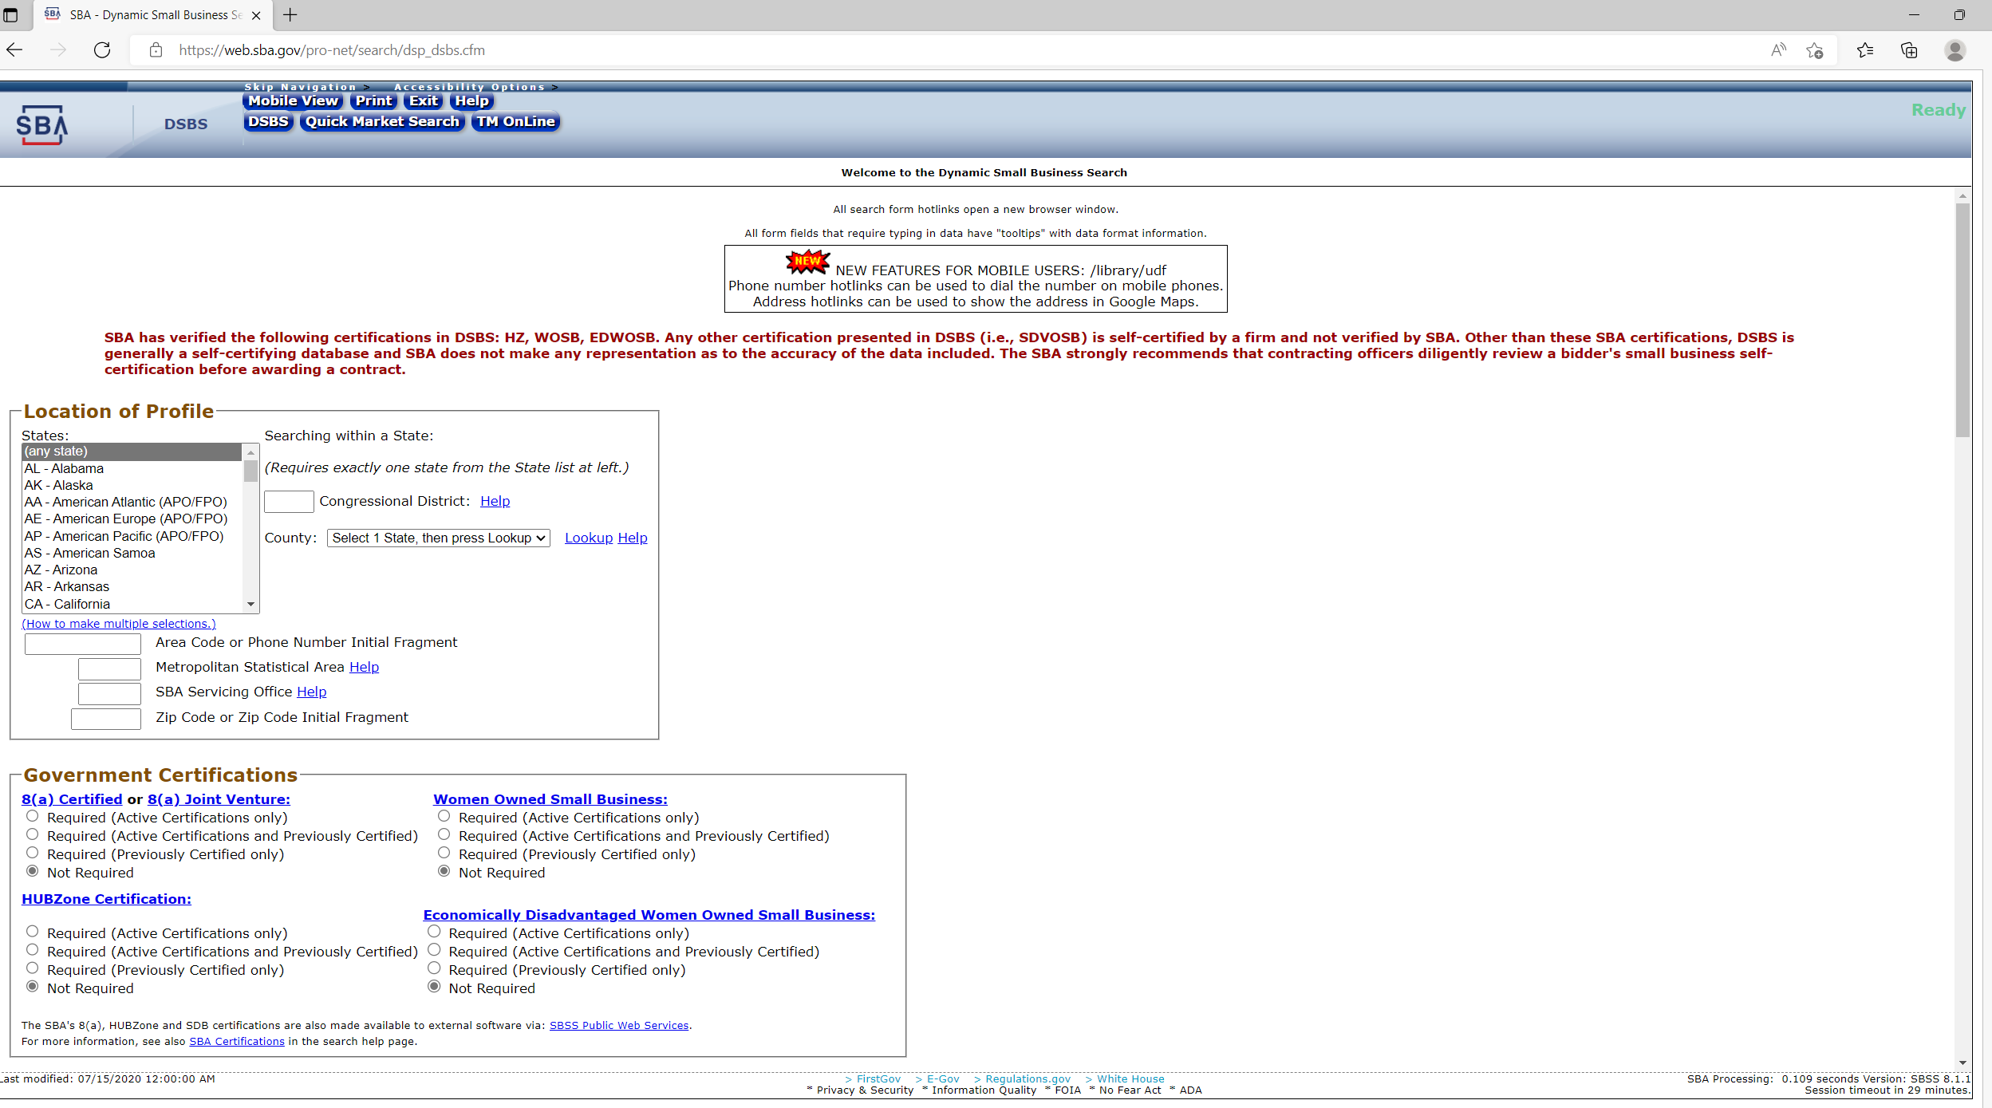
Dynamic small business Search Profile
In this search screen, you can check your data and look for competition.
Click here for a direct link
Notes:
This company registration is available at the end of completing the SAM registration via a link. However, due to the long length of the SAM registration process and glitches that sometimes occur in submitting your SAM profile record, we recommend completing this step separately. Also, since contract awards or product/service offerings may change prior to your annual SAM update it helps to access and edit this profile via the GLIS Login System.

Slide 19
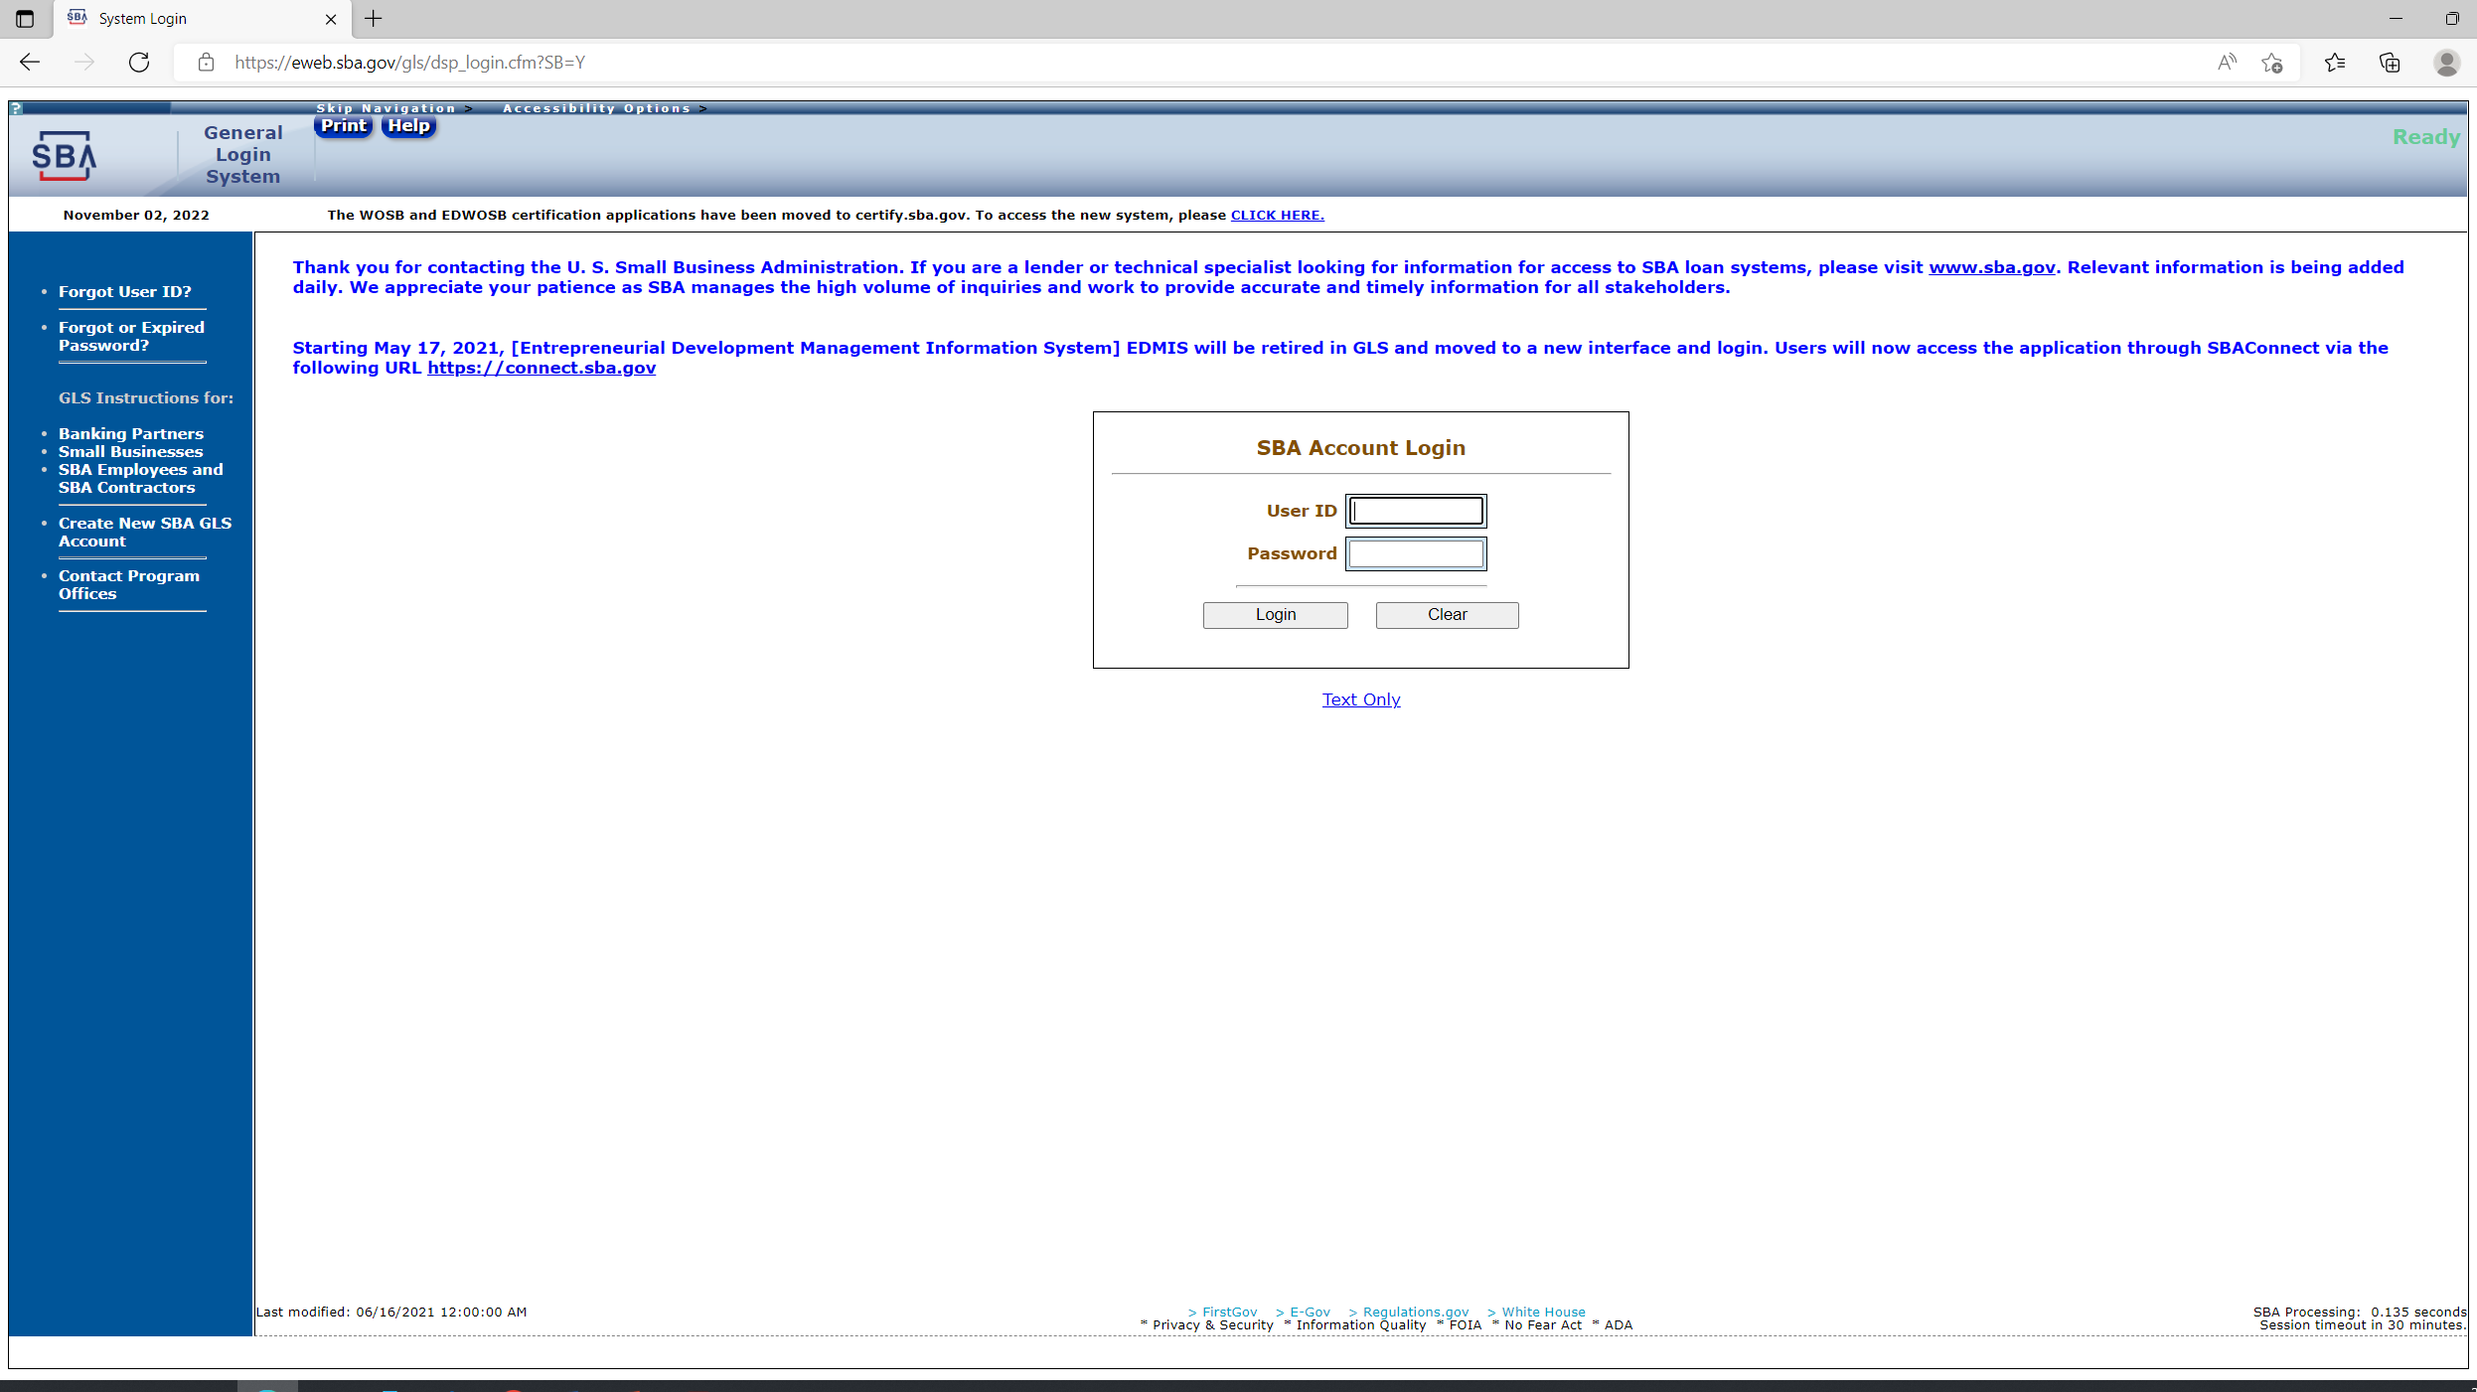
Sba glIs
(general log in system)
Use this website to update your company’s SBA Profile after you have successfully registered in SAM.
Click on Request SBA User ID.
Click here for a direct link.
Notes:
. Prior to logging on please develop a brief 2 – 3 sentence marketing brief to be included as your “capabilities narrative” and be prepared to provide “Past Performance” information on 3 or so of your most recent contracts, preferably from government contracts. This may include subcontracts as well, listing the person who can verify you performance as a subcontractor. This PP asked for a contact name, the agency/company, the $ value and beginning and ending dates of the contract. We recommend entering your own name as the contact name and phone number so you will have that first connection with the inquirer and to not grant easy access to contacts to your competitors.
Note this portal requires to you log in and change your password to maintain access. The SBA profile must be in active status to apply for the SBA set asides.

Slide 20


THANK YOU!
Katey Sherrick Blair
OK APEX Accelerator
918-348-7940
Katey.blair@ictech.edu
www.ictech.edu
Fabiela Kemble
OK APEX Accelerator
918-348-7938
Fabiela.kemble@ictech.edu
www.ictech.edu

