Slide 1


Small Business Works 2024
GSA’s OSDBU A.C.T.S on Maximizing Small Business Opportunities
U.S. General Services Administration

Slide 2
GT APEX Accelerator
GSA Small Business Works 2024
Tips for Writing Competitive Bids and Proposals 2024
“This APEX Accelerator is funded in part through a cooperative agreement with the Department of Defense.”

Slide 3

Today’s GA Tech APEX Accelerator Instructor
Nancy C Cleveland, CPP
Program Manager
Ga Tech APEX Accelerator-Statewide
nancy.cleveland@innovate.gatech.edu

Slide 4
Legal Disclaimer
This material is presented with the understanding that the Presenter is not rendering any legal or other professional service or advice. Because of the rapidly changing nature of the law and acquisition regulations, information contained in the presentation may become outdated. As a result, the user (You) of this material must always do your due diligence and research original sources of authority and update information to ensure accuracy when dealing with a specific matter.

Slide 5
Who We Are and What We Do
The GT APEX Accelerator (formerly GTPAC) is part of NAPEX, our national network of 96 APEX Accelerators, the District of Columbia and the Territories including Guam, Mariana Islands, Puerto Rico and the US Virgin Islands
Funded by the Department of Defense (DoD) Office of Small Business Programs, APEX Accelerators-us and administered by the Army Contract Command, Aberdeen Proving Ground, MD with matching funds from the University System of GA and administered by GA Tech EI2
GT APEX Accelerator is a program under the GA Tech’s Enterprise Innovation Institute (EI2)

Slide 6

Before You Respond to A Solicitation …
You need to know …

Slide 7
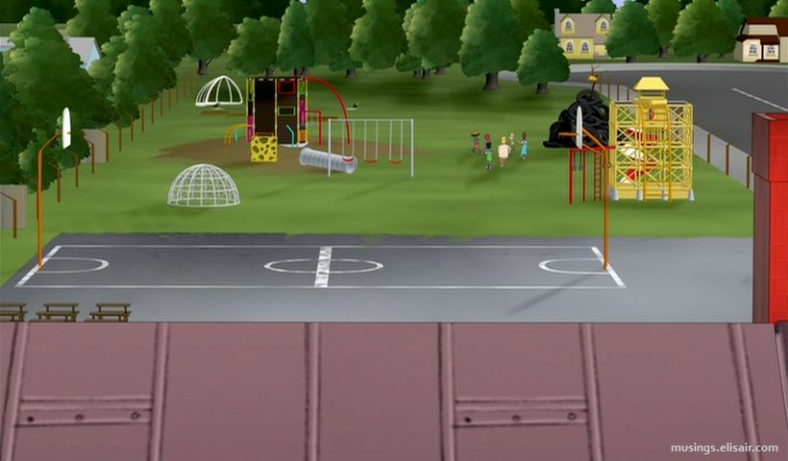
Mandatory Registrations to Play on the Federal Government’s Playground
SAM.gov
Buyers’ Databases
eVerify.gov

Slide 8
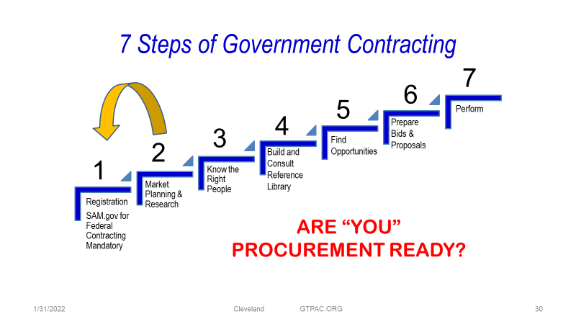
7 Steps to Government Contracting

Slide 9
Contract Methods
Dollar Values | Method | Discussion
<$10,000 | Micro-Purchase | Not Advertised – Contracting Officer Deems Price Reasonable
>$10,000 - <$25,000 Exceptions: $2,000 – Davis Bacon (Construction) $2,500 – Service Contract Act | Simplified Procedures Min for applying prevailing wage requirements Applies to contracts over this amount before prevailing wage rates are required | Not Advertised although sometimes posted locally. Oral or Request for Quotation (RFQ) Normally Reserved for Small Businesses
>$25,000 - <$250,000 | Simplified Acquisition Procedures (SAP) | Advertised in SAM.gov – Contracting Opportunities – Normally focused on Small Businesses
> $250,000 | Formal Large Contract | Advertised in SAM.gov Invitation for Bids (IFB), Request for Proposal (RFP), Set-asides if ≥ 2 or more capable certified 8(a), HUBZone, SD/VOSB, WOSB/EDWOSB will submit offers at fair market prices

Slide 10
Solicitation Types
Solicitation - An advertised invitation to submit a bid, a quote, or a proposal to fulfill a requirement of the government.
  Sources Sought – Market surveying. Interested parties submit their capabilities to determine their ability to perform. Often used to determine whether a set-aside to small businesses can be justified
  Pre-solicitation –Imminent solicitation, not yet ready for a formal bid. Usually issued at least 15 days before the Solicitation. Vendors normally are at liberty to pose questions and offer suggestions and information.
  Combined Synopsis/Solicitation – Streamlined award process usually for commercial items, butt can be used for services
  Request for Proposal (RFP) – Price and non-price factors
  Invitation to Bid (IFB) – Price and price-related factors
  Request for Quote (RFQ) – Standardizes vendor pricing; Requirement is described and buyer looking for pricing and payment standards
  Software as a Service (SAAS), Marketing as a Service(MAAS) et al.
  Special Notices

Slide 11
Special Process for A&E Services
Architectural/Engineering services are solicited differently.
Multi-stage process:
    Submit proposals.
    Gov’t makes “short list” of qualified firms/teams.
    Firms/teams interviewed, ranked.
    Price is negotiated with firm with team selected #1.

Slide 12
Formal Federal Government Contracting Process
1. Requirements
2. Market
Research
3. Solicitation Preparation
4. Proposal
Evaluation
5.
Award
6. Administration
7. Closeout

Slide 13
Due Diligence: Pre-acquisitions
Pre-Acquisitions | Market Research | Post Awards
Agency Forecasts Sources Sought/RFI – Influencing the acquisition Contracting Officials/Buyers, Program Managers, Users, OSBPs Current Contract Holders, Previous Awardees, Teaming Partners | Areas to influence for a competitive advantage include: Technical Scope Specifications Contract Type Small Business Requirement Pricing | Federal Procurement Data System iSearch for current and previous awards USASpending Agencies’ Websites Subcontracting References State and Local Opportunities

Slide 14
Due Diligence: Ghosting
Prospective Procurements, Sources Sought, Request for Information. Your discussions with COs/KOs, Program Managers, Small Business Specialists, User Department Heads pre-advertised procurements, forecast opportunities, etc. to gain business intelligence that may help the writer (government buyer) include or eliminate verbiage that could strengthen your prospects above the competition. This could be areas such as security clearances, contract vehicle selection, past performance, certifications, etc.
Your Competition. Ghosting is a proposal writing strategy where you highlight a competitor’s weakness or downplay their strengths without naming them. This occurs when you are in the process of developing your proposal in response to a Request for Proposal (RFP) or similar solicitation.
Proposal Writing. Your proposal response should include verbiage that diminishes the strong points of a potential competitor, examines weaknesses and/or marketing strategies of those businesses to promote your greater strengths and differentiators. Ref: SB Strategy & Small Business Performance

Slide 15
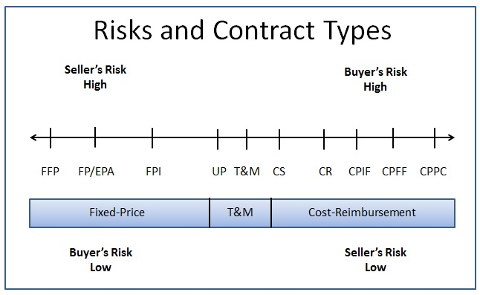
Decoding the Solicitation
Contract Types & Risks
Fixed Price | Cost
Most common; government prefers | Used only when cost can’t be fixed Examples: Cost Reimbursement, Incentive Fee, Time & Material

Slide 16
Decoding the Solicitation
Difference between Bids and Proposals
BIDS | PROPOSALS
Bids are submitted in response to Invitation for Bids (IFBs). Awards are made based on price and price-related factors. | Proposals are submitted in response to Requests for Proposals (RFPs). Awards are made based on price and non-price factors. Quality is most frequently considered.

Slide 17
Decoding the Solicitation
FEDERAL UNIFORM CONTRACT FORMAT
Every RFP and IFB, the government tells you the exact work you’ll be doing, how to organize the proposal, and how it will be scored and awarded.
Follow the RFP to develop your Response.
The Government is telling what their needs are – not what you envision they are or should be – and more importantly, how will you satisfy those needs.

Slide 18
Decoding the Solicitation
Federal Uniform Contract Format
Part 1 – The Schedule
Section A. Standard Form 18, 33, 30, 1449, etc.
Section B. Supplies or Services and Prices/Costs
Section C. Statement of Work (SOW) or Performance Work Statement (PWS)
Section D. Packaging and Marking
Section E Inspection and Acceptance
Section F Deliveries or Performance
Section G Contract Administration Data
Section H Special Contract Requirements
Part II – Contract Clauses
Section I. Contract Clauses
Part III – List of Documents, Exhibits and Other Attachments
Section J. List of Attachments
Part IV – Representations and Instructions
Section K. Representation and Certifications and Other Statements of Offerors
Section L. Instructions to Offerors
Section M. Evaluation Criteria for Contract Award

Slide 19

Decoding the Solicitation
  Getting Ready to Respond to an Invitation to Bid
Solicitation
Bid

Slide 20
Decoding the Solicitation
Buyer’s Request
Bid
Award
State the customer’s needs and requirements as you understand them. Avoid restating the government’s need verbatim. Now is the time:
  To list the products or services your company provides that will help the customer achieve their objectives.
  Compare costs of your product or service with one or more competitors.
  Submit your quote to incl. price-related factors; i.e., shipping & handling you want to be paid from the customer. This will be a firm-fixed price for common items.
If award is won, deliver. If award is not won, request a “debriefing” if applicable.

Slide 21
Decoding the Solicitation
  Getting Ready to Respond to a Request for Proposal
Solicitation
Proposal

Slide 22
Decoding the Solicitation
Understanding the Relationship between the Solicitation and Your Proposal
You Must Know This
To Understand This
Government Solicitation
Contractor Proposal
  SOW
  PWS
Section C
Technical
Past Performance
Price
Requirement
Section L
  Instructions to Offerors
Format
Section M
  Evaluation Factors
Degree of Value

Slide 23
Decoding the Solicitation
Responding to a Request for Proposal
Read and re-read it!
Read reference to the FAR and related Supplements
Assume nothing
Understand everything
If given the opportunity, submit questions within time-frame allotted
Order any specs and standards immediately
Bonus: Be aware of the type of solicitation and contract type

Slide 24
Decoding the Solicitation
Digest the Statement of Work (SOW)
Section C
Make sure you can perform all the work. If not, call in others who can assist.
Begin to articulate why you should be awarded the contract – avoid because of your small business cert(s).
Plan to incorporate this thinking into your proposal.
Be prepared to rate yourself objectively against any evaluation criteria.

Slide 25
Decoding the Solicitation
Understand the Terms and Conditions
Often called the “boilerplate.”
Don’t discount their importance.
No shortcuts – read the T’s & C’s at least once. (FAR and related Supplements)
Research anything you’re not sure of.
The government Expects YOU to Understand all the T’s & C’s.

Slide 26
Decoding the Solicitation
Abide by the Communications Rules
Early in solicitation process, two-way communication is common
Use Q&A period to get clarification re: vague portions of the solicitation (instructions, scope of work)
After Q&A period, communication with officials may be curtailed, even prohibited
Post-proposal submittal, communication may be limited
Familiarize yourself with exact rules
Do not email CO/KO asking when they will make award! Anticipated date should be in the solicitation.

Slide 27
Decoding the Solicitation
Before Responding to a Request for Proposal
READ and RE-READ and summarize in your own words what the customer’s needs and requirements as you understand them.
  Identify the “Must,” “Will,” and “Shall” actions contractors must fulfill
  Participate in pre-proposal conferences
  Submit and/or read, re-read answers to the Qs & As within the requisite time frame
  Envision how you can be a solution expert
  Offer ideas for RFP development/influence the solicitation esp. when responding to a Sources Sought
  Anticipate what will be called for
  Identify resources needed
  Form a team, if necessary

Slide 28
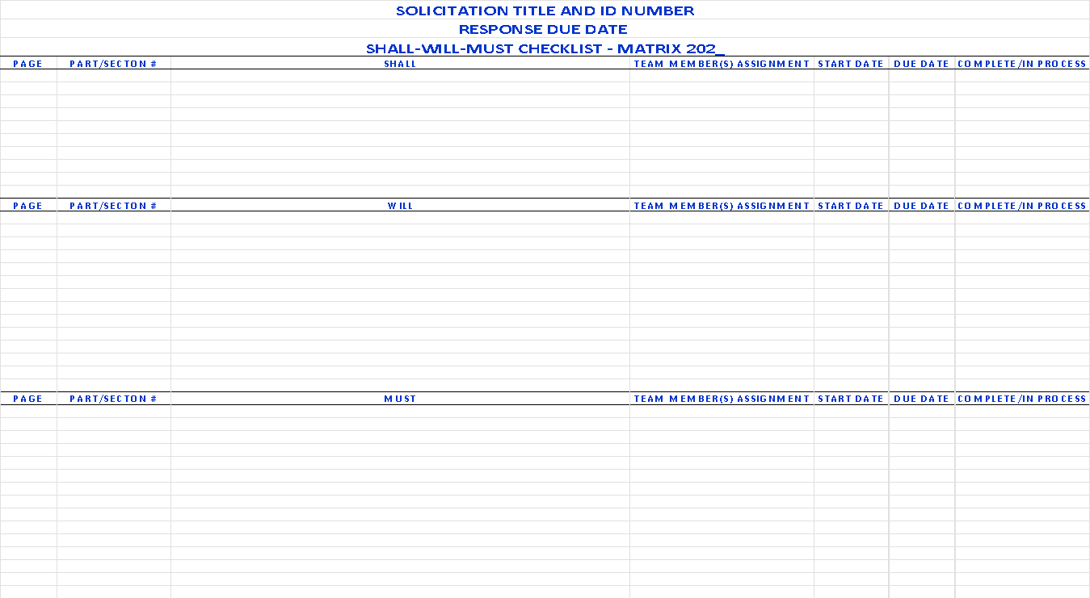
Decoding the Solicitation

Slide 29
Decoding the Solicitation
Anticipate What will be Called For
Work performed of similar size and scope. (Past Performance)
References
Evidence of financial capacity
Resumes of principals
Qualifications of team members
Vendor registrations
Certifications, representations and pre-approvals

Slide 30
Decoding the Solicitation
Determine Your Potential
Is the opportunity consistent with your business plan?
Do you have adequate capacity, equipment and personnel?
Do you have (or can you acquire) sufficient experience?
Can you beat the competition?
Is the risk manageable?
Can you make money?
Make a “Go / No-Go” decision … tool on next slide

Slide 31
Decoding the Solicitation
Go/No-Go Decision Tool
Proposal/Project Manager ___________________ |  |  |  |  |  |  |  | Name of Agency ____________________
Office Location ___________________ |  |  |  |  |  |  |  | Solicitation # ____________________
Business Unit ___________________ |  |  |  |  |  |  |  | Estimated Total Value ____________________
Estimated Proposal Cost _________________ |  |  |  |  |  |  |  | Per Year Value ____________________
Bid Factors | Bid Factor Scoring Scale |  |  |  |  |  |  |  |  |  |  |  | Estimated Score
 | Negative |  |  |  | Neutral |  |  |  | Positive |  |  |  | Our Company | Top Competitor
 | 1 | 2 | 3 |  | 4 | 5 | 6 |  | 7 | 8 | 9 | 10
1.Are you known by the client? | Unknown to this client |  |  |  | Known to client, but not fully cultivated |  |  |  | Well-developed working relationship; previous contracts
2.Is this the first you heard of procurement? | Did not expect RFP; unprepared |  |  |  | Generally up-to-date; no major negatives |  |  |  | Known 3-12 months; good favorable, confirmed intelligence
3.What is our overall technical capability/position? | Not qualified; weak relevant experience |  |  |  | Capable; understand problem; experienced |  |  |  | Can meet/exceed every requirement; technically superior
4.Can we provide proof of qualified staff? | Limited in-house staff available |  |  |  | Good in-house staff available |  |  |  | Best in-house staff available
5.Are subcontractors needed? | Yes, but will dilute position |  |  |  | Yes, but will have little or no effect |  |  |  | Yes, and will enhance overall proposal
6.What is the financial potential? | Marginal long term; no short-term return |  |  |  | Good long term; questionable short term |  |  |  | Excellent long term; excellent short term
7.Can we respond with a complete, compelling proposal? | Unclear understanding of problem/project needs; limited response |  |  |  | Understand problems, project & client needs; can respond |  |  |  | Can meet/exceed all requirements; have compelling story; know hot buttons
8.Who are our competitors? | Competitor is strongly favored or UNKNOWN |  |  |  | Open competition with no strong favorite |  |  |  | We are strongly favored over competition; incumbent
9.Is project within our geographic region? | Poor geographic presence/experience |  |  |  | Good geographic presence/experience |  |  |  | Strong geographic presence and experience
10.What is our pricing competitiveness? | Must cut corners; cost share; risky |  |  |  | Reasonable & competitive; reasonable risks |  |  |  | Honest, credible price within known limits; acceptable risks
Total score of factors evaluated
Maximum potential score (number of factors evaluated above times 10)
Decision (Total score should be about 75+% of maximum score for a "Go" decision, or better than the top competitor.) _______Go ________No Go

Slide 32
Responding to the Solicitation
The Technical Proposal
Attention to detail is paramount
Look for proposal-writing instructions in the RFP (Section L in federal RFPs)
Your proposal now will be viewed as your work later (no errors)
If you are asked 100 questions……. answer 100: not 99 - nor 101
You cannot be late!

Slide 33
Responding to the Solicitation
Master the Evaluation (Selection)Criteria Section M
Understand that these are the grounds on which you will be selected – or not.
If you were the buyer, think about what qualities in a vendor you would look for.
Create a method you can refer to the selection criteria, often and figure out how you can incorporate them into your proposal.

Slide 34
Responding to the Solicitation
The Purpose of Your Proposal Is to Sell & Win the Award
  Introduce yourself (company) in writing – highlight your company and capabilities.
  Emphasize your unique strengths, such as agility, innovation, and specialized expertise.
  Tailor your response to show a clear understanding of the project requirements and how your small business can meet them efficiently.
  Highlight past performance with similar projects which can demonstrate reliability and quality.
  Leverage partnerships or subcontracting with other small businesses enhancing your proposal by broadening the range of skills and services offered and aligning with the government’s small business participation goals.
  Present a Preeminent Solution!

Slide 35
Responding to the Solicitation
General Proposal Outline
Table of Contents
Executive Summary and/or Introduction – Who you are (incl. your team), and what the reader can expect in the following pages. This section has all the answers at a highly, concise level for the CO/KO, Contracting and Evaluation Team
Technical Approach – how you will technically perform the work required
Facilities
Management Approach
Key Project Personnel and Resumes
Past Performance
Risk and Risk Mitigation
Quality Control
Cybersecurity
Cost/Price Proposal – Requirement may be in a separate volume

Slide 36
Components of A Proposal
1 Page - Open with an introduction and statement of your capabilities. Here you will provide the reader with a snapshot of what is to follow.
1-2 Pages Executive Summary Umbrella statement of your capabilities and summary of the entire proposal. Specifically, it summarizes all of the key information and is a sales document designed to convince the reader that your business should be considered for the project. It should be no more than two pages and you should ask for the business. Keep in mind that this may be the only part of your proposal that the customer’s executive management will read.
2 Pages - Statement of Understanding
Why this project is necessary; what are the agency’s objectives?
It presents the facts and evidence that support the need for the project and establishes that your business understands the problems and, therefore, can reasonably address them.
You want the statement to be succinct, yet persuasive.

Slide 37
Components of A Proposal – Cont’d
3 Pages – Project Description
Nuts and bolts of how the project will be implemented and evaluated.
This administrative requirements. section of your proposal should have objectives, methods, staffing, and administrative requirements.
3-4 Pages - Methods by means of the Objectives, explain what will be achieved by the project.
The methods section describes the specific activities that will take place to achieve the objectives. Your methods should match the previously stated objectives. The methods section should present the order and timing for the tasks. You may need to defend your chosen methods, especially if they are proprietary or unconventional. This also addresses why the planned work must effectively lead to the anticipated outcomes.
You can answer this question in numerous ways, including using examples of other projects.

Slide 38
Components of A Proposal – Cont’d
1 Page - Budget/Pricing
The pricing for your proposal may be as simple as a one-page statement of projected expenses. Or your proposal may require a more complex presentation, perhaps including a page on projected support and notes explaining various items of expense or of revenue.
Make sure you document any assumptions you made when developing your pricing.
1 Page – Business Information
Highlight the history and governing structure of your business, its primary activities, and services. In describing the methods, you will have mentioned staffing for the project. Details about individual staff members involved in the project can be included either as part of this section or in the appendix, depending on the length and importance of this information.
You now need to devote a few sentences to discussing the number of staff, their qualifications, and specific assignments.
Ref: FDIC Office of Minority and Woman Inclusion

Slide 39
Components of A Proposal – Cont’d
2 Paragraphs - Conclusion
Every proposal should have a concluding paragraph or two. This section is also the place to make a final appeal for your project. If appropriate, you should outline some of the follow-up activities that might be undertaken to begin to prepare for starting the project.
Ref: FDIC Office of Minority and Woman Inclusion

Slide 40
Responding to the Solicitation
Assign Responsibilities and Update Task Schedule
Make sure everyone knows their role, who’s in charge, and what the deadlines are
Update proposal development schedule daily
Establish back-up plans
Don’t forget to allow time for delivery
Identify documents, specifications and standards needed.
Make a GANTT Chart
Proposal usually written by the Project Manager

Slide 41
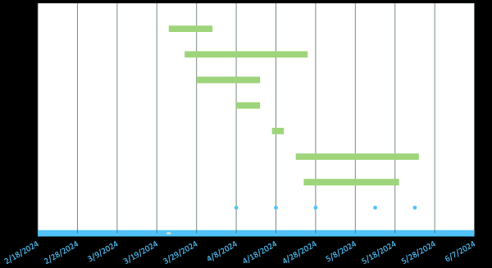
Responding to the Solicitation
SOLICITATION TITLE AND ID NUMBER
DATE TRACKING GANTT CHART

Slide 42
Responding to the Solicitation
Winning Proposals Characteristics
Always format your proposal/bid in the manner requested in the solicitation – this includes headings consistent with proposal layout. Your response should parallel them.
If they say respond by submitting documents or forms A, B, C, D and E in that order, your proposal should be in that same order: A, B, C, D, and E.
If the solicitation has vague instructions, you have more freedom to be creative.
Some solicitations have more rules and requirements than others.
Regardless, ALWAYS provide them EXACTLY WHAT THEY REQUEST
Your response should parallel them.

Slide 43
Responding to the Solicitation
The Cost/Price Proposal
When determining your costs/price
Factor in your direct costs (actual cost of the goods, labor, supplies, equipment) associated with implementing the one contract opportunity you’re bidding on and if awarded.
But don’t forget your indirect costs to perform (overhead + general and administrative expenses or G&A), this includes management salaries, utilities, insurance, bonding, rent, janitorial, office supplies, transportation, depreciation, legal fees, training, tax issues and liability

Slide 44
Responding to the Solicitation
The Cost/Price Proposal
Factor in a reasonable profit or fee
Direct costs + Indirect costs (overhead + G&A) + Profit/fee = Bid price
Army Contracting Guide:
  While overhead varies per type of contact, typically 15% of total direct costs
  G&A is normally between 12-15% of the sum of direct costs + overhead
        Formula: G&A + Overhead = Total Indirect Costs
Typical profit on fixed price contract is 5% (large) and 12% (small business, always somewhere between 5%-12%
If cost contract (reimbursed for actual costs), profit/fees on cost contracts generally run 5% for all firm sizes.

Slide 45
Responding to the Solicitation
The Cost/Price Proposal
Make best offer first time
Best And Final Offer (BAFO) request may come into play, but don’t count on it
Double-check numbers
Make it easy to read
  Not in business to lose money
  Recover costs & ROI
  Reasonable profit (govt. expects you will make some profit)

Slide 46
References
Service Contract Act (SCA) (Prevailing wage)
  http://www.dol.gov/whd/govcontracts/sca.htm
Davis – Bacon Act (Construction)(Prevailing wage)
  http://www.dol.gov/whd/govcontracts/dbra.htm
DFARS Contract Pricing Proposal Adequacy Checklist
  https://www.acq.osd.mil/dpap/dars/dfars/html/current/252215.htm#252.215-7009
Buy GSA.gov – Pricing Central
  https://buy.gsa.gov/pricing/
NASA cost estimating handbook
  https://www.nasa.gov/content/cost-estimating-handbook

Slide 47
Review Teams
Pre-submission Proposal Reviews
The Blue Team review ensures that the basic outline of the proposal is correct and complete and that a writer is assigned to each section.
The Red Team review should reflect the perspective of the customer’s evaluators/selection committee.
Even if you don’t have the resources to form Review Teams, know that review is essential!

Slide 48

Post Awards – Next Steps
CONGRATULATIONS! YOU JUST WON THE CONTRACT!
Now What?
Ya Gotta Perform/Deliver on What You Said You Can Do in your Bid or Proposal!

Slide 49
Contract Administration Roles
Contractor At a minimum, your company must… | Government At a minimum, the govt must…
Read the contract, and read it again and again and again… Go over the contract with the customer Understand all the key clauses, especially change clauses, the termination process, and the payment clauses Attend all meetings Produce the deliverables Submit invoices Resolve issues | Measure your progress against the project plan. Conduct inspections and audits of your work. Evaluate your compliance of legal & contractual requirements Process your invoice submittals

Slide 50
GT APEX Accelerator
Nancy C Cleveland
nancy.cleveland@innovate.gatech.edu
“This APEX Accelerator is funded in part through a cooperative agreement with the Department of Defense.”

Slide 51
Thank You!

