Slide 1

Global to Local: Lessons for Open Government & Civic Engagement for DC.
October 15, 2024

Slide 2

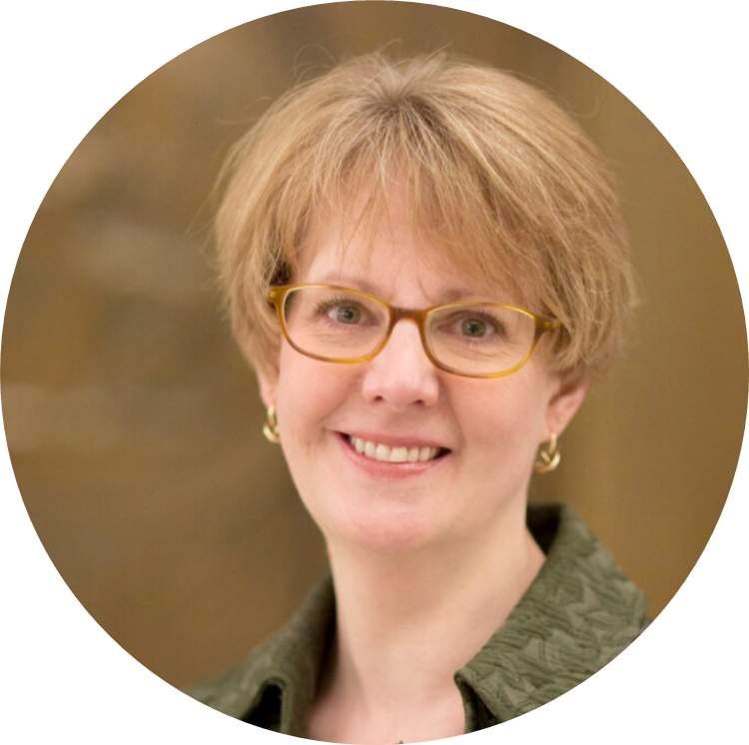

Kirsten Mitchell
President of the DC Open Government Coalition

Slide 3
Agenda
Time | Item | Presenter
5:00 PM - 5:05 PM | Welcome | Kirsten Mitchell, President of the DC Open Government Coalition
5:05 PM - 5:10 PM | Overview of international/national open government efforts and how they relate to local communities such as DC | Daniel York, Director, U.S. Open Government Secretariat, U.S. General Services Administration
5:10 PM - 5:20 PM | Keynote Speaker | Kathleen Patterson, D.C. Auditor
5:20 PM - 6:10 PM | Panel on Establishing a Transparency Reform Commission in DC Moderator: Tom Susman, Founder, DC Open Government Coalition, and four-term member of the federal FOIA Advisory Committee | Niquelle Allen, Esq. Director of the DC Office of Open Government Ginger Quintero-McCall, former Public Records Advocate, state of Oregon Robert Becker, Coalition board member who has drafted legislation to create a transparency reform commission in DC
6:10 PM - 6:25 PM | Q & A
6:25 PM - 6:30 PM | Closing | Kirsten Mitchell, President of the DC Open Government Coalition

Slide 4
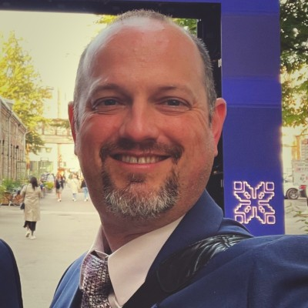
Daniel W. York
Director, U.S. Open Government Secretariat, U.S. General Services Administration

Slide 5
Overview of International and national open government efforts

Slide 6

The Open Government Partnership
In 2011, government leaders and civil society advocates came together to create a unique partnership - one that combines these powerful forces to promote transparent, participatory, inclusive, and accountable governance.
The Open Government Partnership (OGP) is a multilateral initiative aimed at securing commitments from national and sub-national governments to promote open government, combat corruption, and improve governance.

Slide 7
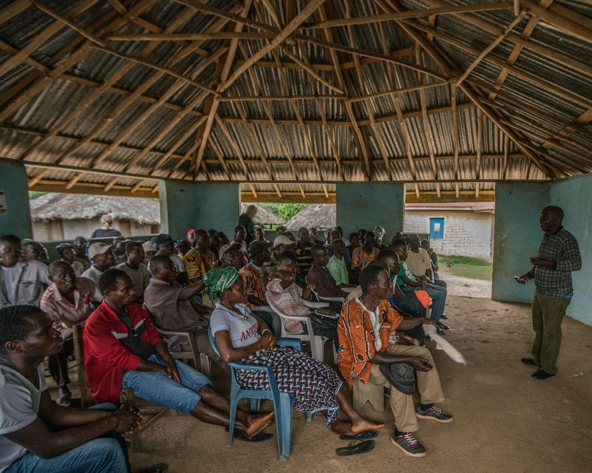
OGP By the
Numbers
77
countries
150
local governments
400+
action plans
5,000+
commitments

Slide 8
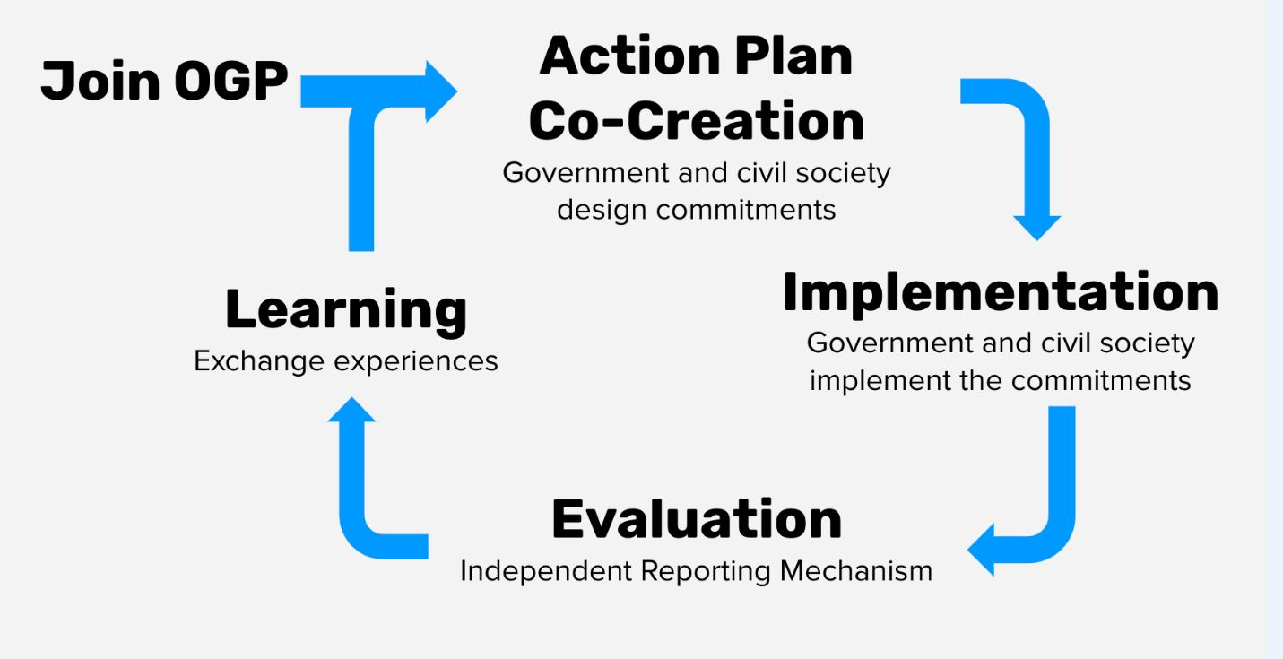
The OGP Action Plan Cycle
OPEN GOVERNMENT PARTNERSHIP

Slide 9

New PPCE Challenge Commitment
United States
Framework for Public Participation and Community Engagement
The government committed to creating a new framework to strengthen current public participation activities led by the federal government and to provide support for agencies that will begin such engagement for the first time or support those with engagement activities already underway. The commitment includes the creation of a toolkit, which will act as an ongoing repository for guidance, case studies, and leading practices on public participation.
This commitment seeks to promote and support federal agencies' obligation to improve public participation throughout the federal government.
Challenge Theme: Public Participation
OGP Challenge Themes
Notes:
OGP Challenge Themes: https://www.opengovpartnership.org/the-open-gov-challenge/open-government-challenge-areas/

Slide 10




U.S. Federal Roles in OGP
WHITE HOUSE OFFICE OF
SCIENCE AND TECHNOLOGY POLICY
Policy Leadership
DEPARTMENT OF STATE
&
USAID
International Implementation Management
GENERAL SERVICES ADMINISTRATION
Domestic Implementation Management

Slide 11
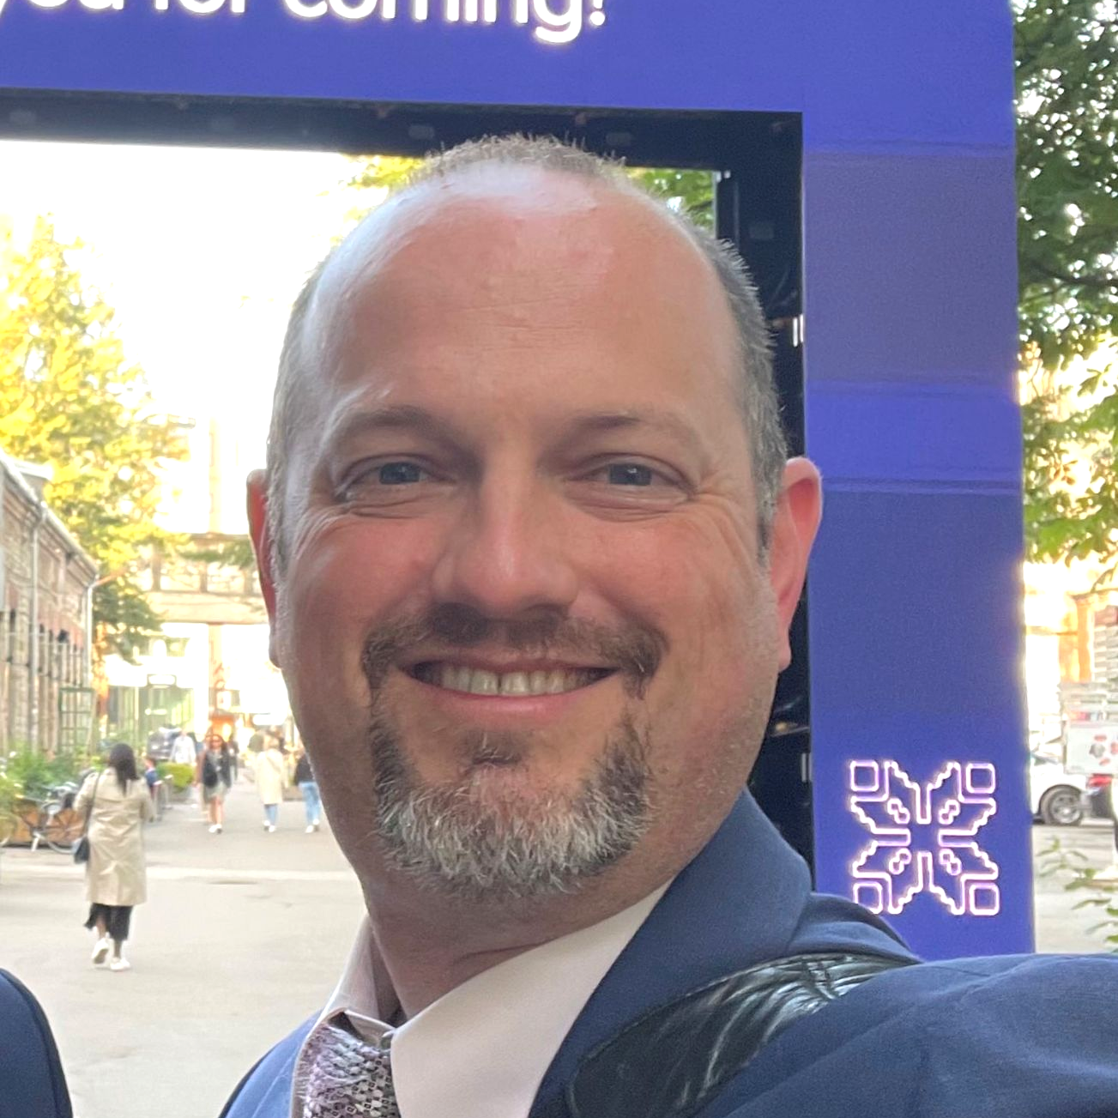
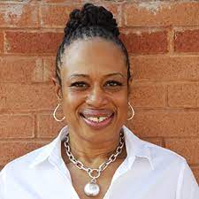

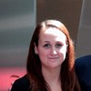
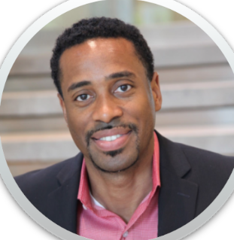
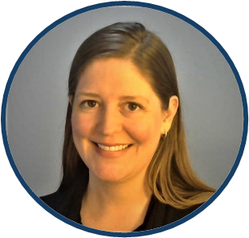
MEET
THE GSA
TEAM
DANIEL YORK
YVETTE GIBSON
ALEXIS MASTERSON
Director,
Inter-Gov Coordination / NAP 5
NAP 6
LAURA SZAKMARY
ARTHUR BRUNSON
Public Engagement
OG FAC
BETH CRON, Detail

Slide 12
What We Do
The GSA Open Government Secretariat serves three primary roles:
National Action Plan (NAP) 5 Implementation: Coordinate with federal partners to track and report progress on NAP commitments.
National Action Plan (NAP) 6 Development: In coordination with White House OSTP, Department of State, and USAID, co-create the 6th US Open Government NAP with Civil Society Organizations and the public through an open and transparent process (using the OG FAC) which advances the ideals of a more inclusive, responsive, and accountable government.
Stakeholder Engagement: Coordinate with federal government and public stakeholders groups:
  Federal Stakeholder Engagement
  Public Stakeholder Engagement
  Host & Maintain a public website
  Follow us on LinkedIn!
1
2
3

Slide 13
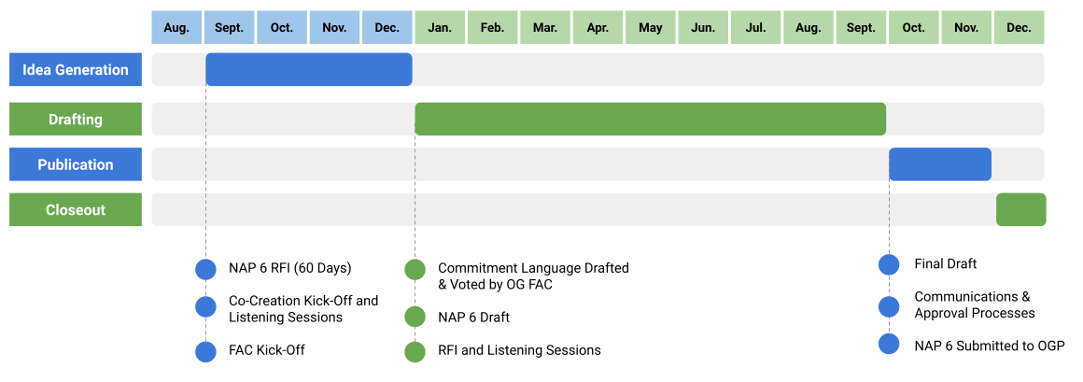

NAP 6 Timeline

Slide 14



NAP 6 RFI Live Now!
Opportunities & Actions for the public
NAP 6 RFI open for public comment through Tuesday, November 12, 2024.
Respond to the RFI & share with your networks
Promote the RFI on other communication channels (if possible)!

Slide 15
NAP 6 Public RFI Areas of Interest
PROBLEM IDENTIFICATION
Please explain a specific problem that open government can address. Identify unmet needs, broken processes, and problems around transparency, participation, and accountability.
OPPORTUNITIES TO BUILD ON EXISTING WORK
Identify existing work by a federal government agency or outside of the government (e.g., by civil society individuals or non-governmental organizations) that can be built upon to support open government efforts.
INNOVATIVE APPROACHES
What innovative approaches or emerging technologies could the government explore to enhance transparency, public participation, and accountability? How could these be integrated into NAP 6?
RESOURCES AND RECOMMENDATIONS
Suggest existing reports, collections of recommendations, and landscape analyses that can help inform a comprehensive, responsive, and evidence-based co-creation process for the 6th National Action Plan.

Slide 16
Open Government Federal Advisory Committee Membership and Operations

Slide 17

Advisory Committee as a Multi-Stakeholder Forum
“A structured environment designed to maximize participation and cooperation between government and civil society by bringing relevant partners into the discussion and ensuring that all voices are heard.”
Open Government Partnership
https://www.opengovpartnership.org/multistakeholder-forums
Notes:
Open Government Partnership: https://www.opengovpartnership.org/multistakeholder-forums

Slide 18
OG FAC Focus Areas
A Collaborative Approach to Open Government
The OG FAC will advise GSA in:
  Increasing the public's access to data
  Advancing equity
  Engaging the public in the regulatory process
  Making government records more accessible
  Improving the delivery of government services/benefits
The initial focus of the OG FAC will be on:
  U.S. National Action Plan 6
  Open Government Policy
  Public Engagement
OG FAC Public Meeting #1
Virtual Registration
In-person Registration
Notes:
OG FAC Public Meeting #1: https://forms.gle/ziF43BUKNnYZk6Ez7

Slide 19
OG FAC Operations
Everyone Can Observe & Provide Input
The OG FAC will operate in accordance with all provisions of the Federal Advisory Committee Act (FACA) which requires:
1
2
Allows For Public Comment:
Written public comments will be accepted through the life of the Committee at ogfac@gsa.gov and oral public comments will be permitted when the agenda allows.
All Meetings Be Open to the Public:
Information on how to attend will be available on the GSA Open Government Secretariat website, through social media, and posted at least 15 days before a scheduled meeting via a notice in the Federal Register.
Notes:
Written public comments will be accepted through the life of the Committee at ogfac@gsa.gov

Slide 20
Federal Advisory Committee
List of Members & Affiliations
Name | Committee Role | Organization/Affiliation
Daniel Schuman | Chair Member; Non-Federal Government Member | Executive Director, American Governance Institute
Dr. Joyce Ajayi | Non-Federal Government Member | Employment Services Manager, City of Little Rock, Department of Human Resources
John Dierking | Non-Federal Government Member | Tax Compliance Officer, City of Los Angeles, Office of Finance
Amy Holmes | Non-Federal Government Member | Executive Director, Bloomberg Center for Government Excellence
Ronald Keefover | Non-Federal Government Member | Education-Information Officer, Office of Judicial Administration
Dr. Steven Kull | Non-Federal Government Member | Director Program for Public Consultation, University of Maryland, School of Public Policy
Janice Luong | Non-Federal Government Member | Policy Associate, Project On Government Oversight
Ade Odutola | Non-Federal Government Member | President and CEO, Solvitur Systems LLC
Suzanne Piotrowski | Non-Federal Government Member | Director, Transparency and Governance Center, Rutgers School of Public Affairs and Administration
Joshua Tauberer | Non-Federal Government Member | Founder, GovTrack.us
Corinna Turbes | Non-Federal Government Member | Director, Center for Data Policy, Data Foundation
Charles Cutshall | Federal Government Member | Department of Commerce, Office of Privacy and Open Government
Dr. Kristen Honey | Federal Government Member | Chief Data Scientist and Executive Director, InnovationX, Department of Health and Human Services
Kiril Jakimovski | Federal Government Member | U.S. Department of State, Bureau of Democracy, Human Rights, and Labor
Bobak Talebian | Federal Government Member | Department of Justice, Office of Information Policy
Pamela Wright | Federal Government Member | Chief Innovation Officer, National Archives and Records Administration

Slide 21







Partnering with Civil Society
If you know of a Civil Society Group interested
in partnering with
us for an event or project,
PLEASE LET US KNOW!
Stakeholder Engagement
Dec 19, 2023 Carter Center, Atlanta GA
Feb 5, 2024 Open Government Roundtable, Washington DC
Apr 25, 2024 Data Foundation, Washington DC
July 15, 2024 Washington Coalition for Open Government, Oak Harbor WA
Sep 17, 2024 City of Austin, Austin TX
Sep 26, 2024 GSA Admin. Carnahan led Open Gov Event on Sidelines of UNGA
Oct 15, 2024 DC Open Gov Coalition, Washington DC

Slide 22
Civil Society ListServ
Instructions to join the public-facing GSA Open Gov ListServ:
Send an email opengov-civ-subscribe-request@listserv.gsa.gov and include “Join: OpenGov-Civ” in the subject line.
Reply “OK” to the auto-generated message you receive within 48hr.
You will get a second auto-generated message letting you know that you have joined the OpenGov-Civ ListServ
Notes:
Send an email opengov-civ-subscribe-request@listserv.gsa.gov and include “Join: OpenGov-Civ” in the subject line

Slide 23
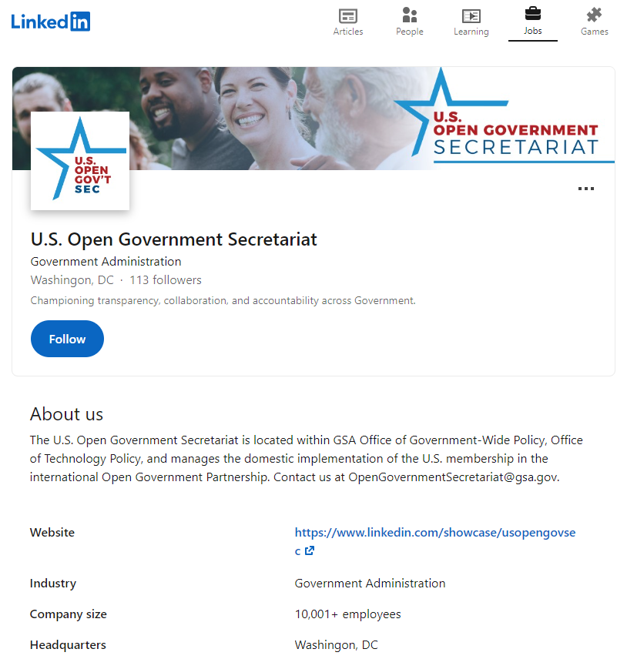
U.S. Open Government Secretariat LinkedIn
Follow us: https://www.linkedin.com/showcase/usopengovsec
Notes:
Follow us: https://www.linkedin.com/showcase/usopengovsec

Slide 24
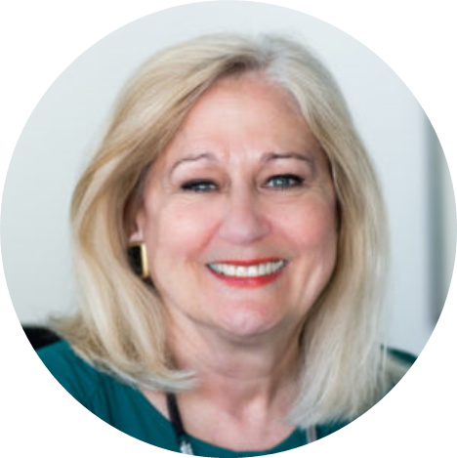
Kathleen Patterson
D.C. Auditor

Slide 25
Panel: Establishing a Transparency Reform Commission in DC
Moderator:
Tom Susman, Founder, DC Open Government Coalition, and four-term member of the federal FOIA Advisory Committee
Panelists:
Niquelle Allen, Esq Director of the DC Office of Open Government
Ginger Quintero-McCall, former Public Records Advocate, state of Oregon
Robert Becker, Coalition board member who has drafted legislation to create a transparency reform commission in DC

Slide 26

Q & A

Slide 27
Thank you
Thank you!
Contact Us:
OpenGovernmentSecretariat@gsa.gov
info@dcogc.org

