Slide 1

How to Market Your Company as a WOSB
Anna Vulaj Fitzsimmons
Program Director, MCFL APEX Accelerator
APTAC Region 2 Director – NY, NJ & DE
avulaj@monroecounty.gov
585-753-2017
www.mcflapex.org

Slide 2

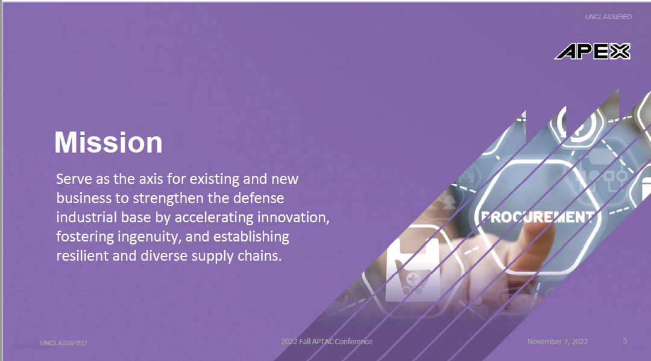
Mission
UNCLASSIFIED

Slide 3

Vision
UNCLASSIFIED

Slide 4
DoD OSBP
The APEX Accelerators program, formerly known as Procurement Technical Assistance Program (PTAP), under management of the Department of Defense (DoD) Office of Small Business Programs (OSBP), plays a critical role in the Department’s efforts to identify and helps a wide range of businesses enter and participate in the defense supply-chain. The program provides the education and training to ensure that all businesses become capable of participating in federal, state, and local government contracts. There are 96 Accelerators Nationwide, including BIA regions. Find your APEX Accelerator here.
Grow the Defense Industrial Base (DIB) & Government Industrial Base (GIB)
Increase Equity and Inclusion
Increase Awareness of and Compliance with FOCI – Foreign Ownership, Control or Influence
Increase Cybersecurity of the Industrial Base
Facilitate Innovation
Strengthen the Supply Chain

Slide 5
DoD Small Business Strategy 2023
Strategic Objective 1: Implement a Unified Management Approach for Small Business Programs and Activities
Implement a Unified Management Structure by Establishing a Group to Integrate Small Business Programs and Activities
Train and Credential a Unified Small Business Professional Workforce
Streamline Entry Points and Improve Small Business Access to Decision-Makers
Strategic Objective 2: Ensure the Department’s Small Business Activities Align with National Security Priorities
Stabilize and Scale Programs that Help Small Technology and Manufacturing Businesses Deliver Capabilities to the Warfighter
Utilize Data Tools to Understand and Expand Small Business Participation and Spending in Order to Ensure a Robust and Resilient Industrial Base
Expand Policy and Process Engagement of Small Business Professionals and Senior Leaders on Small Business Matters
Strategic Objective 3: Strengthen the Department’s Engagement and Support of Small Businesses
Improve Outreach and Communications with Small Businesses
Provide Cybersecurity Training and Resources to Small Businesses
Educate Small Businesses on Risks of Foreign Ownership, Control, and Influence
https://media.defense.gov/2023/Jan/26/2003150429/-1/-1/0/SMALL-BUSINESS-STRATEGY.PDF

Slide 6
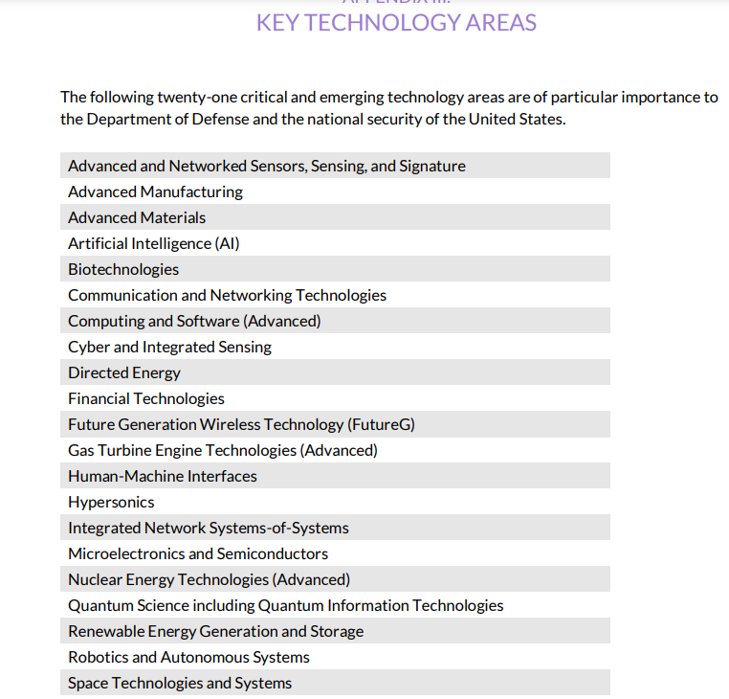
Key Technology Areas
(Note: More information is available at https://www.cto.mil/usdre-strat-vision-critical-tech-areas/ and
https://www.whitehouse.gov/wp-content/uploads/2022/02/02-2022-Critical-and-Emerging-Technologies-List-Update.pdf)

Slide 7
DoD Resources/Updates
DoD National Defense Strategy
10 Steps to Winning Your First DoD Contract
Cyber Security is Critical to ALL

Slide 8
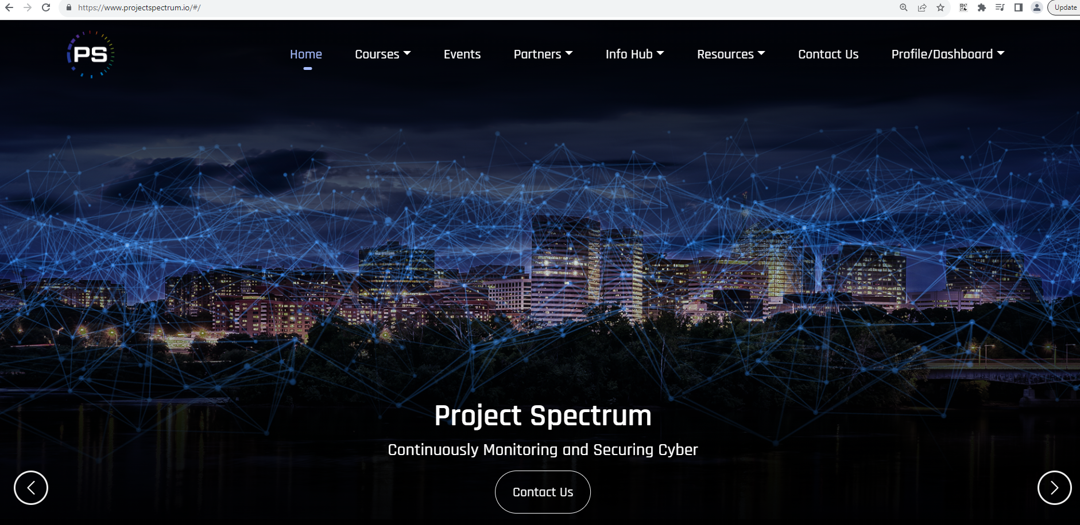

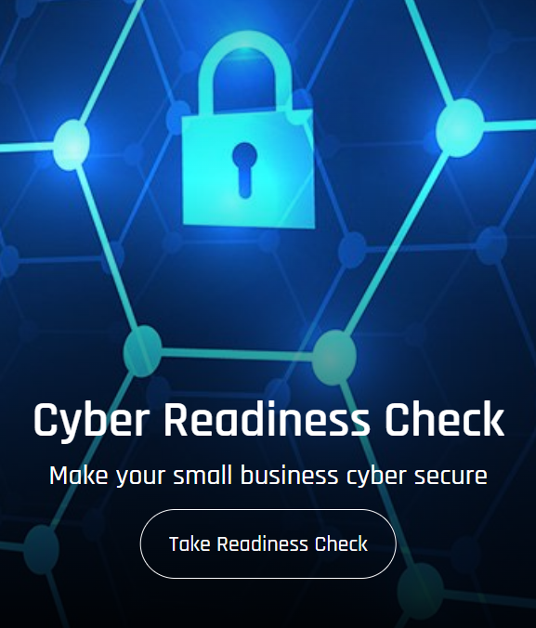
Project Spectrum
https://www.projectspectrum.io/#/

Slide 9
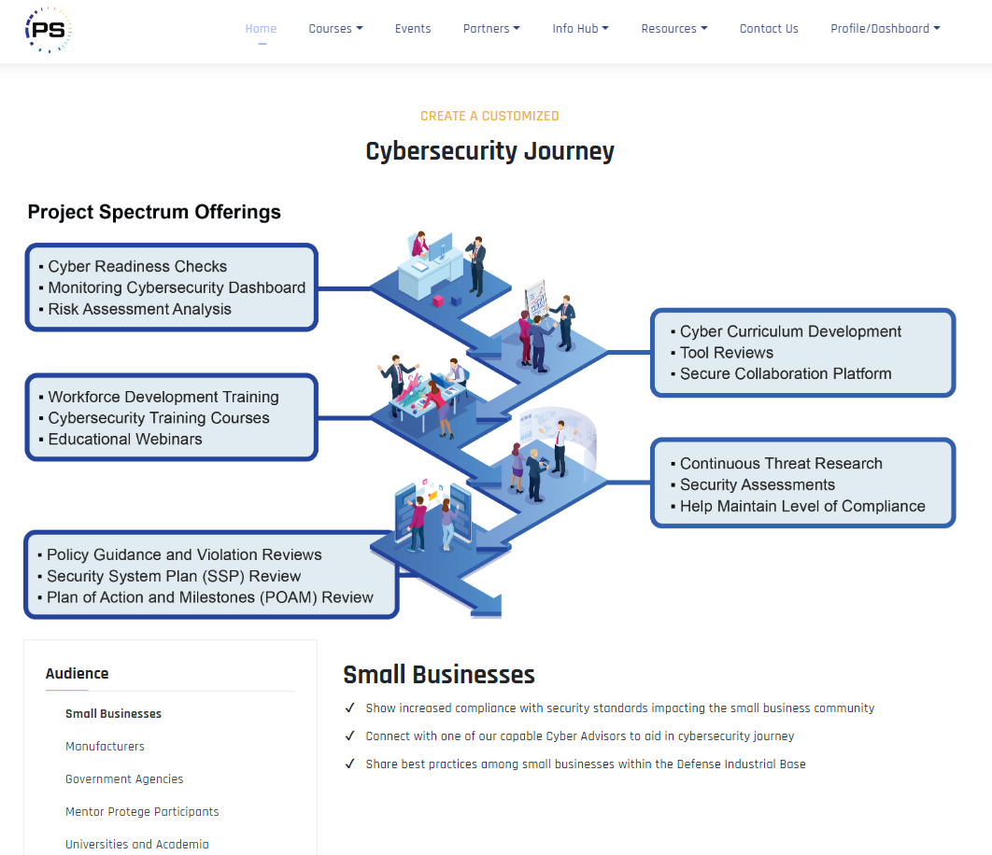
Project Spectrum
https://www.projectspectrum.io/#/

Slide 10
How We Help…
Providing Government Contract Counseling through…
Contract Assistance
One-on-one counseling
Market Strategy
Government Capability Statement
Build a government marketing roadmap
Training & Networking
Workshops/Webinars
G2B Matchmakers / Outreach
Must complete application for free services.
Counseling
Assess
Business potential to do business with the government
Assist
Federal & state registrations & certifications
Government Capability Statement
Identify subcontracting opportunities
Solicitation/bid preparation/SBIRs/STTRs
Post-award performance
Clarify
Technical information/document specifications/standards
Guide
Government markets/government marketing roadmap
Notice of upcoming opportunities “Bid Match” service

Slide 11
How We Help…
Government Agencies
Outreach to small businesses
Identify potential vendors to meet contracting goals
Partner for innovative acquisition strategies
Large Prime Contractors
Prepare subcontracting plans
Identify qualified small business subcontractors

Slide 12

Maximizing your ED/WOSB Certification in the Government Contracting Arena
Importance of integrating a government tactical marketing plan into your sales efforts
Federal Market Research and Building a Sales Pipeline

Slide 13
VS.
Types of Registrations
Most registrations are mandated by law in order to do business with the government.
Federal/
Military
- SAM
- CMMC
- DIBBS
- GSA
- ITAR
- JCP
- SBA Dynamic
- WAWF
State
Varies by State
Primes & Agencies (federal, state and local)
- Vendor Registrations
Types of Certifications
Certifications are optional, governed by law and based on qualifications.
Federal
- SBA: 8(a), HUBZone ED/WOSB, SDVOSB
- DOT DBE
- Self-certs
State
- MBE
- WBE
- SDVOB
Local
- MBE
- WBE
51%

Slide 14

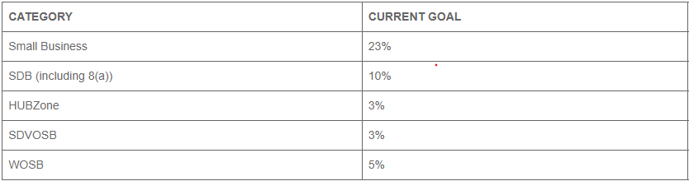
Federal Contracting Goals
12%

Slide 15
Maximizing your ED/WOSB Certification in the Government Contracting Arena
Maximizing your ED/WOSB Certification in the Government Contracting Arena
Are you ready?
Review - Government Contracting Tool Kit
Registrations
Certifications
Government Capability Statement
Do you meet compliance standards? i.e.: Cybersecurity
Importance of integrating a government tactical marketing plan into your sales efforts
Federal Market Research and Building a Sales Pipeline

Slide 16

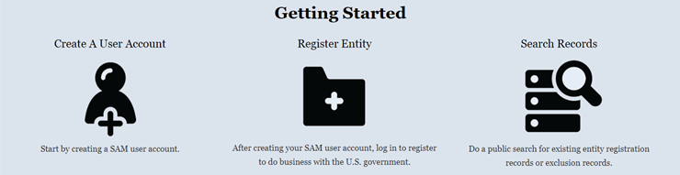
Importance of System for Award Management
Why Register in SAM
FAR Subpart 4.1102
Entities are ineligible for contracts and grants, unless registered at time of submittal (and duration of grant/contract)
Must renew annually
Establishes an electronic funds transfer
Representations & Certifications
CAGE Code issuance
Only emails from dot-gov or dot-mil
Access to SBA Small Business Dynamic Database

Slide 17
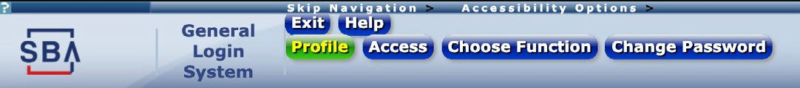
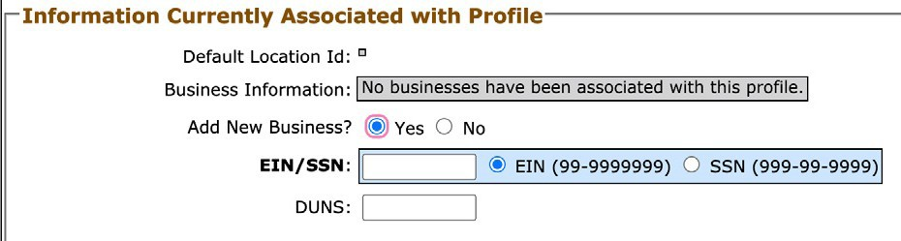
How to update your SBA Profile (SBA Supplemental Page)
At the end of your entity registration on the System for Award Management (SAM.gov) website, if your business meets SBA size standards, you are given the option to complete an SBA Profile to add your business to the Dynamic Small Business Search (DSBS).
To edit your SBA Profile at a later date, you can either use the link in your SAM.gov profile under the Small Business Certification section, or you can access it through SBA’s General Login System (GLS) using the steps below.
If you do not already have a GLS account, follow the GLS Instructions for Small Businesses link in the left navigation on the GLS Login page (https://eweb.sba.gov/gls/dsp_login.cfm) to create one.
Add your business to your GLS profile
Log in on the GLS Login page
(https://eweb.sba.gov/gls/dsp_login.cfm).
2. Select the Profile link in the site header.
3. In the Information Currently Associated with Profile section at the bottom of your profile select Yes next to Add New Business?
Enter either your EIN or SSN, then the DUNS number associated with your business (this must match what is on your SAM profile).
Select the Submit button.

Slide 18
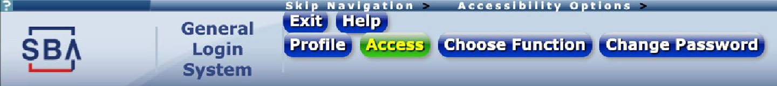
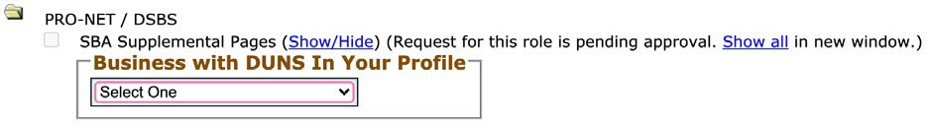
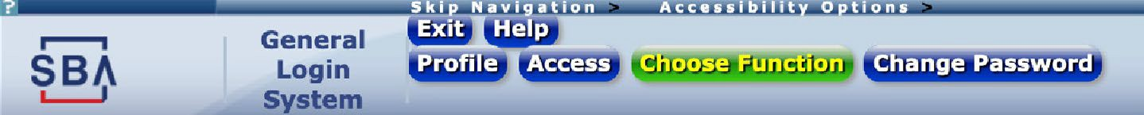

Request access to your SBA Profile
Request access to your SBA Profile
1. Select the Access link in the site header.
2. Select the folder icon next to PRO-NET / DSBS to expand it, then check the box for SBA Supplemental Pages.
Select your business from the dropdown.
Select the Submit button.
The following message will appear at the top of the page indicating that your profile has been successfully updated.
Commentary: Your profile has been successfully updated.
The following roles you requested were sent to the Program Office for approval.
SBA Supplemental Pages
Access your SBA Profile
SBA will notify you by email once your request has been approved.
Log in on the GLS Login page (https://eweb.sba.gov/gls/dsp_login.cfm).
Select the Choose Function link in the site header.
Your list of available applications should now include a link to “PRO-Net Supplemental Pages.”
Open the link. Your SBA Profile will populate on the screen and you can make changes or updates.

Slide 19
Why Are NAICS Codes So Important
Solicitations
Every Federal Solicitation Has One
ED/WOSB Certification
Not Every NAICS Code Qualifies
Qualifying NAICS Codes
Size Thresholds
SBA Establishes for Every NAICS Code
SBA NAICS Size Standard

Slide 20






WOSB/EDWOSB Ownership & Control
Managerial experience
51% ownership requirements
Highest officer position
Management of daily operations
Proper NAICS codes
No minimum time in business
Notes:
Presenter tip: Depending on the audience, provide some information on when this may be an appropriate certification.
Must be a small business concern for the primary NAICS code or contract (not all NAICS codes are authorized for use under the WOSB Federal Contracting Program).
Must be at least 51% owned and controlled by one or more women who are U.S. citizens. The 51% ownership must be direct and unconditional.
There is no minimum amount of time for the business to have been operational.
A woman must manage daily business operations. This means:
A woman must hold the highest officer position within the business;
The woman must work at the business full-time during normal working hours;
The woman must have managerial experience required to run the business; and
Women must make long-term decisions for the business.

Slide 21


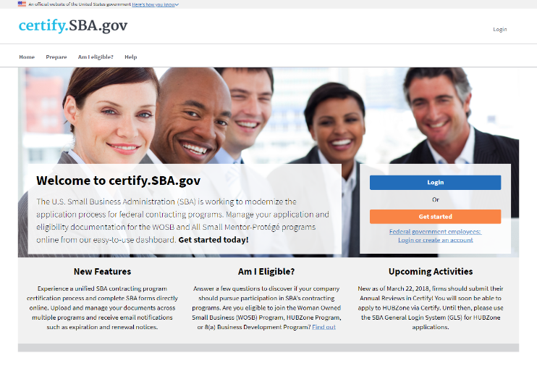
Certification
SBA Certification Portal
SBA’s certification portal where businesses can submit documents to seek SBA certifications
Automatic Migration
Pulls business information from SAM.gov
Online Forms
Forms completed online (no longer required to upload certain SBA forms)
Notes:
Presenter tip: Provide the level of detail needed based on the audience in discussing the Certify system. It may be appropriate to schedule a demonstration of the site with a Q&A session.
SBA’s certification portal where businesses can submit documents to seek SBA certifications.
Pulls business information from SAM.gov.
SBA plans to add other certification programs to certify.sba.gov in the future.
Forms are completed online—no longer required to upload WOSB Federal Contracting Program Certifications (SBA Forms 2413 and 2414) and Personal Financial Statement (SBA Form 413).
Certification questions are filtered by business organization.
Must complete WOSB or EDWOSB certification questionnaire (or application) and add documents to the question when prompted—to be reviewed by CO when in line for award.
Only owner/officer authorized to certify on behalf of company should create account.

Slide 22
Marketing to the Government
A commercial business and a government buyer may need the same item, but their approach is very different.
In the government world, your “market” is a single customer or a small number of customers who are specifying what they want from you. There are few sales people, and little “typical” marketing is required.
In the government world, most of your marketing plan includes targeting the internal customers within the agency and aligning your business’ solution to the government’s needs.

Slide 23
The Government Operates Differently
The term “marketing” is a common term but its meaning in the government world is very different from the commercial world. Marketing to the government generally means selling.
Most businesses that deal with the government don’t do much in the way of marketing as defined in the commercial world.
In the commercial world, a buyer usually has a good idea of what they are buying, what the processes are, what products/services are used, etc.
Government buyers buy the end product/service, not the process.

Slide 24
Preparing to Market to the Federal Government
Answer these questions as you prepare to market:
How does selling to the government fit in your overall business strategy?
What are your core competencies?
Which agencies need what you provide?
What sets you apart from the competition?
Are you willing and able to devote resources to win the government’s business?
What is your output?
What products or services do you make/offer?
What products or services are you capable of making/offering?
How can you use your same equipment and process to provide what the government needs and wants?
What haven’t you considered before?
How can you collaborate with other businesses to give the government a "total" package?

Slide 25
Importance of a
Government Capability Statement
What is it?
A Government Capability Statement is a one-page document that highlights a company’s areas of expertise. It tells potential customers who you are, what you do and what sets you apart from your competitors.
MARKETING to the buyers!
Serves as a resume for your business
Often requested by a government agency or prime contractor at an initial meeting
Matchmaker event handout
Vendor Registrations
May be required as part of a bid or proposal
Opportunity to differentiate you from your competition

Slide 26
FORMAT
Brevity is key!
One page, to the point. Keep it simple and clean
Use bullets
Create several designed to different markets
Visually Interesting
Company brand and logo
Use graphics and color
Use nice paper
Searchable Document
Easy to read
Convert to PDF for email and website posting

Slide 27
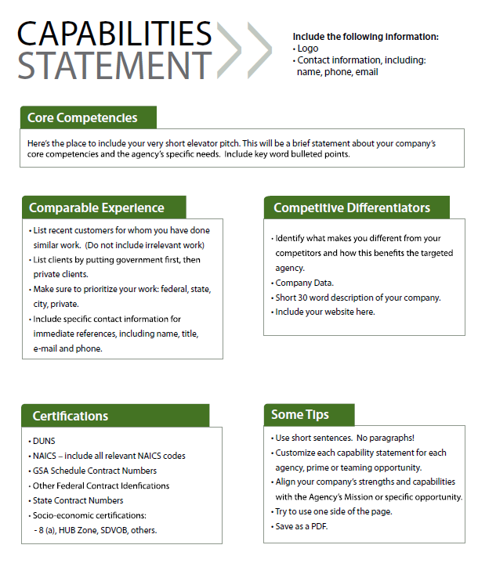
5 Key Elements
Government
Call it what it is
Core Competencies
Past Performance
Differentiators
Company Data/POC Info
Company Data
SAM UEI

Slide 28
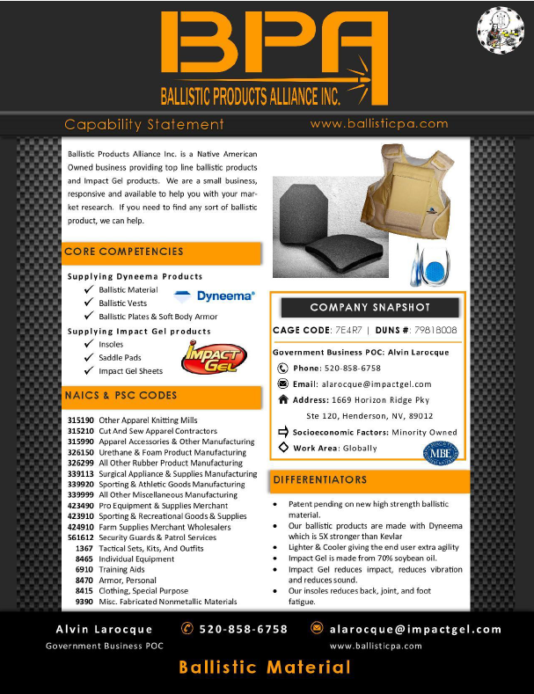
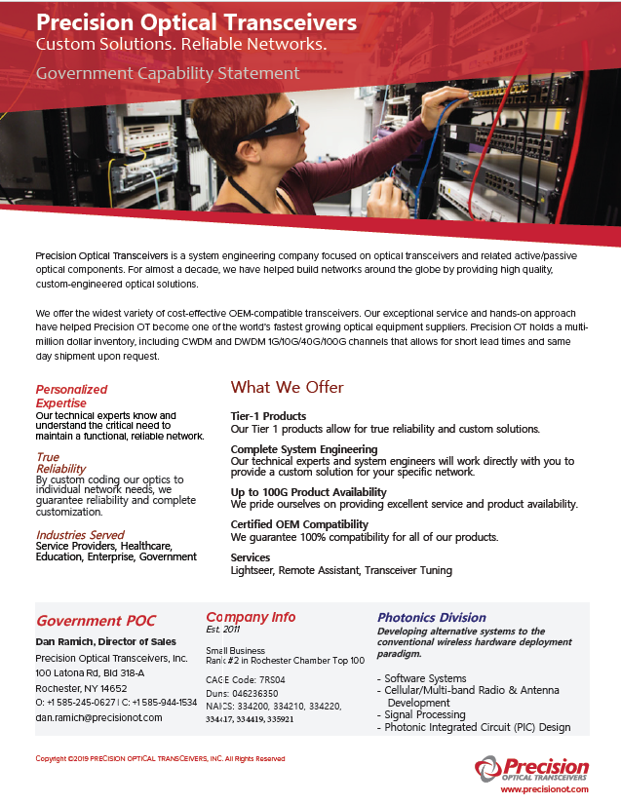
Slide title
UEI:

Slide 29
Grade Your Capability Statement on a 100 point scale, each section is worth 20 points:
Capability Statement Overall
Core Competencies tailored to targeted agency
Past Performance/Comparable Experience tailored to targeted agency/ requirements
Differentiators tailored to targeted agency/requirements
Company Data

Slide 30
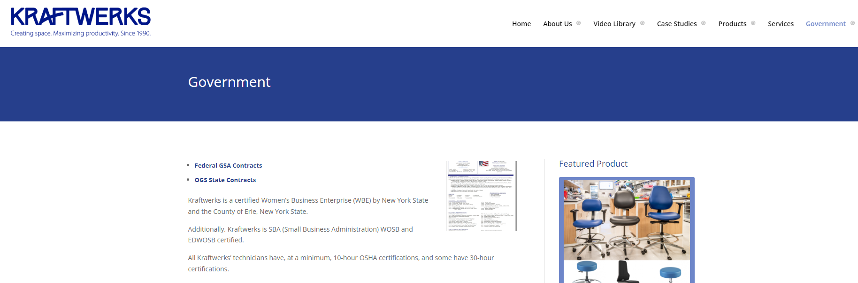
POST IT ON YOUR WEBSITE!

Slide 31
Next…
Government Capabilities Statement
12-month tactical plan
Use government market research tools and bid matching to explore opportunities and understand your competition

Slide 32
Market Development Strategy
Look for government markets and customers
Military
Federal
Large Government Prime Contractors
State
Local
Subcontracting Opportunities
Whose needs might be met by your current commercial products/services
Have you done business with the government in the past as Prime or a Subcontractor
Institutional research and knowledge

Slide 33
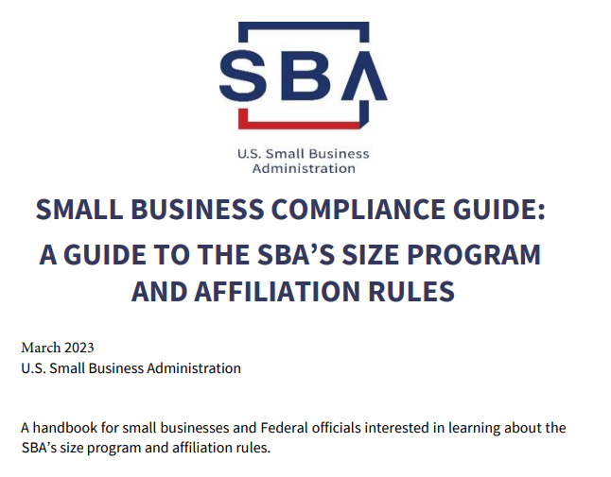
Government Marketing Plan
Goal – generate qualified marketing leads for your sales funnel
to increase revenues
to diversify your customer portfolio
Marketing is all about planning AND execution
Within budget
Within scheduled timeframe

Slide 34
12-Month Marketing Plan
Communication
Government Marketing Database / CRM
Marketing Materials
Government Capability Statement
Research/Bid
Now - SAM
Past - FPDS
Future - Forecasting
Bid Matching
Meetings/Events
Matchmakers, Trade Shows & Industry Days
OSDBU/SBLO

Slide 35
Communication
Government Marketing Database
Capability Statement
Marketing ROI

Slide 36
Government Marketing Database
You need a tool so that your contact list is current, accessible and actionable for marketing purposes
Maintain customer relationships
Develop new customer relationships
Lead generation
Lead qualification
Record complete contact information

Slide 37
What You Need to Track
Record communication with government buyers and prime contractors, customers and prospects
Capability Statement Sent
Cold Call / Email
Meeting (site visit, Matchmaker, etc.)
Bid Submitted
Sale
Debriefing on Bid
Pre &Post Award if you win
Request one if you lose (bids may not always qualify for this action)

Slide 38
Marketing ROI
Refine your “Marketing Materials” for government buyers and prime contractors
SAM UEI, CAGE Code, NAICS, Federal Supply Groups
Obtain certifications – ED/WOSB, SD/VOSB, HUBZone, 8(a) - if appropriate, for socio-economic status
Update buyers when you receive new certifications
Add these to marketing tools (brochures, line cards, website, etc.)
Tailor the 12-month marketing tactics to your business and budget dollars to execute.
Develop a way to measure ROI to determine $X/Qualified Marketing Lead

Slide 39
Slide title
MONTH | COMMUNICATION | MEETING / EVENT | RESEARCH / BID
JANUARY | Require consistent email signatures throughout firm. |  | Determine if current CRM can be used for government marketing database. If not, build using Excel format.
FEBRUARY |  | APEX ACCELERATOR one-on-one meeting. | Research who’s buying. Add contacts to government marketing database.
MARCH | Complete sample capabilities statement. | Attend APEX ACCELERATOR prep meeting for MatchMaker. | Review bid match & alert APEX ACCELERATOR if adjustments needed.
APRIL | Review your website for ease of use, SEO. Create gov’t/primes page. |  | Review bid match & add contacts to government marketing database.
MAY | Start “drip” marketing. Send “Batch #1” of 4-20 letters/emails. Make follow-up phone calls. | Attend MatchMaker/Industry Days | Review bid match & add contacts to government marketing database.
JUNE | Send MM follow-up emails. Make follow-up phone calls. | Batch #1 informational/marketing meetings. | Review bid match & add contacts to government marketing database.
JULY | Refresh webpage content. | MatchMaker Prep informational/marketing meetings. | Review bid match & add contacts to government marketing database. Prepare bid response. Schedule APEX ACCELERATOR meeting to review.
AUGUST | Send “Batch #2” of 4-20 emails. Make follow-up phone calls. | APEX ACCELERATOR one-on-one meeting. | Review bid match & add contacts to government marketing database. Prepare bid response.
SEPTEMBER | Refresh webpage content. | Batch #2 informational/marketing meetings. | Review bid match & add contacts to government marketing database.
OCTOBER | Send “Batch #3” of 4-20 emails. Make follow-up phone calls. | Attend MatchMaker/Industry Day | Review bid match & add contacts to government marketing database. Prepare bid response.
NOVEMBER | Send MM/Industry Day follow-up emails. Make follow-up phone calls. | Batch #3 informational/marketing meetings. | Review bid match & add contacts to government marketing database.
DECEMBER |  |  | Review results of annual activities. Prepare next year’s plan. Budget resources (people, money, time) to support implementation.

Slide 40
Research / Bid
Present – SAM.gov
Past – FPDS
Future – Forecasting
Bid Matching

Slide 41
What You Want to Know
Does the government buy your product/service
What agency is buying your product/service?
How much is being spent?
How does the agency buy your product/service?
Who is your competition?
What price did the agency pay?
Notes:
This didn’t make sense to me at first. Why would I want to sell my products to the gov’t if I wasn’t going to make a large profit?
The answer is simply as we stated before. The gov’t is a reliable an continuous source of business and always pays its bills. If you use this money to level out the “hills and the valleys” of your business and utilize this profit to pay your overhead costs (rent, utilities, heat, etc.), you’re able to be more selective with other contracts you receive and raise your cost.

Slide 42
Who’s Buying?
SAM.gov is single government point-of-entry (GPE) for Federal government procurement opportunities over $25,000
Government buyers publicize opportunities by posting information directly via the Internet
Vendors seeking Federal markets for their products and services can search, monitor and retrieve opportunities solicited by the entire Federal contracting community
https://sam.gov/content/home

Slide 43
Who Bought? Who Sold? Federal Procurement Data System
FPDS-NG offers public users unprecedented access to the spending patterns of the Federal government – at no cost
Access to more than 12 million contract actions from across the Federal government
https://www.fpds.gov/

Slide 44
Forecasting Procurements
Each Federal agency typically produces an Annual Procurement Forecast as required by the Small Business Act
Acquisition Central
https://www.acquisition.gov/comp/procurement_forecasts/index.html

Slide 45
Bid Matching
The Federal government has more than 4,300 websites according to a GAO report
What bid matching can do
Find current bids related to your product/service (in all dollar ranges)
Provide historical purchase data on product/service
Supply awarded contract information
Most APEX Accelerators offer for free

Slide 46
Benefits of Bid Matching
Jump starts you into the government procurement process
Even if you don’t bid immediately, you can use to build your government marketing database with POC from solicitations
Learn how government buyers would buy your product or service
You MUST be registered in SAM.

Slide 47
Meetings / Events
Matchmakers, Trade Shows and Industry Days
OSDBU and SBLO Contacts*

Slide 48
Preparing for a Matchmaker
Research agencies and prime contractors attending. Understand how your product/service meets their needs. Record findings in government marketing database.
Develop a target list of appointments and questions for each.
Register as a vendor on their website
Review your website. Remove dated content.
Notes:
- Add a gov’t tab to your website for buyers interested in your products for ease of use.

Slide 49
Don’t Forget!
Bring plenty of business cards. Or use Virtual QRcards
Prepare concise product descriptions and price listings. Government buyers do not want to weed through reams of material.
Prepare a capabilities statement.
Practice articulating your value proposition
Out loud
Preferably in front of someone to get feedback

Slide 50
Public Law 95-507 The Small Business Act of 1978
“Small, Small Disadvantaged, HUBZone Small, Woman, Owned Small, Veteran-Owned Small and Service Disabled Veteran-Owned Small Business have the maximum practicable opportunity to participate in the performance of contracts awarded by Federal agencies”
Notes:
FAR part 19.201 required osadbu
Each agency also has
program managers who determine need
a contracting officer develops the contract - co
contracting officer’s representative assists in development / oversight of contract - cor
contracting officer’s technical representative provides technical assist. - cotr
involved in the procurement process
However, they may all be the same person

Slide 51
Small Business Act Government Agencies
Each agency must establish an Office of Small and
Disadvantaged Business Utilization (OSDBU)
http://www.osdbu.gov/members.html

Slide 52
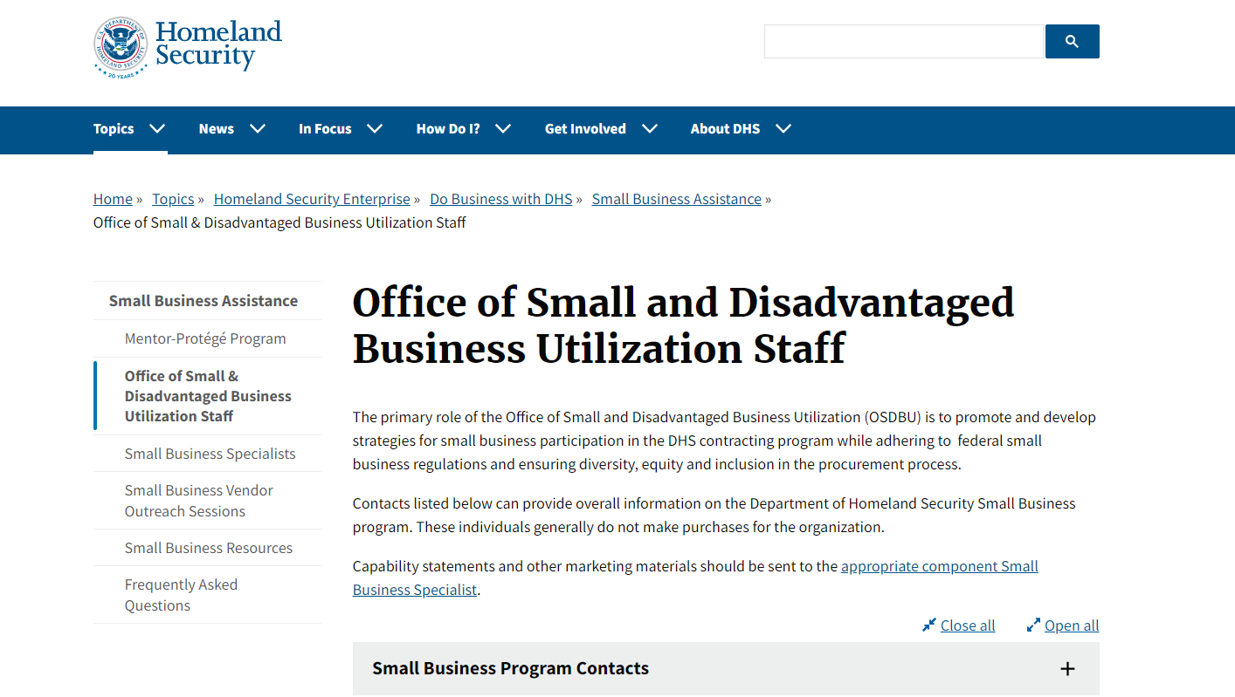
52

Slide 53
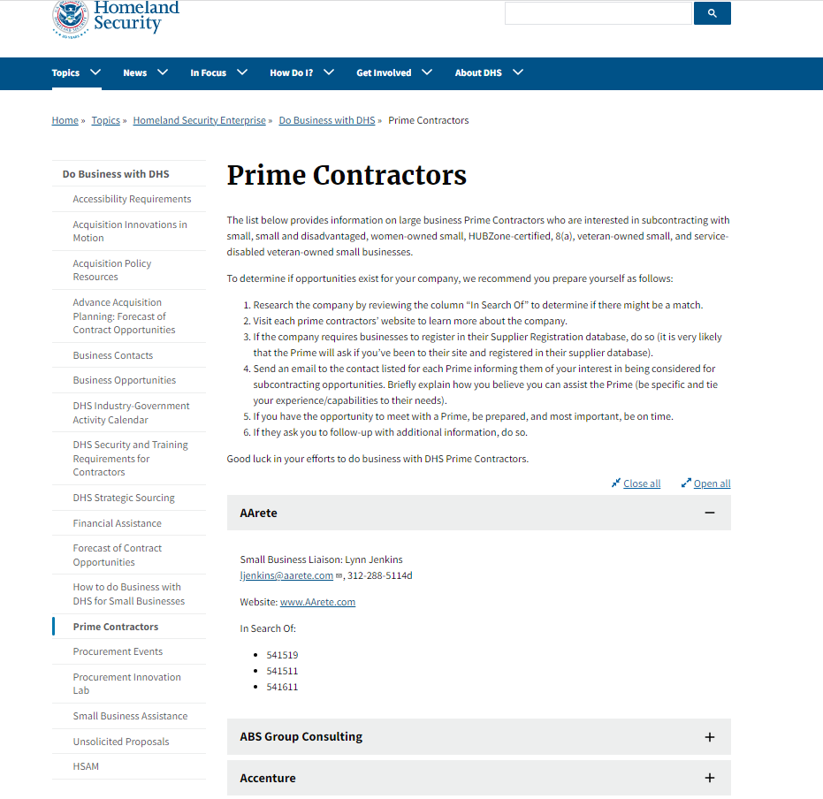
Department of Homeland Security Prime Contractors web page

Slide 54
Small Business Act Prime Contractors
Large Government Prime Contractors are required to establish the position of Small Business Liaison Officer
SBLOs are responsible for advancing the goals of the various socio-economic programs
A small business is never required to have a subcontracting plan.
SAM is the first place to find the designation as a small business.
FAR/DFARS Report

Slide 55
Definition: Prime Contractor
A large firm as defined by NAICS
A large firm awarded a federal contract worth more than $750,000
In construction $1.5 Million
Notes:
FAR 52.219.8-9 regulates sub contracting for primes

Slide 56
Small Business Act Prime Contractors
Contractors must comply with any requirements in the contract for considering small business concerns in awarding subcontracts
Do not assume every contract has a subcontracting requirement
Cybersecurity compliance plays a big role
Contractors must implement the small business subcontracting plan (if any) submitted when competing for the contract

Slide 57

Research Prime Contractors
Build your list
Visit websites
Search for Supplier Diversity Program & complete registrations
Read annual reports
Use FPDS to determine past government contracts
Be compliant with Federal requirements

Slide 58
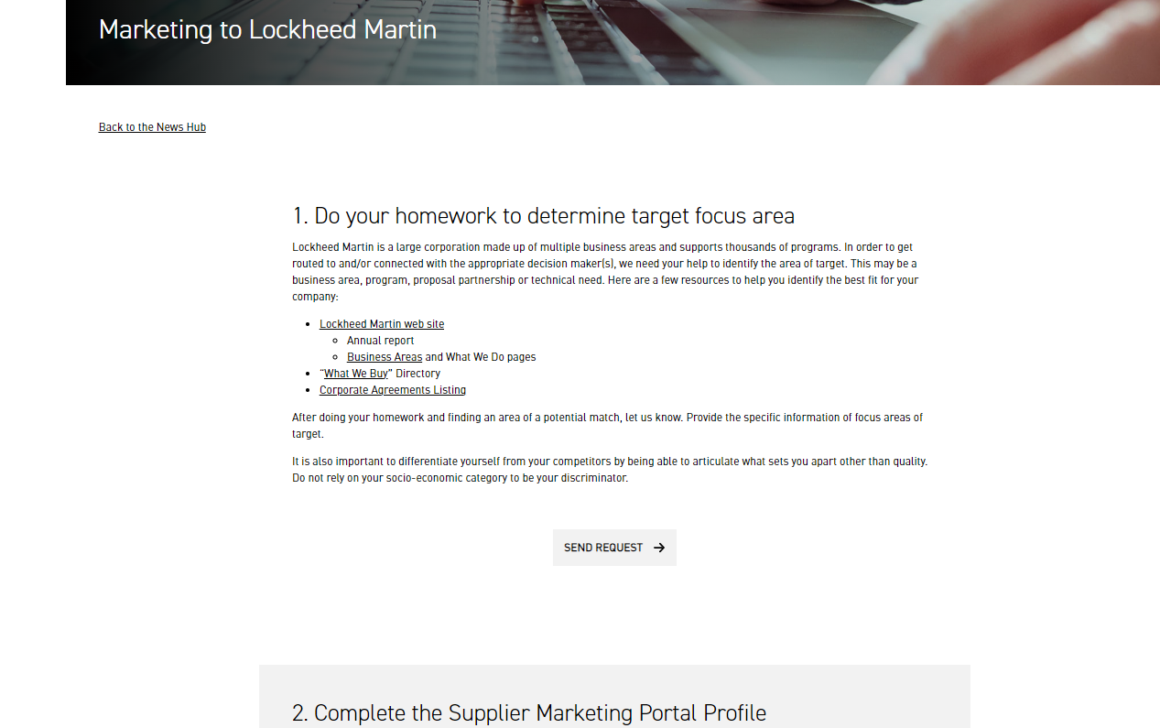
Example - Prime Contractors
Lockheed Martin
https://www.lockheedmartin.com/en-us/suppliers/news/features/2023/marketing-to-lockheed-martin.html

Slide 59
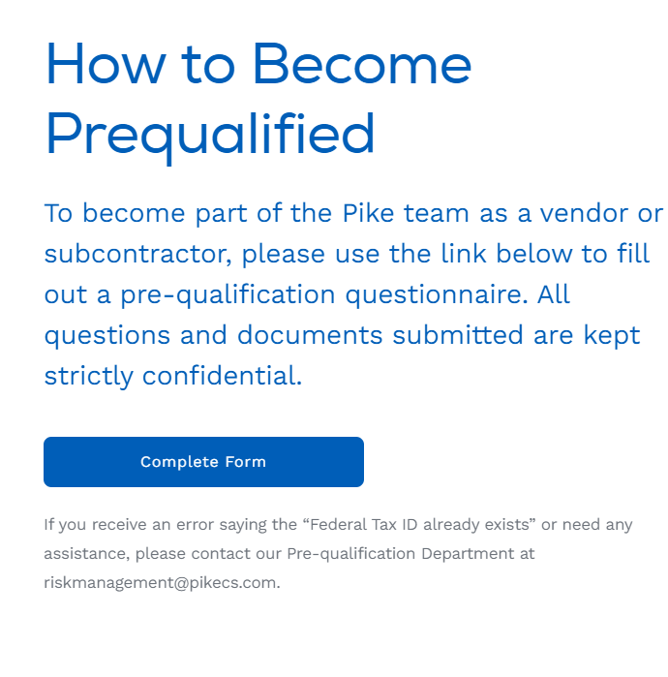
Example - General Contractors
The Pike Company
https://pikecs.com/work-with-pike/
LeChase Construction
https://www.lechase.com/contractor-project-center/

Slide 60
What about GSA Schedules
The GSA Schedule, also known as Federal Supply Schedule, and Multiple Award Schedule (MAS), is a long-term governmentwide contract with commercial companies that provide access to millions of commercial products and services at fair and reasonable prices to the government.
Understand what it means to be on a GSA contract vehicle (“Phase II” of government contracting) - License to ‘hunt’
While you may not be ready, you could find potential subcontract opportunities with those on contract – mine the list for potential subcontractor opportunities

Slide 61
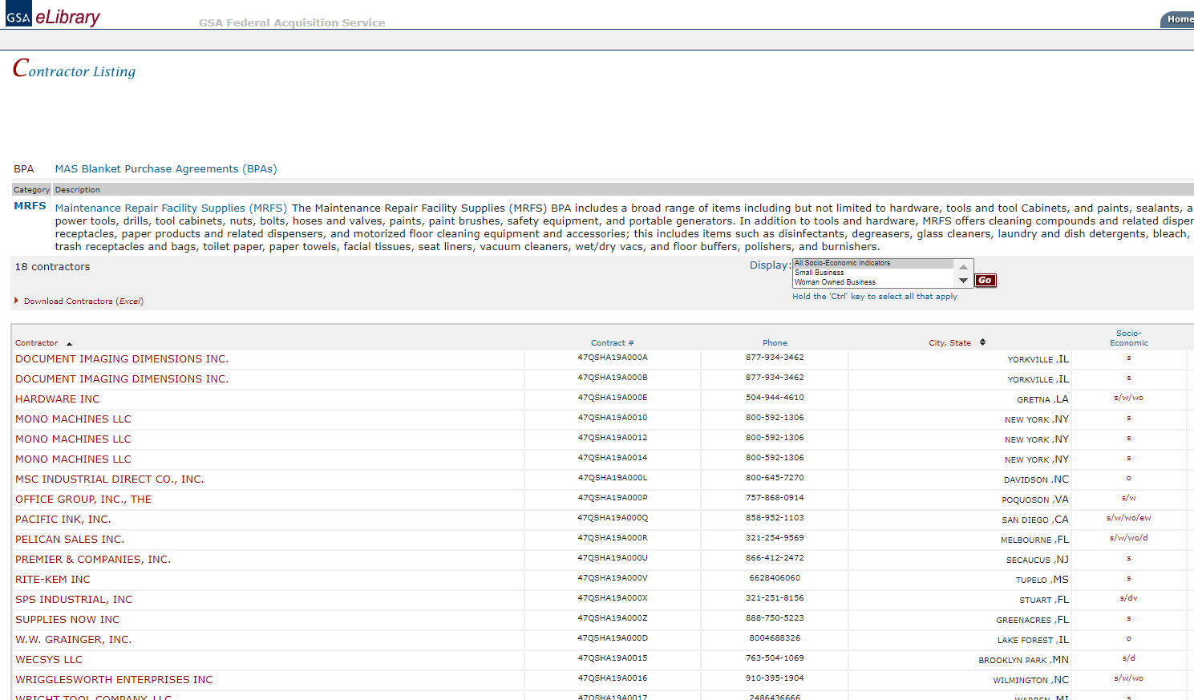
61

Slide 62
Suggested Questions to Ask Government Agencies
“My research indicates you use a competitors product for this widget, here is how our product is more innovative and/or can save you money” ---- INSTEAD of saying: “Are you currently buying our product/service?”
Is the item currently under contract?
When will the contract expire?
Where do you list you requirements? (remember to check vendor pages first)
What buying methods are used: Credit Card $10k/3500i/ Simplified Purchasing $250,000i / Negotiated Contracts / GSA Contracts?
Which office at your agency/firm does the buying?
Central office OR Individual location purchases
How do I contact the appropriate buyer(s)?
What is the best method for first contacting the buyer/program manager?

Slide 63
Suggested Questions to Ask Government Agencies
How can I arrange for an appointment to demonstrate our product / discuss our service?
Does your agency have any new initiatives/projects with possible needs for my firm?
How will my firm’s information be processed / circulated within your agency?
How should I keep your agency up-to-date on my firm’s new products and services?
How can I keep up-to-date on your agencies forecasted procurements?
NOTE: Government buyers are risk and change averse – the story has to be about how they don’t have to take any risks or how they face more risks by continuing with status quo. (Source: Captureplanning.com)

Slide 64
Tips for Success
Do Your Homework
Try not to lead in your Socio-Economic Classification
This is a “value add” for the agency
The important information is how you can help them
Performance and Delivery are KEY
Have a well thought out “Elevator Pitch” 30 – 60 seconds
Plan to discuss upcoming requirements/needs/pain-points
Misplaced frustration – if you’re feeling frustrated, reach out regularly to an APEX Accelerator for guidance

Slide 65
Government Marketing Strategies
In Summary
Use government market research tools to explore opportunities and analyze competition
Have a good understanding on where your product/service fits in the supply chain, and in the general marketplace
Examine your company’s commercial marketing materials and edit for government buyers and primes
Develop a budget and timeline to execute your government market plan
Utilize your certification status
Bid on contracts that fit the size and scope of your capabilities
Patience and Perseverance

Slide 66
How to Market Your Company as a WOSB
Anna Vulaj Fitzsimmons
Program Director, MCFL APEX Accelerator
APTAC Region 2 Director – NY, NJ & DE
avulaj@monroecounty.gov
585-753-2017
www.mcflapex.org

