Slide 1
GSA OSDBU Overview
Bill Strobel
Small Business Technical Advisor
​Regional Small Business Advocacy and Engagement Division (ES)
Office of Small and Disadvantaged Business Utilization (OSDBU)
U.S. General Services Administration

Slide 2


Topics
Glossary of Terms
GSA OSDBU Overview
Agency Overview
Accessing Federal Contract Opportunities
Forecasting of Contracting Opportunities
Guidance on Section 889: Supply Chain Security
Small Business Resources & Events

Slide 3
Agency Overview
Glossary of Terms
GSA – General Services Administration
OSDBU – Office of Small and Disadvantaged Business Utilization
FSS – Federal Supply Schedules (Includes VA’s 9 schedules)
MAS – Multiple Award Schedules (Only GSA schedules)
PBS – Public Building Service
IDIQ – Indefinite Delivery, Indefinite Quantity
BPA – Blanket Purchase Agreement
GWAC – Governmentwide Acquisition Contract
GSA MAS Program – General Services Administration Multiple Award Schedule Program
GSA Schedule – Abbreviated form of the program name.
Schedules Program – Abbreviated form of the program name.
GSA Schedule – The breakdown into categories: such as “Information Technology”, “Furnishings”, etc.
NAICS – North American Industry Classification System.
SIN – Special Item Number. (Based on NAICS Codes.)

Slide 4

OSDBU Overview
Office of Small and Disadvantaged Business Utilization (OSDBU)
According to the Small Business Act as amended by Public Law 95-507, the Office of Small & Disadvantaged Business was established to: Advocate, within each Federal Executive Agency, for the maximum practicable use of all designated small business categories within the Federal Acquisition process. Ensure inclusion of small businesses as sources for goods and services in federal acquisitions as prime contractors and subcontractors. Manage the small business utilization programs for each respective organization.
https://www.gsa.gov/small-business

Slide 5
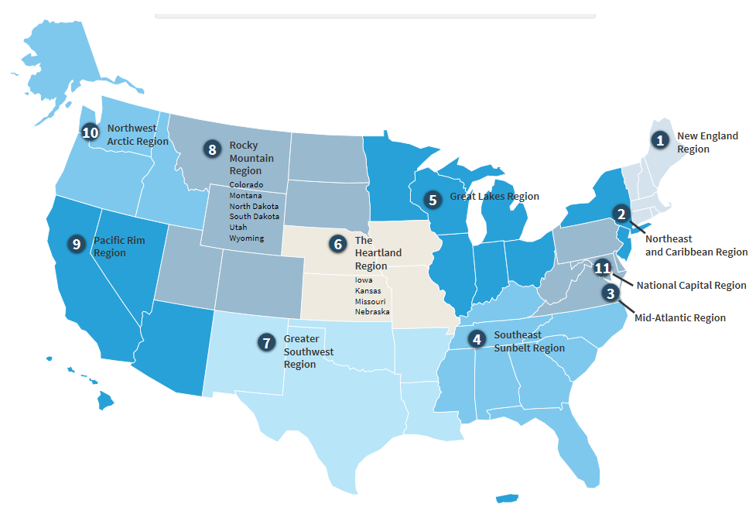
OSDBU Overview (Cont.)
Office of Small and Disadvantaged Business Utilization (OSDBU)
Small Business Goaling Small Disadvantaged Business (SDB) 8(a) Women-owned Small Business Historically Underutilized Business Zone (HUBZone) Veteran-owned Small Business Service Disabled Veteran-owned Small Business Small Business Subcontracting Program Forecast of Contracting Opportunities UPDATE: SBA’s Veteran Small Business Certification Program is now open: www.sba.gov/vetcert SBA Fact Sheet on “How to apply for certification”: https://www.sba.gov/brand/assets/sba/resource-partners/Preparing-for-certification-VetCertFactSheet-508c.pdf
https://www.gsa.gov/about-us/contact-us/small-business-support

Slide 6
GSA Small Business Support
OSDBU Overview (Cont.)
Contact your local small business advocate.
https://www.gsa.gov/about-us/contact-us/small-business-support

Slide 7
OSDBU Overview (Cont.)
GSA receives an A+ rating from the SBA for FY 22.
Category | Dollars ($) | Goal (%) | Achievement (%)
Small Business (Overall) | $2.829B | 34% | 47.51%
Small Disadvantaged Business (SDB) | $1.325B | 21% | 22.25%
Woman Owned Small Business (WOSB) | $589.3M | 5% | 9.90%
Service Disabled Veteran Owned Small Business (SDVOSB) | $557.7M | 3% | 9.37%
HUBZONE | $408.8M | 3% | 6.86%
GSA Total Eligible Spend (FY22): $5,955,134,116

Slide 8
OSDBU Overview (Cont.)
Current GSA Total Eligible Spend (FY23): $6,655,546,537
Category | Dollars ($) | Goal (%) | Achievement (%)
Small Business (Overall) | $3.343B | 33% | 50.23%
Small Disadvantaged Business (SDB) | $1.347B | 21.9% | 20.24%
Woman Owned Small Business (WOSB) | $649.9M | 5% | 9.77%
Service Disabled Veteran Owned Small Business (SDVOSB) | $803.3M | 3% | 12.07%
HUBZONE | $376.9M | 3% | 5.66%
As of 12/27/2023

Slide 9
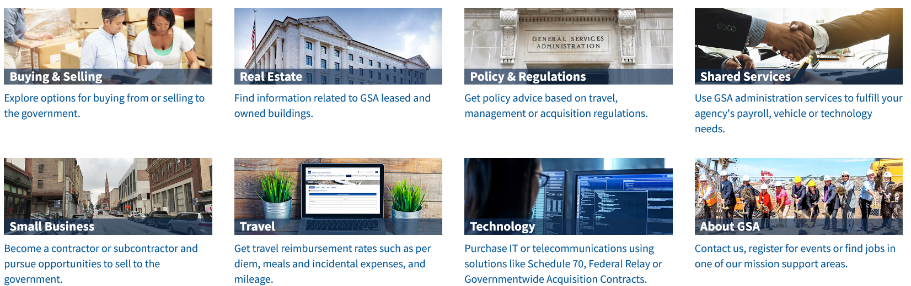
Agency Overview
The U.S. General Services Administration (GSA) is one of the federal government's largest buyers, contracting for billions of dollars’ worth of products and services each year for its U.S. government “customers.” These customers include most agencies of the executive, judicial, and legislative branches and federal government and military facilities worldwide.
GSA rents, builds, furnishes, and maintains government offices and buys products ranging from pens to state-of-the-art computers. GSA also contracts for services as varied as trash removal and information technology.
www.gsa.gov
Mission-
“Deliver value and savings in real estate, acquisition, technology, and other mission-support services across government.”
https://www.gsa.gov/forbusiness

Slide 10
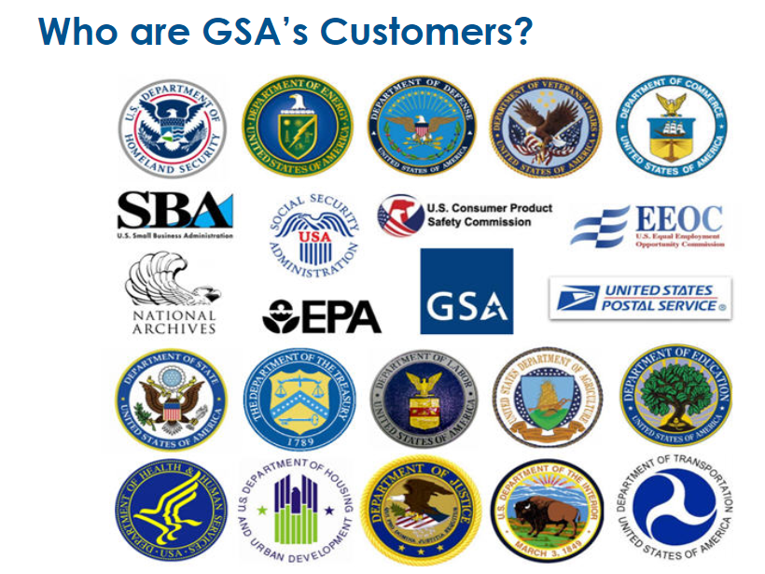
Who Are GSA’s Customers?
Agency Overview (Cont.)

Slide 11
Agency Overview (Cont.)
Public Buildings Service (PBS) As the landlord for the civilian federal government, PBS acquires space on behalf of the federal government through new construction and leasing, and acts as a caretaker for federal properties across the country. PBS owns or leases 8,800 assets, maintains an inventory of more than 370 million square feet of workspace, and preserves more than 500 historic properties. https://www.gsa.gov/pbs | What does PBS Procure? Construction A&E Services Janitorial Landscape Interior Design Asbestos Removal HVAC Lighting Security Window Washing Painting Electrical Lease | Where are the PBS Opportunities? GSA Forecast GSA Subcontracting Sam.gov GSA Multiple Award Schedules (MAS) Indefinite Delivery Indefinite Quantities (IDIQ)

Slide 12
Agency Overview (Cont.)
Federal Acquisition Services (FAS) GSA is America's only source solely dedicated to procuring goods and services for government. As an integral part of GSA, FAS possesses unrivaled capability to deliver comprehensive products and services across government at the best value possible https://www.gsa.gov/fas | What does FAS Procure? Environmental Moving Services Staffing Information Technology Transportation Law Enforcement Equipment Furniture Professional Training Telecom & Network Services Travel Services Emergency Preparedness & Response Equipment And Much More… https://www.gsaauctions.gov | Where are the FAS Opportunities? GSA Forecast GSA Subcontracting Sam.gov GSA Multiple Award Schedules (MAS) Indefinite Delivery Indefinite Quantities (IDIQ) Governmentwide Acquisition Contracts (GWAC)

Slide 13
ACCESSING FEDERAL CONTRACT OPPORTUNITIES
GSA Multiple Award Schedules (MAS)
The GSA Multiple Award Schedule (MAS) Program, also referred to as the “Schedule,” is the premier contract vehicle for the federal government. The Schedule Program is a long term governmentwide contract between commercial suppliers and the federal government. Suppliers give federal, and in some cases state and local buyers (including tribal governments and some educational institutions), access to millions of commercial products and services at negotiated ceiling prices. Schedule purchases represent approximately 21 percent of overall federal procurement spending--approximately $42 Billion per year. | A contract Another arena to bid on opportunities Increases visibility to government customers Not a certification No guaranteed sales Not mandatory to do business with the government Not mandatory for other agencies to use Not used for Construction (236220)
https://www.gsa.gov/masroadmap | https://www.gsa.gov/forbusiness

Slide 14
ACCESSING FEDERAL CONTRACT OPPORTUNITIES (CONT.)
GSA Multiple Award Schedules (MAS) THE GSA MAS INCLUDES SERVICES AND PRODUCTS IN THE VARIOUS INDUSTRIES LISTED BELOW:
Professional Services Schedule Facilities Maintenance & Management Automotive Superstore Office, Imaging and Documents Solutions Transportation, Delivery, and Relocation Solutions Hardware Superstore Photographic Equipment – Cameras, Photographic Printers and Related Supplies and Services (Digital and Film-Based) General Purpose Commercial Information Technology Equipment, Software and Services Furniture Comprehensive Furniture Management Services Furnishing and Floor Coverings Food Service, Hospitality, Cleaning Equipment and Supplies, Chemicals, and Services Temporary Administrative and Professional Staffing Human Capital Management & Administrative Support Services Office Products/Supplies & Services and New Products/Technology | Leasing of Automobiles and Light Trucks Publication Media Sports, Promotional, Outdoor, Recreational, Trophies and Signs (Sports) Shipping, packaging and packing supplies Total Solutions for Law Enforcement, Security, Facility Management Systems, Fire, Rescue, Clothing, Marine Craft and Emergency/Disaster Response Buildings and Building Materials/Industrial Services and Supplies Professional Audio/Video, Telemetry/Tracking, Recording/Reproducing and Signal Data Solutions Travel Services Solutions Note: Veterans Affairs (VA) Schedules are also listed at GSA eLibrary: 621 I – Professional and Allied Healthcare Staffing Services, 621 II – Medical Laboratory Testing and Analysis Services, 65 II A – Medical Equipment and Supplies, and much more… Visit: www.gsaelibrary.gsa.gov
https://www.gsaelibrary.gsa.gov

Slide 15
ACCESSING FEDERAL CONTRACT OPPORTUNITIES (CONT.)
GSA Multiple Award Schedules (MAS)
MAS Office Hours Monthly Webinars Register for the Monthly MAS Office Hours Webinars directly | gsa.gov/events to view the calendar https://gsa.zoomgov.com/webinar/register/WN_EETVm2LNRH2MeM90Kg_D-A
View previous MAS Office Hours webinars | https://www.youtube.com/playlist?list=PLvdwyPgXnxxX3I6FfCXIB5GK0QKfi1EEq
GSA MAS Questions | Email: MASPMO@gsa.gov
Current GSA MAS Contract Holders – Update on eBUY | https://buy.gsa.gov/interact/community/6/activity-feed/post/271602ff-1cd1-4019-b038-63c9742127f7/New_Interested_Feature_in_eBuy_Brings_Benefits_to_Both_Buyers_and_Sellers

Slide 16
ACCESSING FEDERAL CONTRACT OPPORTUNITIES (CONT.)
GSA Multiple Award Schedules (MAS)
GSA's Vendor Support Center (VSC) How to Market to the Government | https://vsc.gsa.gov/vsc/ https://www.gsa.gov/technology/it-contract-vehicles-and-purchasing-programs/multiple-award-schedule-it/sell-through-mas-information-technology/how-to-market-to-the-government
VSC Contractor Start-up Kit | https://vsc.gsa.gov/vsc/app-content-viewer/section/95
GSA Logo Policy | https://www.gsa.gov/reference/gsa-logo-policy/download-gsa-logo
GSA Resource Videos | https://www.gsa.gov/small-business/small-business-resources

Slide 17





ACCESSING FEDERAL CONTRACT OPPORTUNITIES (CONT.)
GSA Governmentwide Acquisition Contracts (GWAC) www.gsa.gov/gwac
8(a) STARS III: GWAC offers access to highly qualified, certified 8(a) small disadvantaged businesses. The contract has a $10 Billion program ceiling with a five-year base period and one five-year option. VETS 2 (SDVOSB): GWAC set-aside exclusively for Service-Disabled, Veteran-Owned Small Businesses (SDVOSB). VETS 2 is designed to meet a variety of diverse agency IT requirements, including new and emerging technologies. The contract has a $5 Billion program ceiling with a five-year base period and one five-year option. Alliant 2: GWAC represents the next generation GWAC vehicle for comprehensive information technology (IT) solutions through customizable hardware, software, and services solutions purchased as a total package. | Alliant 3 Request for Proposal (RFP) will be solicited no earlier than the First Quarter of Fiscal Year 2024. View the Draft Request for Proposal (RFP) on sam.gov https://sam.gov/opp/662de9cafbdd4398af442c8bc12d59e9/view Polaris updates and next steps will be communicated through SAM.gov. GSA Interact - Small Business GWAC Community https://interact.gsa.gov/group/small-business-gwac-community-interest

Slide 18
ACCESSING FEDERAL CONTRACT OPPORTUNITIES (CONT.)
www.gsa.gov/OASIS
OASIS Unrestricted is a Full and Open contract OASIS Small Business is a 100% Small Business Set-Aside OASIS 8(a) were developed to provide the 8(a) community expanded access to the OASIS contract program while creating more options for federal agencies to meet their 8(a) business development program goals Core Services Include: Program management services Management consulting services; Logistics services Engineering services Scientific services Financial services. OASIS Questions: Oasis@gsa.gov Visit: www.gsa.gov/OASIS | OASIS+ is a suite of contracts that combines the scope of OASIS, Building, Maintenance & Operations (BMO) and Human Capital & Training Solutions (HCaTS) under one program Designed to support federal agencies’ procurement requirements for services-based solutions Access to highly qualified contractors of all sizes from multiple industries OASIS+ Questions: PSHC-dev@gsa.gov Visit: OASIS+ Interact Community https://buy.gsa.gov/interact/community/196/activity-feed

Slide 19
ACCESSING FEDERAL CONTRACT OPPORTUNITIES (CONT.)
GSA Multiple Award Schedules (MAS)
Overview of GSA Multiple Awards Schedules (MAS) | www.gsa.gov/masroadmap
GSA MAS Solicitation | To download the GSA MAS Solicitation, please follow the instructions below: 1. www.gsaelibrary.gsa.gov 2. type "MAS" into the search bar 3. Click "MAS" 4. Click on "Contractors click here to view the current solicitation on sam.gov" box 5. Click on SOLICITATION DOCUMENT… 6. You will find the instructions in Section I. Offer Preparation Instructions and Evaluation Criteria .
GSA Interact - MAS updates and information | https://interact.gsa.gov/groups/multiple-award-schedules

Slide 20
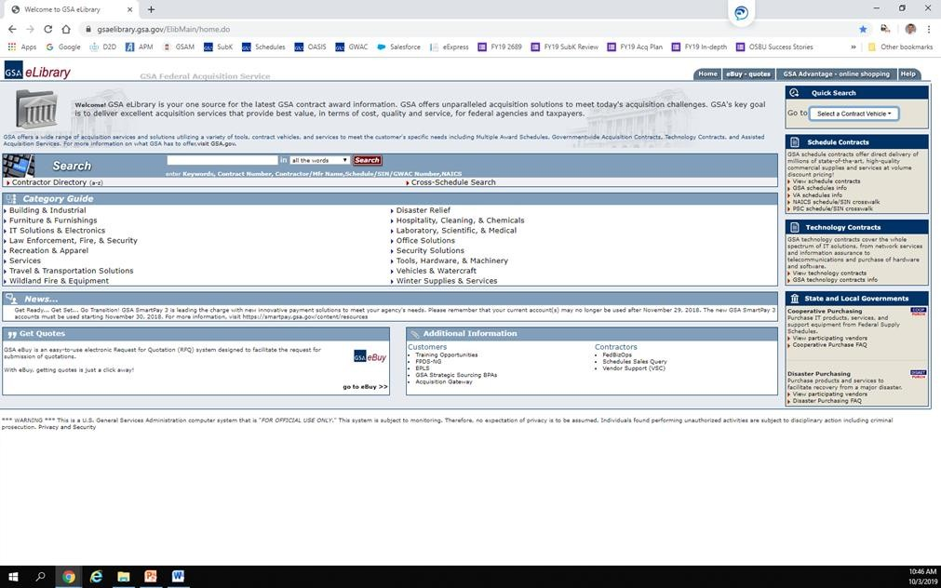
ACCESSING FEDERAL CONTRACT OPPORTUNITIES (CONT.)
If you know the Schedule you want to apply to, you can select it from the quick search box
You can use the search box by submitting terms that relate to your product or service
Visit: https://www.gsaelibrary.gsa.gov

Slide 21
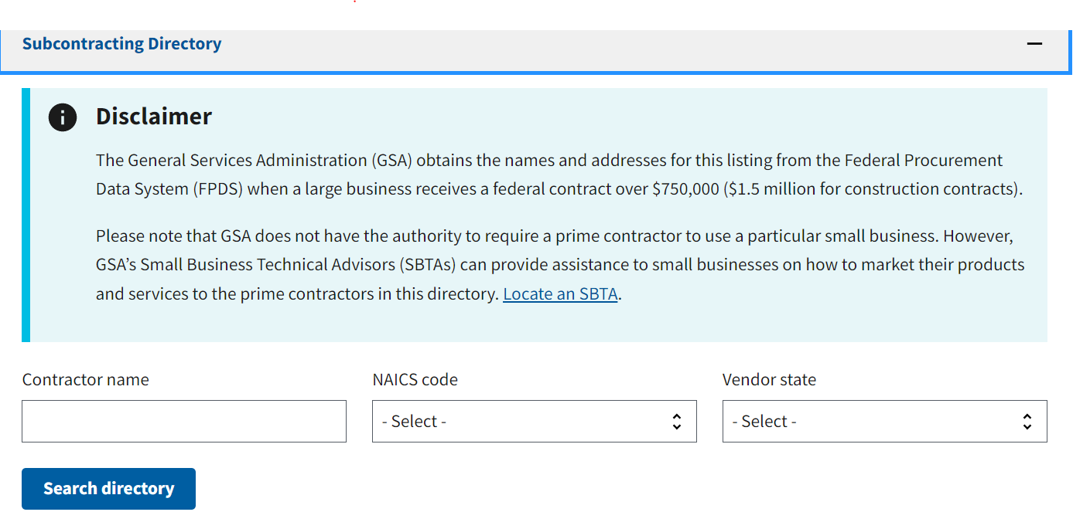
GSA Subcontracting Directory (Nationwide)
ACCESSING FEDERAL CONTRACT OPPORTUNITIES (CONT.)
The General Services Administration (GSA) provides a lists of large prime business contractors
When a large business receives a federal contract over $750,000 ($1.5 million for construction contracts)
Small businesses must contact prime contractors directly
Utilize GSA's Subcontracting Directory and the GSA eLibrary to find potential large prime business contractors.
https://www.gsa.gov/subdirectory

Slide 22
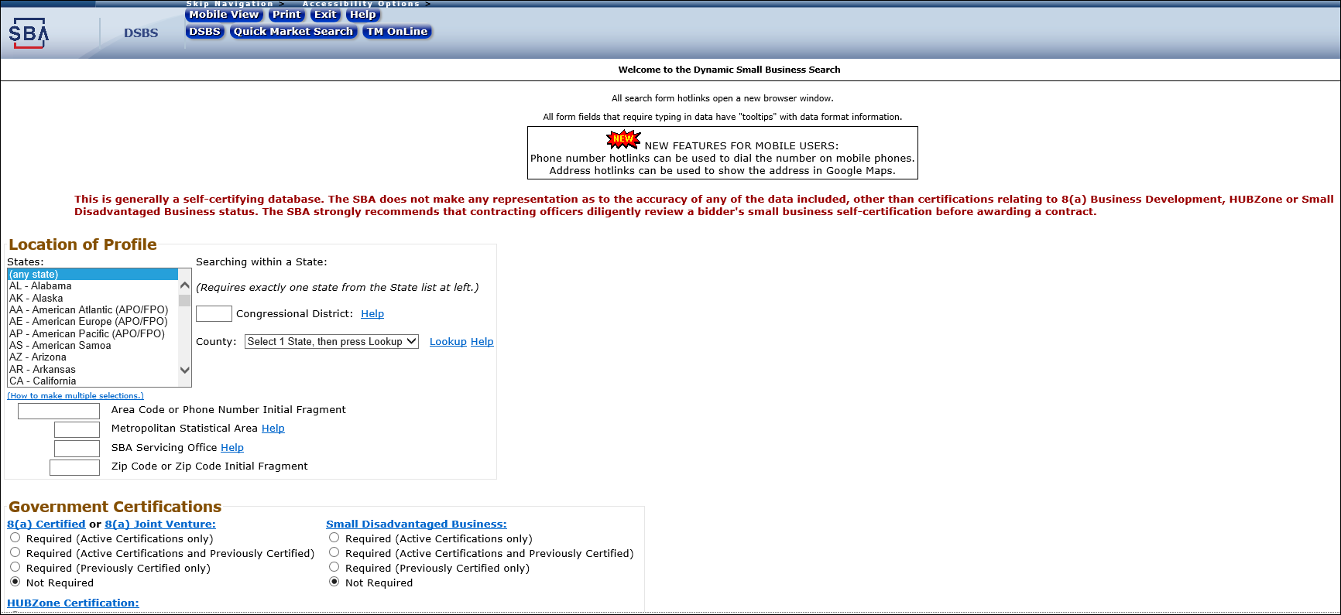

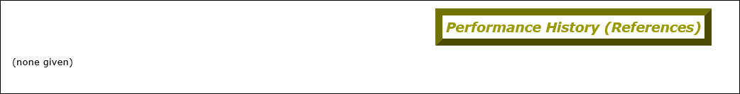
ACCESSING FEDERAL CONTRACT OPPORTUNITIES (CONT.)
Dynamic Small Business Search (DSBS): http://dsbs.sba.gov/
Updates at: https://connect.sba.gov/
Notes:
Please take a look at your current Dynamic Small Business Search profile page. This site is essentially your Free Advertisement to the federal government and potential teaming partners. We mention this because we see outdated information on company profiles quite often, it could be an email or phone number that aren’t in service or a point of contact who is no longer with the company. This site maybe your first contact with a government agency so please update it and ensure it accurately reflects your current business.
The DSBS pulls and populates these fields from the data you’ve entered in SAM.GOV, which does sometimes leave unpopulated fields. Note on the slide, the capabilities narrative, keywords and Performance History are all circled as they all state None Given.
Please ensure your capabilities narrative is polished. Add any specialized services or supplies you provide and highlight technical expertise that separates you from your competitors in this section.
Also, take a look at your keywords! Keywords help narrow the search results which is helpful if we’re looking for some additional specialty or specialized skill which is less common under a general NAICS code category. Make sure you update this section with your common industry keywords and again highlight those specialized keywords that differentiate you from your competitors. If you need assistance, your local Apex Accelerators can assist.
Finally, ensure you highlight your Performance History, by adding relevant and recent work in this section.
Updates to your DSBS information has recently changed. DSBS update is no longer at the end of the sam.gov registration, you’ll now go to https://connect.sba.gov/ and request access to DSBS. This can take up to three days to get access. There’s a video you can view on the site by clicking "I need more information on how to access DSBS“.

Slide 23
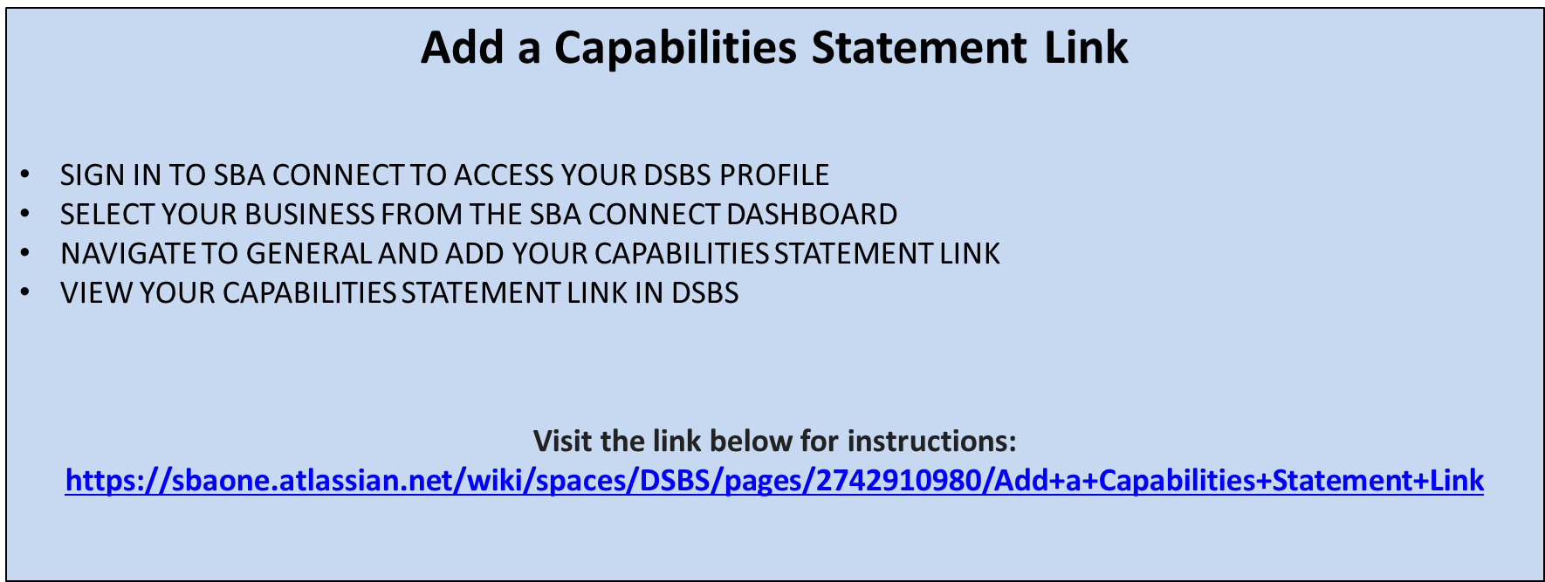
ACCESSING FEDERAL CONTRACT OPPORTUNITIES (CONT.)
UPDATE to the Dynamic Small Business Search (DSBS)

Slide 24
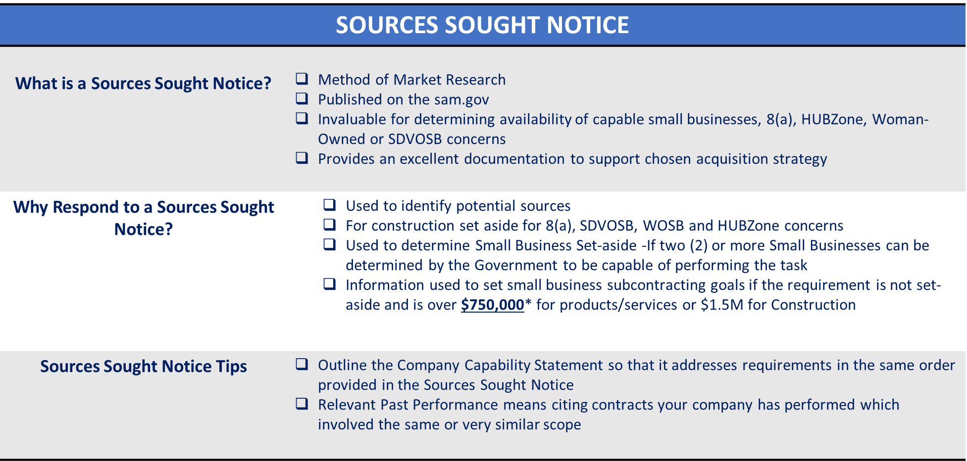
ACCESSING FEDERAL CONTRACT OPPORTUNITIES (CONT.)

Slide 25
ACCESSING FEDERAL CONTRACT OPPORTUNITIES (CONT.)
Minimum Requirements
Have a Unique Entity Identifier (UEI). Assigned through SAM.GOV registration. **DUNS number has converted over to the Unique Entity Identifier (UEI) as of 4/4/22. | https://www.gsa.gov/entityid
Register with the System for Award Management (SAM) | http://www.sam.gov
Size Standards (New Table posted 3/17/23) | https://www.sba.gov/federal-contracting/contracting-guide/size-standards

Slide 26
ACCESSING FEDERAL CONTRACT OPPORTUNITIES (CONT.)
Minimum Requirements
North American Industry Classification System (NAICS) Industry Codes | https://www.census.gov/naics
Small Business Administration (SBA) Business Categories - Small Disadvantaged Business (SDB) 8(a) Women-owned Small Business Historically Underutilized Business Zone (HUBZone) Veteran-owned Small Business Service Disabled Veteran-owned Small Business | https://www.sba.gov/federal-contracting/contracting-assistance-programs

Slide 27
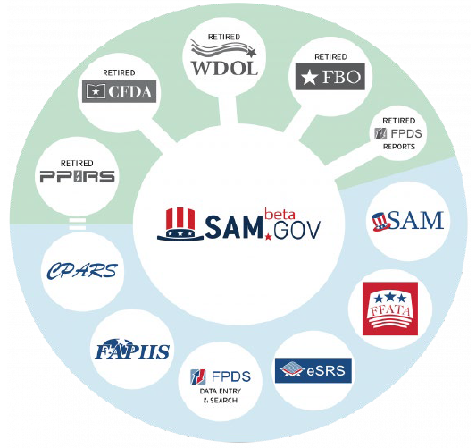
ACCESSING FEDERAL CONTRACT OPPORTUNITIES (CONT.)
Sam.Gov includes the following:
Contract Opportunities: (Formerly fbo.gov)
Contract Data: (Reports only. From fpds.gov)
Wage Determinations: (Formerly wdol.gov)
Entity Registration: (Combined with the former beta.sam.gov)
Entity Reporting
Assistance Listings: (Formerly cfda.gov)

Slide 28
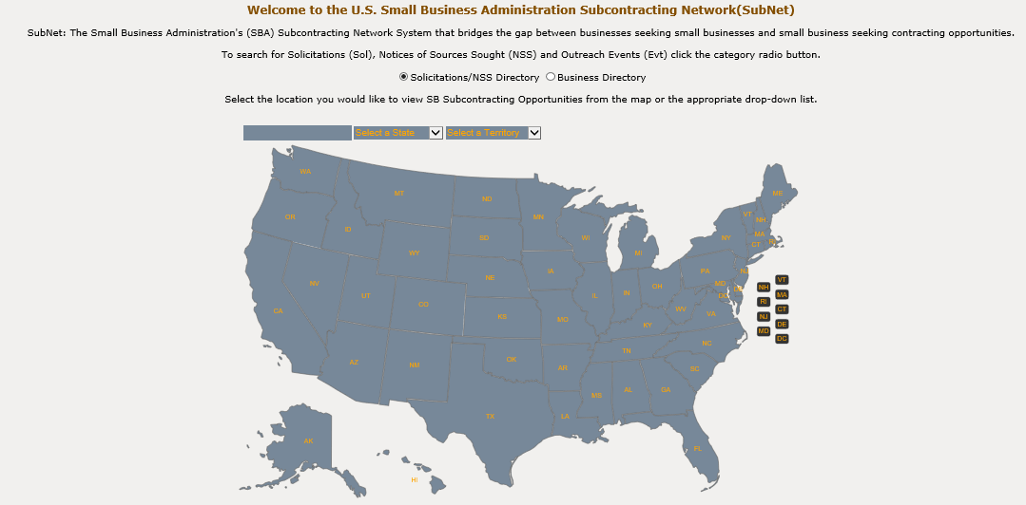

ACCESSING FEDERAL CONTRACT OPPORTUNITIES (CONT.)
SBA Subcontracting Network Database (SUBNet)
The Small Business Administration’s Subcontracting Network database (SubNet) will help bridge the gap between businesses seeking small businesses and small businesses seeking contract opportunities
https://subnet.sba.gov/client/dsp_Landing.cfm

Slide 29
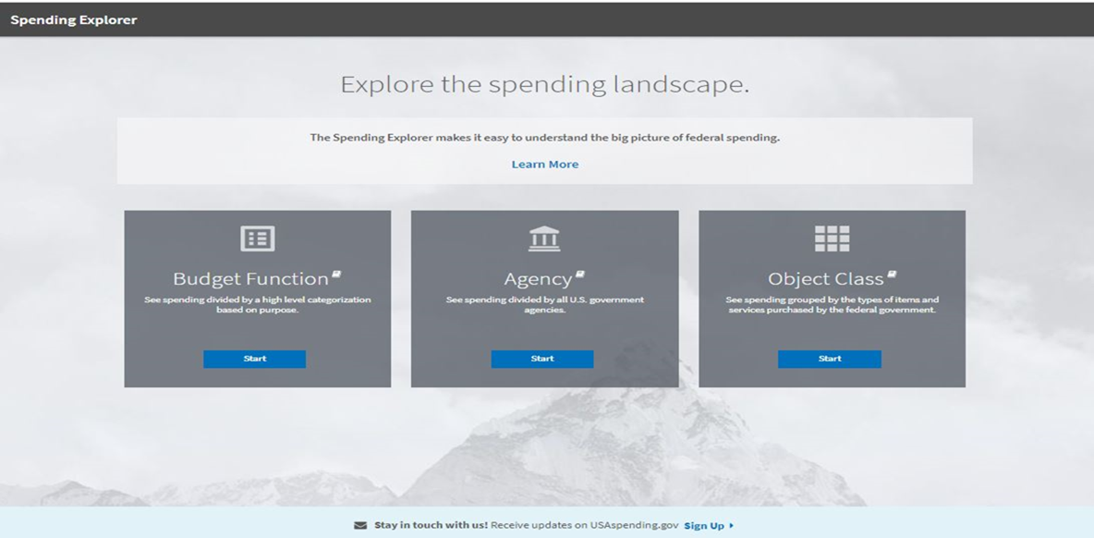

ACCESSING FEDERAL CONTRACT OPPORTUNITIES (CONT.)
USA Spending
USA Spending is another tool that can be used for conducting marketing analysis. It is a government source for data on federal grants, contracts, loans, and other financial assistance.
www.usaspending.gov

Slide 30
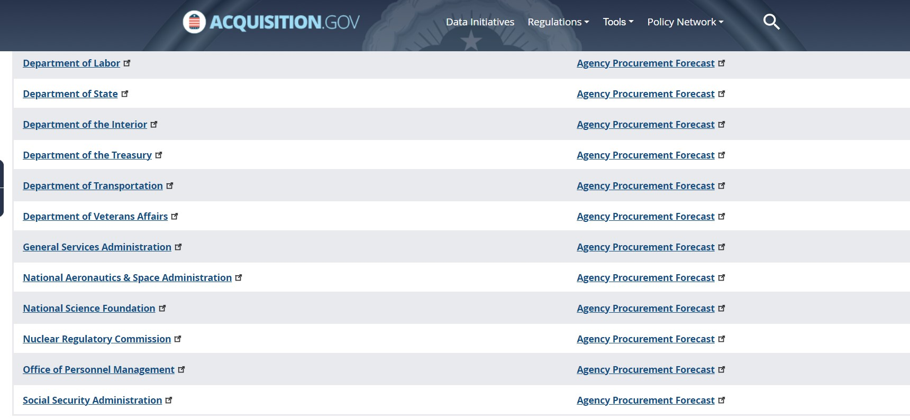
Forecast of Contracting Opportunities
How to Access the Forecast Tool:
Background:
Focuses on acquisition planning and increases awareness of potential prime and subcontracting opportunities.
The goal is to help both GSA buyers and vendors easily communicate around potential contracting opportunities.
The tool includes information for GSA, Department of Interior, Department of Labor, U.S. Small Business Administration (SBA), and U.S. Office of Personnel Management (OPM)
Forecast Website Access:
https://acquisitiongateway.gov/
https://www.fbf.gov
(GSA, SBA, OPM, Dept. of Labor and Dept. of Interior)
https://www.acquisition.gov/procurement-forecasts
(All Federal Agencies Forecast of Contracting Opportunities)

Slide 31
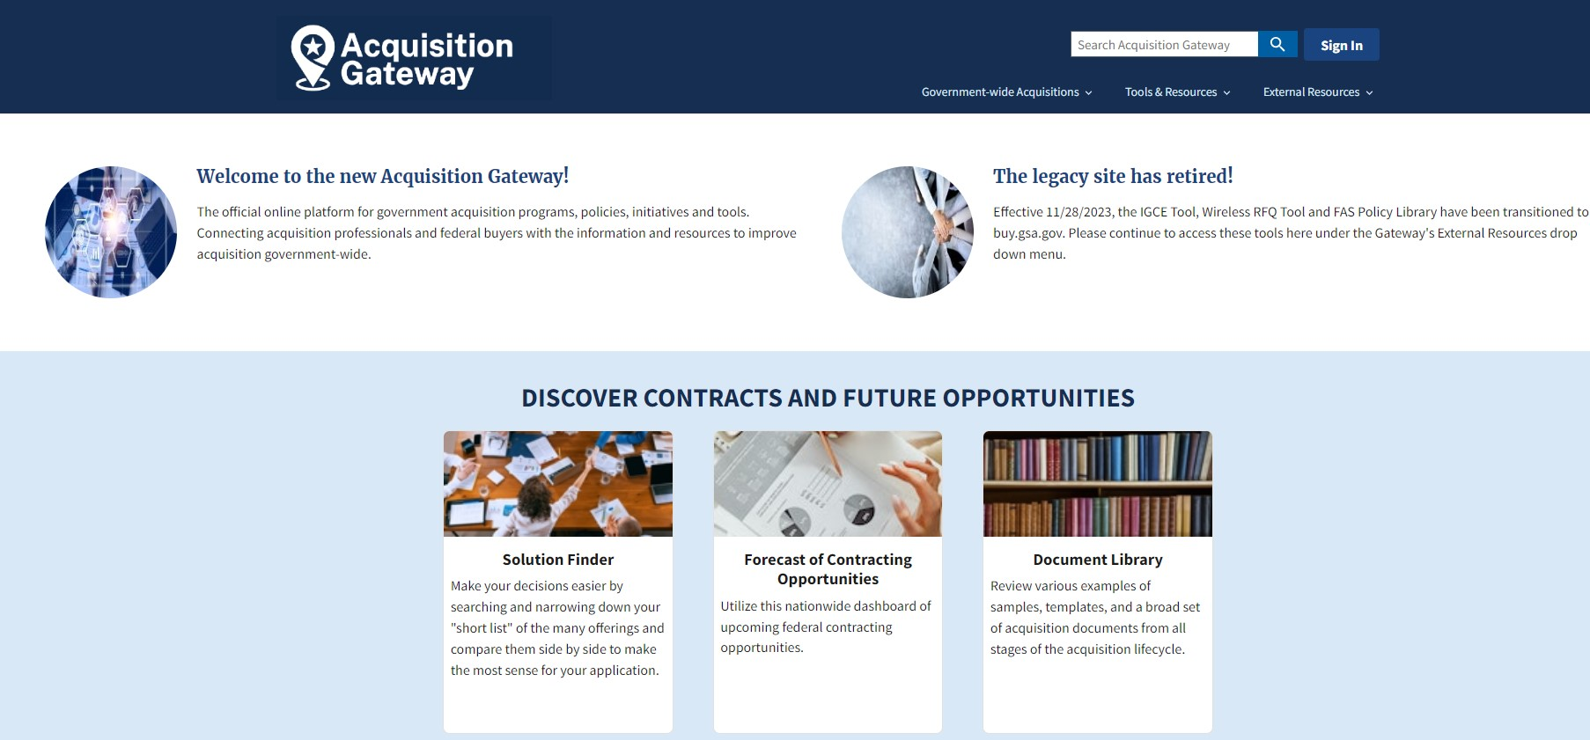

Forecast of Contracting Opportunities (Cont.)
https://acquisitiongateway.gov/

Slide 32

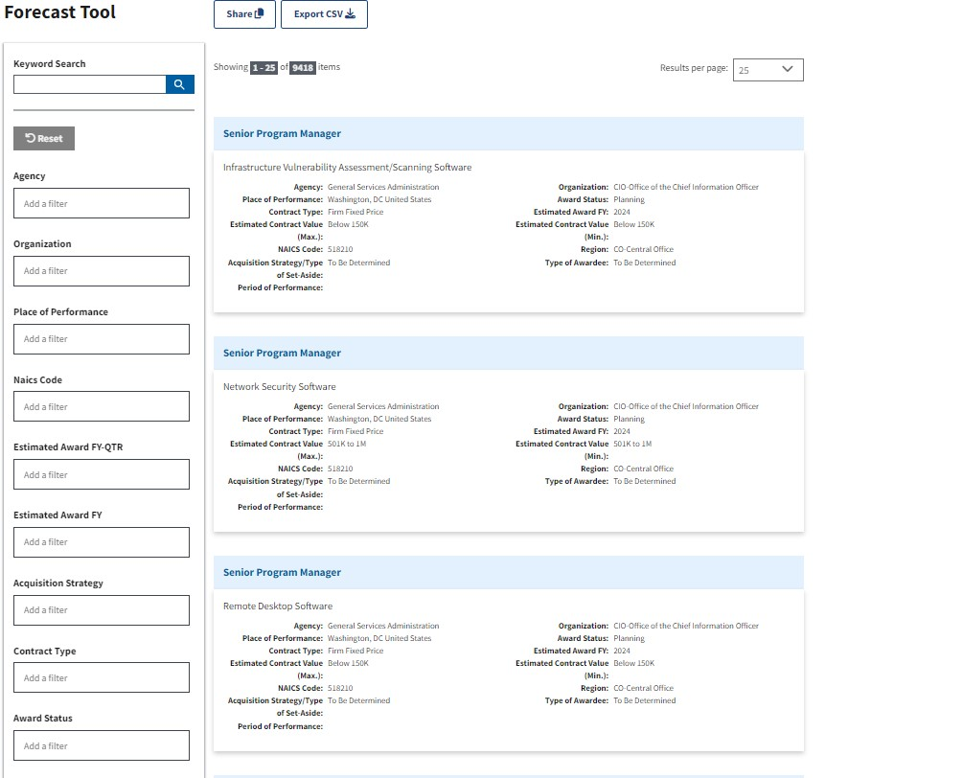
Forecast of Contracting Opportunities (Cont.)
Download to Excel
Filter Options

Slide 33
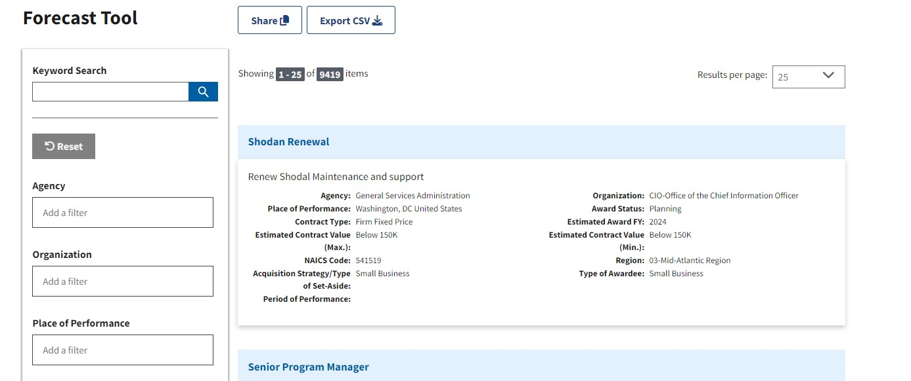
Forecast of Contracting Opportunities (Cont.)
Search for opportunities related to your key terms

Slide 34
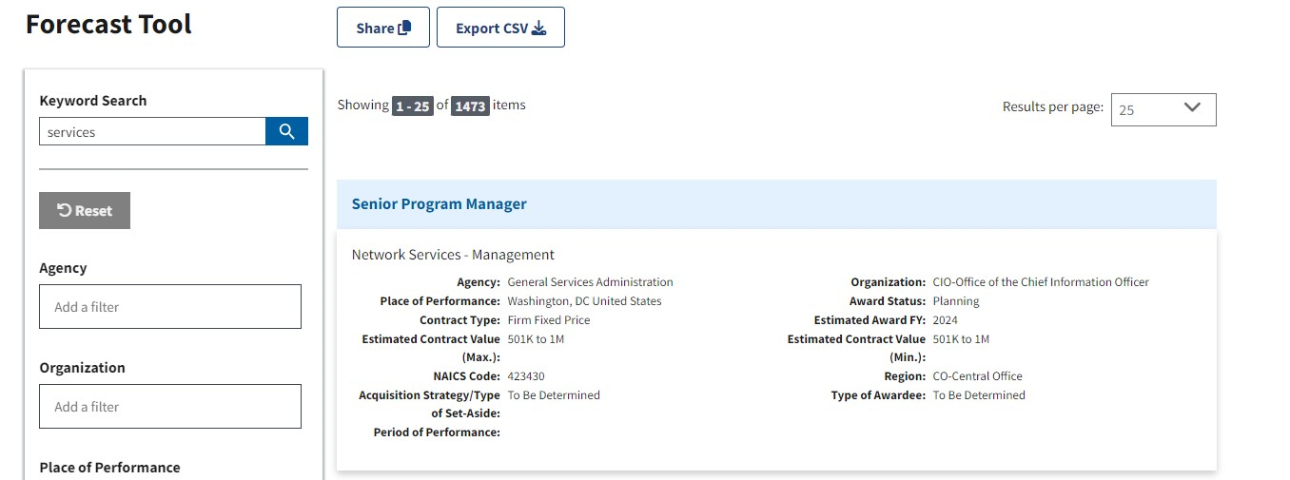
Forecast of Contracting Opportunities (Cont.)
See how many results are available
View applied search term

Slide 35
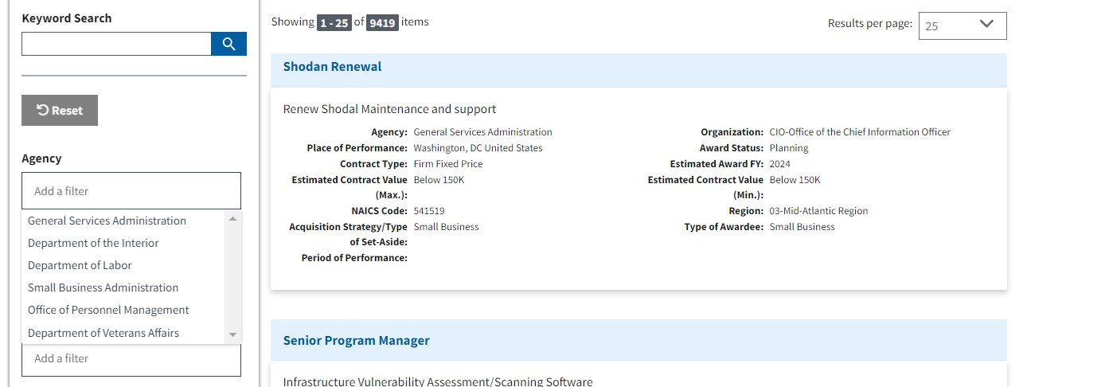
Forecast of Contracting Opportunities (Cont.)
Add another filter by Agency
6 Agencies Forecasts listed

Slide 36
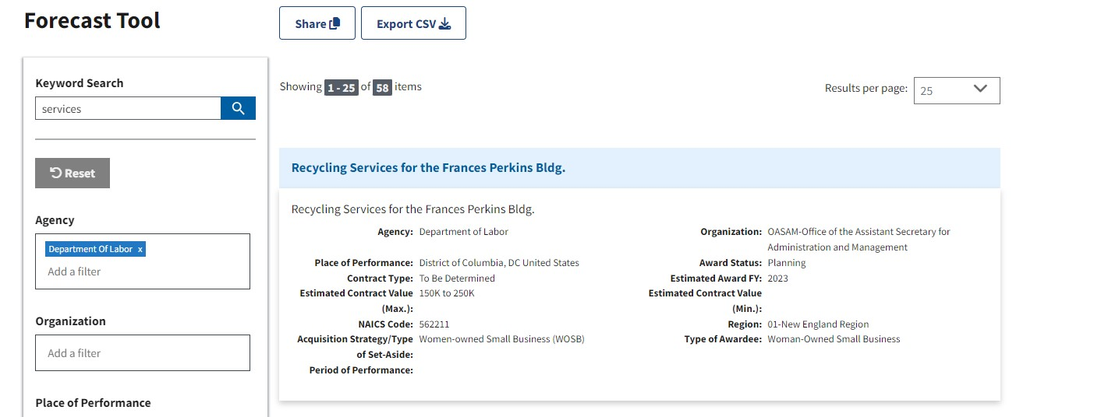
Forecast of Contracting Opportunities (Cont.)
Opportunities by Agency
Agency Selected

Slide 37
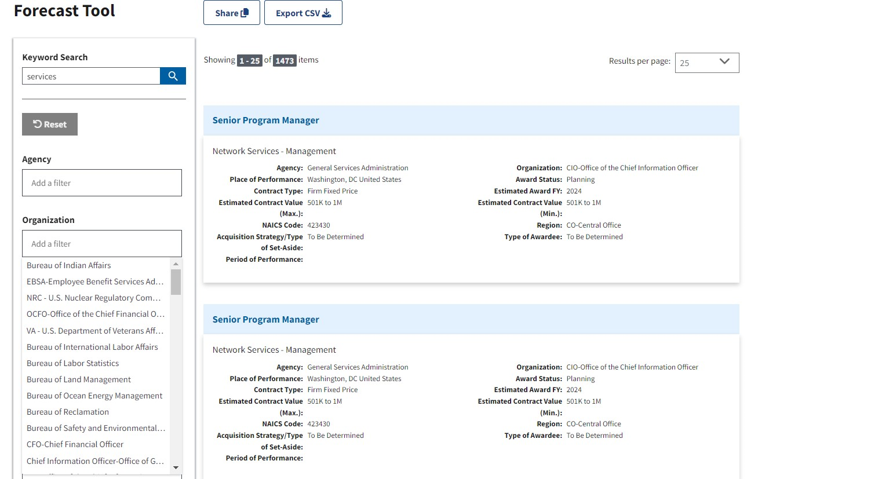
Forecast of Contracting Opportunities (Cont.)
Add another filter by Organization

Slide 38
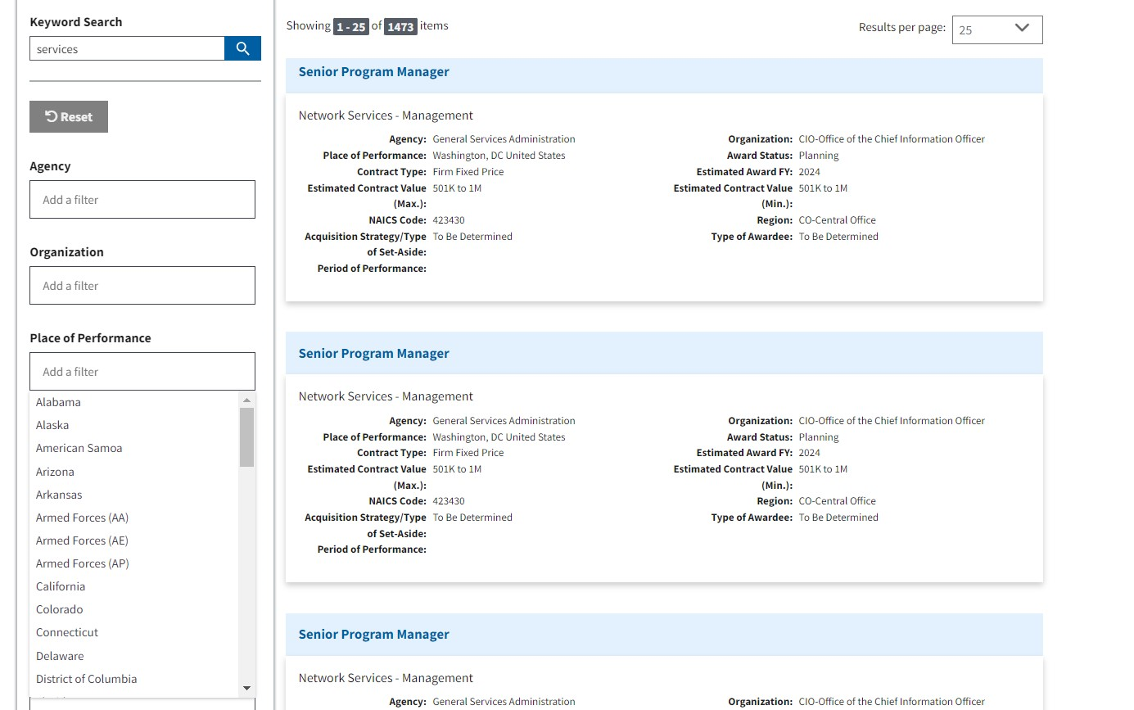
Forecast of Contracting Opportunities (Cont.)
Add another filter by State

Slide 39
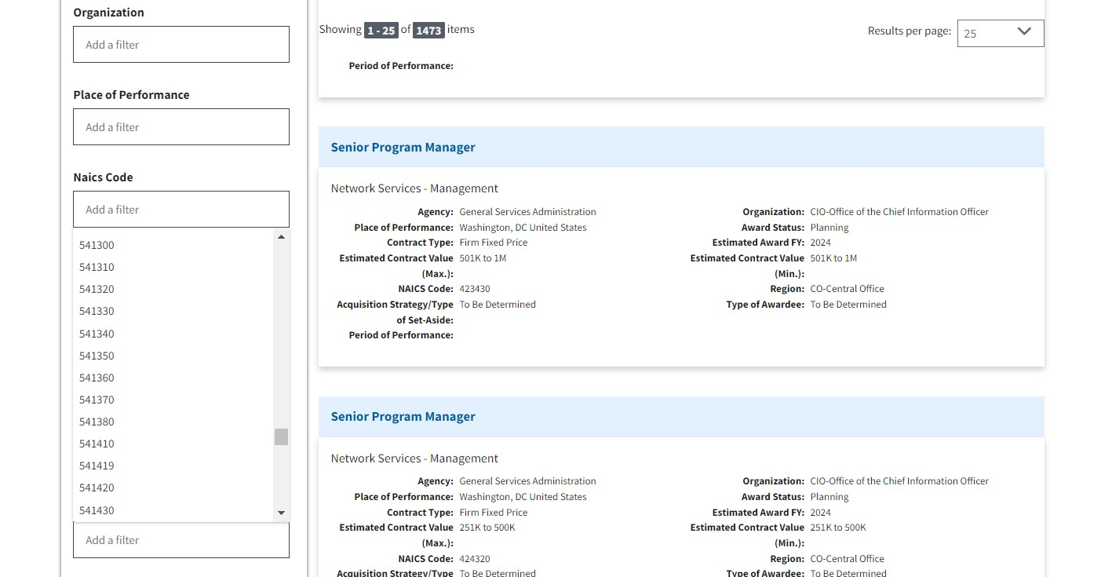
Forecast of Contracting Opportunities (Cont.)
Add another filter by NAICS

Slide 40
Forecast of Contracting Opportunities (Cont.)
Download to Excel
Add another filter by Fiscal Quarter or Year
Add another filter by Acquisition Strategy
Add another filter by Contract Type
Add another filter by Award Status

Slide 41
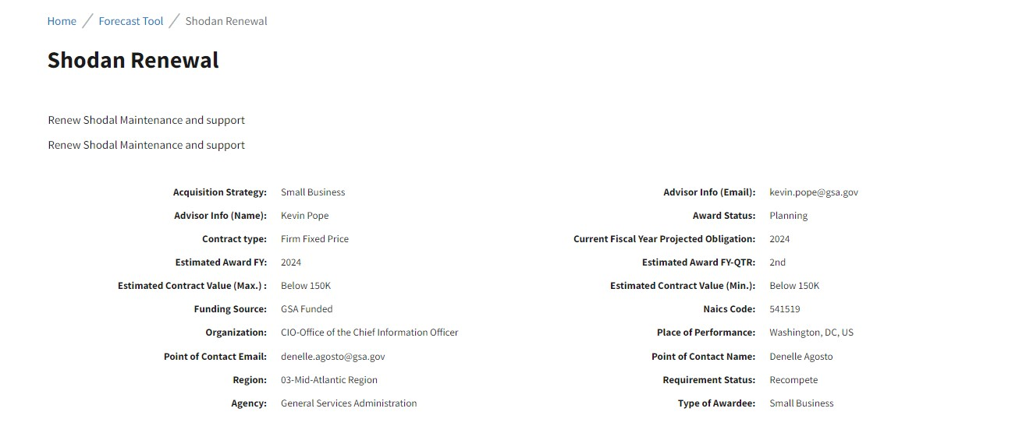
Forecast of Contracting Opportunities (Cont.)

Slide 42
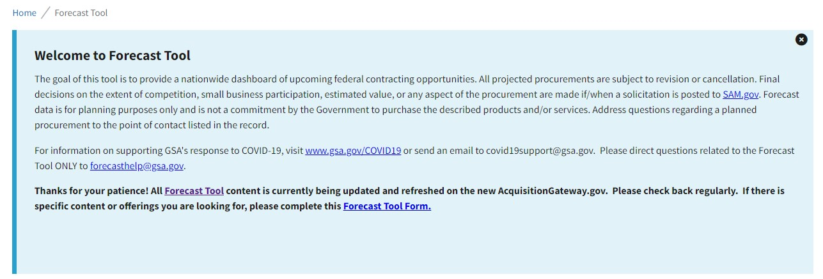
Forecast of Contracting Opportunities (Cont.)

Slide 43
GSA Guidance on Section 889: Supply Chain Security
In order to combat the national security and intellectual property threats that face the United States, Section 889(a)(1)(A) of the John S. McCain National Defense Authorization Act for Fiscal Year 2019 (the NDAA) prohibits the Federal Government from procuring or obtaining, or extending or renewing a contract to procure or obtain, “any equipment, system, or service that uses covered telecommunications equipment or services as a substantial or essential component of any system, or as critical technology as part of any system.”
Prohibiting contractors from providing covered telecommunications equipment or services unless the agency confirms that an exception applies or a waiver is granted;
Requiring every offeror for a contract or order to represent whether or not it will provide covered telecommunications equipment or services as part of its offer and, if so, to furnish additional detail about the covered equipment or services; and
Mandating that contractors report any covered equipment or services if discovered during the course of contract performance.
https://www.acquisition.gov

Slide 44
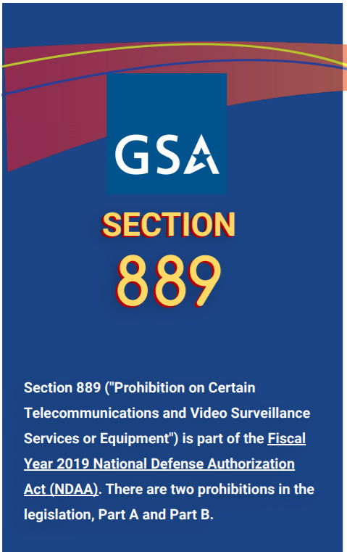
GSA Guidance on Section 889: Supply Chain Security
Effective August 13, 2019, the Government cannot obtain (through a contractor or other instrument) certain telecommunications equipment or services produced by the following companies and their subsidiaries and affiliates:
Huawei Technologies Company
ZTE Corporation
Hytera Communications Corporation
Hangzhou Hikvision Digital Technology Company
Dahua Technology Company
And any subsidiaries or affiliates of the listed companies.
-889 Part B is effective August 13, 2020; the Government cannot contract with an entity that uses these telecommunications
equipment or services.
-889 Part B applies to every sector: (automotive, banking, building services, construction, general supplies and services, etc.)
No matter what your company makes or sells, as of August 13, 2020, any technology your company uses must be checked to ensure that it does not include banned components.

Slide 45
SMALL BUSINESS RESOURCES
APEX Accelerators (Formerly Procurement Technical Assistance Center- PTAC) | Training and counseling on marketing, financial, and contracting https://www.aptac-us.org/ https://www.apexaccelerators.us/
Small Business Administration (SBA) | Procurement Center Representatives (PCRs) - https://www.sba.gov/contracting/resources-small-businesses/pcr-directory SBA Business Development Centers – https://www.sba.gov/tools/local-assistance/sbdc Get free and confidential mentoring by former CEOs through SCORE - https://www.score.org

Slide 46
SMALL BUSINESS RESOURCES (Cont.)
BEWARE OF SCAMS
No charge to apply
Free help from SBA resource partners
SBA will not contact you first
SBA will not solicit you for your tax ID number, SSN, or banking information
Beware of anyone who contacts you first, wants your private information, says you need to pay them, or tells you they can get you a loan
Please check with your local SBA office representative if you think you’ve been scammed or want to check anything out
SCAMS AND FRAUD RESOURCES
Department of Health and Human Services warns about Medicare scams
Federal Deposit Insurance Corporation warns consumers about potential scams
Social Security Administration warns Americans about fraudulent letters threatening the suspension of Social Security benefits
U.S. Postal Inspection Service tips for avoiding and reporting fraud
Cybersecurity and Infrastructure Security Agency (CISA) Cyber Scams:
https://www.cisa.gov/be-cyber-smart/common-scams

Slide 47
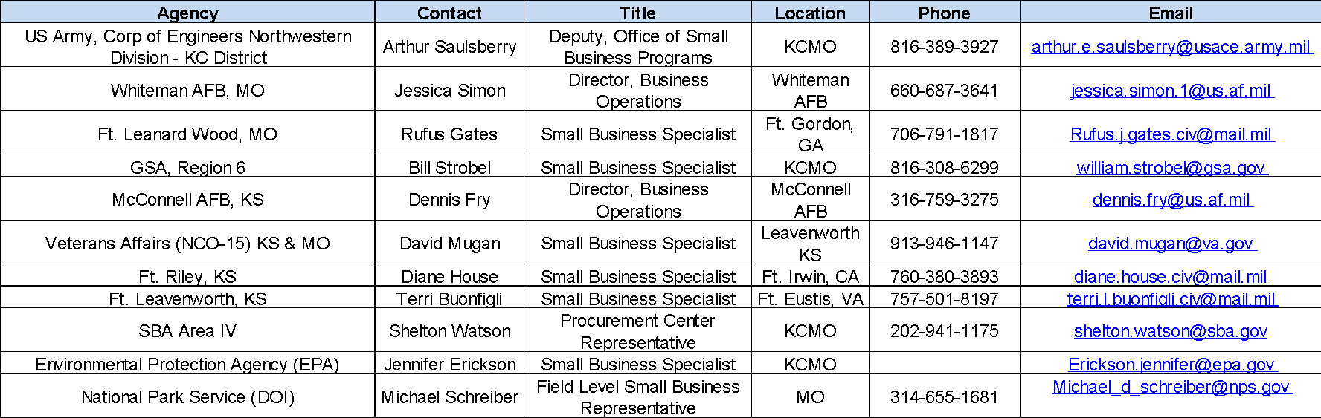
SMALL BUSINESS RESOURCES (Cont.)

Slide 48
SMALL BUSINESS RESOURCES (Cont.)
GSA OSDBU: https://www.gsa.gov/small-business
Public Building Services (PBS): https://www.gsa.gov/pbs
Federal Acquisition Service (FAS): https://www.gsa.gov/fas
GSA “For Businesses”: https://www.gsa.gov/forbusiness
Multiple Award Schedule (MAS) Solicitation: https://sam.gov/opp/d8dfc87dd4cb246f4c5fae066d0b0ef9/view
GSA MAS Roadmap: https://www.gsa.gov/buying-selling/purchasing-programs/gsa-multiple-award-schedule/mas-roadmap
GSA eOffer/eMod: https://eoffer.gsa.gov/
GSA Interact: https://interact.gsa.gov/
GSA Forecasting of Contracting Opportunities (FCO): https://www.fbf.gov
All Federal Agency FOC sites: https://www.acquisition.gov/procurement-forecasts
GSA Subcontracting Directory: https://www.gsa.gov/subdirectory

Slide 49
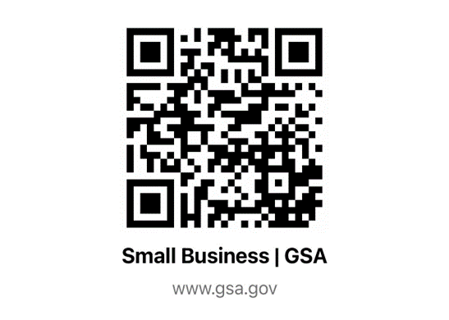
Question and Answer
Bill Strobel
Small Business Technical Advisor (SBTA)
Office of Small & Disadvantaged Business Utilization (OSDBU)
Region 6 (KS, MO, IA, NE)
William.Strobel@gsa.gov
816-308-6299
GSA Small Business Website:
https://www.gsa.gov/small-business
VISIT OUR
GSA SMALL BUSINESS WEBSITE

Slide 50

GSA

